Slide 1
♞
CHESSFORK
AI-POWERED CHESS ANALYSIS & COACHING PLATFORM
PRESENTED BY
[Student Name] · Register No: [XXXXXXXX]
BCA · Department of Computer Applications
[College Name]
Project Guide: [Guide Name]
FINAL YEAR PROJECT · 2026
Notes:
SPEAKER (30-60s): Good morning, respected panel. I am [Student Name], final year BCA student. I present my project 'Chessfork' — an AI-powered chess analysis and coaching platform. It analyzes any chess game with the Stockfish 18 engine, grades every move, explains mistakes in plain language with AI, and coaches players based on their weaknesses — all free in the browser. Q: Why chess? A: Chess has 600M+ players worldwide; most analysis platforms hide explanations behind paywalls. Chessfork makes professional-grade coaching free and accessible. Q: Is this a clone of Chess.com? A: No — it is a greenfield platform built from scratch on Next.js 16, with its own engine pipeline, AI coaching layer, and database; Chess.com is one of the systems we analyzed and improved upon.

Slide 2
ABSTRACT
VERIFIED · FROM SOURCE CODE
Turning raw games into structured learning
Chessfork is an AI-powered chess analysis & coaching platform — fully implemented and verified end-to-end in this repository.
PURPOSE
Chessfork turns raw game data — pasted PGN files, Chess.com and Lichess games — into a complete learning system: engine-grade analysis, AI explanations, coaching and training.
AI-Assisted Analysis
♞
Stockfish 18 grades every move on a 7-level scale; AI explains each verdict.
Personalized Coaching
WHAT IT SOLVES
♛
Engine analysis without educational context → AI explains every move
No personalized feedback → AI coach maps recurring weaknesses
Expensive premium features → free, unlimited browser analysis
No learning path → daily puzzles, streaks and weekly focus plans
Weakness patterns across game history with evidence, drills and weekly focus.
Opening Explorer
♜
ECO database, opening detection, master-book moves and repertoire notes.
GOAL A free, complete future learning platform — analysis, coaching and training in one place.
Game Review & Insights
♟
Accuracy, critical moments, evaluation graph, time-per-move and shareable report cards.
CHESSFORK
BCA FINAL YEAR PROJECT · 2026
01
Notes:
SPEAKER: Chessfork's purpose is to make serious chess improvement accessible. Players paste any game, and the platform evaluates it with Stockfish 18, grades each move, and — crucially — explains the reasons in plain language using an LLM. A personal coach module then scans the player's history for recurring weaknesses and builds a weekly plan. Q: What is the biggest differentiator? A: The educational layer — engine output alone doesn't teach; our AI explanations and coach turn evaluations into understanding. Q: How is this a 'future learning platform'? A: The roadmap — PvP, live review, mobile app — extends today's analysis-first product into a full training ecosystem.

Slide 3
01 · THE PROBLEM
VERIFIED · FROM SOURCE CODE
Why chess players struggle to improve
Existing platforms evaluate games — but they rarely explain, coach, or guide the player.
♚
Expensive premium walls
♝
Engine noise, no meaning
♛
No personalized coaching
Deep analysis and AI explanations sit behind costly subscriptions on mainstream platforms.
Raw evaluation lines with no educational context — players see numbers, not lessons.
Platforms grade games but never diagnose the player's recurring weaknesses.
♞
Beginners feel lost
♜
Tools are scattered
RESEARCH GAP
No guided path — hard for new players to turn reports into actual improvement.
Analysis, puzzles, openings and training live in separate products with no unified loop.
No platform combines professional-grade engine analysis with an educational AI layer, personalized coaching and free access — that is the gap Chessfork fills.
CHESSFORK
BCA FINAL YEAR PROJECT · 2026
02
Notes:
SPEAKER: Most chess sites face one of two extremes — deep but unexplained engine output, or explanations locked behind premium plans. Beginners get numbers they cannot interpret; intermediate players get no diagnosis of recurring mistakes; and no platform turns analysis into a structured training plan. That combination — analysis without education, and education without personalization — is the core problem we address. Q: Is free analysis actually possible with Stockfish? A: Yes — Stockfish 18 is open-source and runs both as a server binary and in the browser via WebAssembly; Chessfork's browser worker needs no server for interactive analysis. Q: Why is this a real problem and not solved by Chess.com? A: Chess.com solves it partially behind Game Review premium tiers; the educational AI layer is limited on free accounts — Chessfork's coach is free.

Slide 4
02 · MARKET ANALYSIS
VERIFIED · FROM SOURCE CODE
Existing Systems — a fair comparison
Evaluated against the actual gaps they leave open.
Platform | Strengths | Limitations
♞ Chess.com | Best-in-class UX, lessons, live play, huge community; deep analysis available. | Premium tiers paywall deep analysis and AI explanations; heavy branding and ads.
♜ Lichess | Free and open-source; powerful analysis board; large opening explorer; no ads. | No AI explanations or personal coaching; learning tools are generic, not personalized.
♝ Chessigma | Pioneered report-style game reviews — accuracy cards and move grades. | Narrow scope and a thin feature set; no robust coaching loop or learning system.
THE GAP Premium-grade analysis is paywalled; free analysis lacks explanation and coaching. Chessfork — per its README — is built as a greenfield functional successor: a robust learning platform, not a thin clone.
CHESSFORK POSITIONING
Free Stockfish 18 depth — Lichess-style openness + AI coaching & explanations — Chess.com-style polish
CHESSFORK
BCA FINAL YEAR PROJECT · 2026
03
Notes:
SPEAKER: We benchmarked three reference platforms. Chess.com leads in experience but gates deep analysis and AI behind premium. Lichess is free and powerful but purely engine — no explanations, no coaching. Chessigma pioneered the report-card style review that inspired our report UI, but is a narrow product. Chessfork intentionally occupies the middle: free engine depth like Lichess, polished review experience, plus an AI coaching layer neither offers. Q: Why compare with Chessigma? A: The project README names Chessigma as the design ancestor — Chessfork is a greenfield, more robust successor, so we evaluated it fairly as both inspiration and limitation. Q: What did you copy from Lichess? A: Philosophy, not code — free access and open standards (PGN, UCI, FEN); every implementation is original.

Slide 5
03 · OUR SOLUTION
VERIFIED · FROM SOURCE CODE
The proposed system — Chessfork
Every item below is implemented in the repository, not a mockup.
♞
AI Explanations
♛
Personalized Coaching
♜
Interactive What-If
IMPLEMENTED
IMPLEMENTED
IMPLEMENTED
Every move's grade is explained in plain language by an LLM (Claude / DeepSeek).
Patterns across up to 50 games → 3 weaknesses, evidence, drills, weekly focus.
Drag pieces on the board; Stockfish re-evaluates your variation live.
♝
Deep Engine Analysis
♟
Shareable Report Cards
♔
Free, No Account
IMPLEMENTED
IMPLEMENTED
IMPLEMENTED
Stockfish 18 — depth 15–24, MultiPV 1–3 lines, Syzygy tablebases.
Accuracy, grades and opening summary rendered as shareable images.
Guest analysis from the homepage — import PGN or usernames instantly.
KEY RESULT One unified loop: import → analyze → understand → train → improve.
CHESSFORK
BCA FINAL YEAR PROJECT · 2026
04
Notes:
SPEAKER: Chessfork's proposal is a unified learning loop. Six implemented pillars: LLM explanations for every move, a personal AI coach, interactive what-if experimentation on the board, deep Stockfish analysis with tablebase support, shareable report cards, and free guest access. None of these are placeholders — each maps to a verified module in the codebase. Q: How deep is the 'deep analysis'? A: Quick reports run depth 15–18 per move; deep jobs depth 20–24 with MultiPV 3 for critical moments, configurable via environment variables. Q: What is a what-if? A: You drag a piece to a new square mid-game; the engine immediately evaluates that hypothetical variation and grades it against the best play — teaching what should have been played.

Slide 6
04 · ARCHITECTURE
VERIFIED · FROM SOURCE CODE
System architecture — end to end
Next.js 16 App Router platform; engine and AI compose the analysis pipeline.
CLIENT
Browser UI
Next.js 16 App Router · React 19 · Tailwind CSS v4 · react-chessboard · PWA shell
SERVER
API Layer
25 REST / SSE routes — analysis, coach, imports, puzzles, leaderboards, auth
ENGINE + AI
Analysis Pipeline
Stockfish 18 (UCI · MultiPV · Syzygy · WASM worker) + LLM layer (Claude / DeepSeek / OpenRouter)
DATA
Persistence & Queue
Drizzle ORM + PostgreSQL 16 (12 tables) · BullMQ + Redis deep-analysis queue
OUTPUT
Products
Game Reports · AI Coach · Dashboard · Puzzles · Leaderboards · Opening Explorer · Shop
CHESSFORK
BCA FINAL YEAR PROJECT · 2026
05
Notes:
SPEAKER: The platform is a classic layered architecture. The browser runs React 19 with a WebAssembly Stockfish worker for instant interactive analysis. All business logic lives behind Next.js API routes. The analysis pipeline composes the Stockfish binary — speaking the UCI protocol with MultiPV and Syzygy tablebase support — with an LLM explanation layer. Persistence is PostgreSQL 16 through Drizzle ORM, with BullMQ and Redis handling deep analysis as background jobs. The pipeline feeds five product surfaces: reports, coach, dashboard, puzzles and leaderboards. Q: Why a WASM worker AND a server binary? A: Browser analysis is free and instant (no server load) for interactive what-ifs; the server binary does deep, multi-PV analysis with configurable depth/hash and gets cached. Q: Why BullMQ/Redis? A: Deep analysis is slow (minutes); we queue jobs so the UI can stream progress via SSE instead of blocking a request.

Slide 7
05 · ENGINE & AI PIPELINE
VERIFIED · FROM SOURCE CODE
How the analysis actually works
Five stages — every stage implemented in src/lib and src/server.
01
02
03
04
05
Import
Evaluate
Grade
Explain
Report
PGN paste · Chess.com · Lichess fetch (with sample fallback)
Stockfish 18 per move · depth 15–24 · MultiPV 1–3 lines
Centipawn loss → 7-level grade (Brilliant → Blunder)
LLM writes plain-language coaching text per move
Accuracy %, critical moments, alternatives, insights
ACCURACY FORMULA
Accuracy = 100 − (average centipawn loss × 0.15) — capped 0–100, computed per player (src/lib/game-analyzer.ts)
SUPPORTING PIPELINES SSE streaming progress (/api/analyze-stream) · deep jobs via BullMQ worker · win-probability chart from centipawns (recharts) · Syzygy tablebases for perfect endgame play
CHESSFORK
BCA FINAL YEAR PROJECT · 2026
06
Notes:
SPEAKER: The pipeline has five stages. First, import — a pasted PGN, or a username fetch from Chess.com or Lichess. Second, evaluation — Stockfish 18 examines every position; quick reports use depth 15–18, deep reports 20–24, and critical moments re-search with three lines. Third, grading — each move's centipawn loss maps to a seven-level scale. Fourth, explanation — the LLM receives the FEN, move and evaluation, and writes a short coaching explanation. Fifth, the report — per-player accuracy (100 minus 0.15 × average centipawn loss), critical moments, and alternatives. Q: Why 0.15? A: It is an empirically chosen scaling factor that spreads typical centipawn losses across a readable 0–100 accuracy band. Q: How is win probability computed? A: Centipawn scores are converted to a probability curve (standard sigmoid mapping) and rendered with recharts on the report page. Q: What if the LLM key is missing? A: The system falls back to deterministic template explanations so analysis never breaks.

Slide 8
06 · ENGINE SCORING
VERIFIED · FROM SOURCE CODE
The 7-level move grading system
Thresholds verified from src/lib/move-classifier.ts.
Grade | Max Centipawn Loss | Meaning
♛ Brilliant | 0 | Only-engine move or sound sacrifice found at depth ≥ 16
♞ Best | 8 | The top engine move in the position
♜ Excellent | 25 | Near-optimal — negligible loss
♟ Good | 50 | Solid move, keeps the game balanced
♝ Inaccuracy | 100 | Missed a better plan
♞ Mistake | 200 | Position clearly worsens
♚ Blunder | ∞ | Game-losing error, missed mate or hung piece
BEYOND THRESHOLDS
Mates handled separately — missed mate is always a blunder
Brilliant requires a sacrifice + engine-only move (depth ≥ 16)
Forced/only-moves are auto-Excellent
Missed wins (>150cp gap) → Mistake
Checkmates and escapes detected across both colors
WHY IT MATTERS Consistent grades drive accuracy %, the coach's weakness analysis and every badge.
CHESSFORK
BCA FINAL YEAR PROJECT · 2026
07
Notes:
SPEAKER: The grading engine classifies each move by centipawn loss against the engine's best. Seven levels: Brilliant (only-engine move or deep sacrifice), Best (top engine move), Excellent, Good, Inaccuracy, Mistake and Blunder. Crucially the grader is more than thresholds — it understands mate dynamics, sacrifices, forced moves and missed wins, so a 'brilliant' is genuinely earned at depth 16+, not awarded for every odd-looking move. Q: What is centipawn loss? A: The difference in engine evaluation (in hundredths of a pawn) between the move played and the best move. Q: How is a Brilliant decided? A: It must be a sacrifice — lower-valued piece captures higher — that is also the engine's only good move, confirmed by a deep search (depth ≥ 16); otherwise it is downgraded to Best.

Slide 9
07 · COACHING FEATURES
VERIFIED · FROM SOURCE CODE
Interactive What-If analysis + AI Coach
The two signature features — both fully implemented.
♞
What-If Analysis
♛
AI Coach
IMPLEMENTED
IMPLEMENTED
Drag any piece to a new square on the review board
Stockfish re-evaluates the variation live (depth 14 cap → responsive UI)
8-step grader: sacrifices, mates, forced moves, missed wins
Top-3 alternative lines (MultiPV) — click to explore
Board & panel stay consistent — variation is never lost
Scans up to 50 past games for recurring patterns
3 prioritized weaknesses — each with evidence and a drill
Weekly focus plan with tracked checkboxes
Opening recommendations and estimated rating level
Reports cached locally for 24 hours (fast re-views)
POWERED BY client-side WASM Stockfish worker for instant interaction · server LLM calls (Claude / OpenRouter deepseek-chat) for coach reports.
CHESSFORK
BCA FINAL YEAR PROJECT · 2026
08
Notes:
SPEAKER: Two signature features. What-If analysis turns the report board into a laboratory — drag a piece, and the engine immediately tells you whether your idea works, with an eight-step grader that understands sacrifices, mates and forced moves. The AI Coach is the personal trainer: it digests up to 50 games, finds the three most damaging recurring patterns, attaches evidence and a drill to each, and produces a weekly focus plan the player can track. Q: Why cap what-if depth at 14? A: Interactive board responsiveness — deeper searches freeze the drag-and-drop experience; the full-depth server analysis still runs for the actual game. Q: What data does the coach see? A: Per-game — both accuracies, top blunders and mistakes with their positions, opening, phase and result (structure in src/lib/ai-coach.ts).

Slide 10
08 · TECHNOLOGY STACK
VERIFIED · FROM SOURCE CODE
Technologies used — every entry verified from package.json
Versions as locked in the repository.
Layer | Technology
Frontend | Next.js 16 · React 19 · TypeScript · Tailwind CSS v4 · react-chessboard
Backend | Next.js API Routes · BullMQ + Redis queue · Node worker (tsx)
Database | PostgreSQL 16 (Docker) · Drizzle ORM · optional MongoDB user store
Engine | Stockfish 18 — server binary (UCI) + browser WASM worker
AI Layer | Anthropic Claude SDK · DeepSeek client · OpenRouter (deepseek-chat) · Groq
Authentication | Supabase Auth · OAuth Google / GitHub · scrypt password hashing
Billing | Stripe checkout (Pro / Coach tiers)
Styling & UX | Tailwind v4 · Framer Motion · GSAP · Lenis smooth scroll
Libraries | chess.js · recharts · three.js / React Three Fiber · mapbox-gl · satori + resvg · zod
DevOps | Docker Compose (Postgres + Redis) · Playwright e2e · Vitest · ESLint 9 · PWA (next-pwa)
CHESSFORK
BCA FINAL YEAR PROJECT · 2026
09
Notes:
SPEAKER: The stack is modern and TypeScript-only. Frontend: Next.js 16 App Router with React 19 and Tailwind v4, plus chess.js and react-chessboard for board logic. Backend: Next API routes with BullMQ/Redis for deep analysis. Engine: Stockfish 18 in two forms — a server binary over the UCI protocol, and a WebAssembly worker in the browser. AI: Anthropic Claude SDK, a DeepSeek client, and OpenRouter with the deepseek-chat model, with Groq as an alternative. Data: PostgreSQL 16 with Drizzle ORM. Supporting: Stripe for the shop tiers, Supabase for OAuth, satori+resvg for shareable report images, Playwright and Vitest for testing. Q: Why both Claude and DeepSeek? A: Redundancy and cost — the explanation endpoints can switch providers via environment keys; coach reports use OpenRouter's deepseek-chat with a Groq fallback. Q: Why Drizzle over Prisma? A: Type-safe SQL with full control — lightweight, no code generation overhead, and it matches the project's lean, dependency-light philosophy.

Slide 11
09 · LANGUAGES
VERIFIED · FROM SOURCE CODE
Programming languages used
Only languages present in the repository.
01
02
03
04
05
TypeScript
JavaScript
SQL
HTML / JSX
CSS
PRIMARY
WORKERS & SCRIPTS
DATABASE
MARKUP
STYLING
Entire application — Next.js pages, API routes, engine pipeline, Drizzle schema, tests.
Stockfish WASM wrapper workers, service worker (PWA), build scripts.
PostgreSQL schema — 12 tables via Drizzle migrations (drizzle/*.sql).
All UI rendered as React JSX components.
Tailwind CSS v4 utility system + global stylesheet.
NOTABLE A single language across frontend and backend keeps the codebase small and auditable — roughly 130 source files, 12 Vitest suites, 1 Playwright e2e spec.
CHESSFORK
BCA FINAL YEAR PROJECT · 2026
10
Notes:
SPEAKER: The entire platform is written in five languages. TypeScript dominates — nearly all pages, routes, engine logic, schema and tests. JavaScript appears in engine workers and PWA service workers, SQL in the Postgres migrations, JSX as React markup, and CSS through Tailwind. One language across the stack means shared types between the engine, database and UI — a real correctness benefit. Q: Why is TypeScript chosen over JavaScript? A: Type safety across 25 API routes and 12 tables prevents whole classes of runtime errors; the engine payloads are complex nested types. Q: Any Python used? A: Not in the shipped product — reference Python code exists in docs/python-engine-integration.md for CAPS/Syzygy/Polyglot research only.

Slide 12
10 · SYSTEM MODULES
VERIFIED · FROM SOURCE CODE
Modules — mapped 1:1 to routes in the repository
12 modules, all accessible at their own routes.
♔
Authentication
♛
Dashboard
♞
Game Review
♜
Opening Explorer
Supabase OAuth · credentials · sessions
Board, move navigation, live evaluation
Full analysis report with grades & graph
ECO database · book detection · master moves
IMPLEMENTED
IMPLEMENTED
IMPLEMENTED
IMPLEMENTED
♝
AI Coach
♟
Puzzle Trainer
♞
What-If Analysis
♜
Games Library
Weakness reports · weekly focus · drills
Daily puzzle · attempts · rating
Interactive board · live engine · grader
Saved reports · import · stats
IMPLEMENTED
IMPLEMENTED
IMPLEMENTED
IMPLEMENTED
♝
Leaderboards
♚
Chess Globe
♛
Account & Profile
♟
Shop
Puzzles & brilliant moves
3D world activity map (demo data)
Profile, linked accounts, subscription
Merch store · cart · Stripe checkout
IMPLEMENTED
BETA
IMPLEMENTED
IMPLEMENTED
CHESSFORK
BCA FINAL YEAR PROJECT · 2026
11
Notes:
SPEAKER: Twelve modules, each mapped to a real route in the repository: authentication, dashboard, game review, opening explorer, AI coach, puzzle trainer, what-if analysis, games library, leaderboards, account/profile, and a shop with Stripe. Two modules ship as Beta: the Chess Globe — a three.js world map showing sample activity arcs — and the board editor (position setup with FEN). Everything else is live. Q: Which module is the most complex? A: The game review page — one component of 2,200+ lines integrating the board, engine worker, grading, evaluation graph, alternative lines, LLM explanations and what-if sessions. Q: What is the Chess Globe? A: A React Three Fiber globe visualising connections between countries with sample game metadata; Beta because it currently uses demo data, not live traffic.

Slide 13
11 · FEATURE MATRIX
VERIFIED · FROM SOURCE CODE
Features — implemented, beta and planned
Status reflects actual code, honestly graded.
Feature | Description | Status
PGN Game Review | 3-column review — grades, eval graph, keyboard navigation, autoplay | ● IMPLEMENTED
Chess.com / Lichess Import | Live public fetch with graceful sample-data fallback | ● IMPLEMENTED
AI Move Explanations | Plain-language LLM coaching text for every move | ● IMPLEMENTED
What-If Interactive Analysis | Drag pieces, live engine re-evaluation, 8-step grader | ● IMPLEMENTED
AI Coach Reports | Weakness patterns, evidence, drills, weekly focus | ● IMPLEMENTED
Daily Puzzle & Streaks | Puzzle attempts with rating, streaks, badge system | ● IMPLEMENTED
Report Card Sharing | Accuracy + grades rendered to PNG (satori + resvg), OG images | ● IMPLEMENTED
Streaming Analysis (SSE) | Live progress events during analysis | ● IMPLEMENTED
Deep Analysis Queue | BullMQ background jobs, depth 20–24, MultiPV | ● IMPLEMENTED
Board Editor | Position setup with FEN snapshots | ● BETA
Chess Globe | 3D world activity visualisation (demo data) | ● BETA
Year Wrapped | Year-in-review stats page (sample data today) | ● BETA
Live PvP Multiplayer | Internet matchmaking — only local two-player play exists today | ● PLANNED
SuperCoach / Voice Coach | Next-gen AI coaching suite | ● PLANNED
CHESSFORK
BCA FINAL YEAR PROJECT · 2026
12
Notes:
SPEAKER: The feature matrix is deliberately honest. Nine core features are fully implemented — review, imports, AI explanations, what-if, coach, puzzles, report-card sharing, SSE streaming, and the deep queue. Three are Beta: the board editor (position setup works, drag-and-drop editing doesn't yet), the globe (demo data) and year wrapped (sample data). Two are planned: internet PvP — today only local two-player is implemented — and the SuperCoach suite. Q: Why mark things Beta at all? A: Academic integrity — the examiner must know exactly what is finished. Beta items are visibly demo-able, not hidden. Q: What is the report card? A: A generated image showing accuracy, opening name, grade counts and watermark — produced server-side with satori and resvg for social sharing (OG images).

Slide 14
12 · END-TO-END FLOW
VERIFIED · FROM SOURCE CODE
Workflow — from import to training plan
A single vertical pipeline; every step implemented.
1
Import Game
WHAT THE PLAYER GETS
Paste PGN · fetch Chess.com / Lichess username · sample fallback
2
Analyze
Accuracy % per player
Critical moments list
Alternative lines
Evaluation graph
Weakness diagnosis
Weekly training focus
Shareable report card
Quick mode (depth 15–18) or deep mode (depth 20–24, queued via BullMQ)
3
Engine Evaluation
Stockfish 18 scores every position · MultiPV 1–3 · Syzygy tablebases
4
AI Explanation
LLM writes per-move coaching text with classification and eval change
5
Accuracy Calculation
100 − avg centipawn loss × 0.15 · per player · per phase (opening/mid/end)
6
Report Generation
Grades, evaluation graph, alternatives, critical moments, insights
7
Training Suggestions
IMPLEMENTED
AI Coach converts findings into weaknesses, drills and a weekly focus
CHESSFORK
BCA FINAL YEAR PROJECT · 2026
13
Notes:
SPEAKER: The workflow is one continuous pipeline, and it is fully implemented end-to-end. A game enters through PGN or a username import. It is analyzed in quick or deep mode — deep jobs queue through BullMQ. Stockfish evaluates every position, the classifier grades each move, and the LLM writes the explanation. Accuracy is computed per player per phase. The report assembles everything, and finally the coach converts the findings into a training plan — weaknesses, drills, weekly focus. Q: Where does the user see this? A: The homepage accepts a PGN and lands on /analysis; the full interactive report lives at /analysis/[id]. Q: How long does analysis take? A: The landing page targets under 5 seconds for typical quick games with the fallback evaluator; deep runs are queued and streamed via SSE progress.

Slide 15
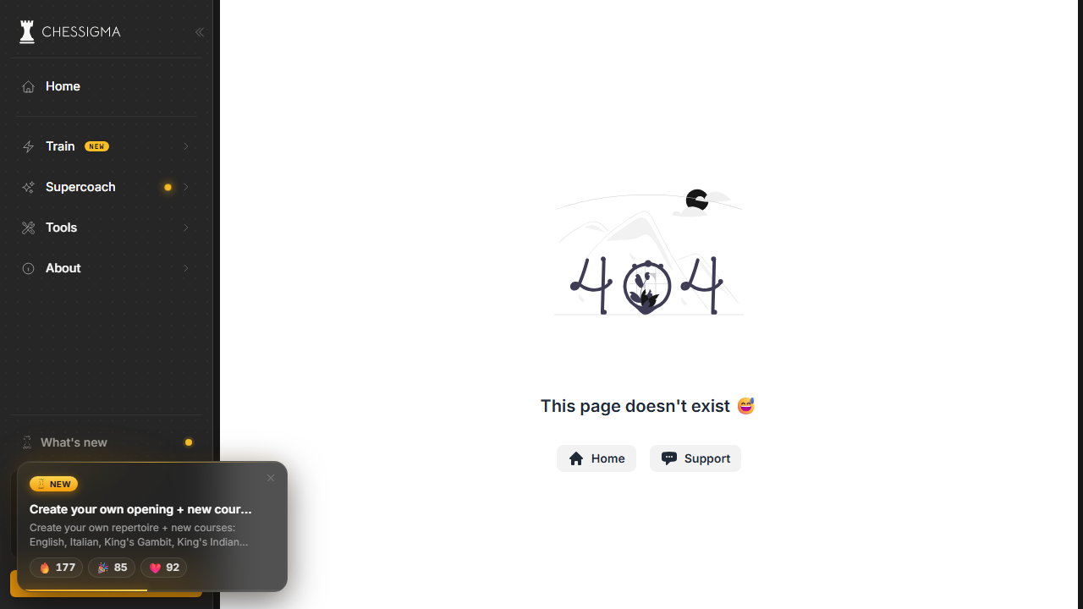
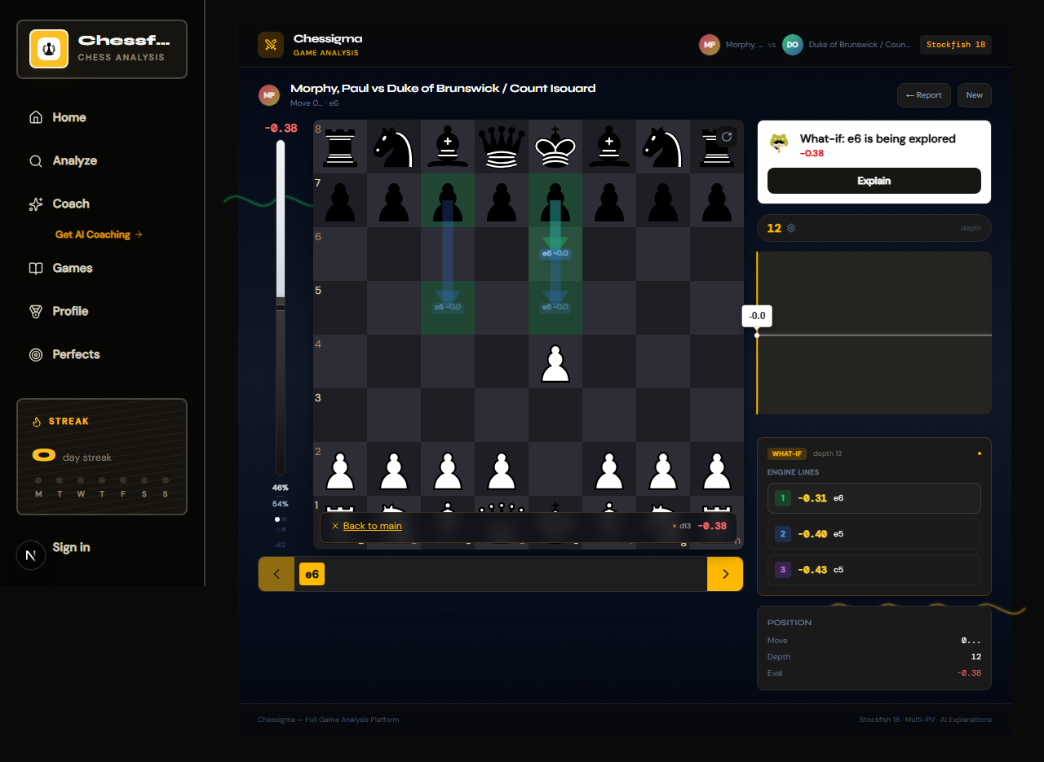
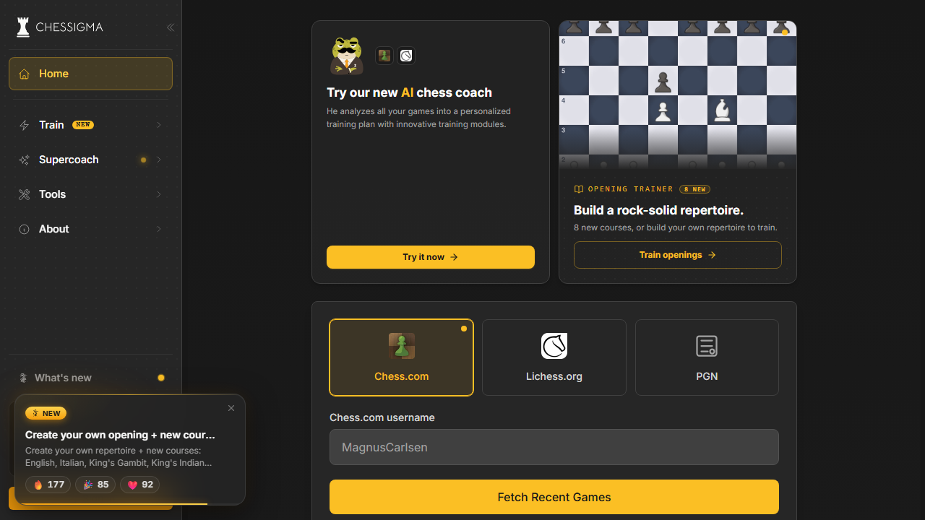
13 · LIVE APPLICATION
VERIFIED · FROM SOURCE CODE
Screenshots — captured from the running app
Real Playwright captures from the repository's e2e test suite.
1280×720
1280×936
crop 1280×720
Game Review — grades, evaluation graph, alternatives
Home — PGN import & launch screen
What-If — interactive variation analysis
MORE CAPTURES RECOMMENDED Coach report · Opening explorer · Puzzles · Dashboard · Profile — capture these from the running app before submission (scripts: e2e/).
CHESSFORK
BCA FINAL YEAR PROJECT · 2026
14
Notes:
SPEAKER: These are genuine screenshots of Chessfork captured by the project's own Playwright end-to-end test suite — the game review screen with grades and the evaluation graph, the what-if interactive analysis with a drag-and-drop variation, and the home import screen. For the final submission we recommend capturing the coach, opening explorer, puzzles and dashboard screens the same way. Q: How were these captured? A: Playwright drives a real browser against the running app (e2e/ specs, screenshots in e2e/screenshots). Q: Can we see the analysis page live? A: Yes — with the dev server running, paste any PGN at the homepage and the full report opens at /analysis/[id].

Slide 16
14 · DATA MODEL
VERIFIED · FROM SOURCE CODE
Database design — Drizzle ORM + PostgreSQL 16
12 tables · UUID keys · JSONB payloads · verified from src/server/db/schema.ts.
IDENTITY & ACCOUNTS
ANALYSIS PIPELINE
LEARNING & COMMUNITY
users
imported_pgns
puzzles → puzzle_attempts
identities
coach_snapshots
user_credentials
analysis_runs
leaderboard_entries
subscriptions
leaderboards
chess_accounts
move_evaluations
→ OAuth providers, credentials, tiers, linked Chess.com/Lichess
→ 1 import : many runs : many move evaluations
→ puzzles, attempts with rating, coach reports, rankings
Unique indexes: email, public_id, pgn_hash, provider+provider_user
JSONB payloads: engine lines, audit trails, themes, solutions
Migrations versioned in /drizzle · seeded via npm run db:seed
Optional MongoDB user store (MONGODB_URI)
CHESSFORK
BCA FINAL YEAR PROJECT · 2026
15
Notes:
SPEAKER: The schema has twelve tables in three groups. Identity and accounts: users, identities for OAuth, credentials with scrypt hashes, subscriptions and linked chess accounts. The analysis pipeline is the core — imported PGNs each produce analysis runs, each run stores one row per move in move_evaluations with scores, centipawn loss, grade and engine payload. Learning and community: puzzles and attempts with ratings, coach snapshots, and leaderboard entries. Everything uses UUID primary keys, JSONB for flexible payloads and unique indexes for deduplication. Q: Why JSONB? A: Engine output varies by version and depth; JSONB keeps move payloads flexible without migrations per change. Q: How is a report looked up? A: A public_id unique index maps short URLs like /analysis/[id] to runs, with pgn_hash preventing duplicate imports.

Slide 17
15 · BENEFITS
VERIFIED · FROM SOURCE CODE
System advantages — by player level
Why each level of player gains something real.
♟
For Beginners
♞
For Intermediate
♛
For Advanced
Free instant analysis — no signup
Plain-language AI explanations
Daily puzzles & streaks to build habit
Every grade explained, not assumed
AI Coach finds recurring weaknesses
Opening explorer + repertoire notes
What-If experiments to test ideas
Accuracy tracking across games
Deep analysis: depth 20–24, MultiPV
Syzygy 3-4-5 tablebases
Shareable report cards & benchmarks
Engine diagnostics tooling
FOR THE DEVELOPER Type-safe end-to-end (TypeScript + Drizzle) · 12 Vitest suites · Playwright e2e · lint enforced at zero warnings.
CHESSFORK
BCA FINAL YEAR PROJECT · 2026
16
Notes:
SPEAKER: The advantages map to real audiences. Beginners get free, explained analysis and habit-building puzzles. Intermediate players get the coach — recurring weakness diagnosis, opening notes and what-if experiments that build understanding. Advanced players get depth 20–24 analysis, MultiPV lines, Syzygy tablebases and shareable reports. And for the developer, the codebase is type-safe and fully tested — twelve Vitest suites cover the engine, grading, openings and rating math, plus Playwright e2e. Q: What is the benchmark page? A: /benchmark — a utility that runs engine diagnostics comparing settings, used to validate engine behaviour during development. Q: How do tests protect the engine layer? A: Vitest suites assert classifier thresholds, rating math, opening detection and repository fallbacks — regression-safe refactoring.

Slide 18
16 · ROADMAP
VERIFIED · FROM SOURCE CODE
Future enhancements — planned, not promised
Honest scope: these are next steps, not current features.
01
02
03
04
Multiplayer PvP
Live Game Review
Chess Globe with real data
AI Voice Coach
Internet matchmaking; today only local two-player play exists (/play/local).
Analyze games while they are being played — streaming position eval.
Replace demo arcs with real-world live game traffic on the 3D globe.
Spoken coaching feedback during review sessions.
05
06
07
08
Mobile App
Opening Repertoire AI
Cloud Sync
Tournament Mode
PWA exists today; native apps with offline report sync.
Auto-built repertoire from a player's actual games and preferences.
Guest-local reports become cross-device saved libraries.
Structured study groups with match pairing and standings.
PLANNED
PLANNED
PLANNED
PLANNED
CHESSFORK
BCA FINAL YEAR PROJECT · 2026
17
Notes:
SPEAKER: The roadmap is deliberately honest. Internet PvP is planned — today the app has local two-player play with clocks. Live review during play, real-world globe data, a voice coach, mobile apps, repertoire AI, cloud sync and tournament mode are all future work. The PWA foundation already exists, which shortens the mobile path. Q: Why is multiplayer not implemented? A: It requires real-time server infrastructure (websockets + game rooms); the current scope focuses on analysis and coaching, which is complete. Q: Which enhancement is easiest next? A: Cloud sync — the report repository and public IDs already exist; a session-aware fetch would enable it.

Slide 19
CONCLUSION
VERIFIED · FROM SOURCE CODE
What was built, and why it matters
Verified end-to-end in the repository.
Chessfork is a complete, free analysis + coaching platform — not a prototype
Stockfish 18 engine + LLM explanations: analysis with understanding
Personalized AI Coach turns game history into a training plan
25 API routes · 39 pages · 12 database tables · 7-level grading system
Honest scope: Beta modules flagged, roadmap published
25
39
12
7
18
API ROUTES
PAGES
DB TABLES
MOVE GRADES
STOCKFISH
FINAL STATEMENT
An analysis product that teaches, and a coaching product built on real engine data — delivered as one free, working platform.
STACK SNAPSHOT Next.js 16 · TypeScript · Tailwind v4 · Stockfish 18 · Drizzle ORM + PostgreSQL · BullMQ + Redis · Claude / DeepSeek
CHESSFORK
BCA FINAL YEAR PROJECT · 2026
18
Notes:
SPEAKER: In summary — Chessfork is a working platform, not a demo. Analysis runs on Stockfish 18 at real depth; every verdict is explained by an LLM; a coach converts game history into a training plan; puzzles, streaks, leaderboards and shareable cards complete the loop. The numbers are real: 25 API routes, 39 pages, 12 tables, a 7-level grading system. Beta modules are flagged honestly and the roadmap is public. The stack — Next.js, TypeScript, Drizzle, Stockfish, Claude/DeepSeek — is modern and maintainable. Q: Biggest technical challenge? A: Making deep engine analysis feel instant — solved by splitting browser WASM analysis (interactive) from server deep analysis (queued, streamed via SSE). Q: What would you improve with more time? A: PvP multiplayer and replacing the Beta modules' sample data with live user data — both are on the roadmap.

Slide 20
♞
THANK YOU
Questions & discussion are welcome
ANALYZE · LEARN · DOMINATE
[Student Name] · Register No: [XXXXXXXX] — BCA Final Year · [College Name] · Guide: [Guide Name]
Notes:
SPEAKER: Thank you for your time. I would be happy to answer questions — whether about the engine pipeline, the AI coaching layer, the database design or the roadmap. (Live demo suggestion: paste a PGN on the homepage and walk through a full report.) Q: (Any) A: Refer to the appendix slides — repository structure, API surface, security and limitations — placed after this slide for exactly this moment.

Slide 21
APPENDIX · A
VERIFIED · FROM SOURCE CODE
Repository structure
A clean separation of concerns across ~130 source files.
src/app
39 pages + 25 API routes (Next.js App Router)
src/components
landing · analysis · coach · chess · shop · auth · globe · puzzles
src/lib
engine, analysis, classification, coach, grading, report cards, chess domain
src/server
auth · db (Drizzle schema) · queue (BullMQ) · repositories · chess
src/hooks
useEngine · useWhatIfSessions · useLiveAnalysisSession
src/test
12 Vitest suites — engine, grading, openings, rating, repositories
e2e
Playwright specs + real UI screenshots
drizzle
Versioned SQL migrations + snapshots
public
Stockfish WASM · workers · images · sounds · PWA assets
vendor
Syzygy 3-4-5 tablebases · opening books
docs
Analysis roadmap · Python engine integration reference
scripts
Stockfish / Syzygy / book installers · engine diagnostics
CHESSFORK
BCA FINAL YEAR PROJECT · 2026
19
Notes:
SPEAKER (viva reference): The repository is organized by separation of concerns: App Router pages and routes; components per product area; lib for pure chess/engine logic (framework-free and fully unit-tested); server for auth, database, queue and repositories; hooks for engine state; e2e Playwright tests; versioned Drizzle migrations; public assets including the WASM engine and workers; vendor data — Syzygy 3-4-5 tablebases; and install/diagnostics scripts. Q: Where is the analysis algorithm? A: src/lib/analysis-engine.ts (orchestration), src/server/chess/stockfish.ts (UCI), src/lib/move-classifier.ts + whatif-grader.ts (grading). Q: How is the DB schema versioned? A: Drizzle generates numbered SQL migrations in /drizzle, applied with npm run db:push.

Slide 22
APPENDIX · B
VERIFIED · FROM SOURCE CODE
API surface — 25 routes
Key endpoints verified from src/app/api.
Endpoint | Method | Purpose
/api/analyze | POST | Quick / deep full-game analysis → saved report
/api/analyze-stream | POST / GET | SSE streaming analysis with progress events
/api/ai-coach | POST | Coach report from game history (OpenRouter deepseek)
/api/explain-move · /api/explain | POST | Per-move AI explanations and classifications
/api/import/chesscom · lichess · pgn | POST | Game imports with sample-data fallback
/api/positions/evaluate | POST | Single-position engine evaluation
/api/puzzles/attempt | POST | Puzzle attempts + rating updates
/api/leaderboards/[type] | GET | Puzzle & brilliant-move leaderboards
/api/coach/report | POST | Coach snapshot persistence
/api/analysis/[id] | GET | Fetch saved report by public ID
/api/auth/oauth/[provider] | GET / POST | OAuth redirect + callback (Google, GitHub)
/api/shop/checkout | POST | Stripe checkout session
/api/health | GET | Backend health (DB / queue status)
CHESSFORK
BCA FINAL YEAR PROJECT · 2026
20
Notes:
SPEAKER (viva reference): 25 API routes power the platform; the key ones are shown. /api/analyze is the core — it accepts a PGN and mode, runs the full engine + classification pipeline and persists a report. Streaming analysis exposes SSE progress so the UI shows depth/score live. The AI routes (ai-coach, explain-move, explain) wrap the LLM providers. Imports fetch Chess.com/Lichess with a graceful fallback to bundled samples when offline. Auth is OAuth with provider callbacks; shop checkout delegates to Stripe. Q: How is an analysis submitted? A: POST /api/analyze with {pgn, mode: quick|deep}; response includes metadata, classified moves, chart data and a report URL. Q: Where is validation? A: Every route validates input with zod schemas and applies rate limiting (src/server/rate-limiter.ts).

Slide 23
APPENDIX · C
VERIFIED · FROM SOURCE CODE
Security & performance
Practices verified in source files.
SECURITY
PERFORMANCE
scrypt password hashing (node:crypto, timing-safe compare)
Supabase OAuth — Google & GitHub provider flows
Server-side session cookies for authenticated users
zod validation on every API route
In-memory rate limiting (token buckets per key)
Secrets only in server env — never in client bundles
Engine in browser via WebAssembly worker — zero server cost for interactive analysis
Deep analysis offloaded to BullMQ + Redis background jobs
Depth & movetime tuned (quick 350ms / deep 3000ms per move)
Coach reports cached 24h in localStorage; analysis cached by hash
PWA offline shell with workbox service worker
Lazy-loaded recharts graph; SSE progress keeps UI responsive
CHESSFORK
BCA FINAL YEAR PROJECT · 2026
21
Notes:
SPEAKER (viva reference): Security — passwords are hashed with scrypt plus a per-user salt, verified with timing-safe comparison; OAuth uses Supabase for Google and GitHub; sessions are server-side cookies; every route validates with zod and rate-limits via token buckets; no secret ever reaches the client. Performance — the interactive board runs a WASM Stockfish worker entirely in the browser; deep analysis is queued; coach results are cached for 24 hours; report caching is keyed by PGN hash; the app is PWA-installable. Q: Why scrypt and not bcrypt? A: scrypt is memory-hard and resists GPU attacks; it is built into node:crypto — no native dependency needed. Q: Rate limiting in production? A: The in-memory bucket works single-instance; production would move to Redis-backed limits — the bucket API is already abstracted.

Slide 24
APPENDIX · D
VERIFIED · FROM SOURCE CODE
Known limitations & honest scope
What is Beta, what is planned, and what depends on external services.
KNOWN LIMITATIONS
NEXT STEPS
Year Wrapped renders sample data — not yet personal stats
Chess Globe uses demo arcs, not live traffic
Board editor: position setup works; drag-and-drop editing pending
Local play is two-player (no engine opponent yet)
AI features need provider keys (Claude / OpenRouter / DeepSeek)
Full persistence requires Postgres + Redis (docker compose)
Landing-page stats (e.g. 2.4M games) are aspirational targets
PvP multiplayer over websockets
Live game review during play
Real data for Globe + Wrapped
Cloud sync for saved reports
Mobile app from the existing PWA
Tournament & study-group modes
Public demo deployment (Vercel) with managed Postgres + Redis
CHESSFORK
BCA FINAL YEAR PROJECT · 2026
22
Notes:
SPEAKER (viva reference): Being honest about scope protects credibility. Wrapped and the Globe render sample data — clearly labeled Beta. The editor supports position setup but not yet drag-and-drop piece editing. Local play is PvP only. AI features require provider API keys at runtime. Persistence needs Postgres and Redis via Docker Compose — without them the app runs fully in-memory (BACKEND_DRIVER=memory). The large numbers on the landing page are aspirational marketing targets, not production metrics. Q: Does the app run without a database? A: Yes — BACKEND_DRIVER=memory keeps everything functional in-memory; hybrid/database modes enable persistence. Q: What happens when Chess.com/Lichess fetch fails? A: Bundled sample games are loaded so the flow stays demoable offline.

