Slide 1

Digisay Assessement
Developed By: Esmail Shabayek
Esmail.shabayek@gmail.com
+201097072480

Slide 2
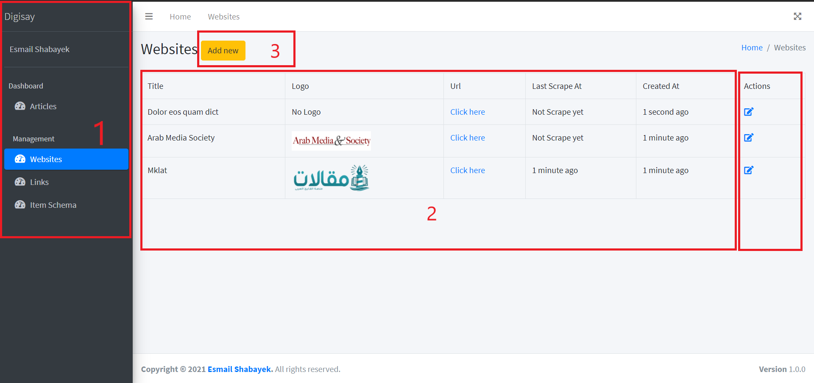
List Websites
Sidebar you can navigate to website module
List table of all websites inserted in database
Button to add a new website
Button to edit each website

Slide 3
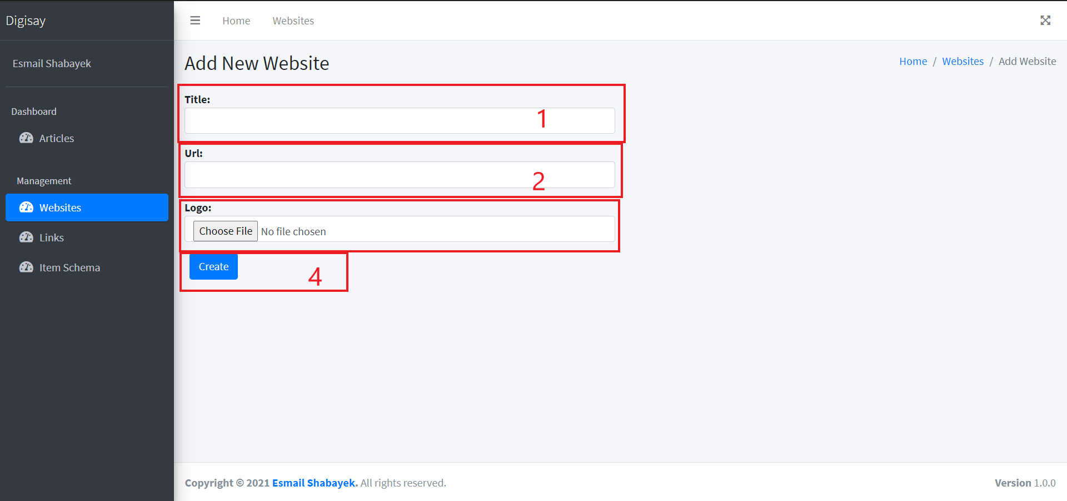
Add New Website
Title of Website - required field
URL of Website - required field
Logo of Website – optional field
Submit button to add website

Slide 4
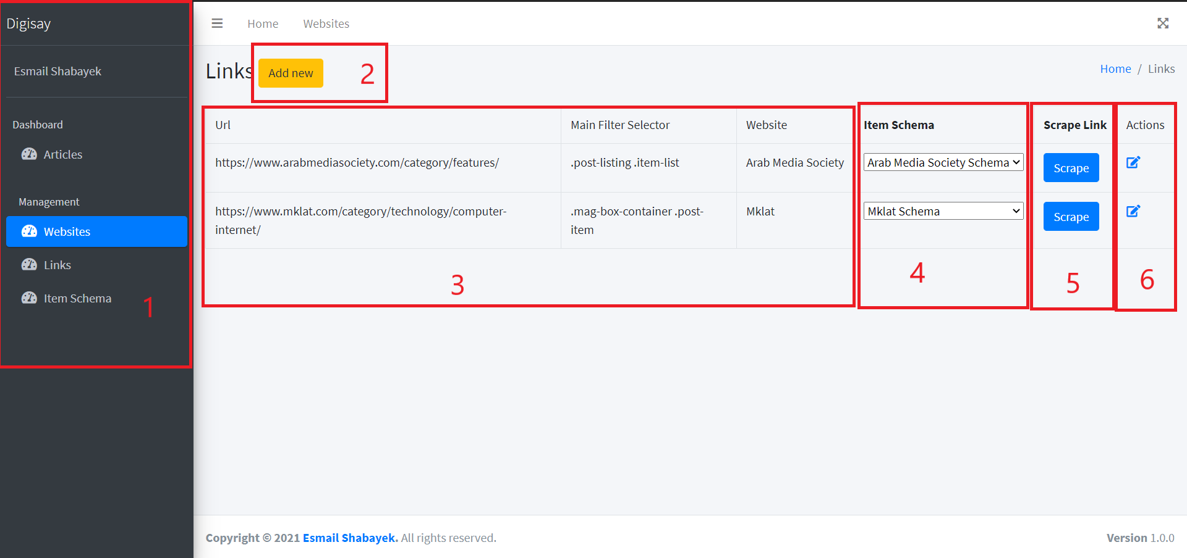
List Links of Website
Sidebar you can navigate to link module
Button to add a new link
List table of all links inserted in database
Dropdown to change item schema for every link
Scrape button to re-scrape the link of website and get the new data
Button to edit each website

Slide 5
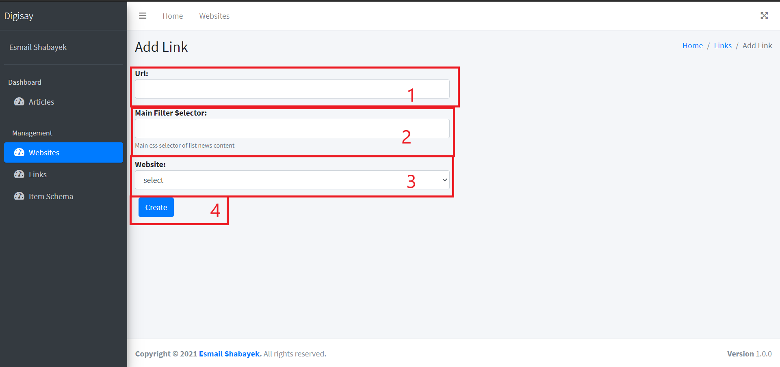
Add new link to website
The link from which the news will be fetched
Main CSS selector of list news content
The select website which we insert before
Submit button to add link

Slide 6
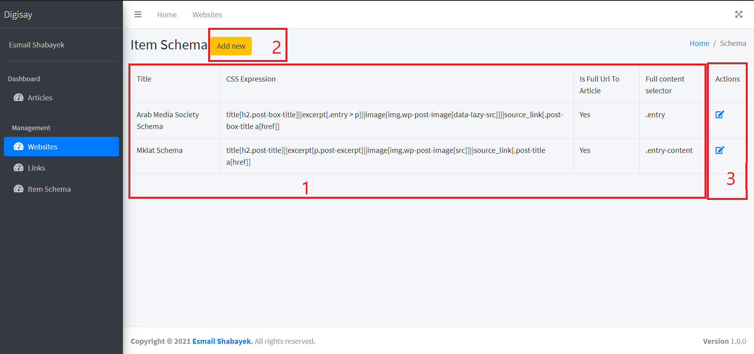
Item Schema
List table of all schema inserted in database
Button to add a new item schema
Button to edit each schema

Slide 7
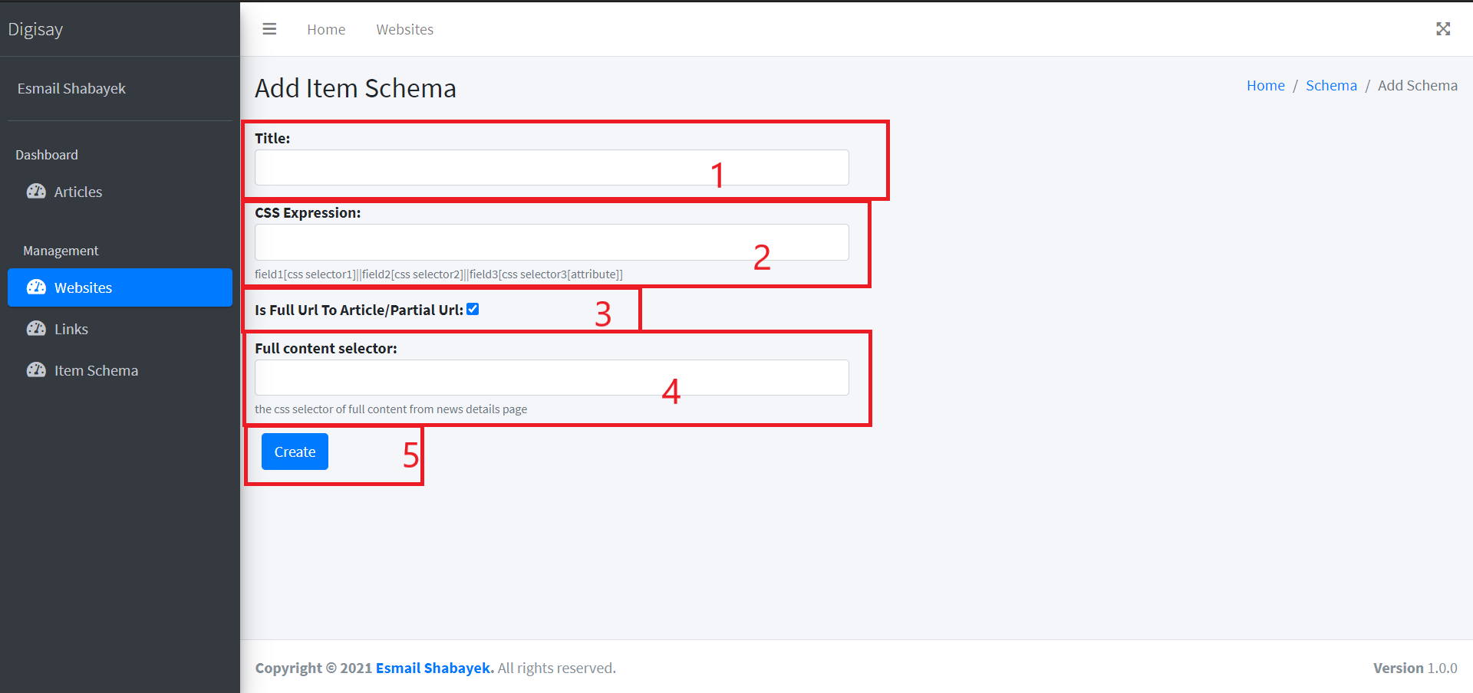
Add new item schema
Title schema
CSS selector expression that will fetch news from it *
Checkbox if the article URL is full URL or not
the CSS selector of full content from news details page
Submit button to add schema
Note
Css expression should be :
title[css selector1]
excerpt[css selector2]
image[css selector3[src]]
source_link[css selector4 a[href]]
css selector is item that to be fetched, and separate every item with ||

Slide 8
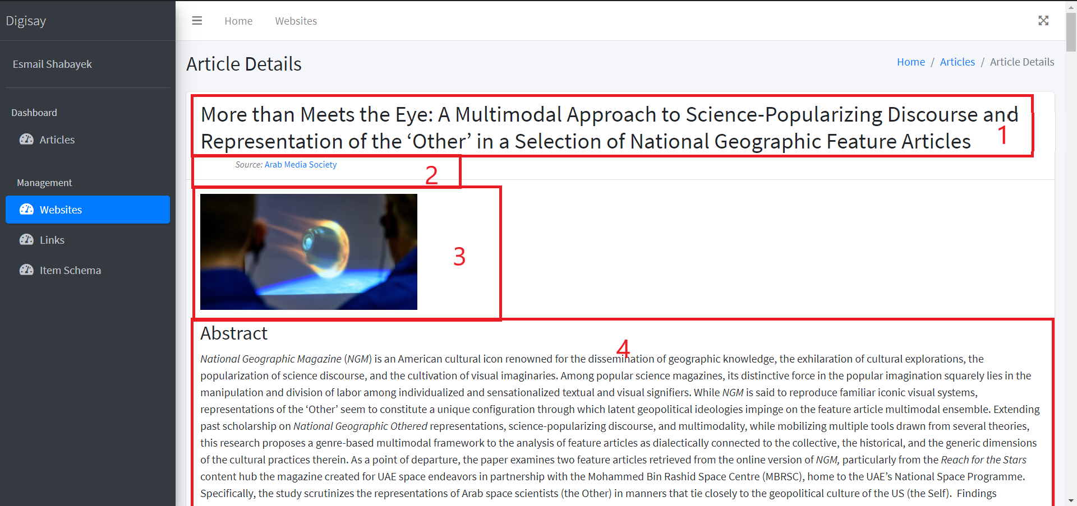
Article Details
Article title
From which website fetched
Article Image
Full content article

Slide 9
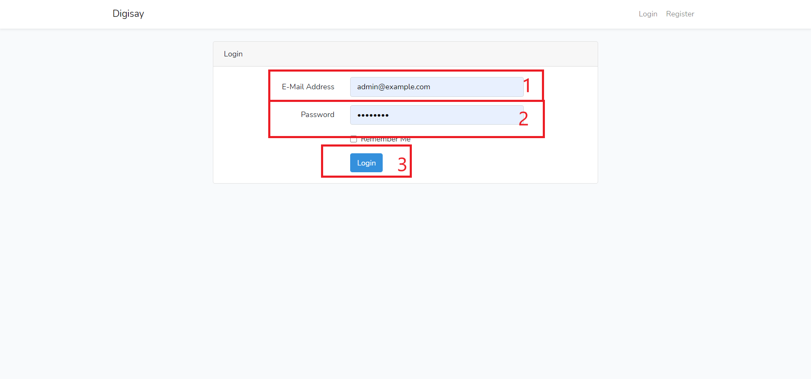
Login page
Email Address – admin@example
Password – 12345678
Login submits

