Slide 1



StudyWithRaghwendra-part7
View in Power BI
Last data refresh:
16/08/2023 10:43:32 UTC
Downloaded at:
16/08/2023 10:51:29 UTC

Slide 2
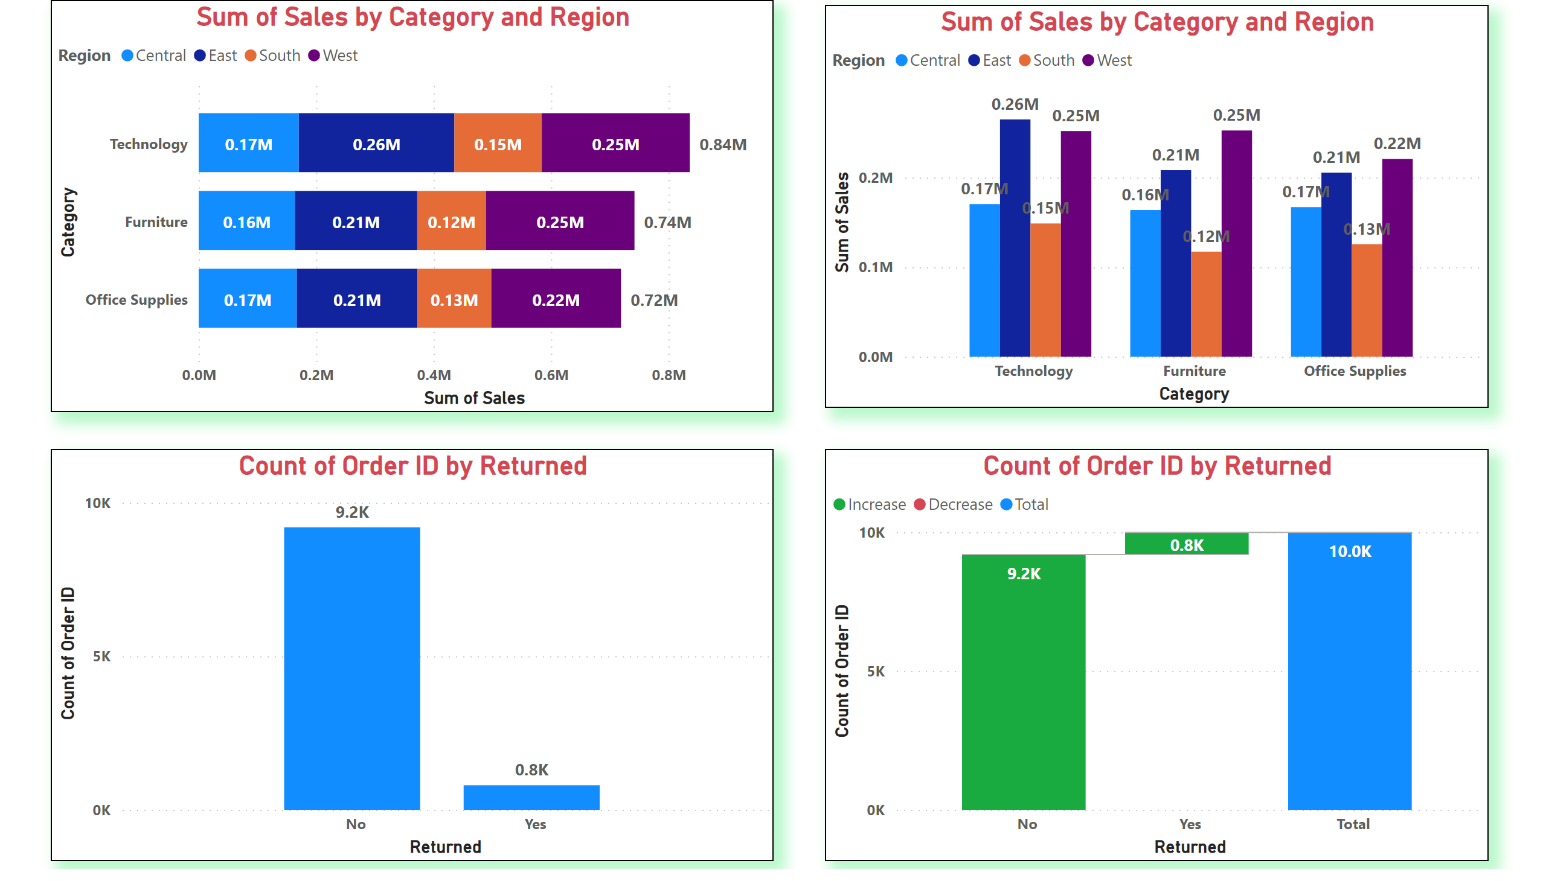
CATEGORY_SALES_CHART
Notes:
barChart
No alt text provided
clusteredColumnChart
No alt text provided
clusteredColumnChart
No alt text provided
waterfallChart
No alt text provided

