Slide 1
Chrome extension
The quick start guide

Slide 2

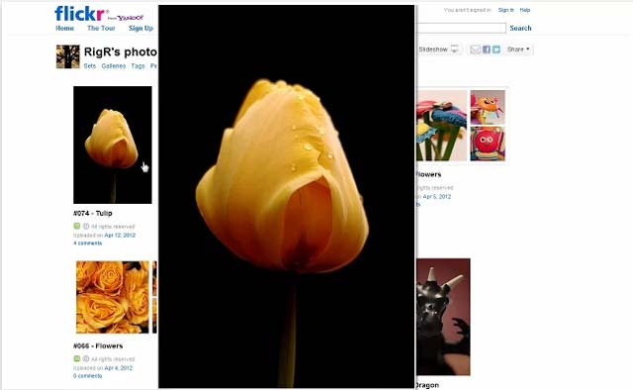

What Chrome extensions do
Allow browser customisation without effort
Add content to webpage
Add functionality to browser
Remove functionality from the browser

Slide 3

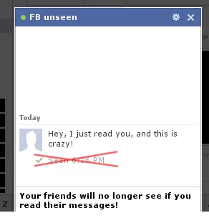


What Chrome extensions can do
Take your app to the customer
Change the internet to be what you want

Slide 4

Understanding the Web
The parts that make up a webPage

Slide 5
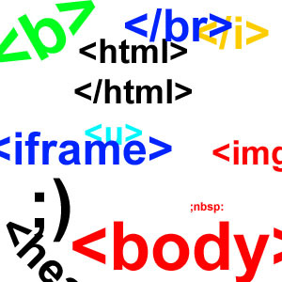
HTML and the DOM
HTML stands for HyperText Markup Language
Language used to make webpage templates
DOM stands for Document Object Model
Browser’s Representation of HTML
Lets look at the BasicWebPage.html example

Slide 6
JavaScript
JavaScript is a programming language understood by all browsers
JavaScript can manipulate the DOM
Lets go back to the example and change the DOM using JavaScript (JS)

Slide 7

Coding our Own Chrome extension
Start you laptops

Slide 8
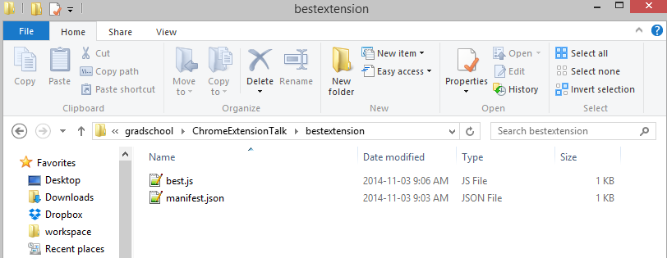
Structure of a Chrome extension
Put all related files in a folder
Folder must contain manifest.json
Folder should contain at least one HTML or JS file

Slide 9
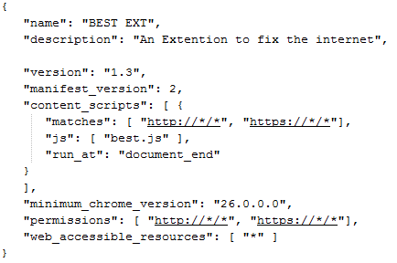
Manifest File
Explains to browser what it has to do
Declares all the required resources
Declares all the required permissions

Slide 10
Loading Our first Chrome Extension
Extract all Tutorial files into a folder
Open Chrome
Go to chrome://extensions
Click “Load unpacked extension”
Navigate to the folder where the manifest is located
Click OK

Slide 11
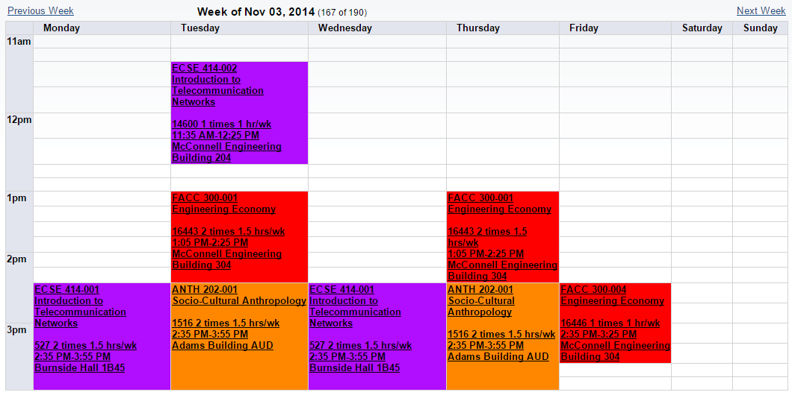
Making our second Chrome Extension
Time to break the McGill website

Slide 12
What’s next
Upload your Extension to the store
Integrating with a backend website
Integrating with a mobile device
The possibilities are endless

Slide 13
References
Getting started: https://developer.chrome.com/extensions/getstarted
The DOM: http://css-tricks.com/dom/

