Slide 1
Git Work flows
Also Presentation skills

Slide 2
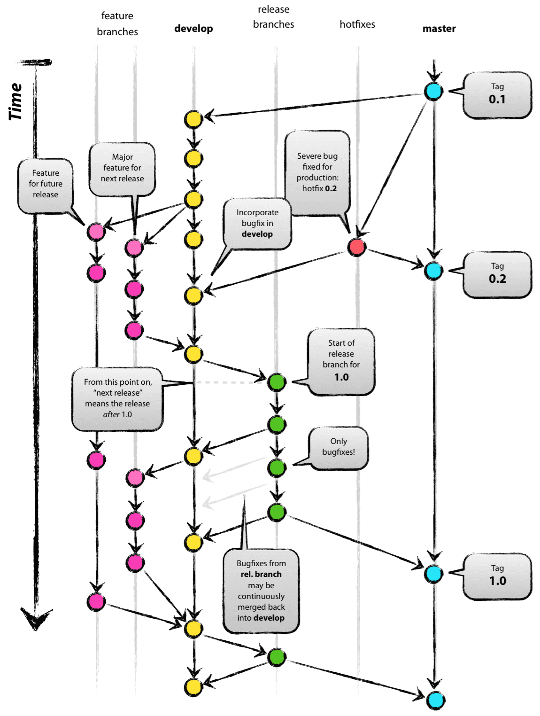
Git as a Team
Vincent Driessen's model --------------------------------->
Notes:
Pic: http://nvie.com/posts/a-successful-git-branching-model/

Slide 3
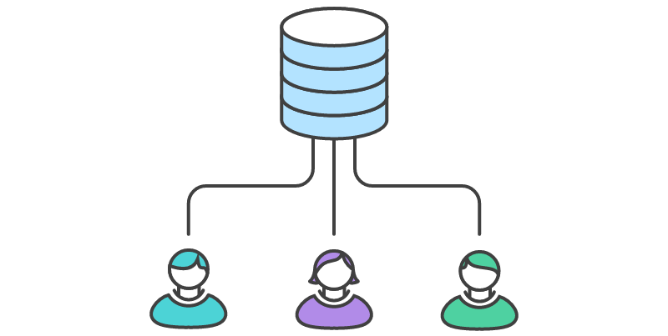
Central Repo Problems
Notes:
https://www.atlassian.com/git/tutorials/comparing-workflows/centralized-workflow

Slide 4
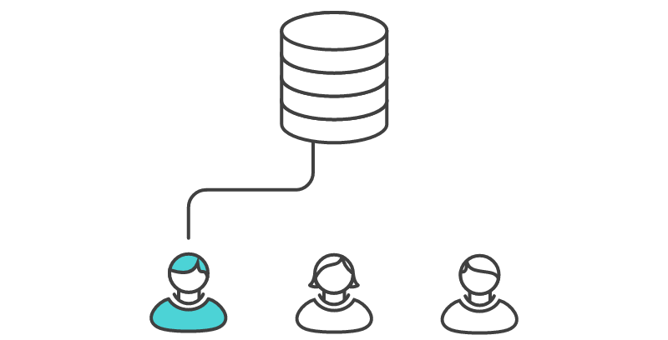
Central Repo Problems
Notes:
https://www.atlassian.com/git/tutorials/comparing-workflows/centralized-workflow

Slide 5
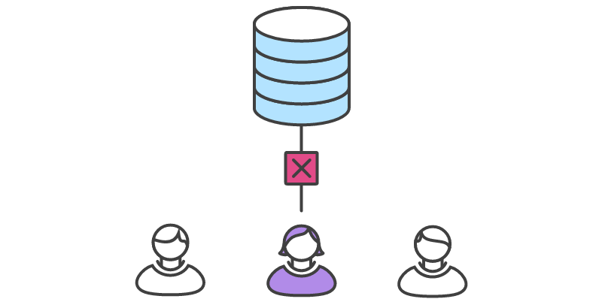
Central Repo Problems
Notes:
https://www.atlassian.com/git/tutorials/comparing-workflows/centralized-workflow

Slide 6
Central Repo Problems
Notes:
https://www.atlassian.com/git/tutorials/comparing-workflows/centralized-workflow

Slide 7
Central Repo Problems
#2
Notes:
https://www.atlassian.com/git/tutorials/comparing-workflows/centralized-workflow

Slide 8
Central Repo Problems
#2
Notes:
https://www.atlassian.com/git/tutorials/comparing-workflows/centralized-workflow

Slide 9
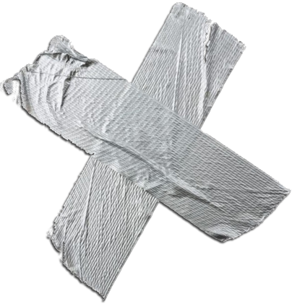
Central Repo Problems
Notes:
https://www.atlassian.com/git/tutorials/comparing-workflows/centralized-workflow

Slide 10
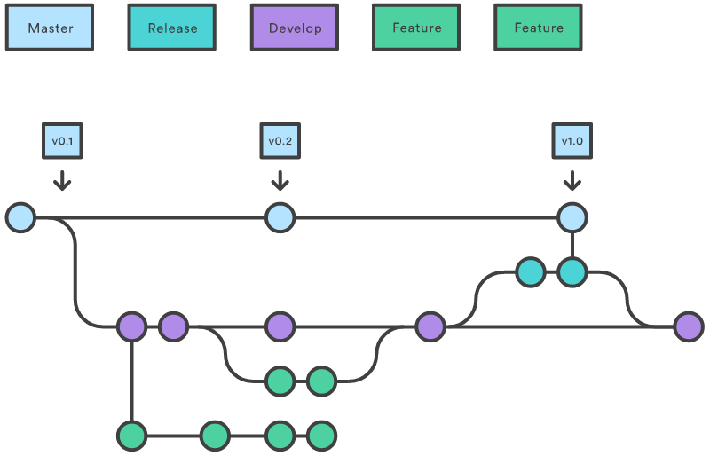
Solution Dev/Release/Feature
Keep Clean Versions
Freedom for new ideas
Notes:
https://www.atlassian.com/git/tutorials/comparing-workflows/centralized-workflow

Slide 11
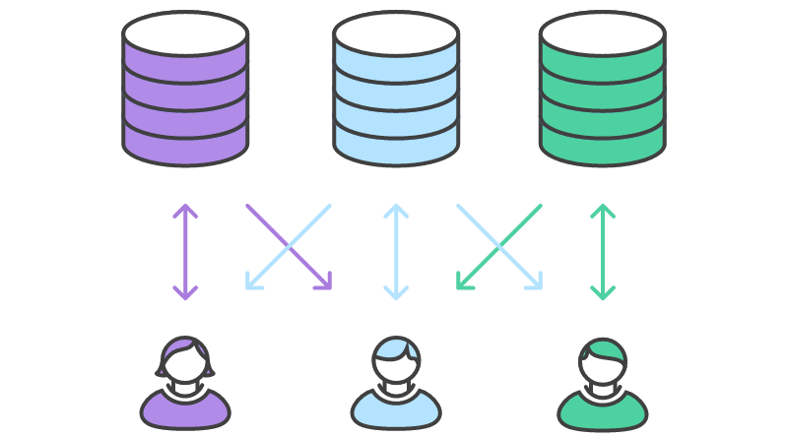
Solution Forking/Pull Requests
Permissions
Code Reviews
Notes:
https://www.atlassian.com/git/tutorials/comparing-workflows/centralized-workflow

Slide 12
References
Atlassin:
https://www.atlassian.com/git/tutorials/comparing-workflows/centralized-workflow Vincent Driessen:
http://nvie.com/posts/a-successful-git-branching-model/

Slide 13
Presentation Skills
Tips and tricks

Slide 14
Requirements
12-20 Minutes Including questions (revised to 10 minutes)
Unique aspects of Team's Solution
Answering Questions
Notes:
https://www.atlassian.com/git/tutorials/comparing-workflows/centralized-workflow

Slide 15
Slide Deck
Easy Mode
  PowerPoint/libreOffice
  Google Presentation
Intermediate
  Microsoft Sway
  Prezi
  SlideShare
Advanced
  Reveal.js
  HTML Framework
Notes:
https://www.atlassian.com/git/tutorials/comparing-workflows/centralized-workflow

Slide 16
Structured Presentation
Establish problem that your group faced
Always be addressing the Problem
Notes:
https://www.atlassian.com/git/tutorials/comparing-workflows/centralized-workflow

Slide 17
Demo
Prepare ahead of time
Consider using Video instead of live
Highlight features that were unique to your team
Practice your demo if you're live demoing!
Notes:
https://www.atlassian.com/git/tutorials/comparing-workflows/centralized-workflow

Slide 18
Good Luck!
Notes:
https://www.atlassian.com/git/tutorials/comparing-workflows/centralized-workflow

Slide 19
Travis CI
Tips and tricks

Slide 20
Example
See a working Travis CI with ANT example at:
https://github.com/shabbir-hussain/TravisExercise
Notes:
https://www.atlassian.com/git/tutorials/comparing-workflows/centralized-workflow

Slide 21

Setting up Travis
Sign up for Travis
Notes:
https://www.atlassian.com/git/tutorials/comparing-workflows/centralized-workflow

Slide 22
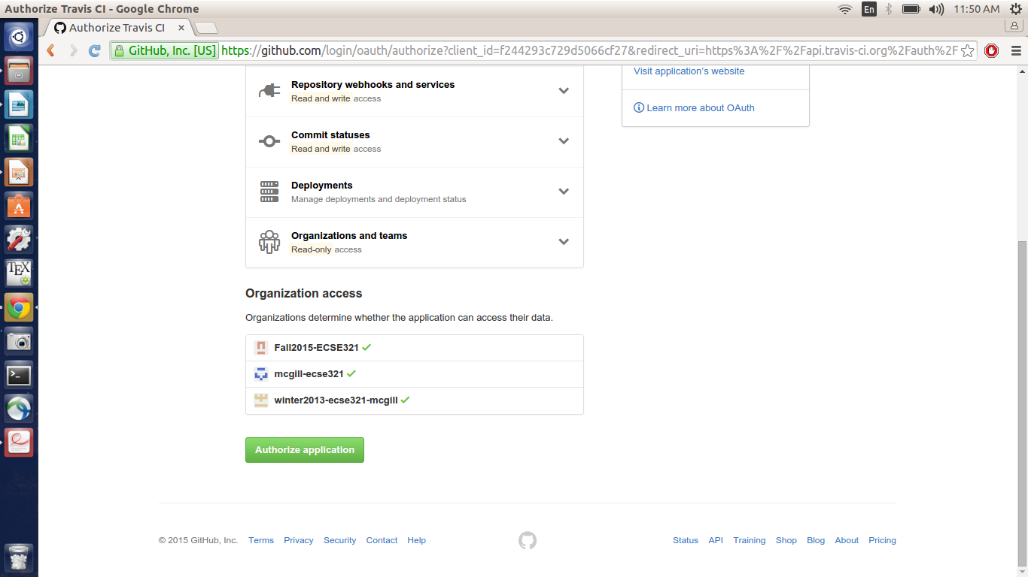
Setting up
Allow travis access to your github
Notes:
https://www.atlassian.com/git/tutorials/comparing-workflows/centralized-workflow

Slide 23

Setting up
Choose the repo you want for CI
Notes:
https://www.atlassian.com/git/tutorials/comparing-workflows/centralized-workflow

Slide 24

Setting up
Add .travis.yml
Notes:
https://www.atlassian.com/git/tutorials/comparing-workflows/centralized-workflow

Slide 25

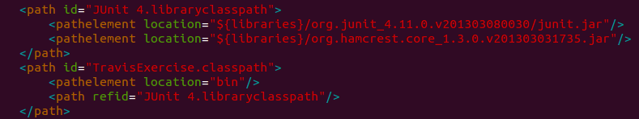
Setting up
Add properties to the build.xml file
Notes:
https://www.atlassian.com/git/tutorials/comparing-workflows/centralized-workflow

Slide 26
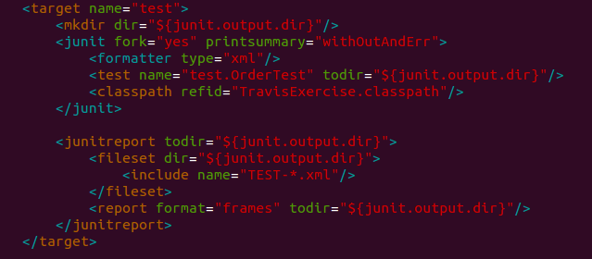
Setting up
Add the test target to the build.xml file
Notes:
https://www.atlassian.com/git/tutorials/comparing-workflows/centralized-workflow

Slide 27
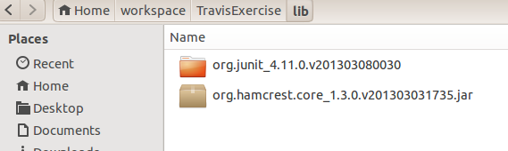
Setting up
Make a lib folder with the following jars
(For your project it will be easiest to copy paste the lib folder from the example to your project)
Notes:
https://www.atlassian.com/git/tutorials/comparing-workflows/centralized-workflow

Slide 28
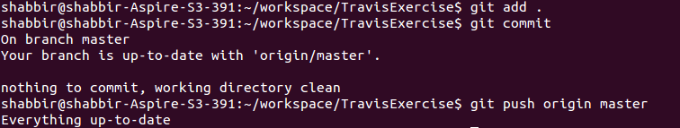
Setting up
Push your changes
Notes:
https://www.atlassian.com/git/tutorials/comparing-workflows/centralized-workflow

Slide 29
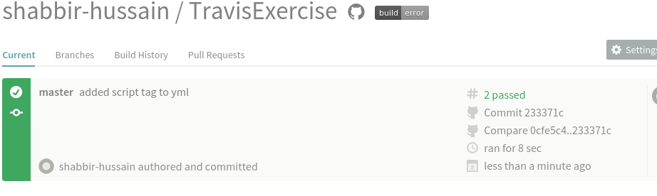
Did it work?
Check travis homepage
Green is good
Notes:
https://www.atlassian.com/git/tutorials/comparing-workflows/centralized-workflow

Slide 30
Setting up Travis
12-20 Minutes Including questions (revised to 10 minutes)
Unique aspects of Team's Solution
Answering Questions
Notes:
https://www.atlassian.com/git/tutorials/comparing-workflows/centralized-workflow

