Slide 1
OO Design
Working in groups
Notes:
<number>

Slide 2
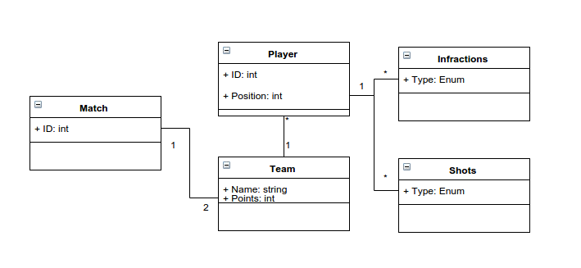
Exercise
Implement the following in groups of 2
Notes:
<number>

Slide 3
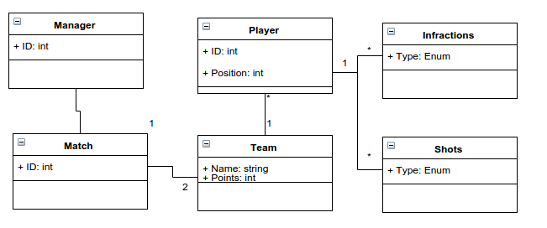
Exercise
Create a manager class and instantiate 6 matches between 4 teams (make up the numbers)
Notes:
<number>

Slide 4
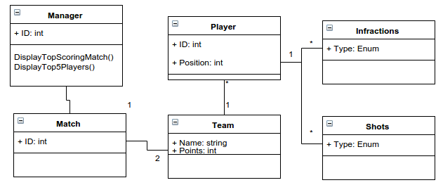
Exercise
Add a method to display top scoring matches and top 5 players (print statements are enough)
Notes:
<number>

Slide 5
Exercise
Add a method to display top scoring matches and top 5 players (print statements are enough)
Notes:
<number>

Slide 6
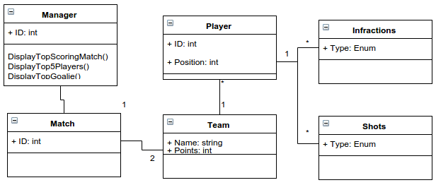
Exercise
Add a method to display top goalie
Notes:
<number>

