Slide 1
Requirement Modelling
Domain Modelling
Notes:
<number>

Slide 2
UML Software
MS Visio
Huge library images
Not Free
Draw.io https://www.draw.io/
Syncs with Google drive or Dropbox
Lots of options
Creately https://creately.com
No Registration Required

Slide 3
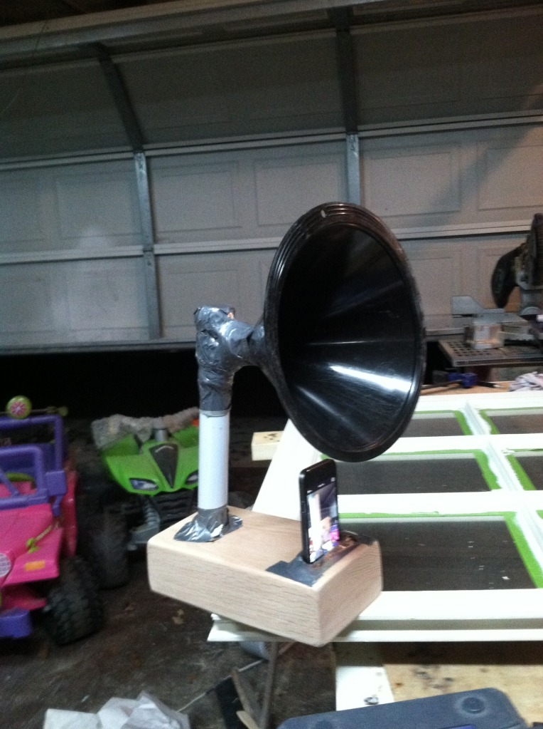
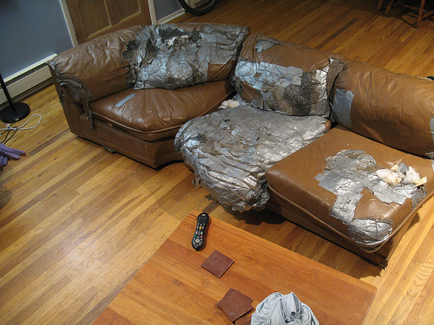
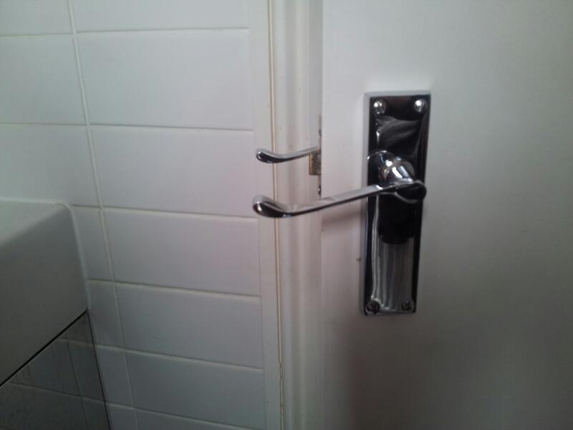
Design Documentations omitted
Notes:
Humor obtained from reddit.com/r/diwhy
https://www.youtube.com/watch?v=FqhZZNUyVFM
<number>

Slide 4
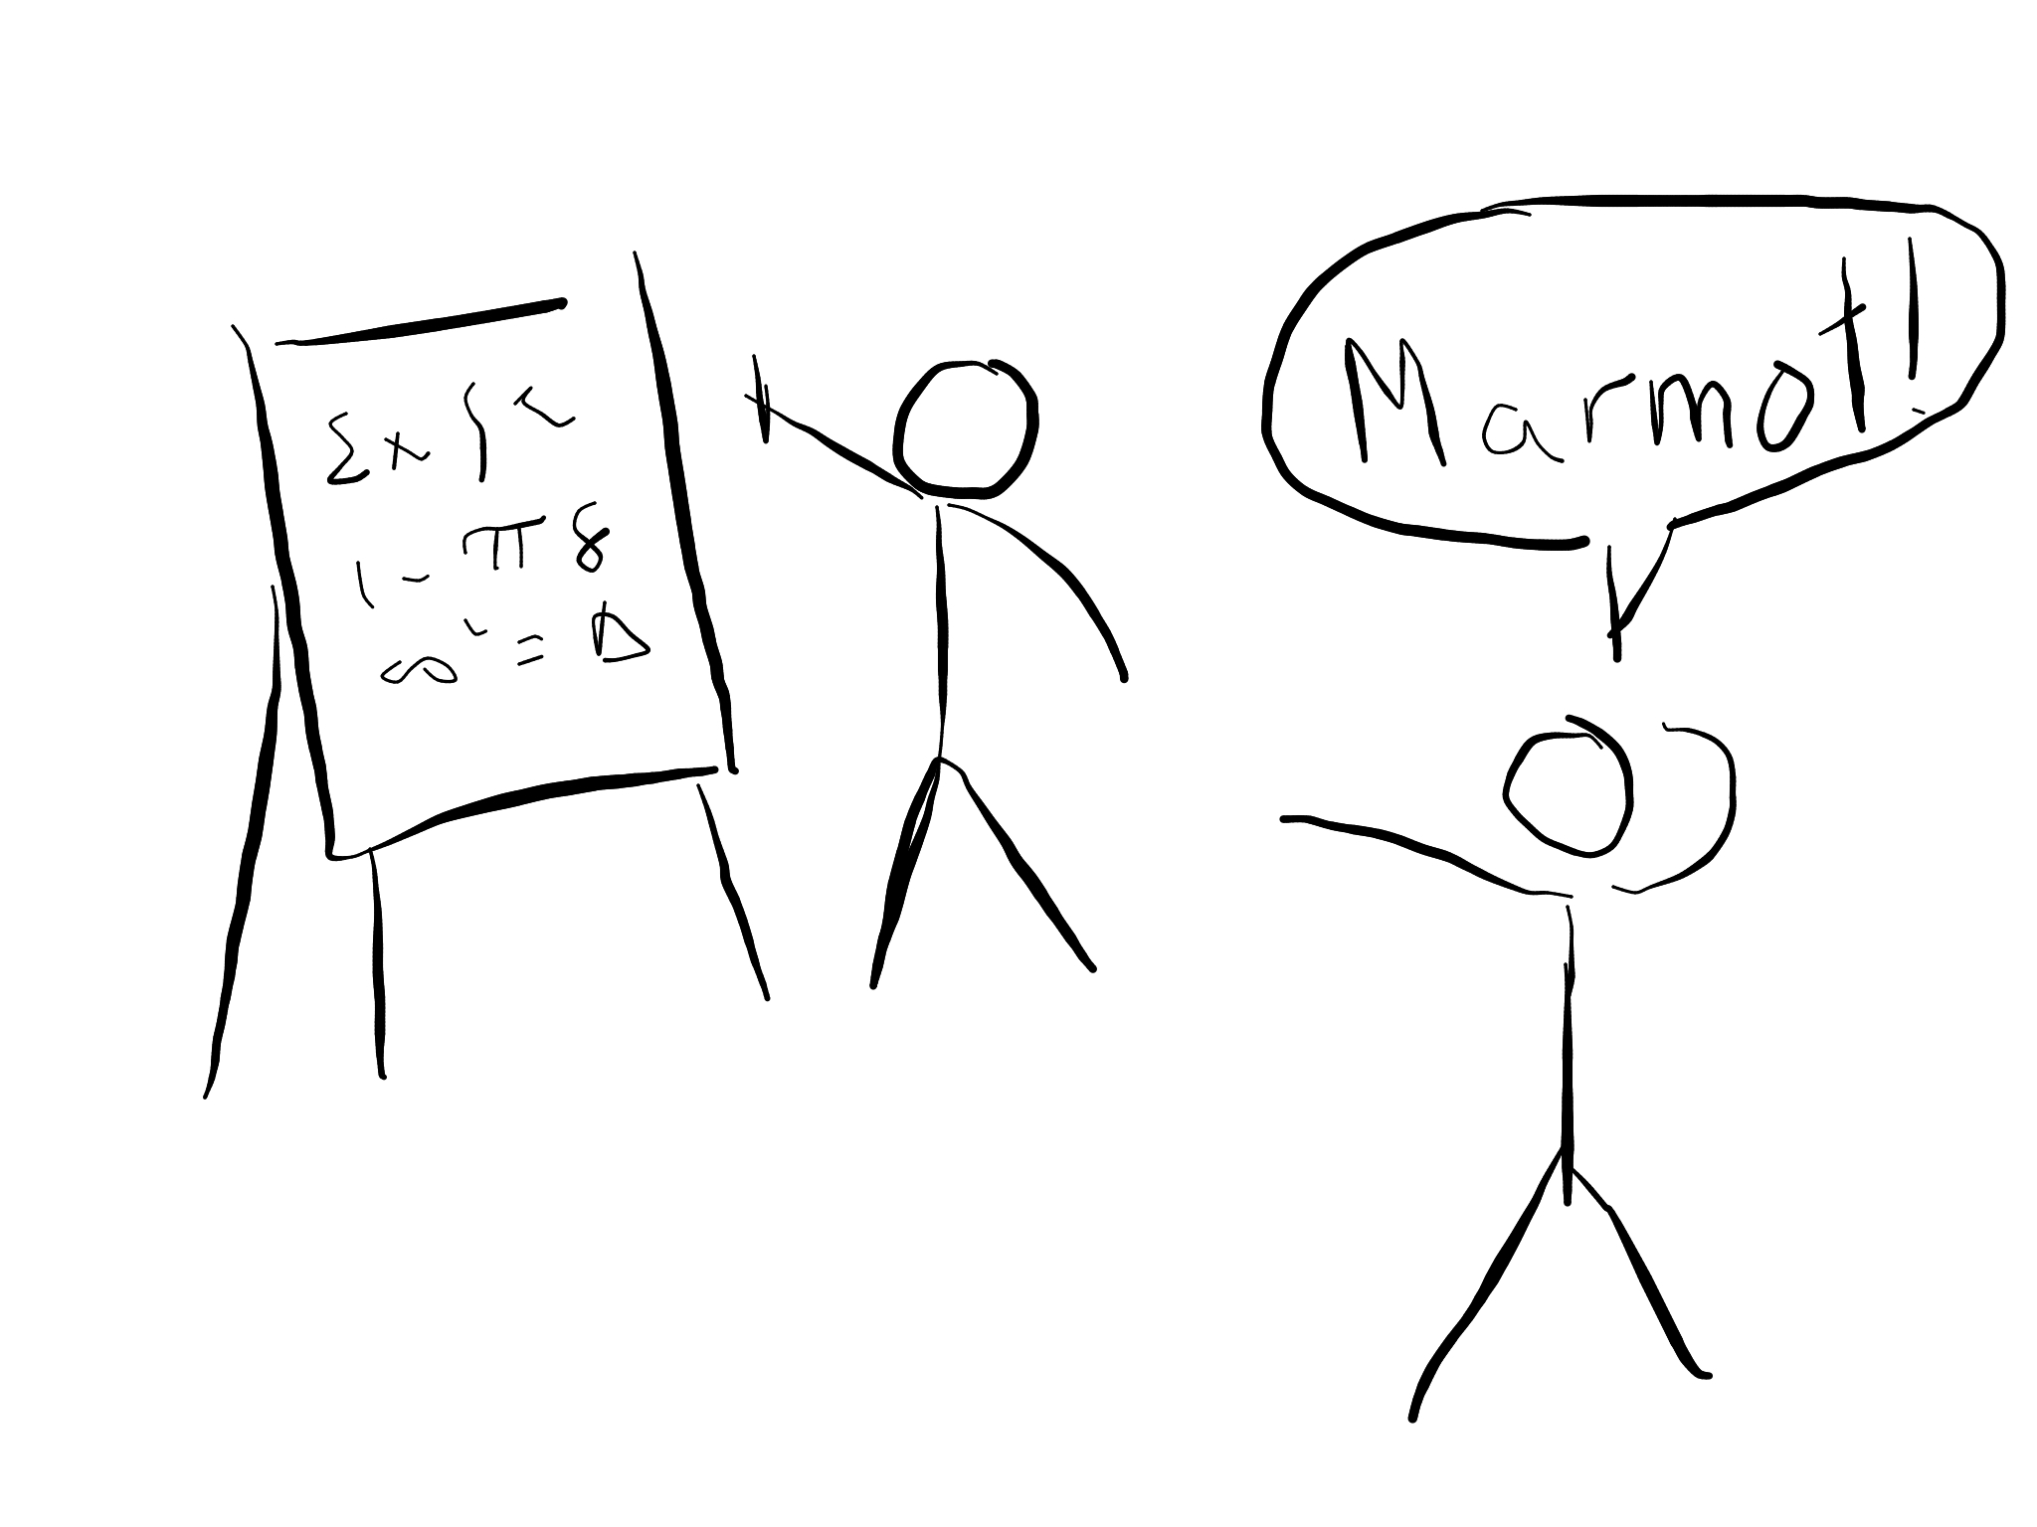
Domain Modelling
Explaining a problem using Pictures

Slide 5
Domain Modeling
Domain Modeling is a way to model (explain) a problem in the real world using diagrams
A Domain Model is not a class Diagram
Notes:
Image obtained from:
http://www.codeproject.com/Articles/330447/Understanding-Association-Aggregation-and-Composit
<number>

Slide 6
Domain Modeling Questions
Can a domain object have another domain object as an attribute?
Can a domain object have zero attributes?
Is a domain model a description of my Java classes?

Slide 7
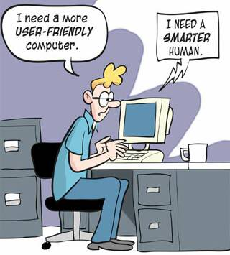
Use Cases
Describing user actions
Notes:
Photo credit: http://i717.photobucket.com/albums/ww173/prestonjjrtr/Funny/userfriendly.jpg
<number>

Slide 8
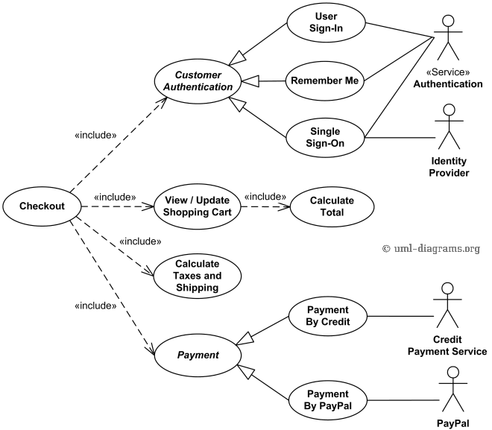
Use case Diagrams
Actors
Use Cases
Relationships
Descriptions
Notes:
<number>

Slide 9
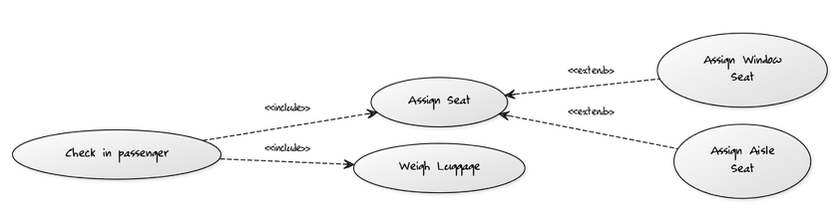
Include vs extend
Include: When one action requires another. Reuse an action
Extend: When one action can be replaced by another (inheritance)
Notes:
<number>

Slide 10
Exercise
The VP Communication of ECSESS needs a new way to send the livewire newsletter to the students in EE, SE and CE. Currently students send him emails and subsequently he sends an email blast to many people including those who do not wish to receive the live wire.
What he would like is system where ECSE students can login to their MyMcGill account and post their announcements or campus events, these news items can be edited or removed. Those news events would come up on a news feed that students can view in their MyMcGill page. Of course, he would like to have administrative rights in order to prevent abuse. This would allow him to edit and remove abusive posts.
Draw a use case Diagram to represent the user interface for this scenario. Be sure to have more than one actor and the correct relations between the actions and the actors.
Notes:
<number>

Slide 11
Use Case Description
Describes a use case in the following manner:
Goals
Entry conditions
Flow of events
Exit condition
Notes:
<number>

Slide 12
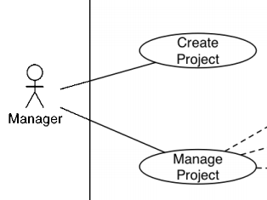
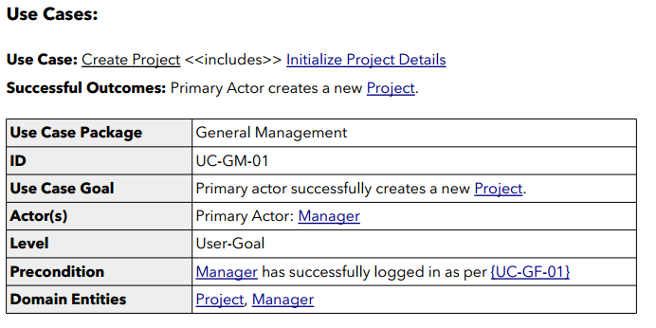
Use Case Description
Notes:
<number>

Slide 13
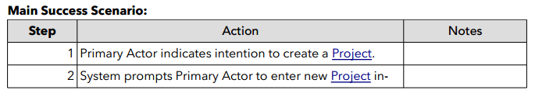
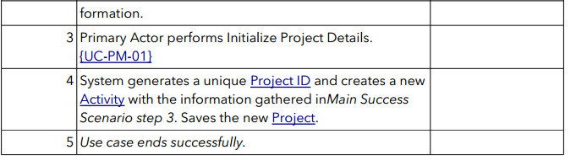
Use Case Description
Notes:
<number>

Slide 14
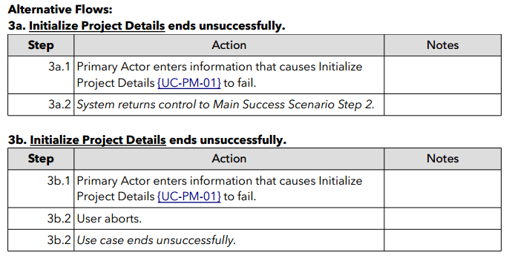
Use Case Description
Notes:
<number>

Slide 15
Use Case Concept Questions
Can a software component be an Actor?
Do Use Case Diagrams describe High Level concepts or Low Level Concepts?
Notes:
<number>

Slide 16
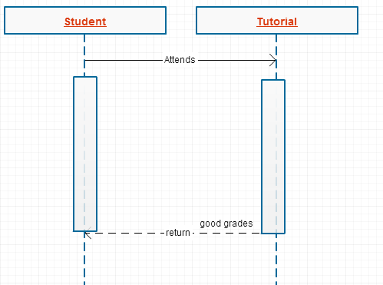
Sequence Diagrams
It can describe sequences of events

Slide 17
UML Sequence Diagrams
Describes interaction between objects
Also indicates timing and order between those interactions
Notes:
<number>

Slide 18
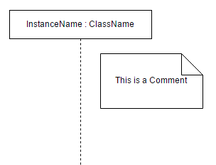
UML Sequence Diagrams (Basics)
Notes:
<number>

Slide 19
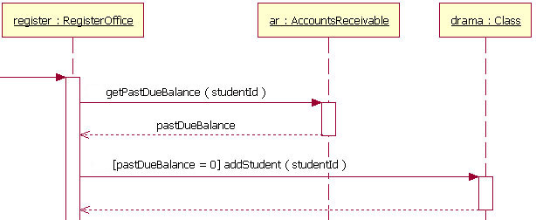
UML Sequence Diagrams (Parts)
Life Lines
Messages
Return Values
Conditions
Notes:
Image obtained from: http://www.ibm.com/developerworks/rational/library/content/RationalEdge/feb04/3101_figure7.jpg
<number>

Slide 20
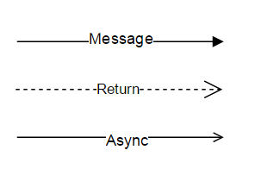
UML Sequence Diagrams (Arrows)
Message
Return value
Asynchronous message
Notes:
Image obtained from: http://www.ibm.com/developerworks/rational/library/content/RationalEdge/feb04/3101_figure7.jpg
<number>

Slide 21
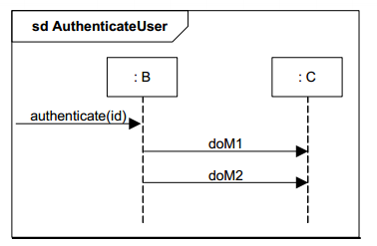
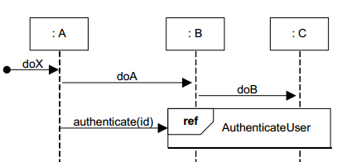
UML Sequence Diagrams (Abstraction)
Abstract away complicated interactions
Use frames to reference to other interactions
Notes:
Image obtained from: http://www.ibm.com/developerworks/rational/library/content/RationalEdge/feb04/3101_figure7.jpg
<number>

Slide 22
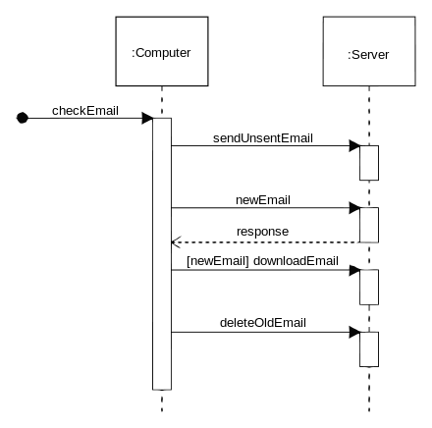
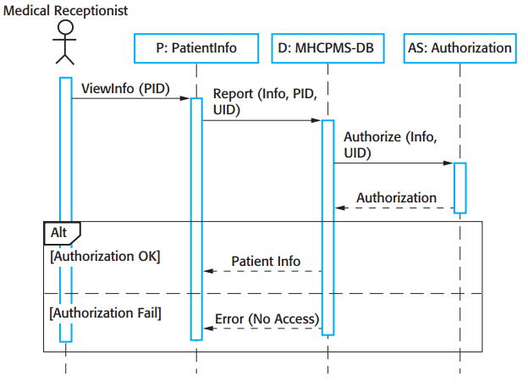
Simple Example
Notes:
Taken from http://upload.wikimedia.org/wikipedia/commons/thumb/9/9b/CheckEmail.svg/440px-CheckEmail.svg.png
<number>

Slide 23
Pop Quiz
In a racing game, are sequence diagrams useful for describing car components and its various attributes?
You are designing the user interface for a tablet PC used in the construction industry, under what scenario would you use a sequence diagram?
Notes:
Taken from http://upload.wikimedia.org/wikipedia/commons/thumb/9/9b/CheckEmail.svg/440px-CheckEmail.svg.png
<number>

Slide 24
Exercise
McGill University is “upgrading” its room booking services for students. Students can now use an online portal to book all rooms at anytime for a “small” fee.
To request a room the student will input the time at which to make the booking and the amount of students the room needs to hold. This information will be sent the booking system which will find a room that fits all the students at the requested time, if it such a room exists. The booking system will hold the room in pending for 5 business days for inconvenience's sake. Then, the booking system will also send an invoice to the requester’s student account charging them for the booking along with a confirmation email to the student’s mail.mcgill.ca email.
Draw a sequence diagram using software mentioned above to represent the events described above. Be sure to have at least 2 classes, the relevant arrows and conditions. Make any assumptions necessary for a plausible scenario.
Notes:
Image obtained from: http://www.ibm.com/developerworks/rational/library/content/RationalEdge/feb04/3101_figure7.jpg
<number>

Slide 25
References
http://www.ibm.com/developerworks/rational/library/3101.html
http://www.objectmentor.com/resources/articles/umlClassDiagrams.pdf
http://www.ibm.com/developerworks/rational/library/content/RationalEdge/sep04/bell/
http://en.wikipedia.org/wiki/Class_diagram
http://slides.com/dominiccharleyroy/

Slide 26
References
http://www.codeproject.com/Articles/330447/Understanding-Association-Aggregation-and-Composit
http://aviadezra.blogspot.ca/2009/05/uml-association-aggregation-composition.html

