Slide 1
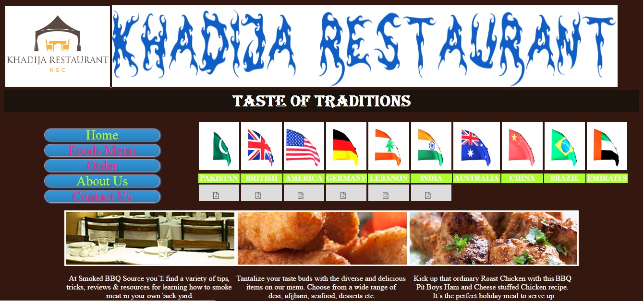

Slide 2
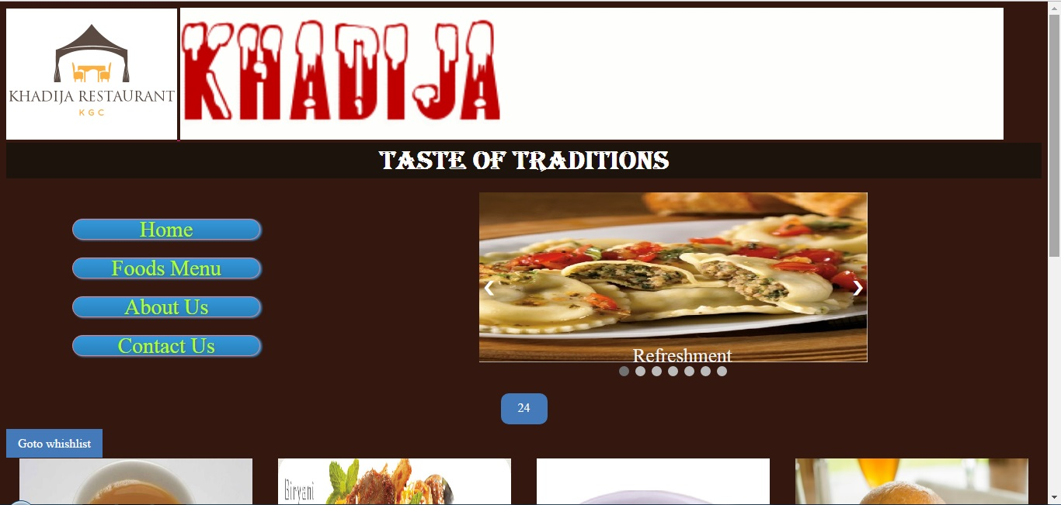

Slide 3
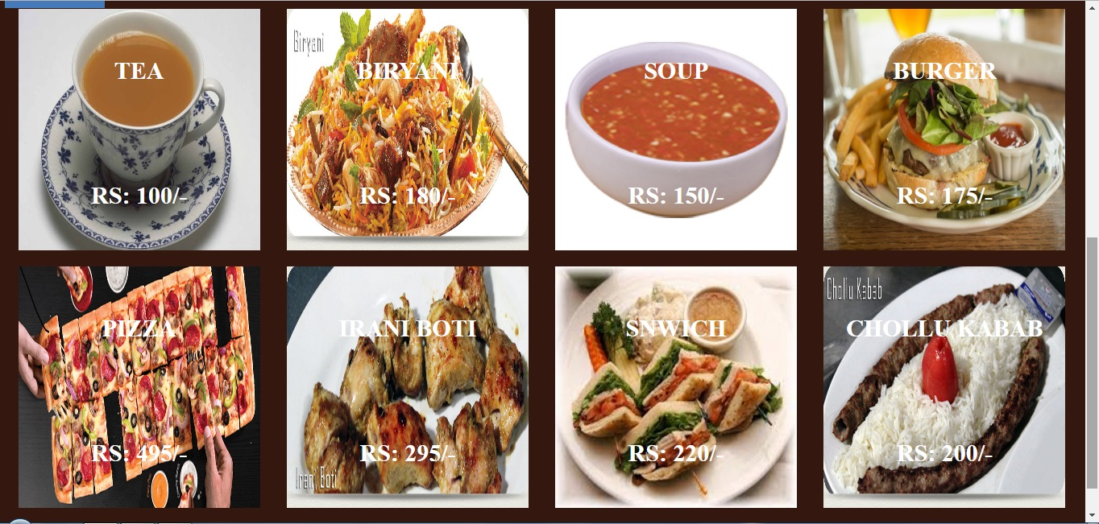

Slide 4
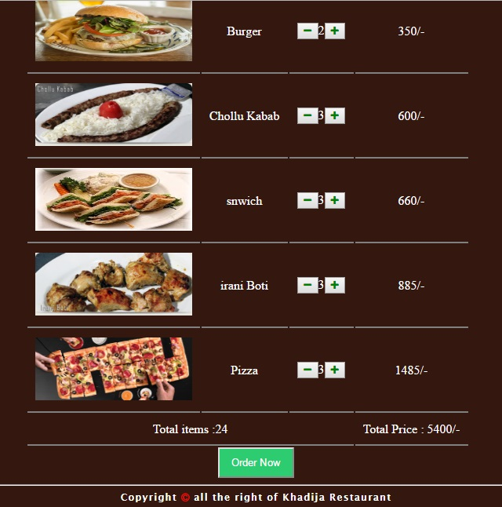

Slide 5


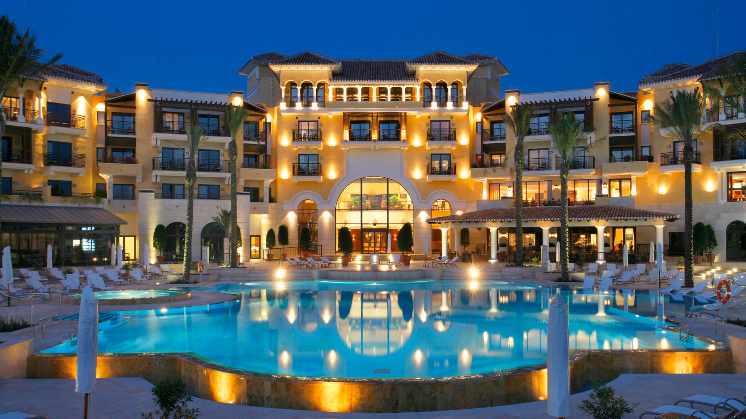
KHADIJA RESTAURANT
Email: muhammadshabbirmemon@gmail.com
Mobile No. 0331-2881648

