Slide 1


TNR • DIGITAL TRANSFORMATION
TNR DIGITAL
PLATFORM
Building a Connected, Transparent and
Future-Ready Roundu Community
SHABBIR HUSSAIN
Technical Coordinator – TNR
OFFICIAL PLATFORM OVERVIEW
TNR
Notes:
Open by framing the platform as community infrastructure, not simply a website.
[Sources]
- Platform content and presenter details: user-provided TNR Digital Platform brief, 2026-08-04.
- Official TNR logo: user-provided transparent PNG, tnr-logo-transparent.png.
- Icons: Lucide v1.8.0, ISC License, bundled runtime — https://lucide.dev/.
- Hero artwork: user-provided hero.jpg, also used by the live TNR election portal.
[/Sources]

Slide 2
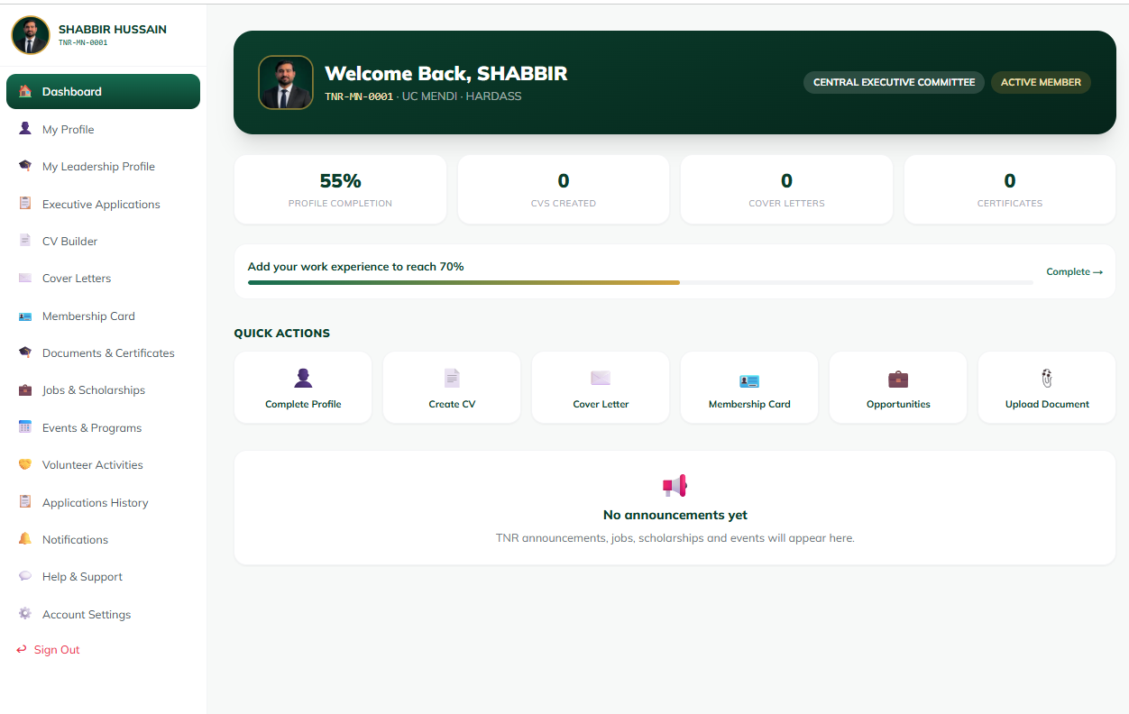
TNR DIGITAL PLATFORM
Why TNR Digital Platform?
A shared digital foundation replaces fragmented records, tools and communication.
REAL MEMBER PORTAL VIEW
WHY NOW
One reliable
source of truth.
Centralization makes information easier to find, services easier to access, and decisions easier to understand.
Members
Records
Services
Communication
Transparency
CONNECTED • TRANSPARENT • FUTURE-READY
02
Notes:
Use the member dashboard to show how identity, services, records and communication meet in one interface.
[Sources]
- Platform content and presenter details: user-provided TNR Digital Platform brief, 2026-08-04.
- Official TNR logo: user-provided transparent PNG, tnr-logo-transparent.png.
- Icons: Lucide v1.8.0, ISC License, bundled runtime — https://lucide.dev/.
- Member portal dashboard: user-provided tnr portal dashbaoard.png.
[/Sources]

Slide 3
TNR DIGITAL PLATFORM
One identity connects the whole community
Every step builds on the one before it—ending in a connected Roundu community.
ONE
01
One Member
Recognized in the community
02
One Profile
Always-current member record
A SIMPLE PRINCIPLE.
A COMPLETE DIGITAL FOUNDATION.
03
One Digital Identity
Trusted credentials and access
04
One Centralized Database
A shared source of truth
Identity becomes the bridge between people, services, governance and opportunity.
05
One Connected Community
People, services and opportunity
CONNECTED • TRANSPARENT • FUTURE-READY
03
Notes:
[Sources]
- Platform content and presenter details: user-provided TNR Digital Platform brief, 2026-08-04.
- Official TNR logo: user-provided transparent PNG, tnr-logo-transparent.png.
- Icons: Lucide v1.8.0, ISC License, bundled runtime — https://lucide.dev/.
[/Sources]

Slide 4
TNR DIGITAL PLATFORM
Twenty-four implemented modules power the platform
A complete operating layer across access, trust, member services, governance and intelligence.
FOUNDATION & ACCESS
MEMBER SERVICES & TRUST
GOVERNANCE & ELECTIONS
01
TNR Public Website
09
TNR Digital Membership Card
17
Election Management System
02
Membership Management System
10
QR Code Membership Verification
18
Online Voting Portal
03
Member Registration and Login
11
Certificate Management System
19
Candidate Management System
04
Member Profile Management
12
QR Code Certificate Verification
20
Election Results and Reporting
05
Admin Dashboard
13
TNR AI Assistant
21
Advisory Council Management
06
Role-Based Portals
14
Professional CV Builder
22
CEC Member Portal
07
Security and Verification
15
Announcements and Notifications
23
Applications and Approval System
08
Reports and Analytics
16
Roundu Information and Statistics Database
24
Executive and Organizational Management
CONNECTED • TRANSPARENT • FUTURE-READY
04
Notes:
The TNR Digital Platform now includes twenty-four implemented modules across access, member services, trust, governance and reporting.
[Sources]
- Platform content and presenter details: user-provided TNR Digital Platform brief, 2026-08-04.
- Official TNR logo: user-provided transparent PNG, tnr-logo-transparent.png.
- Icons: Lucide v1.8.0, ISC License, bundled runtime — https://lucide.dev/.
- Module status and wording: user-provided TNR Digital Platform Modules list, 2026-08-05.
[/Sources]

Slide 5
TNR DIGITAL PLATFORM
Membership becomes one clear digital journey
A visible path from first registration to full access.
01
02
03
04
05
06
Registration
Profile
Completion
Admin Review
Approval
Digital Membership
Card
Member
Dashboard
Create account
Complete details
Records checked
Membership confirmed
Verified identity
Services unlocked
Every stage is trackable, reviewable and connected.
CONNECTED • TRANSPARENT • FUTURE-READY
05
Notes:
[Sources]
- Platform content and presenter details: user-provided TNR Digital Platform brief, 2026-08-04.
- Official TNR logo: user-provided transparent PNG, tnr-logo-transparent.png.
- Icons: Lucide v1.8.0, ISC License, bundled runtime — https://lucide.dev/.
[/Sources]

Slide 6
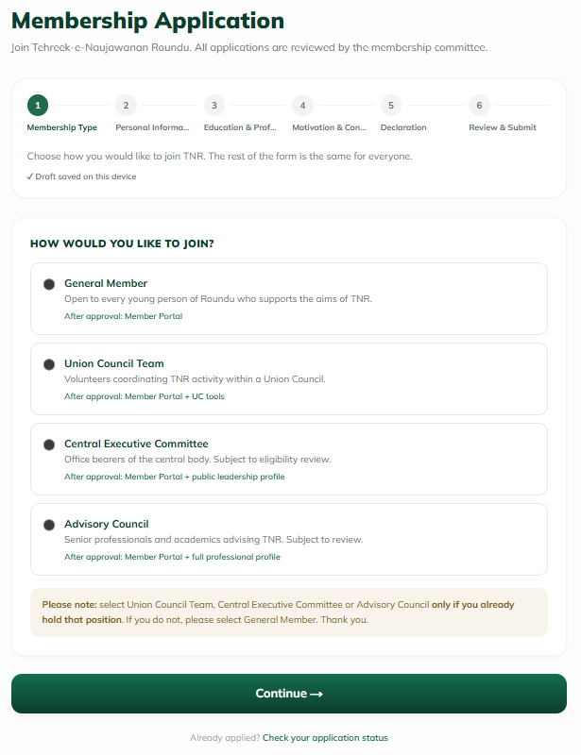
TNR DIGITAL PLATFORM
REAL MEMBER PORTAL VIEW
One reliable
source of truth.
Members
Records
Services
Communication
Transparency
CONNECTED • TRANSPARENT • FUTURE-READY
02
Notes:
Use the member dashboard to show how identity, services, records and communication meet in one interface.
[Sources]
- Platform content and presenter details: user-provided TNR Digital Platform brief, 2026-08-04.
- Official TNR logo: user-provided transparent PNG, tnr-logo-transparent.png.
- Icons: Lucide v1.8.0, ISC License, bundled runtime — https://lucide.dev/.
- Member portal dashboard: user-provided tnr portal dashbaoard.png.
[/Sources]

Slide 7

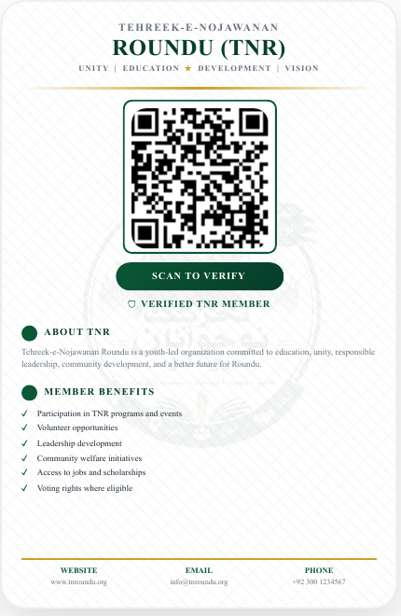
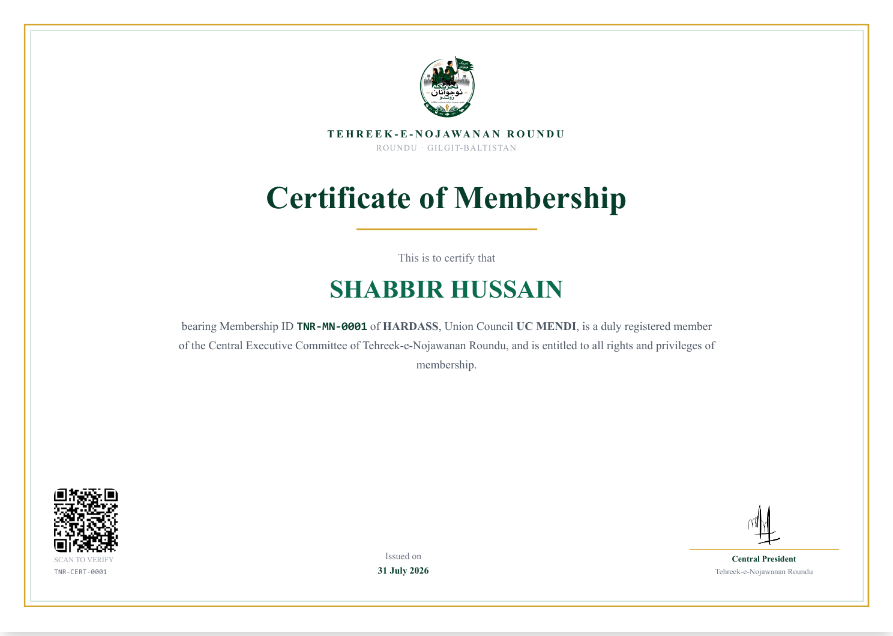
TNR DIGITAL PLATFORM
Digital identity is visible—and instantly verifiable
The actual member card and certificate carry the credentials needed to confirm identity and status.
DIGITAL CARD • FRONT
QR VERIFICATION • BACK
MEMBERSHIP CERTIFICATE • QR + REFERENCE
Unique Membership ID • QR-verified Digital Card • Certificate Verification • Reference Number Verification • Secure Member Records
CONNECTED • TRANSPARENT • FUTURE-READY
06
Notes:
Show the card front, QR-enabled back and certificate as one trust system rather than three separate documents.
[Sources]
- Platform content and presenter details: user-provided TNR Digital Platform brief, 2026-08-04.
- Official TNR logo: user-provided transparent PNG, tnr-logo-transparent.png.
- Icons: Lucide v1.8.0, ISC License, bundled runtime — https://lucide.dev/.
- Membership card: user-provided TNR Card.pdf, rendered from the original PDF.
- Membership certificate: user-provided tnr certificate.pdf, rendered from the original PDF.
[/Sources]

Slide 8
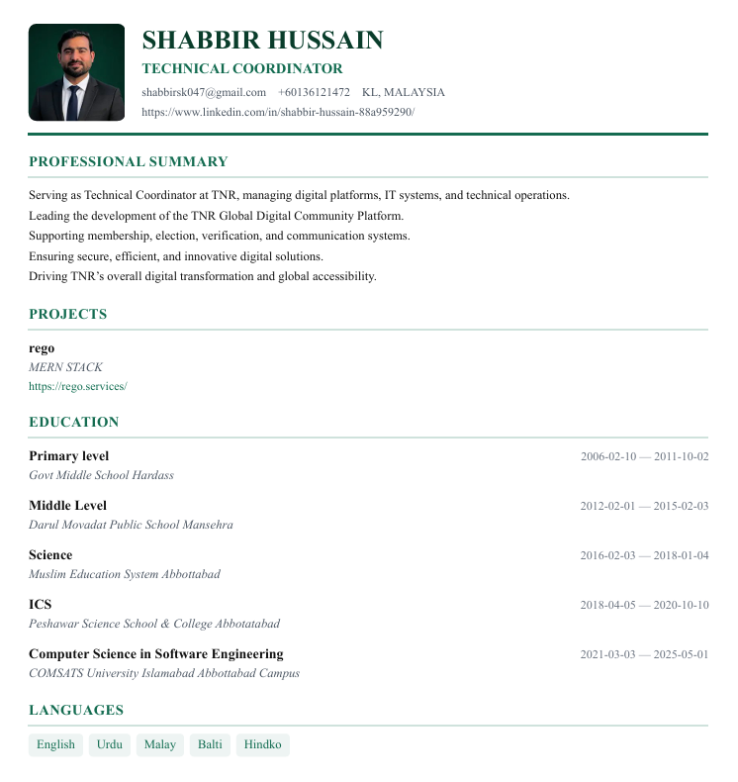
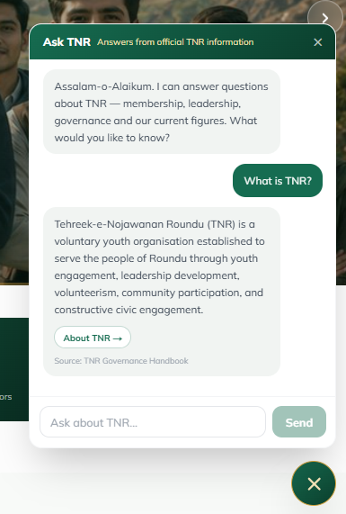
TNR DIGITAL PLATFORM
AI turns member data into guidance and opportunity
Two practical tools extend the value of every completed member profile.
CV BUILDER
AI ASSISTANT
REAL PLATFORM VIEW
GUIDANCE, ON DEMAND
24/7 member guidance
TNR-related information
Smart assistance
Answers grounded in official TNR information.
Automatic CV generation from member profile
Downloadable professional CV
CONNECTED • TRANSPARENT • FUTURE-READY
07
Notes:
Use the real AI Assistant screenshot to demonstrate that member guidance is already available within the platform.
[Sources]
- Platform content and presenter details: user-provided TNR Digital Platform brief, 2026-08-04.
- Official TNR logo: user-provided transparent PNG, tnr-logo-transparent.png.
- Icons: Lucide v1.8.0, ISC License, bundled runtime — https://lucide.dev/.
- AI Assistant screenshot: user-provided platform capture, ai-assistant-real.png.
- No real CV Builder screenshot was provided; the CV frame remains clearly labeled as a screenshot placeholder.
[/Sources]

Slide 9
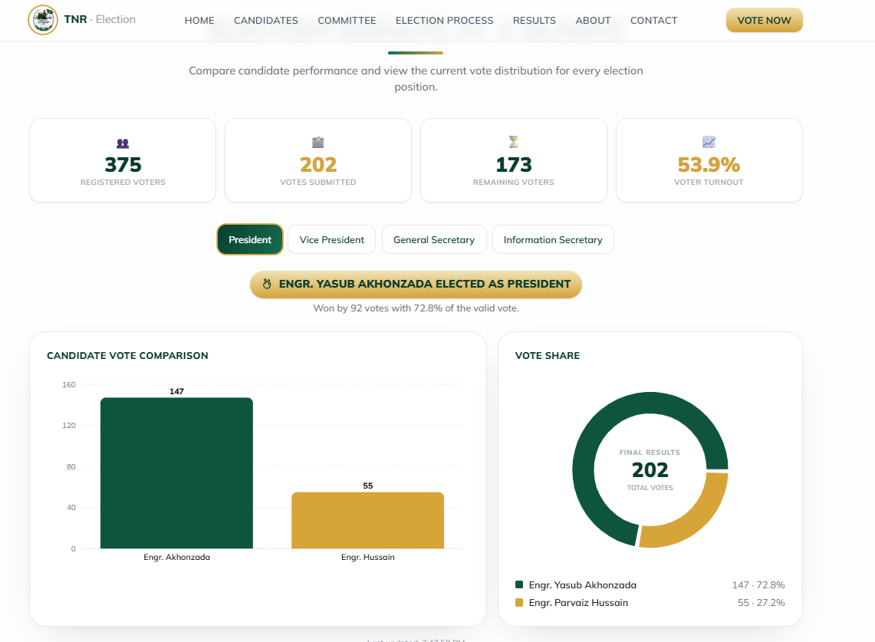
TNR DIGITAL PLATFORM
Secure participation strengthens governance
Verified voting and structured organizational workflows support transparent decisions.
REAL RESULTS VIEW • EVOTEGB.COM
SECURE ONLINE VOTING
ONE MEMBER.
ONE VERIFIED VOTE.
EMAIL OTP • IDENTITY CHECK • BALLOT RECEIPT
Secure Online Voting
OTP Verification
Duplicate Vote Prevention
Live Results
ORGANIZATIONAL MANAGEMENT
Application Review
CEC Management
Advisory Council Management
CONNECTED • TRANSPARENT • FUTURE-READY
08
Notes:
The live election portal verifies a registered email with a six-digit OTP, confirms member identity, supports a reviewed ballot, issues a unique receipt code, and publishes results views.
[Sources]
- Platform content and presenter details: user-provided TNR Digital Platform brief, 2026-08-04.
- Official TNR logo: user-provided transparent PNG, tnr-logo-transparent.png.
- Icons: Lucide v1.8.0, ISC License, bundled runtime — https://lucide.dev/.
- TNR Election Portal and process details: https://www.evotegb.com/election-portal, accessed 2026-08-04.
- Election results screenshot: user-provided platform capture, election-results-real.png.
[/Sources]

Slide 10
TNR DIGITAL PLATFORM
Member value grows with every interaction
Identity, services, communication and opportunity come together in one place.
Digital Identity
Better Communication
Verified Membership
Transparency
MEMBER
VALUE
Easy Access to Services
Global Networking
One connected experience
Professional CV
Centralized Opportunities
CONNECTED • TRANSPARENT • FUTURE-READY
09
Notes:
[Sources]
- Platform content and presenter details: user-provided TNR Digital Platform brief, 2026-08-04.
- Official TNR logo: user-provided transparent PNG, tnr-logo-transparent.png.
- Icons: Lucide v1.8.0, ISC License, bundled runtime — https://lucide.dev/.
[/Sources]

Slide 11
TNR DIGITAL PLATFORM
Thirty Planned Modules Define The Next TNR Ecosystem
The roadmap expands opportunity, inclusion, resilience, learning and participation.
COMMUNITY & SERVICES
INCLUSION & NETWORKS
TALENT & FUTURE READINESS
01
Jobs and Opportunities Portal
11
IAI Services
21
Digital Library
02
Scholarships and Education Portal
12
Recognition and Achievement
22
Youth Skills Marketplace
03
Events and Programs Management
13
Donations and Financial Transparency
23
Business and Entrepreneur Directory
04
Community Service and Charity
14
Women Wing Portal
24
Student Talent Database
05
Blood Donor Management
15
Overseas Chapters Portal
25
TNR Alumni Network
06
Media and Publications
16
Regional and UC-Level Portals
26
Internship Matching System
07
Document Management
17
Volunteer Management System
27
Mobile Voting Application
08
Complaint and Feedback System
18
Mentorship and Guidance System
28
Roundu Emergency Response Network
09
Meeting Management
19
TNR Mobile Application
29
Member Contribution Points and Badges
10
Member Communication System
20
Online Learning Platform
30
TNR Research and Policy Centre
CONNECTED • TRANSPARENT • FUTURE-READY
10
Notes:
Present these thirty modules as the planned expansion roadmap for the TNR Digital Platform.
[Sources]
- Platform content and presenter details: user-provided TNR Digital Platform brief, 2026-08-04.
- Official TNR logo: user-provided transparent PNG, tnr-logo-transparent.png.
- Icons: Lucide v1.8.0, ISC License, bundled runtime — https://lucide.dev/.
- Planned module status and wording: user-provided TNR Digital Platform Modules list, 2026-08-05.
[/Sources]

Slide 12
TNR DIGITAL PLATFORM
THANK YOU
Questions & Answers
Together, we are building the digital future of TNR.
Technology becomes meaningful
when it serves the community.
TNR DIGITAL PLATFORM
ONE CONNECTED COMMUNITY
SHABBIR HUSSAIN • TECHNICAL COORDINATOR – TNR
Notes:
Thank the audience, invite questions and close on the community purpose: technology is the enabler, not the destination.
[Sources]
- Platform content and presenter details: user-provided TNR Digital Platform brief, 2026-08-04.
- Official TNR logo: user-provided transparent PNG, tnr-logo-transparent.png.
- Icons: Lucide v1.8.0, ISC License, bundled runtime — https://lucide.dev/.
[/Sources]

