Slide 1


TNR • DIGITAL TRANSFORMATION
TNR DIGITAL
PLATFORM
Building a Connected, Transparent and
Future-Ready Roundu Community
SHABBIR HUSSAIN
Technical Coordinator – TNR
OFFICIAL PLATFORM OVERVIEW
EVOTEGB.COM
Notes:
Open by framing the platform as community infrastructure, not simply a website.
[Sources]
- Platform content and presenter details: user-provided TNR Digital Platform brief, 2026-08-04.
- Official TNR logo: user-provided transparent PNG, tnr-logo-transparent.png.
- Icons: Lucide v1.8.0, ISC License, bundled runtime — https://lucide.dev/.
- Hero artwork: user-provided hero.jpg, also used by the live TNR election portal.
[/Sources]

Slide 2
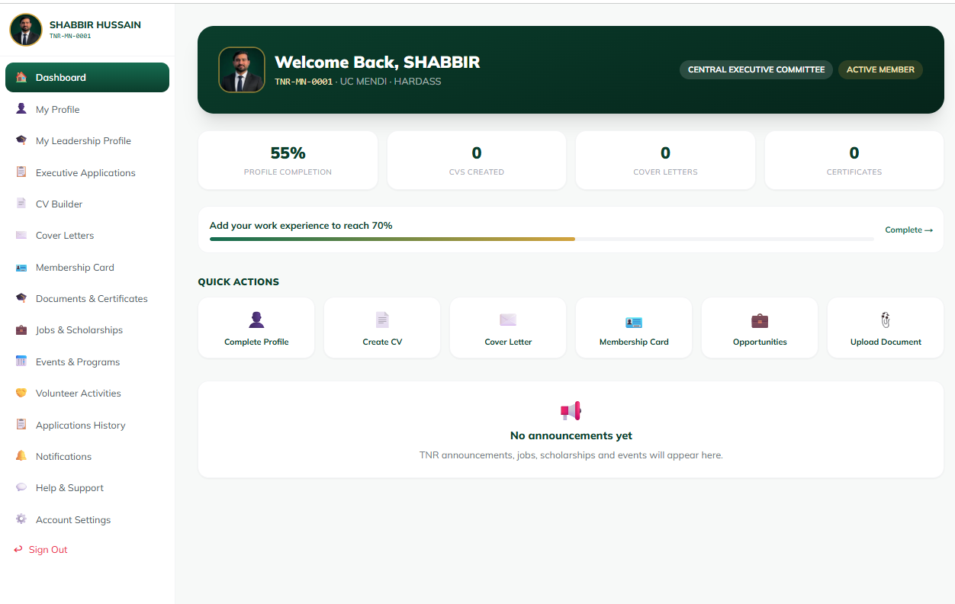
TNR DIGITAL PLATFORM
One platform brings TNR into view
A shared digital foundation replaces fragmented records, tools and communication.
REAL MEMBER PORTAL VIEW
WHY NOW
One reliable
source of truth.
Centralization makes information easier to find, services easier to access, and decisions easier to understand.
Members
Records
Services
Communication
Transparency
CONNECTED • TRANSPARENT • FUTURE-READY
02
Notes:
Use the member dashboard to show how identity, services, records and communication meet in one interface.
[Sources]
- Platform content and presenter details: user-provided TNR Digital Platform brief, 2026-08-04.
- Official TNR logo: user-provided transparent PNG, tnr-logo-transparent.png.
- Icons: Lucide v1.8.0, ISC License, bundled runtime — https://lucide.dev/.
- Member portal dashboard: user-provided tnr portal dashbaoard.png.
[/Sources]

Slide 3
TNR DIGITAL PLATFORM
One identity connects the whole community
Every step builds on the one before it—ending in a connected Roundu community.
ONE
01
One Member
Recognized in the community
02
One Profile
Always-current member record
A SIMPLE PRINCIPLE.
A COMPLETE DIGITAL FOUNDATION.
03
One Digital Identity
Trusted credentials and access
04
One Centralized Database
A shared source of truth
Identity becomes the bridge between people, services, governance and opportunity.
05
One Connected Community
People, services and opportunity
CONNECTED • TRANSPARENT • FUTURE-READY
03
Notes:
[Sources]
- Platform content and presenter details: user-provided TNR Digital Platform brief, 2026-08-04.
- Official TNR logo: user-provided transparent PNG, tnr-logo-transparent.png.
- Icons: Lucide v1.8.0, ISC License, bundled runtime — https://lucide.dev/.
[/Sources]

Slide 4
TNR DIGITAL PLATFORM
Ten completed modules form one operating layer
Member experience, trusted verification, organizational management and shared data.
CONNECTED EXPERIENCE
TRUSTED OPERATIONS
10
Membership Portal
AI Assistant
Digital Membership Card
Election Management System
COMPLETED
MODULES
QR Verification
CEC Portal
Certificate Verification
Advisory Council Portal
Designed to work together as one digital ecosystem.
CV Builder
Centralized Community Database
CONNECTED • TRANSPARENT • FUTURE-READY
04
Notes:
[Sources]
- Platform content and presenter details: user-provided TNR Digital Platform brief, 2026-08-04.
- Official TNR logo: user-provided transparent PNG, tnr-logo-transparent.png.
- Icons: Lucide v1.8.0, ISC License, bundled runtime — https://lucide.dev/.
[/Sources]

Slide 5
TNR DIGITAL PLATFORM
Membership becomes one clear digital journey
A visible path from first registration to full access.
01
02
03
04
05
06
Registration
Profile
Completion
Admin Review
Approval
Digital Membership
Card
Member
Dashboard
Create account
Complete details
Records checked
Membership confirmed
Verified identity
Services unlocked
Every stage is trackable, reviewable and connected.
CONNECTED • TRANSPARENT • FUTURE-READY
05
Notes:
[Sources]
- Platform content and presenter details: user-provided TNR Digital Platform brief, 2026-08-04.
- Official TNR logo: user-provided transparent PNG, tnr-logo-transparent.png.
- Icons: Lucide v1.8.0, ISC License, bundled runtime — https://lucide.dev/.
[/Sources]

Slide 6

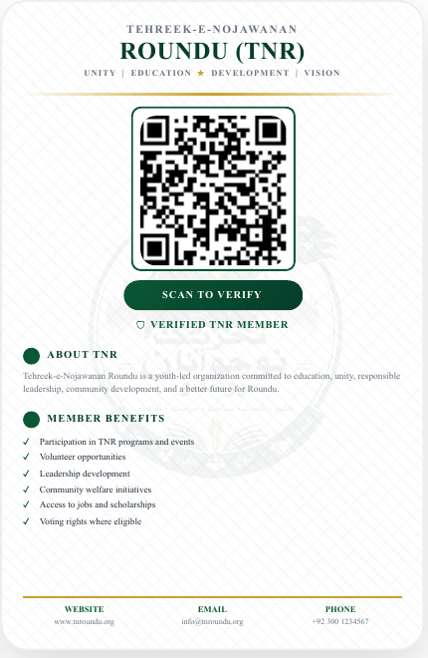
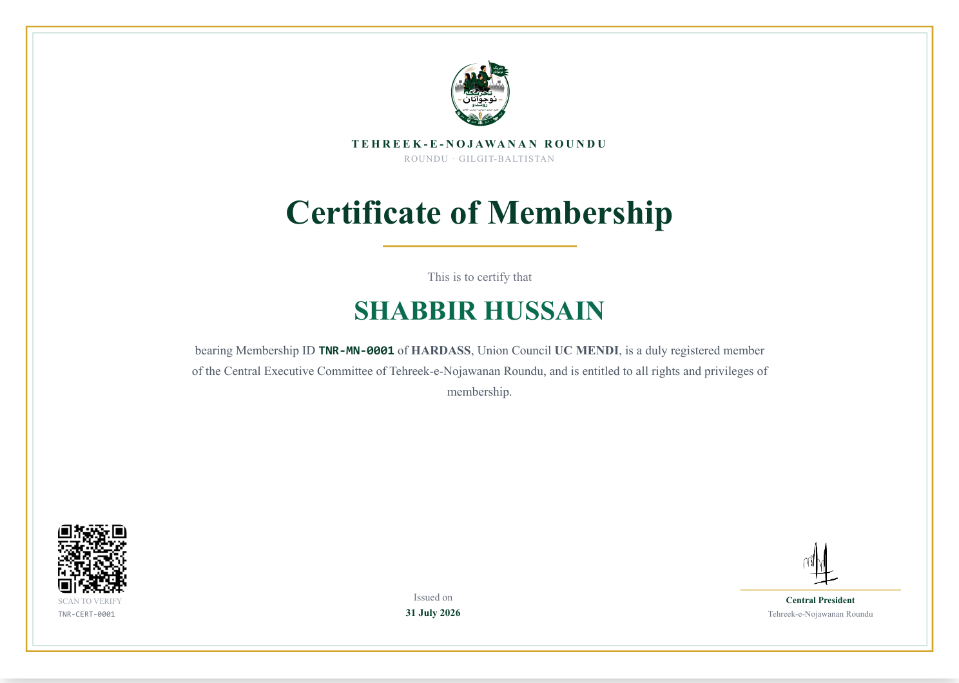
TNR DIGITAL PLATFORM
Digital identity is visible—and instantly verifiable
The actual member card and certificate carry the credentials needed to confirm identity and status.
DIGITAL CARD • FRONT
QR VERIFICATION • BACK
MEMBERSHIP CERTIFICATE • QR + REFERENCE
Unique Membership ID • QR-verified Digital Card • Certificate Verification • Reference Number Verification • Secure Member Records
CONNECTED • TRANSPARENT • FUTURE-READY
06
Notes:
Show the card front, QR-enabled back and certificate as one trust system rather than three separate documents.
[Sources]
- Platform content and presenter details: user-provided TNR Digital Platform brief, 2026-08-04.
- Official TNR logo: user-provided transparent PNG, tnr-logo-transparent.png.
- Icons: Lucide v1.8.0, ISC License, bundled runtime — https://lucide.dev/.
- Membership card: user-provided TNR Card.pdf, rendered from the original PDF.
- Membership certificate: user-provided tnr certificate.pdf, rendered from the original PDF.
[/Sources]

Slide 7
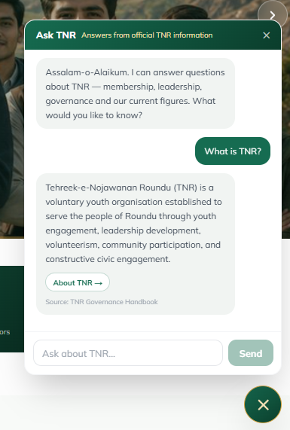
TNR DIGITAL PLATFORM
AI turns member data into guidance and opportunity
Two practical tools extend the value of every completed member profile.
AI ASSISTANT
CV BUILDER
REAL PLATFORM VIEW
GUIDANCE, ON DEMAND
SCREENSHOT PLACEHOLDER • CV BUILDER
24/7 member guidance
MEMBER PROFILE
TNR-related information
PROFESSIONAL CV
Smart assistance
Answers grounded in official TNR information.
Automatic CV generation from member profile
Downloadable professional CV
CONNECTED • TRANSPARENT • FUTURE-READY
07
Notes:
Use the real AI Assistant screenshot to demonstrate that member guidance is already available within the platform.
[Sources]
- Platform content and presenter details: user-provided TNR Digital Platform brief, 2026-08-04.
- Official TNR logo: user-provided transparent PNG, tnr-logo-transparent.png.
- Icons: Lucide v1.8.0, ISC License, bundled runtime — https://lucide.dev/.
- AI Assistant screenshot: user-provided platform capture, ai-assistant-real.png.
- No real CV Builder screenshot was provided; the CV frame remains clearly labeled as a screenshot placeholder.
[/Sources]

Slide 8
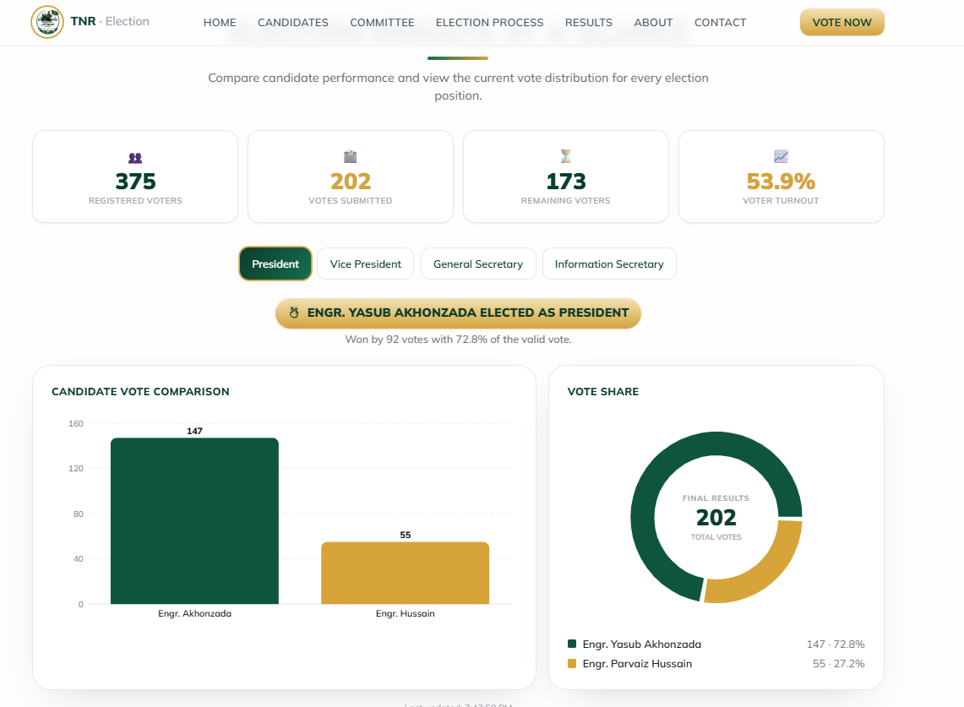
TNR DIGITAL PLATFORM
Secure participation strengthens governance
Verified voting and structured organizational workflows support transparent decisions.
REAL RESULTS VIEW • EVOTEGB.COM
SECURE ONLINE VOTING
ONE MEMBER.
ONE VERIFIED VOTE.
EMAIL OTP • IDENTITY CHECK • BALLOT RECEIPT
Secure Online Voting
OTP Verification
Duplicate Vote Prevention
Live Results
ORGANIZATIONAL MANAGEMENT
Application Review
CEC Management
Advisory Council Management
CONNECTED • TRANSPARENT • FUTURE-READY
08
Notes:
The live election portal verifies a registered email with a six-digit OTP, confirms member identity, supports a reviewed ballot, issues a unique receipt code, and publishes results views.
[Sources]
- Platform content and presenter details: user-provided TNR Digital Platform brief, 2026-08-04.
- Official TNR logo: user-provided transparent PNG, tnr-logo-transparent.png.
- Icons: Lucide v1.8.0, ISC License, bundled runtime — https://lucide.dev/.
- TNR Election Portal and process details: https://www.evotegb.com/election-portal, accessed 2026-08-04.
- Election results screenshot: user-provided platform capture, election-results-real.png.
[/Sources]

Slide 9
TNR DIGITAL PLATFORM
Member value grows with every interaction
Identity, services, communication and opportunity come together in one place.
Digital Identity
Better Communication
Verified Membership
Transparency
MEMBER
VALUE
Easy Access to Services
Global Networking
One connected experience
Professional CV
Centralized Opportunities
CONNECTED • TRANSPARENT • FUTURE-READY
09
Notes:
[Sources]
- Platform content and presenter details: user-provided TNR Digital Platform brief, 2026-08-04.
- Official TNR logo: user-provided transparent PNG, tnr-logo-transparent.png.
- Icons: Lucide v1.8.0, ISC License, bundled runtime — https://lucide.dev/.
[/Sources]

Slide 10
TNR DIGITAL PLATFORM
Upcoming modules expand the platform’s reach
A proposed next-stage roadmap shaped by the live platform and emerging community needs.
PROPOSED ROADMAP
TNR Mobile App
Mentorship Exchange
Services and notifications anywhere
Students connected with professionals
NEXT
Welfare Management
Scholarship Tracker
Transparent support and community giving
Guidance and application progress
Extend access.
Deepen participation.
Measure community impact.
Local Council Portals
Impact Analytics
Village and union-council coordination
Reach, outcomes and transparent reporting
Priorities can be phased by community value and operational readiness.
CONNECTED • TRANSPARENT • FUTURE-READY
10
Notes:
Present these as proposed next-stage modules, not as already approved delivery commitments.
[Sources]
- Platform content and presenter details: user-provided TNR Digital Platform brief, 2026-08-04.
- Official TNR logo: user-provided transparent PNG, tnr-logo-transparent.png.
- Icons: Lucide v1.8.0, ISC License, bundled runtime — https://lucide.dev/.
- Roadmap framing informed by the live TNR public platform and current service architecture: https://www.evotegb.com/, accessed 2026-08-04.
- Membership services reviewed at https://www.evotegb.com/membership, accessed 2026-08-04.
[/Sources]

Slide 11
TNR DIGITAL PLATFORM
Together, We Are Building
the Digital Future of TNR.
Technology becomes meaningful
when it serves the community.
TNR DIGITAL PLATFORM
ONE CONNECTED COMMUNITY
SHABBIR HUSSAIN • TECHNICAL COORDINATOR – TNR
Notes:
Close on the community purpose: technology is the enabler, not the destination.
[Sources]
- Platform content and presenter details: user-provided TNR Digital Platform brief, 2026-08-04.
- Official TNR logo: user-provided transparent PNG, tnr-logo-transparent.png.
- Icons: Lucide v1.8.0, ISC License, bundled runtime — https://lucide.dev/.
[/Sources]

