Slide 1
Credit Card Fraud Detection DSC530-Exploratory Data Analysis Term Final Project
Syed Shabbir

Slide 2
Statistical question
Analyzing fraudulent transactions manually is unfeasible due to huge amounts of data and its complexity. However, given sufficiently informative features, one could expect it is possible to do using Exploratory Data Analysis.
Using this dataset, I will use machine learning to develop a model that attempts to predict whether or not a transaction is fraudulent.

Slide 3
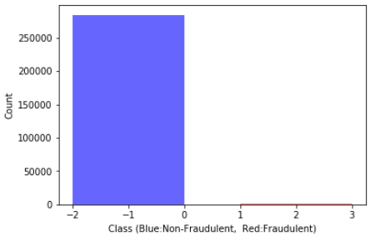
Background Information
The dataset contains transactions made by credit cards in September 2013 by European cardholders. This dataset presents transactions that occurred in two days, where I have found 492 frauds out of 284,807 transactions. From the outset it seems the dataset is highly unbalanced, instances of fraud account for 0.172% of all transactions. A campaign can be listed between 1 and 60 days.
The dataset is extremely unbalanced. Even a “null” classifier which always predicts class=0 would obtain over 99% accuracy on this task. This demonstrates that a simple measure of mean accuracy should not be used due to insensitivity to false negatives.

Slide 4
Five Variables that define the dataset
Variable 'Class' is the response variable and it takes value 1 in case of fraud and 0 otherwise.
Variable 'Time' contains the seconds elapsed between each transaction and the first transaction in the dataset
Variable 'Amount' is the transaction Amount, this feature can be used for example-dependent cost-sensitive learning
Variable 'V1' the first principal component obtained with PCA, credit card holder with the first transaction
Variable 'V2 to V28' the principal components obtained with PCA.

Slide 5
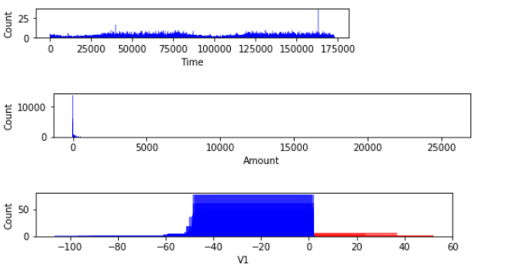
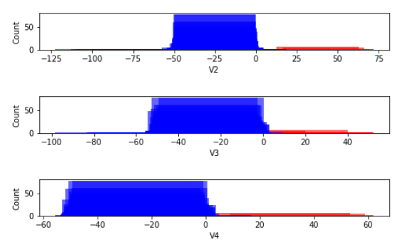
Analysis
Histograms

Slide 6
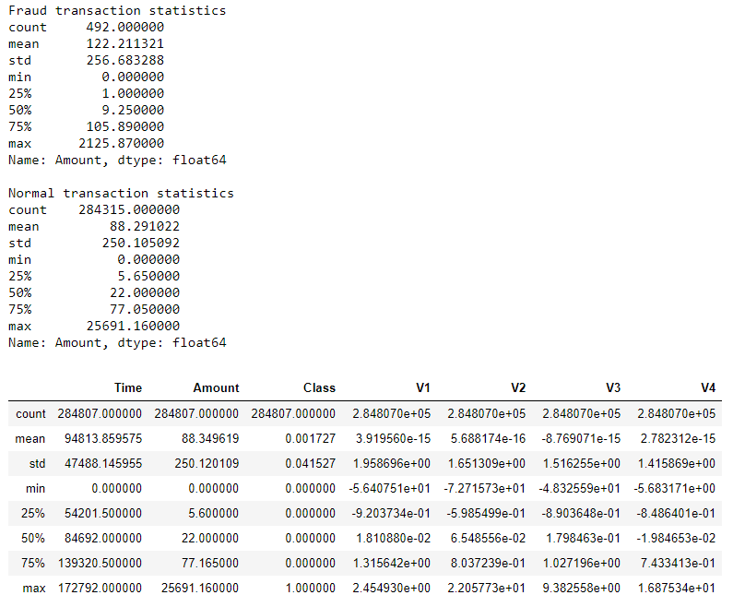
Analysis (Descriptive Characteristics)

Slide 7
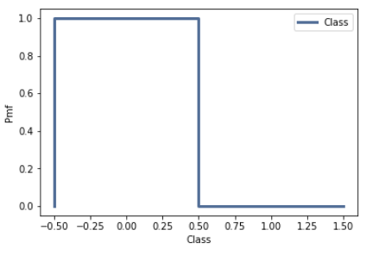
Analysis
PMF

Slide 8
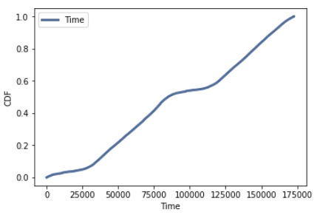
Analysis
CDF

Slide 9
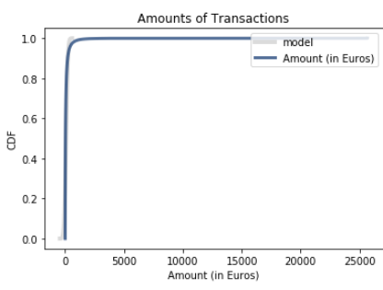
Analysis
Probability Distribution Plot

Slide 10
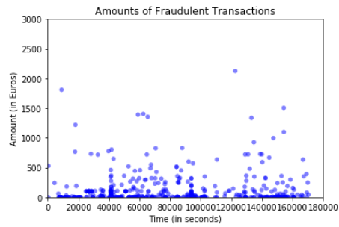
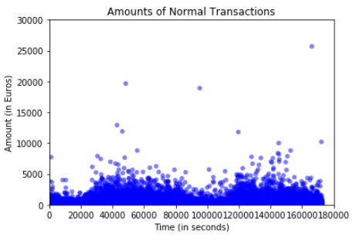
Analysis
Scatterplot

Slide 11
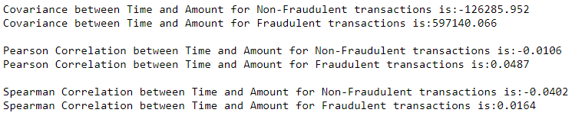
Analysis
Covariance and Correlation

Slide 12
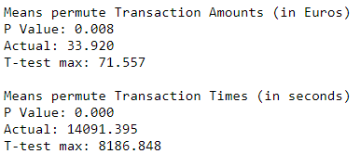
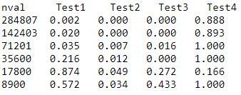
Analysis
Hypothesis Testing

Slide 13
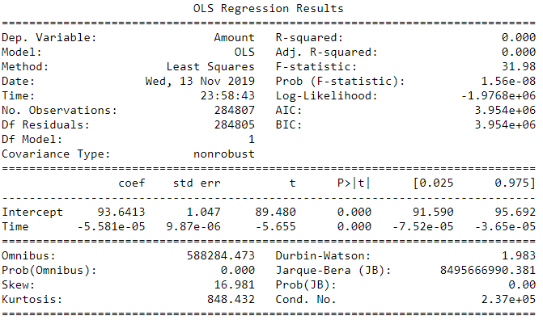
Analysis
Regression Analysis

Slide 14
Key Observations
Out of 284k transactions 1825 transactions were made which had zero value.
Out of these transactions only 27 were fraudulent and 1798 legal transactions.
The mean value of fraudulent transactions is 122.21 while mean value of valid transactions is only 88.29.
50% of the fraudulent transactions are below 10 while 50% of valid transactions is below 22.
75% of the fraudulent transactions are below 106 while 75% of valid transactions are below 77.
Max value of fraudulent transaction is 2125.87 while max value of valid transaction is 25691.16
More fraudulent transaction occurs between first 12 hours and between 23rd and 30th hour.
If transaction were recorded from 12'o clock midnight then we can observe that during morning hours there is more chance of occurrence of fraud transactions. During rest of the time more chance that legal transaction will occur.
99% of the legal transactions are of value less than 2000.
99% of the fraudulent transactions are of value less than 1250.

