Slide 1
Adult income data final project report
Shabbir Yousuf Ali – 039081070
CMKE 136 – Capstone Project
syali@ryerson.ca
https://github.com/shabbiryousufali/CKME136

Slide 2
Contents
Introduction
Data Preparation
Data Analysis
Test and Train Data
Model Selection
Results and Recommendation

Slide 3
Introduction
1994 Census database by Barry Becker
Predict whether income exceeds $50K/year
Statistics
14 attributes
8 are categorical and 6 are numerical

Slide 4
Data Preparation
Load the data
Add headers to the data
Data Cleansing - remove the unknown values
Produce Train and Test data

Slide 5
Test and Train Data
Load the data
Add headers to the data
Data Cleansing - remove the unknown values
Produce Train and Test data

Slide 6
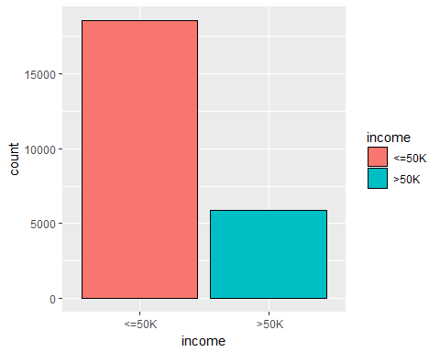
Income distribution – Data Analysis
<= 50K is approximately 76%
> 50K is approximately 24%

Slide 7
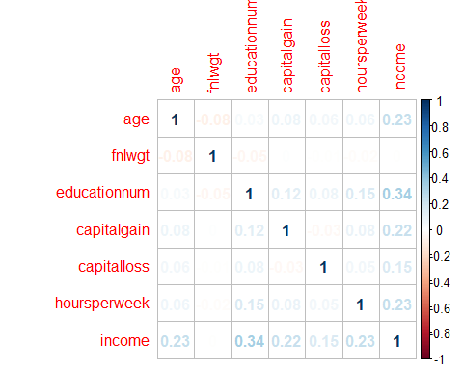
Income distribution – Correlation
Numeric attributes are related
But NOT strongly correlated
Education | 0.33
Capital Gain | 0.22
Age | 0.24
Hours worked | 0.23

Slide 8
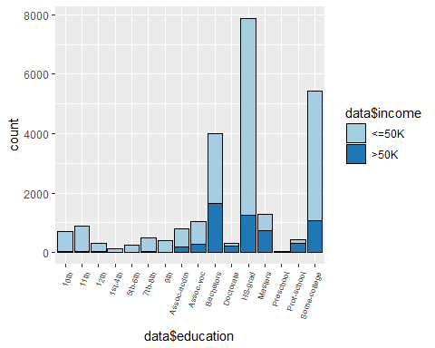
Income distribution – Correlation
Education and Income
Higher education earning >50K
Lower education earning <= 50K
Bachelors | > 50K
Doctorate | > 50K
Masters | > 50K
High School or lower | < 50K

Slide 9
Results and Recommendation - Model
Decision Tree
Prediction <=50K >50K <=50K 17328 1212 >50K 2576 3305 | Accuracy : 0.8449 Sensitivity : 0.8706 Specificity : 0.7317 Pos Pred Value : 0.9346 Neg Pred Value : 0.5620 Prevalence : 0.8150
Prediction <=50K >50K <=50K 5700 479 >50K 888 1072 | Accuracy : 0.832 Sensitivity : 0.8652 Specificity : 0.6912 Pos Pred Value : 0.9225 Neg Pred Value : 0.5469 Prevalence : 0.8094

Slide 10
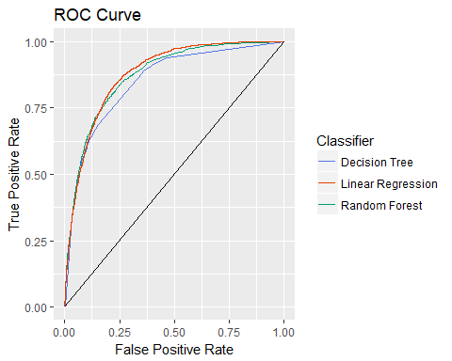
Results and Recommendation
Linear regression with highest curve
 | ROC Curve Area
Decision Tree | 0.879603
Random Forest | 0.850069
Linear Regression | 0.873392

