Slide 1
INTERNSHIP
PRESENTATION
Generative AI, Large Language Models
and AI Voice Assistant
Shabd Mishra
Roll No. 2410031135 • B.Tech CSE • Batch 2024-28

Slide 2
Internship Overview
01
Organization
Location
Duration
Globus Infocom Ltd.
Software Development Department
Corporate Office
Noida, Uttar Pradesh
1 May 2026 – 15 June 2026
Focus Area
Generative AI (GenAI), Large Language Models (LLMs), an AI Chatbot using LLMs, and a Voice Assistant.
Shabd Mishra • INTERNSHIP PRESENTATION 2

Slide 3
Organization Profile
02
Internship completed at Globus Infocom Ltd. in the Software Development Department.
The internship was conducted at the company’s Corporate Office in Noida.
The work was related to Generative AI and Large Language Model initiatives.
Practical exposure included an AI Chatbot using LLMs and a Voice Assistant.
The experience provided exposure to a professional software-development environment.
Shabd Mishra • INTERNSHIP PRESENTATION 3

Slide 4
Project Introduction
03
What I Studied
My Internship Work
Artificial Intelligence is used in software applications to provide automated and interactive services.
Generative AI and LLMs can understand user questions and generate natural-language responses.
• Understood the basic workflow of an AI Chatbot and Voice Assistant.
• Tried different inputs and prompts.
• Checked generated outputs.
• Observed how AI applications are tested in a software-development environment.
Shabd MIshra • INTERNSHIP PRESENTATION 4

Slide 5
Problem Statement & Objectives
04
Problem Statement
Project Objectives
Understand how conversational AI applications process user input and generate responses, and evaluate whether those responses are clear, relevant and understandable.
• Understand GenAI and LLM fundamentals.
• Understand AI Chatbot working.
• Prepare prompts and user queries.
• Check responses for relevance and clarity.
• Understand Voice Assistant interaction flow.
• Gain exposure to testing and documentation.
Shabd Mishra • INTERNSHIP PRESENTATION 5

Slide 6
Scope of the Project
05
Simple prompt creation and query testing.
Review of chatbot responses for relevance and clarity.
Basic testing of voice-based interaction.
Observation of AI application workflows.
Repeated checking with changed wording when required.
The project focused on learning, testing and observation rather than building a complex AI model from scratch.
Shabd Mishra • INTERNSHIP PRESENTATION 6

Slide 7
Technologies & Tools Used
06
Generative AI
Large Language Models
Chatbot Interaction
Understanding AI-generated content and interaction.
Understanding LLM-based conversational responses.
Working with user queries and generated answers.
Prompt Testing
Voice Interaction
Documentation
Trying different prompts and query wording.
Observing basic voice input and response flow.
Recording observations and learning outcomes.
Shabd Mishra • INTERNSHIP PRESENTATION 7

Slide 8
System Architecture
07
User Query
Prompt / Input
LLM
Generated
Response
VOICE ASSISTANT FLOW
Voice Input
Processing
AI Response
Output
Shabd Mishra • INTERNSHIP PRESENTATION 8

Slide 9
Methodology
08
Study
Learn GenAI and LLM basics.
Test
Run applications with different inputs.
01
04
Observe
Study chatbot and voice-assistant flow.
Evaluate
Check relevance and understandability.
02
05
Prepare
Create questions, prompts and voice commands.
Document
Record observations and prepare documentation.
03
06
Shabd Mishra • INTERNSHIP PRESENTATION 9

Slide 10
Expected Outcomes & Learning
09
Technical Learning
Testing Skills
Professional Skills
• Basic practical exposure to GenAI and LLMs.
• Understanding chatbot interaction.
• Understanding voice-based AI applications.
• Prompt and query testing.
• Checking output relevance.
• Understanding the importance of repeated testing.
• Observation.
• Communication.
• Documentation.
• Working within a professional software-development environment.
Shabd Mishra • INTERNSHIP PRESENTATION 10

Slide 11
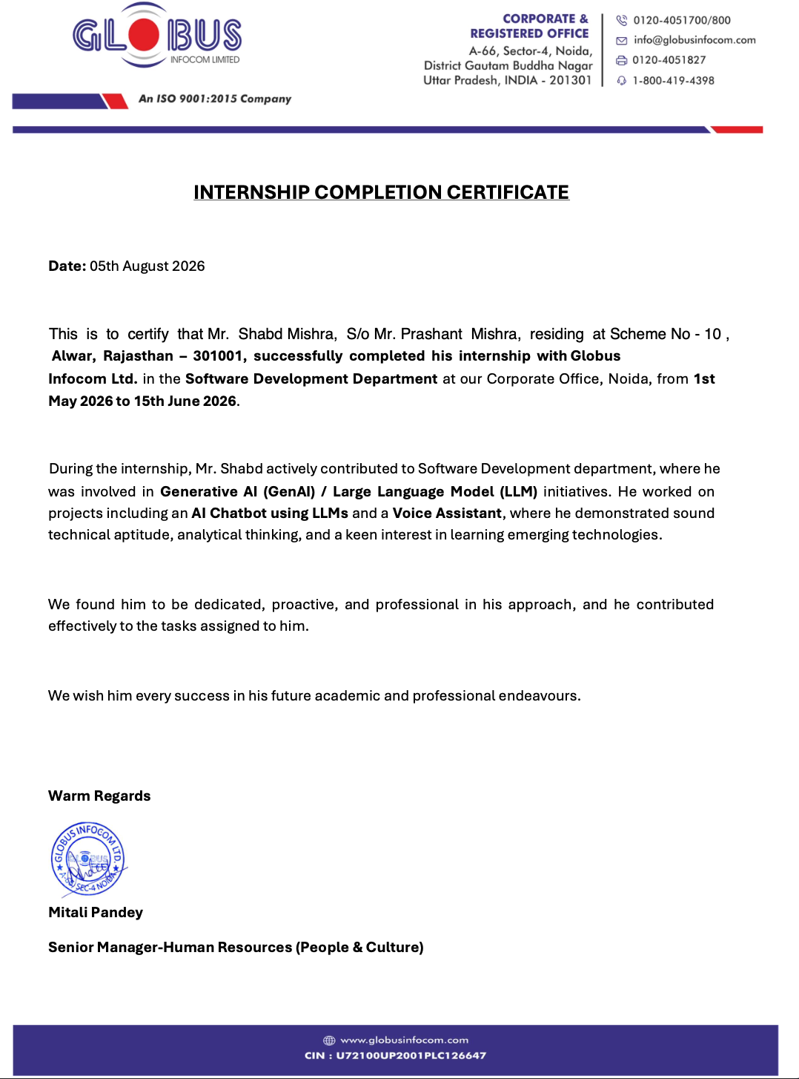
Internship Completion Certificate
10
Certificate issued by Globus Infocom Ltd.
Shabd Mishra • INTERNSHIP PRESENTATION 11

Slide 12
THANK YOU
Shabd Mishra
B.Tech CSE • Batch 2024–28
Generative AI • LLMs • AI Chatbot • Voice Assistant

