Slide 1
INTERNAL · SALES ENABLEMENT DECK
Odoo Diet Management
System
The complete feature reference — and how it elevates Freshhouse's subscription business
Real-Time App · Full Odoo Sync · Zero Manual Work
41 screens · 8 Odoo report types · 7 access-rights areas · Customer App + Driver App
Prepared by Code-Ox Technologies for the Sales Team · Riyadh

Slide 2

THE ACCOUNT
Freshhouse, At a Glance
Saudi meal-subscription app — Riyadh-based, bilingual Arabic/English, live in production today
Four distinct subscription plans already built: Lifestyle, FreshFit (customizable), High Protein, Flex (points/cashback)
THE HEADLINE
Gram-level meal customization and allergy/dislike filtering already live in the subscribe flow
They already run Odoo.
A native support chat and a dietitian-booking feature already exist in the product
This isn't a rip-and-replace pitch. It's a direct extension of the system Freshhouse already runs and already trusts — no new ERP to adopt, no new platform for their team to learn.
Current ERP: Odoo — the same platform this entire system is built on
Zero ERP migration risk.
ODOO DIET MANAGEMENT SYSTEM · INTERNAL SALES ENABLEMENT
1

Slide 3


FROM OUR LIVE APP AUDIT — TODAY
A Strong Product, Hidden Behind One Wall
“Every one of Freshhouse's best features — real pricing, plan variety, the dietitian, the support chat — sits behind a mandatory sign-up with zero preview. The product isn't the problem. The funnel is.”
What's already working
What's costing them
4 real subscription plans (Lifestyle, FreshFit, High Protein, Flex) — not flat tiers
Gram-level meal customization and a real allergy/dislike filter
A live dietitian-booking feature with named branches
A native support chat with text, voice notes and attachments
Full pricing transparency and a loyalty layer — once logged in
Weekly calendar browsing with per-meal macros on the card
Zero preview — guests see none of the above (no price, no plan comparison)
The Login screen is a dead end — its back arrow doesn't return to the menu
Two live promo codes, two different discounts (23% vs 13%)
The promo pop-up fired 5+ times in one session — even mid-checkout
Outlet Order data doesn't match the dietitian-booking branch data
No live dashboard — the ops team has no visibility into what's happening
ODOO DIET MANAGEMENT SYSTEM · INTERNAL SALES ENABLEMENT
2

Slide 4



WHY NOW
Three Problems. One System Fixes All of Them.
01
02
03
Low engagement, hidden product
Manual, disconnected operations
Zero visibility for the team
Customers have no reason to open the app before they buy — and guests can't see the strong product that's already built.
Duplicate promo codes, mismatched branch data between Outlet Order and dietitian booking — symptoms of no single source of truth.
No live dashboard for deliveries, sales, or complaints. Problems get discovered from a customer, not from a screen.
These are the exact problems the Odoo Diet Management System was purpose-built to solve.
WHAT FOLLOWS
The complete feature set — Odoo backend, Customer App, Driver App — in full detail, so any rep can answer any question in the room.
ODOO DIET MANAGEMENT SYSTEM · INTERNAL SALES ENABLEMENT
3

Slide 5

THE FIX
One Connected Platform
Customer App ⇄ Odoo Backend ⇄ Driver App — every action flows live, in both directions, with zero manual entry.
⇄
Odoo Backend
⇄
Customer App
One source of truth
Driver App
41 screens, all synced live
The platform Freshhouse
already runs
Live delivery status
41 screens
60 sec
0
all synced to Odoo live
avg onboarding time
manual entries needed
ODOO DIET MANAGEMENT SYSTEM · INTERNAL SALES ENABLEMENT
4

Slide 6
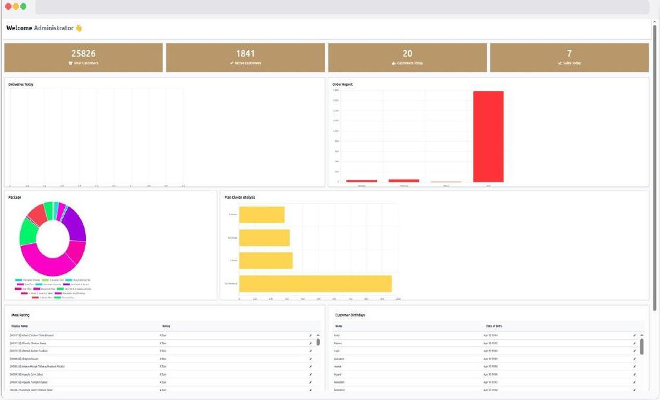
ODOO BACKEND · COMMAND CENTRE
See Everything, the Moment It Happens
25,826
customers synced live
1,841
active paying customers
20
new app sign-ups today
7
subscriptions converted today
Every subscription, delivery, and rating appears here the instant it happens — no refresh, no spreadsheet to check. This is the dashboard Freshhouse's ops team doesn't have today.
ODOO DIET MANAGEMENT SYSTEM · INTERNAL SALES ENABLEMENT
5

Slide 7

ODOO BACKEND · CUSTOMER RECORDS
Every Customer. Fully Tracked.
When a customer fills in their profile on the app, it syncs to Odoo instantly. No copy-paste. No manual entry.
AUTO-SYNCED FROM THE APP
— Synced from app registration Name, address, GPS — entered once in the app, stored forever in Odoo
— Uploaded via app or admin Health documents from app or admin — stored in one place, always accessible
— From the app onboarding flow Goals, allergies, vegetarian flag — set in app, tracked in Odoo
— Pulled from app calendar choices Customer sets Home/Office + Morning/Evening in app → Odoo schedules the driver
— Every order placed in the app App subscriptions appear in Odoo instantly, with plan, price and promo
— Booked in app, logged in Odoo Dietitian sessions booked from the app appear in the Odoo customer record instantly
— Set in app, respected in every meal Marked in app → Odoo excludes that ingredient from the customer's meals forever
— Long-term data from the app Health tracking, referral source, partner data — all from app interactions, auto-logged
ODOO DIET MANAGEMENT SYSTEM · INTERNAL SALES ENABLEMENT
6

Slide 8

ODOO BACKEND · SUBSCRIPTIONS
Subscriptions That Run Themselves
Customer subscribes in the app → the subscription appears in Odoo instantly. Plan details, macros, promo codes, delivery days — all auto-filled. Your team doesn't touch a single field.
ZERO MANUAL ENTRY REQUIRED
— Auto-created on app checkout Checkout complete in app → Odoo subscription record created automatically
— Calculated from app plan choice Macros auto-calculated from the plan the customer selected — no manual input
— Duration chosen in app 1-week, 2-week or monthly — picked in app, captured in Odoo immediately
— From app checkout, automatically Full pricing — promo discounts, add-ons and 15% VAT all included
— Set by customer in app checkout Customer's delivery day selection from app checkout flows directly into Odoo
— Applied in app, validated in Odoo Promo codes entered in app are verified in Odoo in real time — zero double-entry
Earned in app, tracked in Odoo: Reward points earned in-app are tracked in Odoo and deducted automatically at checkout.
ODOO DIET MANAGEMENT SYSTEM · INTERNAL SALES ENABLEMENT
7

Slide 9
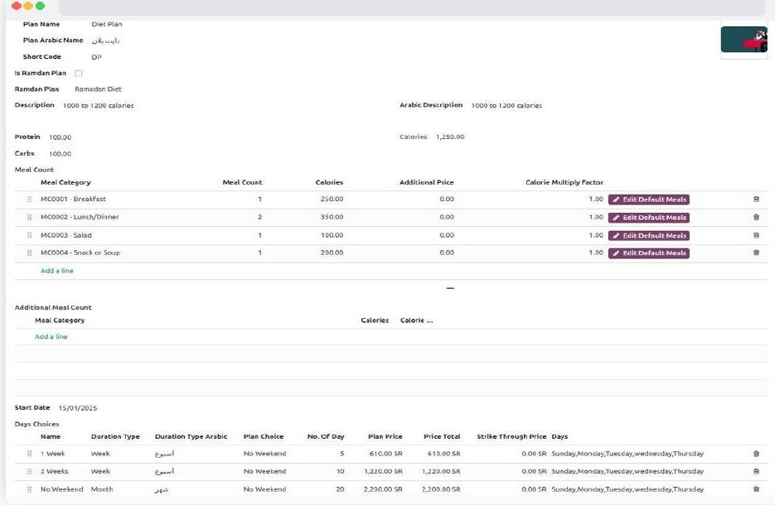
ODOO BACKEND · PLANS & PRICING
Plans That Sell Themselves
— Live in app in both languages Change the plan name in Odoo → updates in the app immediately
— Displayed as bars in the app Set macros in Odoo → customers see the protein/carb/fat breakdown live
— Customers see this in the app Breakfast x1, Lunch x2, Salad x1 — defined in Odoo, shown transparently
— Prices update in app immediately Run a sale → update price in Odoo → app shows new price + strike-through
— Controls what customers can select Set available days in Odoo → customers can only choose those days
Configure a plan in Odoo — it appears in the app instantly. No developer. No app update. No delay.
— One click activates in app One checkbox in Odoo → a Ramadan plan activates across the entire app
— Fallback if a plan is unavailable If the primary plan sells out, Odoo automatically offers the fallback plan
ODOO DIET MANAGEMENT SYSTEM · INTERNAL SALES ENABLEMENT
8

Slide 10

ODOO BACKEND · OPERATIONS
Operations That Run on Autopilot
Mark an ingredient as an allergen in Odoo — hidden instantly from any app customer who flagged that allergy. Assign a driver to a zone — their app loads only their orders. Automatically.
Ingredient Record
Driver Profile
— Catalogued in Odoo Referenced in meal records across the full system
— Registered here, used to log in They use these credentials to log into the Driver App
— Categories feed the kitchen Feeds into kitchen prep workflow and nutritional reporting
— Shifts set in Odoo Determine which orders the driver sees in their app each day
— Flagged ingredients route automatically Route to the correct prep station automatically
— Zone assigned here Driver App shows only that zone's orders automatically
— Marked here, hidden in the app Hidden in the app for any customer who flagged this allergy at sign-up
— Export or reset without code Export daily order lists or reset Driver App passwords, no app code needed
ODOO DIET MANAGEMENT SYSTEM · INTERNAL SALES ENABLEMENT
9

Slide 11


ODOO BACKEND · DELIVERY OPERATIONS
Deliver On Time. Every Time.
Late deliveries are the #1 reason customers cancel. Configure precise windows per district in Odoo — the system routes each driver to the right area, on the right time, automatically.
Districts List — All Zones, Cities & Windows
District Detail — e.g. Al Andalus, Riyadh East
— Bilingual district data District name, zone number and city classification, in Arabic and English
— Default shift Set to Evening Delivery, 03:00 PM – 04:00 PM, per district
— Morning window 05:30 AM – 12:00 PM
— Morning & evening windows Set per district — every district carries its own delivery time windows
— Evening window 03:00 PM – 04:00 PM
— Streets & drivers Assign specific streets and drivers per shift
From today's audit: Outlet Order shows “no branches available” while the dietitian-booking flow lists real branches in the same app — one district/branch data source fixes this for good.
ODOO DIET MANAGEMENT SYSTEM · INTERNAL SALES ENABLEMENT
10

Slide 12


ODOO BACKEND · RE-ENGAGE · CONVERT · RETAIN
One Clean Promo Engine. No More Conflicting Codes.
Promo Code Configuration
Push Notification Composer
— Fixed or percentage discount Set a fixed amount or percentage discount on any subscription
— Precise targeting Target all customers, a specific gender segment, or search by name
— Usage limits Limit usage per customer, or make it universal for all customers
— Bilingual composition Compose title and description — supports English & Arabic first-name placeholders
— Expiry tracking Set an expiry date and track how many times the code was used
— Rich media Attach a notification image for rich push notifications
— Governed lifecycle Draft → Active → Expired — one source of truth, no conflicting live codes
— Delivery tracking Track delivery response and SMS response per notification sent
From today's audit: Freshhouse's guest flow currently runs two different live promo codes advertising two different discounts (23% vs 13%), and the same promo pop-up fired five separate times in one session. This system replaces both with one governed engine.
ODOO DIET MANAGEMENT SYSTEM · INTERNAL SALES ENABLEMENT
11

Slide 13



ODOO BACKEND · TEAM & ACCESS
Your Team. Their Role. Their View.
Give your ops team deliveries. Give finance invoices. Give support the customer profiles. Nobody sees what they shouldn't — and nobody misses what they need to do their job.
Sales administration
Invoicing & billing
Inventory & purchasing
HR & employee management
Full access to customer orders, subscriptions and sales reports
Access to invoices, payments and all financial transaction records
Manage ingredient stock levels, purchase orders and supplier records
View and manage staff profiles, job roles and shift assignments
Customer shift rights
Subscription management
Audit log & hidden menus
Permission to edit and reassign delivery shifts for any customer
Create, edit, freeze and renew customer meal subscriptions
View the full system audit trail and hide specific menus per user role
ODOO DIET MANAGEMENT SYSTEM · INTERNAL SALES ENABLEMENT
12

Slide 14
ODOO BACKEND · REPORTING & VISIBILITY
Every Report. Zero Exports.
Every action taken in the app is stored in Odoo and available as a report instantly — no exports, no waiting.
Order Report
Delivery Report
Meal Calendar
Package Report
Every app subscription tracked live — plan, dates, pricing, customer
Driver marks delivered → shows here instantly. See failures before customers complain
Every meal selection made in the app, visible here for every customer, every day
See which plans are selling and which aren't — adjust strategy in minutes
Monthly Sales Report
Sale Report
Free Subscriptions
Meal Sticker
Full revenue picture — which months, plans and segments are growing
Full P&L per customer — app promo discounts included and reconciled automatically
Gift cards sent in the app create free subscription records automatically
Auto-generated from app orders — print labels for every bag, no manual input
ODOO DIET MANAGEMENT SYSTEM · INTERNAL SALES ENABLEMENT
13

Slide 15
SECTION TWO
Customer App
Every tap, every selection, every order — instantly stored in Odoo. The app isn't just a frontend. It's a live data pipeline that runs the entire operation automatically.
60 sec
41 screens
0
avg onboarding time
all synced to Odoo live
manual entries needed
ODOO DIET MANAGEMENT SYSTEM · INTERNAL SALES ENABLEMENT
14

Slide 16
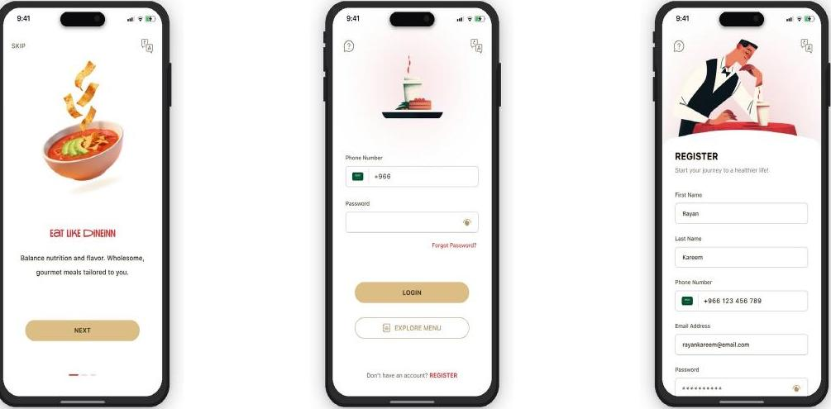
CUSTOMER APP · ONBOARDING
First Impression That Converts
A slow sign-up kills conversions. This onboarding is under 60 seconds — and the moment a customer registers, their full profile is created in Odoo automatically.
— Welcome Screen Hooks the customer immediately — an Odoo profile is created on first app open
— Log In Every login is tracked in Odoo — customer activity recorded from the very first tap
— Register Registration complete → Odoo customer record created automatically, instantly
ODOO DIET MANAGEMENT SYSTEM · INTERNAL SALES ENABLEMENT
15

Slide 17
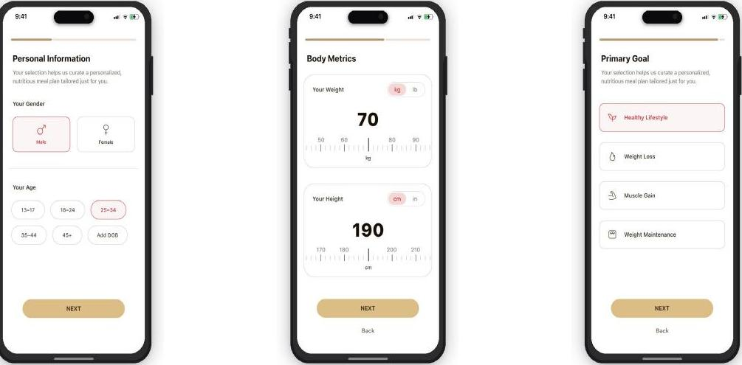
CUSTOMER APP · PERSONALIZATION
A Plan for Every Goal
Customers who get personalised recommendations are far more likely to subscribe. Every answer here is stored in Odoo — your team sees the customer's goals before ever speaking to them.
— Personal Info Stored in Odoo customer record — your team knows who they're talking to before they dial
— Body Metrics Body data stored in the Odoo health profile — used to personalise every future interaction
— Primary Goal Goal saved in Odoo — informs plan recommendation and future upsell opportunities
ODOO DIET MANAGEMENT SYSTEM · INTERNAL SALES ENABLEMENT
16

Slide 18
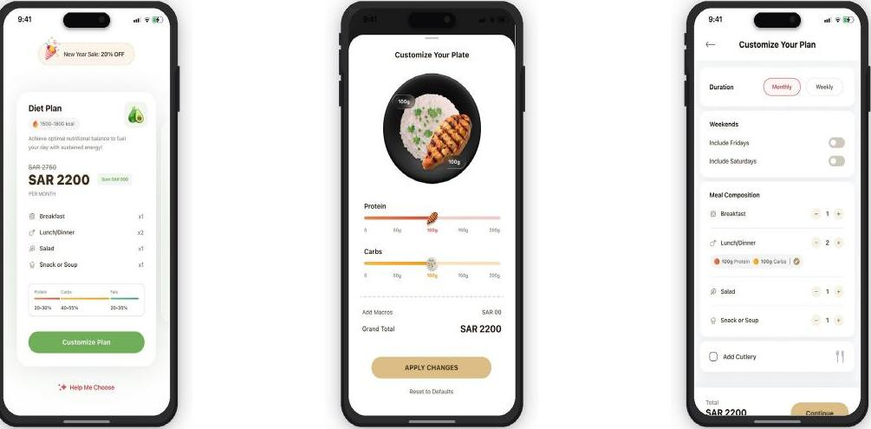
CUSTOMER APP · MEAL CUSTOMIZATION
Their Meal. Their Macros.
Customers who customise their plan have significantly lower cancellation rates. Every macro adjustment is stored in Odoo — your kitchen knows exactly what to prepare.
— Select a Plan Plan data pulled live from Odoo — a price change in Odoo is an instant update in the app
— Customize Plan Every macro adjustment (protein / carbs) stored in the Odoo subscription record in real time
— Customize (cont.) Customised meal counts sync to Odoo — the kitchen gets the exact right quantities
ODOO DIET MANAGEMENT SYSTEM · INTERNAL SALES ENABLEMENT
17

Slide 19


CUSTOMER APP · DAILY ENGAGEMENT
Keep Them Opening the App Every Day
The home screen shows today's meals with calorie counts, delivery status and a weekly mini-calendar. Customers can browse the full menu, mark favourites, and see macro details per item.
Home Dashboard & Browse Menu
Favourites
— Home Dashboard Delivery status updates here the moment the driver marks it done in the Driver App
— Favourites tab Customers can heart any meal to save it — view all favourites in one dedicated tab. Neither Feed Meals nor Freshhouse's current build has this today.
— Browse Menu Menu pulled live from Odoo — update a meal in Odoo, it appears in the app immediately
ODOO DIET MANAGEMENT SYSTEM · INTERNAL SALES ENABLEMENT
18

Slide 20


CUSTOMER APP · TRUST & SELF-SERVICE
Transparency and Full Schedule Control
Transparency That Builds Trust
Their Schedule, Fully in Their Hands
— Meal Detail Ingredient list pulled from Odoo — update it once, every customer sees it immediately
— Select Meal Day Selection saved to Odoo immediately — kitchen and driver see the update in real time
— Select Meal Available meals controlled by Odoo — sold-out meals removed from the app automatically
— Meal Status Status driven by Odoo — the moment your team updates an order, the app reflects it
— Rate Your Meal Rating stored in Odoo meal-rating reports — use it to make better menu decisions
Right Meal, Right Place, Right Time: delivery location and time preferences set in the app save straight to Odoo — future orders automatically route to the new address, and the driver app shows the updated window instantly.
ODOO DIET MANAGEMENT SYSTEM · INTERNAL SALES ENABLEMENT
19

Slide 21
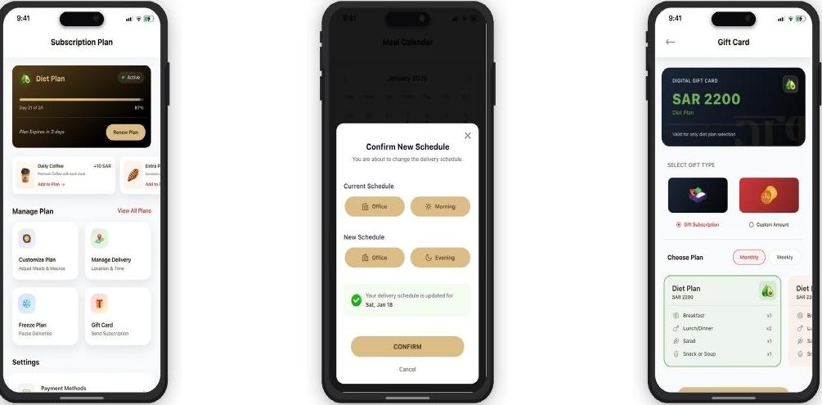
CUSTOMER APP · SELF-SERVICE & REFERRAL
Total Control for Them. Zero Work for Your Team.
Customers have full control — renew, freeze deliveries, customize the plan, switch delivery location, view payment history or send the plan as a digital gift card.
— Manage Plan Progress data pulled from Odoo subscription — days remaining calculated in real time
— Edit Schedule Reschedule saved to Odoo instantly — Driver App shows the updated delivery plan
— Gift a Subscription A gift purchase triggers a new Odoo subscription for the recipient automatically — Freshhouse's lowest-cost acquisition channel, pure growth with zero admin
ODOO DIET MANAGEMENT SYSTEM · INTERNAL SALES ENABLEMENT
20

Slide 22
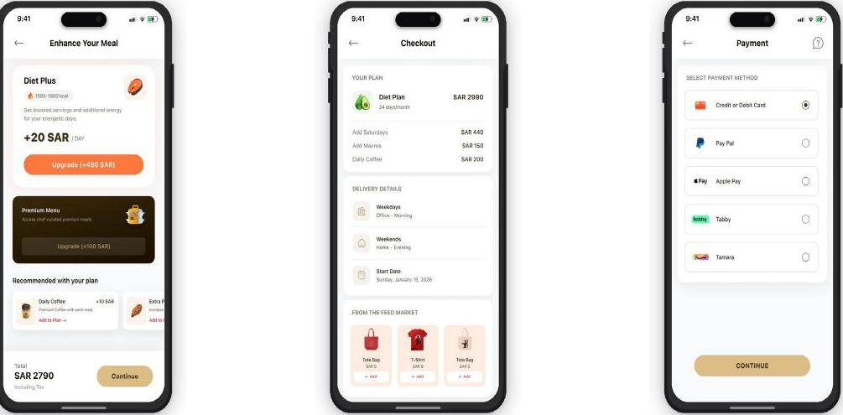
CUSTOMER APP · REVENUE EXPANSION
More Revenue. Same Delivery.
— Add-ons at checkout Add-ons increase average order value by 15–25%. Every add-on selected creates a line item in the Odoo subscription automatically
— Marketplace Browse products by category — tote bags, coffee, granola, T-shirts and lifestyle items
— Vouchers Buy and send gift cards for 10+ popular brands — Starbucks, Nike, Nahdi, Under Armour, Foot Locker and more
Every purchase — marketplace item or voucher — creates an order line in Odoo automatically: tracked, invoiced and reported, with zero extra delivery cost.
ODOO DIET MANAGEMENT SYSTEM · INTERNAL SALES ENABLEMENT
21

Slide 23
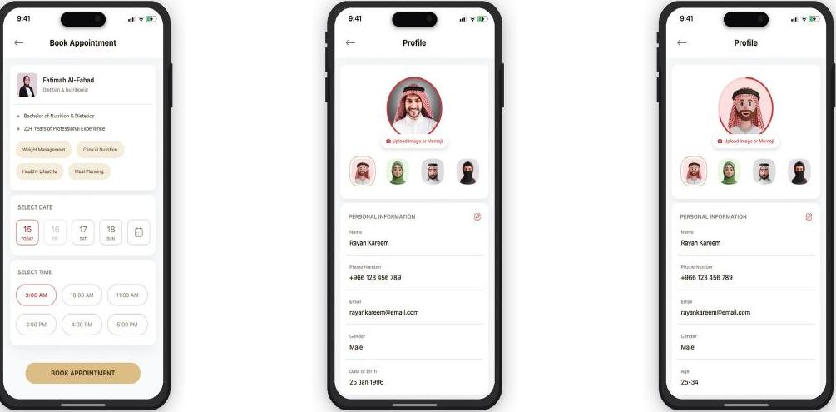
CUSTOMER APP · RETENTION FEATURE
The Feature That Makes Them Stay
Access to a real dietitian is the top reason premium customers don't cancel. Every appointment booked in the app is logged in the Odoo customer record — your team is always prepared.
— Book Dietitian Browse available dietitians, view their specialty and book a time slot instantly
— Health Profile Stores health goals, allergies, favourite meals, dietary preferences and personal details
— Complete Profile A guided prompt completes missing profile sections and tracks completion percentage
ODOO DIET MANAGEMENT SYSTEM · INTERNAL SALES ENABLEMENT
22

Slide 24


CUSTOMER APP · LOYALTY & RETENTION
Loyalty That Lives in the App
Customers with reward points have significantly higher renewal rates. Wallet balance and points are calculated in Odoo — the app always shows the live, accurate figure.
Account & Wallet
Notifications
Language
Shows wallet balance and reward points, plus links to all account settings
Push notifications from Odoo appear here with title, message and timestamp
Switch between English and Arabic — the entire app interface updates immediately
ODOO DIET MANAGEMENT SYSTEM · INTERNAL SALES ENABLEMENT
23

Slide 25



CUSTOMER APP · SUPPORT
Problems Resolved. Customers Retained.
Customers who can resolve issues without calling your team are far less likely to cancel. Every ticket raised in the app creates an Odoo record instantly — with full order context attached.
Help & Support
Raise an Issue
Manage Tickets
Access help-centre articles, raise a new issue, or view and manage existing tickets
Select issue type, link to an order, describe the problem and upload a photo, then submit
View all Active and Closed tickets with status — In Progress, Investigating or Resolved
ODOO DIET MANAGEMENT SYSTEM · INTERNAL SALES ENABLEMENT
24

Slide 26
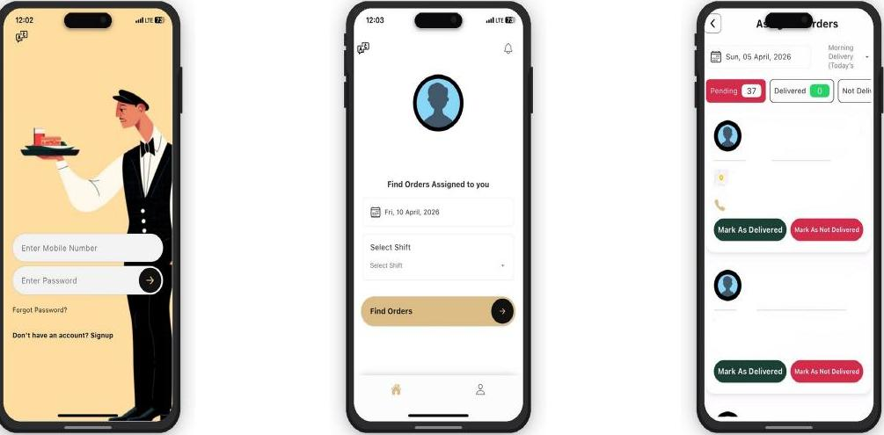
SECTION THREE
Driver App
Drivers see only their orders. Mark a delivery done — it updates Odoo and the customer's app simultaneously. No calls, no manual logs, no late surprises.
37+
Live
0
orders per shift tracked
Odoo update on each tap
manual dispatch calls
ODOO DIET MANAGEMENT SYSTEM · INTERNAL SALES ENABLEMENT
25

Slide 27
DRIVER APP · DELIVERY EXECUTION
Drivers Deliver. Odoo Tracks. You Know.
The Driver App is a live extension of Odoo. Every order the driver sees was assigned in Odoo. Every status tap — delivered or not — updates Odoo and the customer's app simultaneously.
1
2
3
Driver Login
Find Orders
Assigned Orders
Driver credentials are managed in Odoo — access can be revoked instantly from admin if needed
Shift selection filters Odoo orders for that driver — only their assigned area appears
Status tap → Odoo updates instantly → customer app shows delivery confirmed in real time
ODOO DIET MANAGEMENT SYSTEM · INTERNAL SALES ENABLEMENT
26

Slide 28
THE PITCH IN ONE SLIDE
Straight From Today's Audit: Gap → Fix
FRESHHOUSE GAP (FROM OUR AUDIT)
ODOO DIET MANAGEMENT SYSTEM FIX
Best features hidden behind a mandatory login — guests see nothing
Preview content configured directly in Odoo — no dev cycle to change what a guest sees
Two conflicting promo codes live at once (23% vs 13%)
One promo engine, one lifecycle (Draft → Active → Expired), enforced centrally
The promo pop-up fired five times in one session, even mid-checkout
Notifications composed and scheduled centrally in Odoo, not ad-hoc in the app
Outlet Order shows “no branches” while dietitian booking lists real ones
One district/branch data source powers both — no more mismatched data
The Login screen is a dead end (back arrow doesn't return to the menu)
One connected navigation and account layer, built on the same data model throughout
No dashboard — ops can't see deliveries, sales or complaints live
Command Centre: every order, delivery and rating live the instant it happens
No tool to re-engage guests who browse but don't convert
Segmented push notifications composed and sent straight from Odoo
Manual admin for plan changes, pricing updates, promo entry
Every change made once in Odoo — instantly live in the app, zero re-entry
ODOO DIET MANAGEMENT SYSTEM · INTERNAL SALES ENABLEMENT
27

Slide 29



WHY THIS DEAL WINS
Why Freshhouse. Why Code-Ox. Why Now.
Zero migration risk
A proven pattern, already shipped
Fast, demoable ROI
Freshhouse already runs Odoo. We're not asking them to adopt a new ERP — we're extending the platform they already trust and already pay for.
This connected pattern is already built into Feed Meals and Planet Zero — Code-Ox's own apps. This isn't a concept deck, it's shipped work.
The guest-funnel fix alone — surfacing what's already built — is a contained, fast-to-scope project. An easy first win that proves the partnership.
ODOO DIET MANAGEMENT SYSTEM · INTERNAL SALES ENABLEMENT
28

Slide 30
FOR THE SALES TEAM
If They Push Back, Say This
“We already have an app, why do we need this?”
This isn't a new app — it's the connected backend your current app is missing. Nothing changes for your customers except that it finally runs without manual effort behind the scenes.
“We already use Odoo for other things.”
Even better — this is a purpose-built module on the same platform. There's no new system for your team to learn.
“Our app already has plans and pricing.”
It does, and it's good. The problem isn't the product — it's that it's hidden behind a login wall. We fix the funnel, not rebuild the app.
“How long would this take?”
We can scope a contained first phase — the guest-funnel and promo-engine fix — in days, not months, to prove the model before a full build.
“What's the risk?”
Low. We're not replacing their ERP or their app — we're connecting what already exists, incrementally, starting with the highest-ROI gaps.
ODOO DIET MANAGEMENT SYSTEM · INTERNAL SALES ENABLEMENT
29

Slide 31
NEXT STEPS
Ready to Pitch It
Open with the guest-flow finding — it's concrete and easy to demo live. Walk the gap-to-fix table. Close by proposing a short discovery sprint on the guest-checkout and promo-engine fix, backed by a live demo of the Command Centre and Customer App.
The Ask: A 30-minute working session with Freshhouse's ops + tech lead to scope the guest-funnel fix as a first, fast win.
Odoo Diet Management System · Developed by Code-Ox Technologies

