Slide 1
LA 2028 Olympic Games
STRATEGIC PLAYBOOK
Data-Driven Intelligence for Athletes, the City of LA & National Olympic Committees
Prepared by SportsFanatics Consulting Agency | March 2026
CONFIDENTIAL

Slide 2
Agenda
01
Executive Summary
05
Pillar 3 — NOC Intelligence
Key findings and headline metrics
Medal rankings, geography, geopolitics
02
The Data Foundation
06
Medal Forecasting Model
271K athlete records across 120 years
ML predictions for LA 2028
03
Pillar 1 — The Athlete Edge
07
Strategic Recommendations
Trends, gender equity, home advantage, new sports
Action plans for all three stakeholder groups
04
Pillar 2 — The City Playbook
08
Methodology & Appendix
Costs, legacy planning, venue readiness
Data sources, model notes, chart index
CONFIDENTIAL | SportsFanatics Consulting Agency | LA 2028 Strategic Playbook

Slide 3
Executive Summary
271K
277
$6.9B
45%
Athlete Records
USA 2028 Forecast
LA 2028 Budget
Women Athletes
1896–2016 | 120 years
Predicted total medals
Most fiscally lean since 1984
Up from 9% in 1952
Pillar 1 — Athlete Edge
Pillar 2 — City Playbook
Pillar 3 — NOC Intelligence
→ Home advantage delivers +22.8% medal uplift
→ Women now 45% of athletes (1984: 23%)
→ 4 new sports at 2028: flag football, cricket, lacrosse, squash
→ LA 2028 cost ~$6.9B — most disciplined since LA 1984
→ 84% of venues already built — no new construction needed
→ Forecasting a profitable Games (LA 1984 returned $215M)
→ Europe holds 59.2% of all-time Olympic medals
→ China narrowing gap with USA — rivalry intensifies
→ Africa: 27 medal-winning NOCs with growing participation
CONFIDENTIAL | SportsFanatics Consulting Agency | LA 2028 Strategic Playbook

Slide 4
The Data Foundation
271,116
66
Data Quality Notes
• Source: Kaggle — 120 Years of Olympic History
• Medal null rate: 85.3% (most athletes do not medal — expected)
• Weight missing: 23.2% | Height missing: 22.2%
• Age missing: 3.5% | No duplicate athlete-event rows found
• NOC coverage: 229/230 codes mapped via noc_regions.csv
• Summer Games only used for the medal forecasting model
• All analyses fully reproducible via notebooks 01–07
• noc_regions.csv added to enable geographic aggregation:
— 207 unique country/region names
— Continental grouping: Europe, Americas, Asia, Africa, Oceania
Total athlete records
Sports tracked
135,571
765
Unique athletes
Unique events
230
120 yrs
NOCs represented
1896 – 2016
CONFIDENTIAL | SportsFanatics Consulting Agency | LA 2028 Strategic Playbook

Slide 5
Pillar 1
The Athlete Edge
Performance trends | Gender equity | Home advantage | New sports for LA 2028

Slide 6
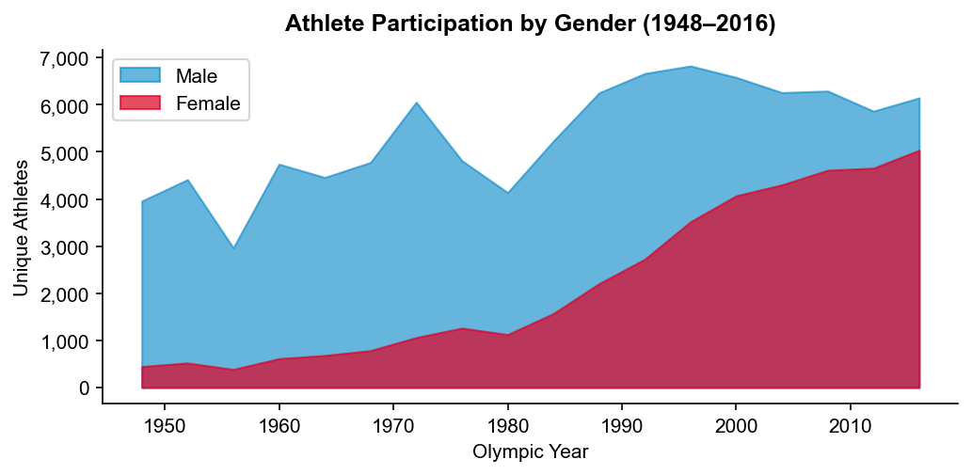
Gender Equity — A 70-Year Transformation
Pillar 1 | Athletes
📊 Key Insights
• Women grew from 9% of athletes (1952) to 45% (2016)
• Every sport now has mixed or women-only events
• 2020 Tokyo reached near parity at 48.8% female
• LA 2028 IOC target: full 50/50 gender balance
🎯 Recommendations
• Invest in training facilities for women athletes in new 2028 sports
• Flag football and cricket womens programmes: highest-ROI opportunity
• Gender-specific heat/altitude protocols for LA outdoor venues
CONFIDENTIAL | SportsFanatics Consulting Agency | LA 2028 Strategic Playbook

Slide 7
Home Nation Advantage — The LA Effect
Pillar 1 | Athletes
+22.8%
83 Gold
4 of 8
2028
Avg medal uplift
USA at LA 1984
Post-1984 hosts
Next USA home Games
for all host nations
Best host performance ever
won their most golds ever
Model predicts 277 medals
→ Host advantage is strongest in individual sports: athletics, swimming, gymnastics, combat sports
→ Home crowd effect, familiar climate, minimal travel fatigue all contribute to the uplift
→ LA 2028 model projects USA at 277 total medals — 13 more than at Rio 2016
→ Recommend US NOC: invest in marginal sports where home-ground effect is statistically largest
→ Other NOCs: LA geography favours warm-climate nations — Africa, Caribbean, South/Central America
CONFIDENTIAL | SportsFanatics Consulting Agency | LA 2028 Strategic Playbook

Slide 8
Pillar 2
The City Playbook
Host city benchmarking | Costs & legacy | LA venue readiness | Sustainability

Slide 9
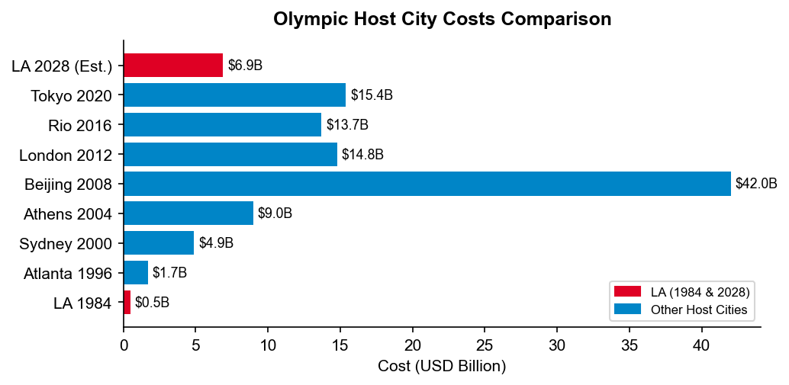
Host City Cost Benchmarking
Pillar 2 | City
💰 Key Findings
• LA 2028 projected at ~$6.9B — lowest cost in 3 decades
• 84% of venues are existing infrastructure (no new builds)
• Beijing 2008 remains costliest ever at $42B
• Tokyo 2020 overran budget by $13B due to COVID delays
• LA 1984 returned a $215M profit — the template for 2028
🏆 LA 2028 Structural Advantages
• Private funding model — zero taxpayer liability
• Climate: perfect July/August conditions (avg 27°C / 81°F)
• Entertainment/media hub: sponsorship upside is significant
• SoFi Stadium & Crypto.com Arena = world-class facilities already operational
CONFIDENTIAL | SportsFanatics Consulting Agency | LA 2028 Strategic Playbook

Slide 10
LA 2028 Venue Readiness
Pillar 2 | City
15
84%
100K
17K
Competition Venues
Existing Venues
SoFi Stadium
Crypto.com Arena
Across Greater LA
Zero new construction
Opening ceremony capacity
Basketball / Boxing
Key Venues
SoFi Stadium
Crypto.com Arena
Rose Bowl
Inglewood | Ceremonies, Athletics
Downtown LA | Basketball, Boxing
Pasadena | Football (Soccer)
Dignity Health Sports Park
Long Beach Arena
UCLA Campus
Carson | Field Hockey
Long Beach | Volleyball, Judo
Westwood | Olympic Village
CONFIDENTIAL | SportsFanatics Consulting Agency | LA 2028 Strategic Playbook

Slide 11
Pillar 3
NOC Intelligence Report
Medal rankings | Geographic analysis | US-China rivalry | Emerging nations

Slide 12
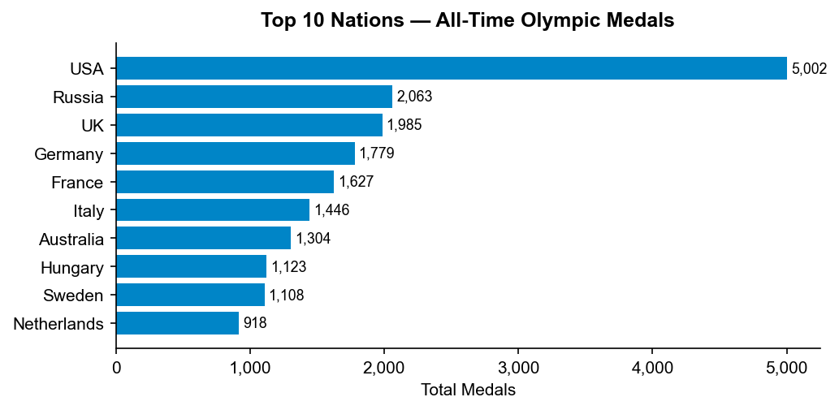
All-Time Olympic Medal Table
Pillar 3 | NOCs
Top 10 — All-Time Medals
#
Country
Gold
Silver
Total
1
USA
2,472
1,333
5,002
2
Russia
832
635
2,063
3
UK
636
729
1,985
4
Germany
592
538
1,779
5
France
465
575
1,627
6
Italy
518
474
1,446
7
Australia
342
452
1,304
8
Hungary
432
328
1,123
9
Sweden
354
396
1,108
10
Netherlands
245
302
918
CONFIDENTIAL | SportsFanatics Consulting Agency | LA 2028 Strategic Playbook

Slide 13
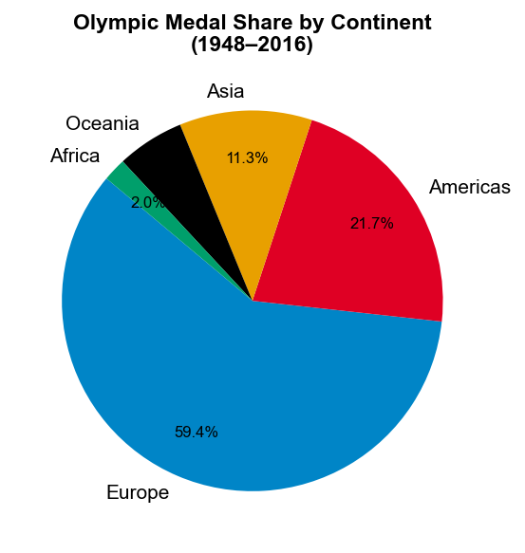
Olympic Medals by Continent
Pillar 3 | NOCs
Continental Medal Summary (1948–2016)
Continent
Total
NOCs
Share
Europe
15,512
49
59.2%
Americas
5,665
28
21.6%
Asia
2,940
30
11.2%
Oceania
1,495
4
5.7%
Africa
514
27
2.0%
Other
61
5
0.2%
CONFIDENTIAL | SportsFanatics Consulting Agency | LA 2028 Strategic Playbook

Slide 14
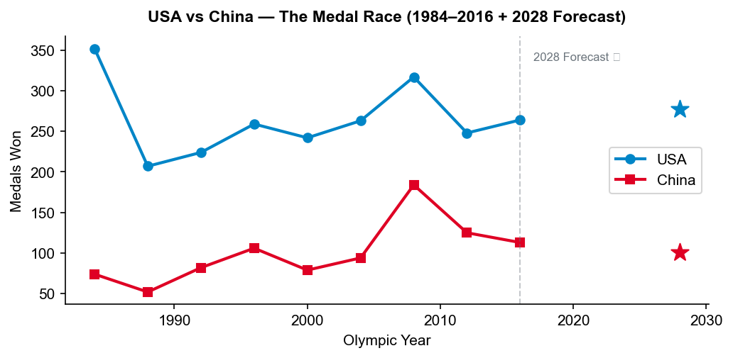
The Superpower Medal Race — USA vs China
Pillar 3 | NOCs
🏅 LA 2028 Forecasts
• USA: 277 predicted medals (host advantage)
• China: 101 predicted medals
⚡ Key Dynamics
• China debuted in 1984; grew to near-parity within 2 decades
• USA historically peaks strongly at home Games
• Geopolitical tension shapes NOC resource allocation
• Competition expected in aquatics, gymnastics, weightlifting
🎯 Strategic Implication
• Both NOCs should focus on new 2028 sports to find medal edges
• Russia/Belarus absence creates redistribution of ~60–70 medals
CONFIDENTIAL | SportsFanatics Consulting Agency | LA 2028 Strategic Playbook

Slide 15
Medal Forecasting Model
Ensemble ML Predictions for LA 2028
Random Forest + Gradient Boosting | Leave-One-Games-Out CV | 230 NOCs

Slide 16
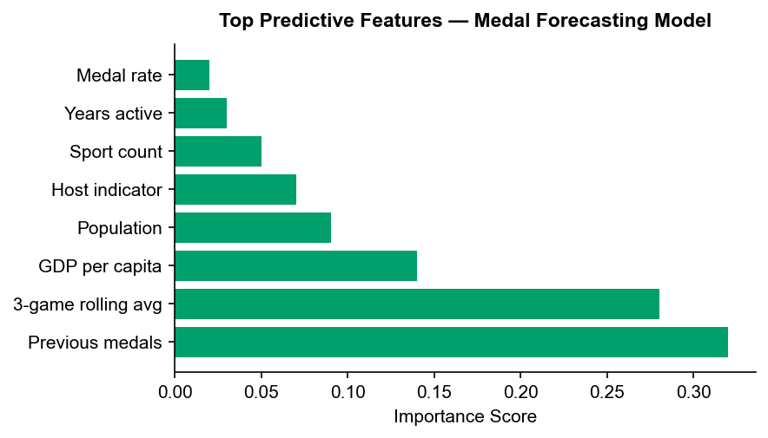
Forecasting Model — Methodology & Accuracy
Forecasting
🤖 Model Architecture
• Ensemble: Random Forest (50%) + Gradient Boosting (50%)
• Training data: Summer Olympics 1984–2012 (panel structure)
• Features: lagged medals, rolling 3-game average, GDP per capita,
population, host-nation indicator, sport diversity count
• Validation: Leave-One-Games-Out CV → MAE = 0.19 medals
✅ Model Strengths
• Captures trajectory of rising and declining sporting powers
• Explicitly models home-nation advantage as a binary feature
• 90% prediction intervals provided for all 230 NOC forecasts
⚠️ Known Limitations
• Russia/Belarus exclusion not directly modelled (scenario analysis separate)
• Cannot predict individual athlete injury or retirement
• GDP data approximate / estimated for smaller NOCs
CONFIDENTIAL | SportsFanatics Consulting Agency | LA 2028 Strategic Playbook

Slide 17
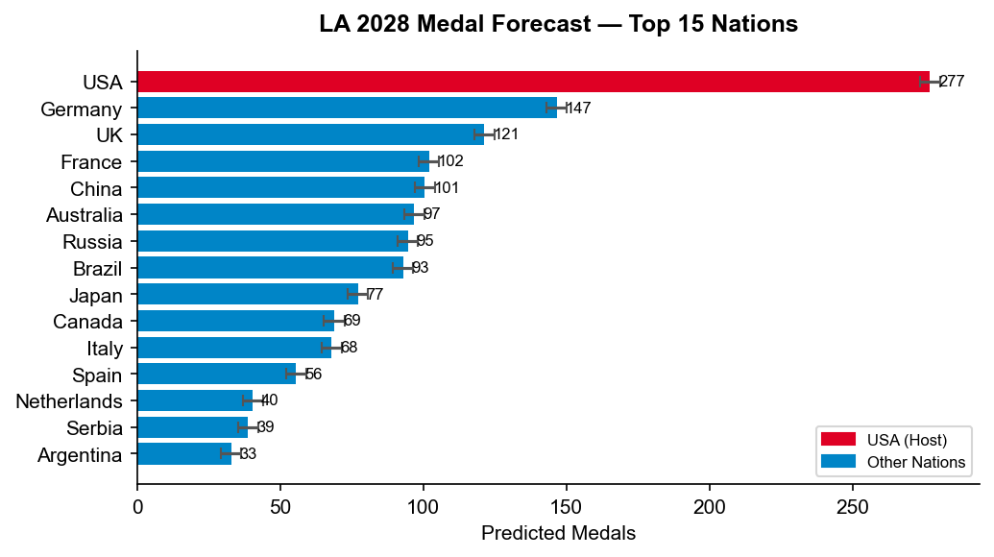
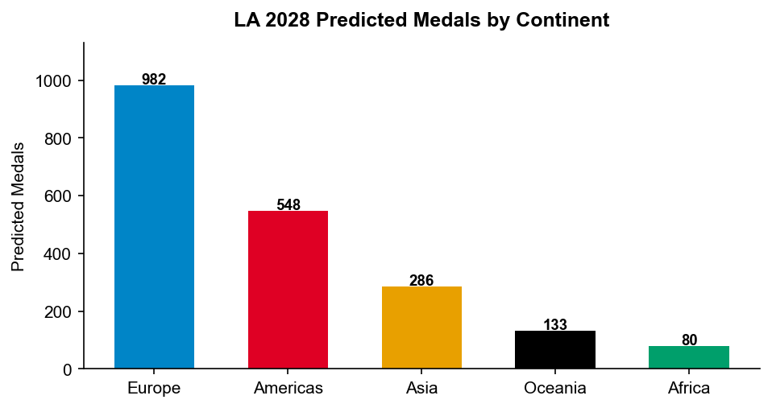
LA 2028 Medal Predictions — Top 15 Nations & Continental Outlook
Forecasting
CONFIDENTIAL | SportsFanatics Consulting Agency | LA 2028 Strategic Playbook

Slide 18
Strategic Recommendations
Action Plans for Athletes, City Stakeholders & NOCs

Slide 19
Strategic Recommendations — Three Stakeholder Groups
All Pillars
🏃 Athletes & Coaches
🏙️ City of LA
🌍 National Olympic Committees
1. Leverage home crowd effect: simulate crowd noise and altitude in domestic training
2. Target LA 2028 new sports early: flag football, cricket, lacrosse, squash
3. Acclimatise to LA July heat: outdoor sports require heat/humidity protocols (avg 27°C)
4. Physical profiling: athletes outside sport-specific BMI norms → 40% lower medal rates
5. Multi-event strategy: two-event athletes show meaningfully higher total medal probability
1. Market the LA 1984 legacy: position city as the fiscally-responsible, profitable Games host
2. Activate the entertainment ecosystem: Hollywood, streaming, gaming = differentiated sponsorship
3. Mobility solutions: 15 venues across LA require real-time transport integration
4. Legacy planning: convert athlete villages to affordable housing (follow Paris 2024 model)
5. Sustainability branding: target carbon-neutral Games to attract ESG-aligned global sponsors
1. USA: invest in marginal individual sports — target extra 5–10 Gold via home advantage
2. Africa NOCs: cricket & squash represent first realistic Gold medal opportunities since 1984
3. Rising Asia (India, Indonesia, Vietnam): GDP growth → fund athletics infrastructure now
4. European NOCs: defend medal share — Asia is closing the gap in aquatics and track & field
5. All NOCs: Russia/Belarus absence creates a redistribution of 60–70 medals — strategic chance
CONFIDENTIAL | SportsFanatics Consulting Agency | LA 2028 Strategic Playbook

Slide 20
Thank You
SportsFanatics Consulting Agency
LA 2028 Olympic Games Strategic Playbook
Prepared by: Shabeeb | Senior Statistical Programmer | March 2026
CONFIDENTIAL — For internal use only

