Slide 1
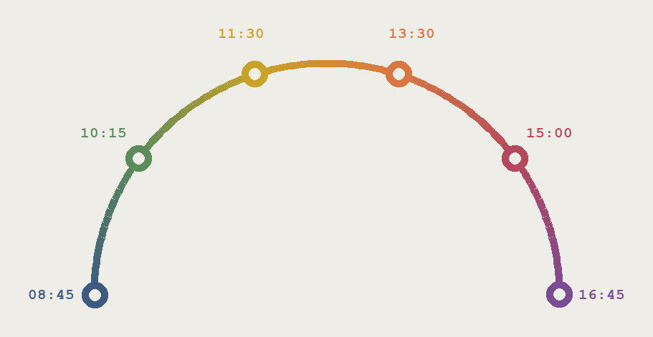
CLINICAL PROGRAMMING BOOTCAMP · DAY 1
A day in the life
What a clinical programmer actually does, hour by hour
Before we open a single dataset — this is the job you are training for.
Notes:
Open the day with this. The point is orientation, not content — they should leave this deck able to picture the work, not perform it. Adjust the hours and tasks to match your own routine; the shape is what matters. Everything shown later uses the real ABC-01 study data they will build in this course.

Slide 2
The whole job, in one sentence
Take the messy data a hospital actually recorded, and turn it into something a regulator on the other side of the world can read without asking you a single question.
Everything else — the standards, the code, the checks — exists to make that sentence true.
Notes:
Let this sit for a moment. Freshers usually arrive thinking the job is SAS. It is not — SAS is the tool. The job is making data legible to someone who was never in the room. Ask them: who is the reader? Answer: a reviewer who cannot phone you.

Slide 3
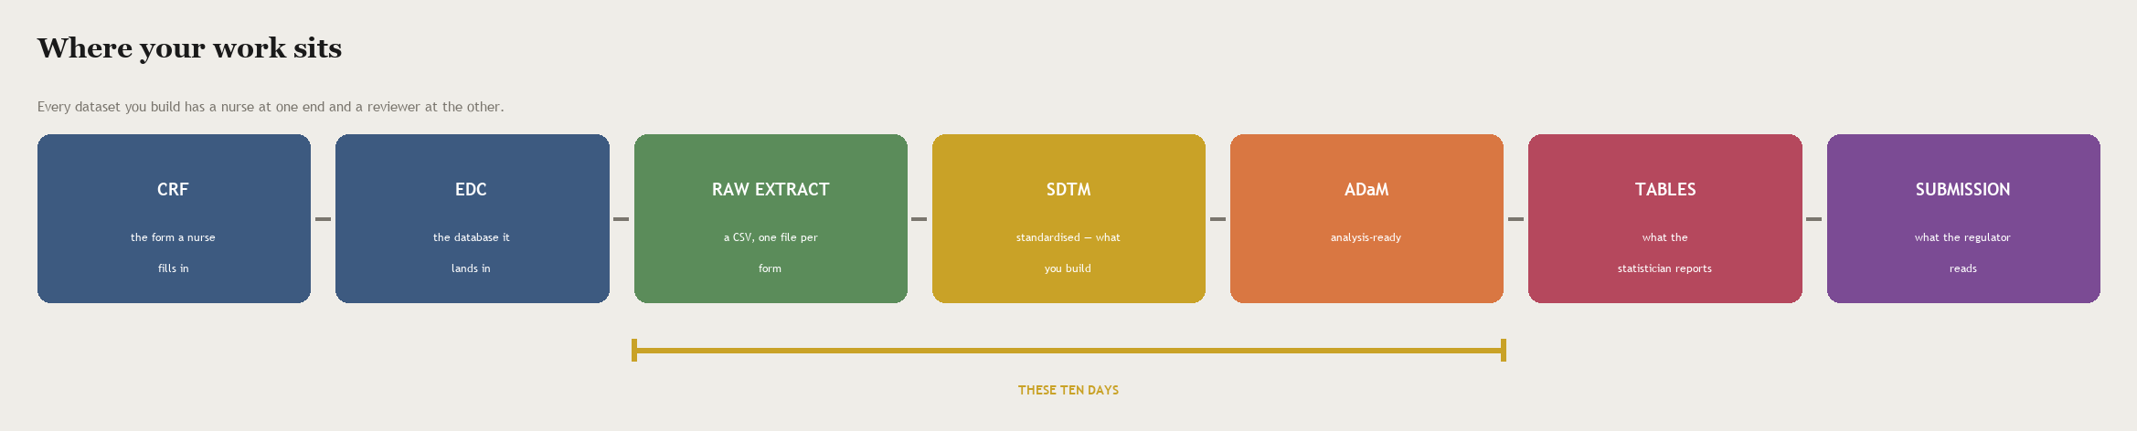
You are one link in a long chain
A nurse writes on a form. Years later a reviewer decides whether a medicine reaches patients. Your datasets are what connects those two people.
The ten days ahead cover the amber stretch — raw extract through to analysis-ready.
Notes:
Worth stressing the timescale: the gap between the nurse and the reviewer can be years, and by then nobody remembers what a value meant. That is the entire reason standards and define.xml exist.

Slide 4
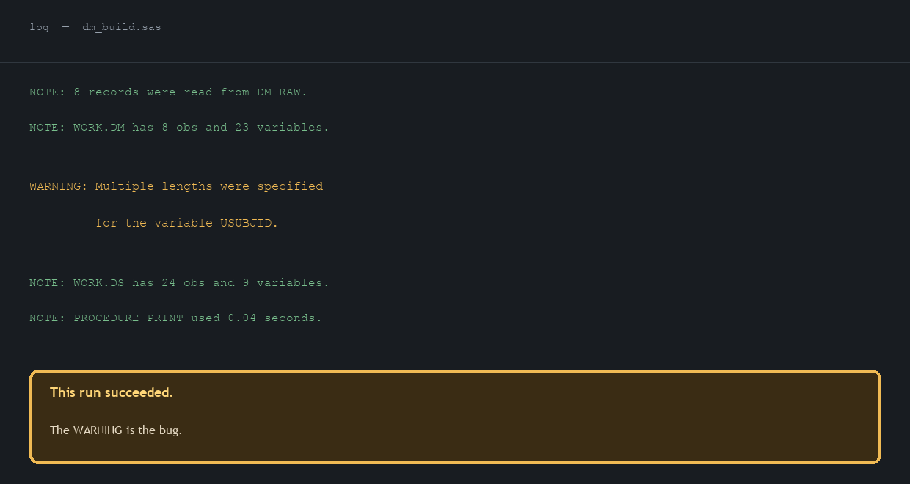
08:45
The first thing I do is read yesterday's log
Not the output. The log. Overnight the study data refreshed and every programme re-ran.
Why this comes first
A programme can finish with no error and still be wrong.
Three of the four worst bugs in this course announced themselves only as a WARNING.
“It ran fine” is not a status. The log is the status.
08:45
Notes:
This is the single habit that separates a reliable programmer from an unreliable one, and it costs nothing. The log shown is a real pattern from this course: a length mismatch on USUBJID that truncates data while the run reports success.

Slide 5
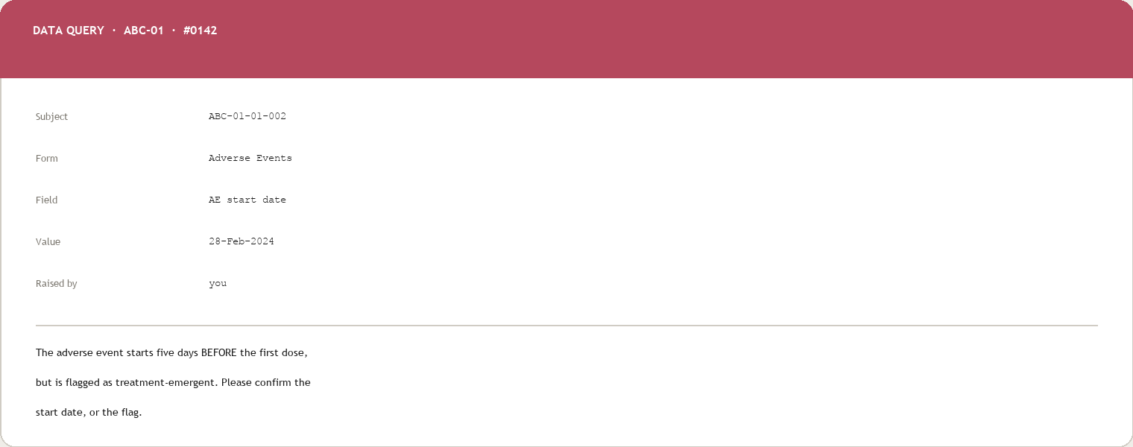
10:15
The data asks me a question I cannot answer
Something in the data is not possible. I am not allowed to guess — so I ask the site.
The rule
A programmer never invents a value.
If a date is impossible, you do not repair it quietly. You raise a query, and the site — the people who saw the patient — answer it. That answer is part of the trial record.
Guessing is the one unforgivable habit in this job.
10:15
Notes:
This query is genuinely from ABC-01 — subject 01-002 has an adverse event starting five days before first dose. It is not an error; it is a screening event, and it is why AETRTEM exists. Trainees meet this exact record on Day 5.

Slide 6
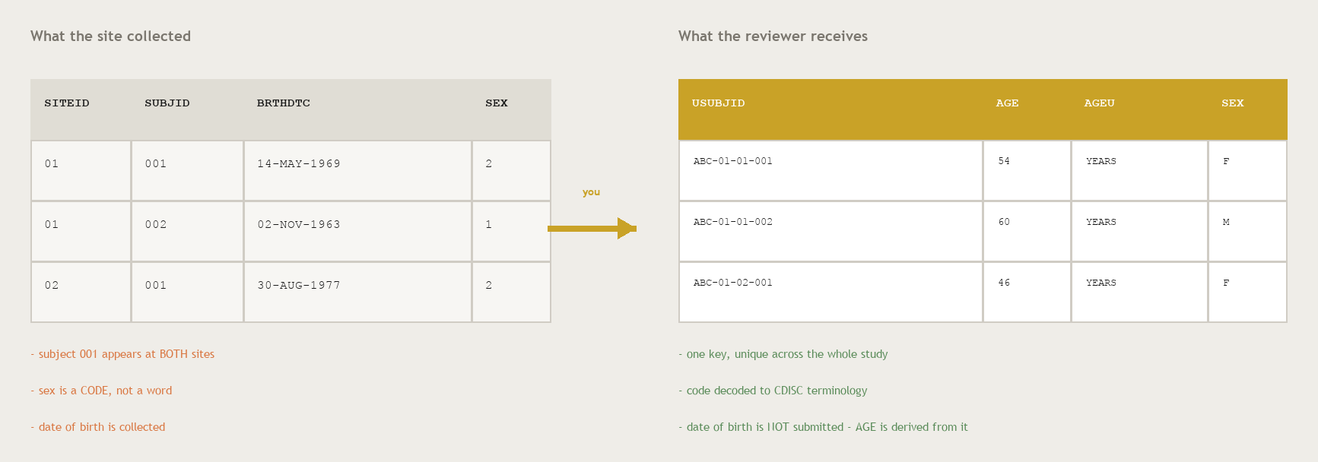
11:30
Now I build the thing I am paid to build
One raw file in. One standard dataset out. This is the craft at the centre of the job.
11:30
Notes:
These are the real first rows of ABC-01. Point at three things: subject 001 exists at both sites so USUBJID has to be constructed; sex arrives as a numeric code and must be decoded; and date of birth is collected but never submitted — AGE is derived from it and the birth date stays behind. That last one usually surprises people.

Slide 7
13:30
Half of this job is agreeing what a column means
Afternoon: a spec review. Five people, one spreadsheet, one argument about a variable.
What gets argued about
Whether a value is 'derived' or 'collected'. Where a non-standard flag belongs. Which visit counts as baseline.
Why it matters more than the code
The specification is the contract. Code that perfectly implements a wrong spec is wrong.
What you contribute
You are the person who has actually looked at the data. That makes you the person who knows what is really in it.
13:30
Notes:
Freshers assume seniority means writing harder code. It does not — it means being trusted in this meeting. Encourage them to speak up in spec reviews early; having read the data is a real qualification.

Slide 8
15:00
Someone else writes my programme again, from scratch
Double programming. Two people, one specification, no conversation — then the results are compared.
You
Your QC partner
write dm.sas from the spec
writes it again, never seeing your code
PROC COMPARE
If the two datasets differ by a single value, one of you is wrong — and the point is to find out which before a regulator does.
15:00
Notes:
Expect a reaction — it sounds wasteful. Explain the economics: a wrong number in a submission can cost a company a review cycle, or worse, mislead a safety decision. Two independent implementations is cheap by comparison. They will do this on Day 9.

Slide 9
16:45
And then something changes
Late afternoon. The spec is updated, or the data refreshes, and work you finished is suddenly out of date.
“
This is not a sign that something went wrong. It is the normal condition of a live study.
Which is why everything you will learn here is built to be RE-RUN, not hand-edited:
a programme, not a spreadsheet edit — so the change is repeatable
a specification, not a memory — so the reason survives the person
a check that fails loudly — so a stale result cannot pass quietly
16:45
Notes:
This slide quietly justifies the whole course design — why we generate rather than hand-write, and why every check gets tested by breaking it on purpose. If they take one working habit away, make it this one.

Slide 10
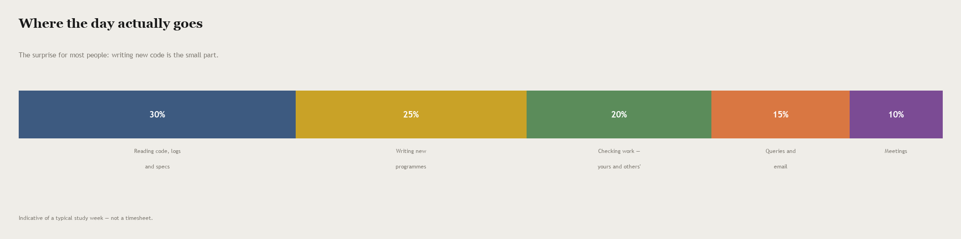
If you only remember one slide from today, remember this one.
You will spend far more time reading — code, logs, specifications, other people's programmes — than writing. Being fast at typing is worth very little. Being careful when reading is worth almost everything.
Notes:
Adjust these proportions to your own experience before presenting — they are indicative of a typical study week, not a timesheet. The teaching point holds regardless: this is a reading job more than a writing job.

Slide 11
What actually makes someone good at this
None of these is about how much SAS you know on your first day.
Suspicion
You assume a clean-looking result is hiding something, and you go and check.
Precision about words
You notice that 'severe' and 'serious' are different, and that the difference matters.
Comfort asking
You raise the query rather than quietly making the data look tidy.
Leaving a trail
Someone can pick up your work in two years and see why every value is what it is.
All four are learnable. That is the good news.
Notes:
Say plainly that people from a clinical background and people from a coding background both do well here, for different reasons, and both have a gap to close. Nobody in the room is starting behind.

Slide 12
What the next ten days look like
You will build a complete study — then do it again on your own.
Days 1–3
The ground
trials, the toolkit, and getting raw data in without breaking it
Days 4–7
The domains
DM, AE, CM, EX, VS, LB — one observation class at a time
Days 8–9
The rigour
controlled terminology, derivations, QC, and the submission package
Day 10
On your own
a second study, no worked notebook, four traps nobody solves for you
By Day 10 you will have built two studies, and read a lot more code than you wrote.
Notes:
Set the expectation that Day 10 is unguided on purpose. They get a data dictionary and a skeleton, and the four hard cases are named but not solved. That is the closest thing here to a real first week on a study.

Slide 13
One thing to carry into tomorrow
A clean-looking run is not a correct run.
Everything in the next ten days is a way of proving that a result is right, rather than hoping it is. Bring the suspicion. We will supply the rest.
Tomorrow: Module 01 · Introduction to CDISC & SDTM Foundations
Notes:
Close on the sentence, not on logistics. It is the thread running through every module, and it is the habit that will make them trusted.

