Slide 1
ElectViz: Election Data Visualization for Media
Batch-11
Mentor : Mrs Nithyasri S J
Neelapu Herambudu
Francis Daniel
Swathika Murugan
Shaik Shabeena Praveen
Gopi Krishna
Tanmay parulkar

Slide 2
Project Overview
The Mission: Transform complex election data into clear, interactive visualizations to make democracy transparent, accessible, and data-driven.
The Information Gap: US Elections are uniquely complex, the public
needs a clear guide to navigate the "Red Mirages" and shifting data of
election night.
Media Value: Specialized for newsrooms to transform high-volume data
(like AP feeds) into broadcast-ready stories instantly.
The Human Connection: We bridge the gap between cold statistics and
the real-world concerns of voters, making the democratic process
accessible to everyone.

Slide 3
Project Files
Primary Development File: The central Power BI project file that contains the entire data model, visual reports, and interactive dashboard layout seen in your screenshots.
Cleaned Source Dataset : The "source of truth" containing historical US Election records (1976–2022) after the data cleaning process was completed.
Power Query Logic: The internal transformation scripts used to clean, filter, and format the raw election data before it entered the dashboard.
DAX Measure Repository: A collection of custom formulas created within the file to calculate complex metrics like "Weighted Vote Share %" and "Seats Won by Party".

Slide 4
Key Features
Dynamic Geographic Insights: A state-wise breakdown of candidate performance and participation, allowing for hyper-local reporting.
Special Election Analytics: Unique tracking of Fusion Tickets and Special Elections to provide context beyond standard general races.
Path to Victory Tracker: Real-time calculation of "Seats Won" and "Vote Share %" to help media houses identify the 270-threshold.
Multivariate Trend Analysis: Interactive line and area charts that visualize voting patterns and seat distributions from 1976 to 2022.
Candidate & Party Benchmarking: Comparative analysis of Top 10 candidates and party-wise dominance to identify political shifts.
Deep-Dive Filtering: Synchronized "Year," "State," and "Party" slicers that allow journalists to isolate specific election stories instantly.

Slide 5
Tools
& Technologies
Primary Platform: Microsoft Power BI Desktop – Used for end-to-end data modeling, analytical calculations, and interactive dashboard design.
Data Engine: Power Query (M Language) – Leveraged for the ETL process: cleaning raw US Election datasets, handling missing values, and normalizing state/county naming conventions.
Analytical Logic: DAX (Data Analysis Expressions) – Created custom measures to calculate complex metrics like Weighted Vote Share %, Electoral Thresholds, and Year-over-Year Participation Trends.
Visualization Suite:
  Native AI Visuals: Used for identifying key influencers and performance trends.
  Geospatial Mapping: Integrated Bing Maps for real-time state-wise candidate distribution.
  Interactive Slicers: Implemented synchronized filters for "Year," "State," and "Party" to allow for deep-dive investigative reporting.

Slide 6
License
MIT License: A short and permissive software license that allows media houses to use, copy, and modify your dashboard, provided the original copyright and permission notice are included.

Slide 7
Team Learnings
Data Empathy: We learned that cleaning a "US Election" dataset is an ethical duty; behind every row is a voter whose intent must be accurately represented.
The Power of Clarity: We discovered that "less is more"—simplifying complex "Fusion Ticket" or "Special Election" data into clear donut charts makes the story accessible to non-experts.
Technical Agility: We mastered DAX to handle "Weighted Vote Share" and Power Query to merge fragmented state records into a unified national narrative.
User-Centric Design: By testing our "Year Sliders," we learned how to design for a high-pressure newsroom where a journalist needs historical context in under three seconds.
Integrity over Aesthetics: We prioritized data validation over "flashy" visuals, ensuring that every seat count and percentage on the dashboard is bulletproof and auditable.

Slide 8




Outcomes

Slide 9
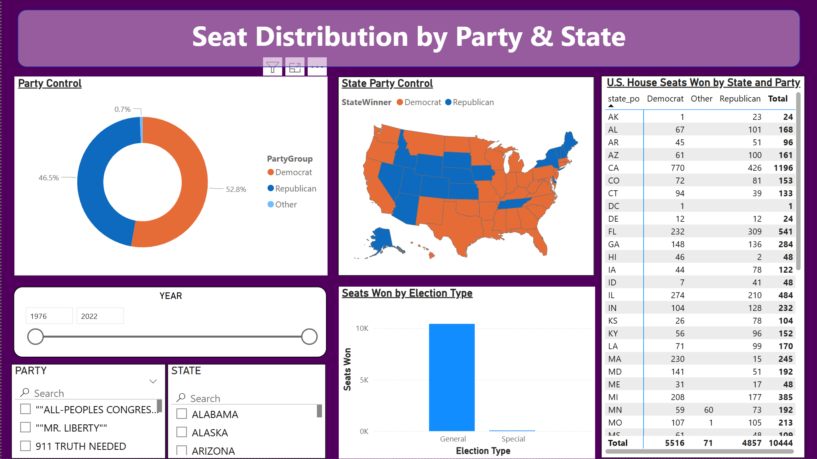


Outcomes

Slide 10
Future Enhancements
Predictive AI Integration: Incorporating machine learning models to project "Likely Winners" in real-time based on early partial returns.
Predictive "What-If" Modeling: Enabling a "The Needle" feature (similar to major news networks) to estimate final outcomes as soon as key precincts report.
Demographic Overlay: Integrating US Census data to visualize how factors like income, education, and age influenced the voting shifts seen in your current charts.
Live API Connectivity: Transitioning from static datasets to live Web API feeds (such as the Associated Press) for automated updates during election nights.

Slide 11
Conclusion
Every Vote a Story: ElectViz makes the American democratic experiment visible to everyone.
Clarity in Chaos: We provide the "Eye of the Storm" for journalists during the most chaotic nights in media.
Final Quote: "In a democracy, data is the heartbeat. ElectViz makes sure everyone can hear it clearly."

Slide 12
Contributors
&
Reference,
Notes
Team: Neelapu Herambudu, Francis Daniel, Swathika Murugan, Shaik Shabeena Praveen, Gopi Krishna, Tanmay Parulkar
Data Collection: US Election Data set 1976-22 (Kaggle).
The Three-Second Rule: In a fast-placed newsroom, clarity is king. We designed our visualizations so that a viewer can understand the state of a race in under three seconds.
Data with a Pulse: We didn't just build a dashboard; we built a storyteller. Our "Trend Arrows" and "Swing Analysis" explain the movement of the American people, not just the final score.

