Slide 1
Events
Interactivity and Javascript

Slide 2
What is a Event?
An event is a signal which fires either in case of user’s interactivity with the system or when a any kind of process starts on ends in the system.

Slide 3

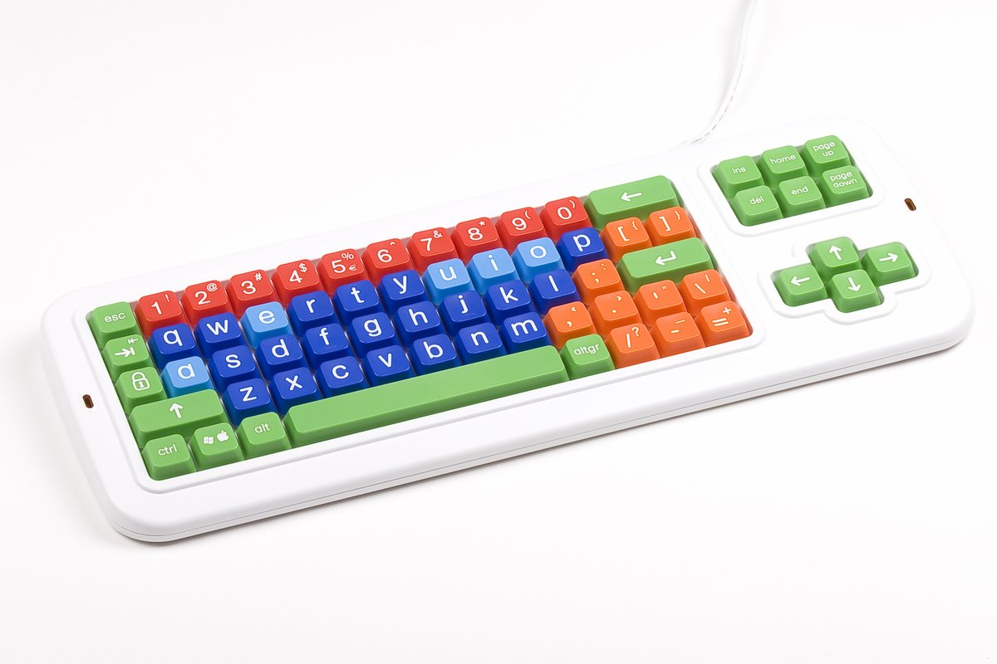

Examples
1). User clicks on a button or an image
2). User presses any key on the keyboard
3). User pinch and zoom an image on a mobile phone

Slide 4

How to use Events?
JavaScript's interaction with HTML is controlled
through Events.
HTML events are “things” that happen to HTML elements.
We can listen to the events using a mechanism called Event Binding

Slide 5
HTML and Javascript
Event Listener
Event Handler
<button onclick=“sayHi()”>Click ME<<button>
function sayHi(){ console.log(“Say hi”); }

