Slide 1
LEARNING LIGHT
Submitted By, GUIDED BY,
Limitha k r Smitha p r

Slide 2
INTRODUCTION
Learning Light is a website for Educational Institutions and students who seek help from
the public to meet their digital necessities.
This application provides valuable contributions to educational institutions and students for their needs.
The web application comprises of 4 modules - admin, educational institutions, student and contributor.

Slide 3
EXISTING SYSTEM
The existing system’s main objective is enabling every children to learn online.
The system identifies beneficiary students that requires support and collect with quality laptop/tablets to put them on the same starting line as the rest of the students in the world.
The system works with globally renowned hardware manufacturers to provide laptops of standard specifications at a significantly subsidized price.
Also this system enables contributors to purchase and place orders for either a laptop or a batch of laptops.

Slide 4
PROPOSED SYSTEM
The proposed system that is going to be built is a contribution website for both students and educational institutions.
The proposed system enables both students and educational institution can register and request for their digital needs.
Here proposed system allows contribution in terms of financial and digital devices needed for the online education.
Digital needs not only includes the laptops.

Slide 5
OBJECTIVES
The main objective of this website is to meet the contributors all over the world.
Both educational institutions and students can register separately.
Contributors can choose their way of contribution.
Contribution can be either financial form or digital terms.

Slide 6
FEASIBILITY STUDY
Feasibility study is an analysis and evaluation of a proposed project to determine if it is feasible in terms of technical, operational and economical features.
Feasibility is a test of a proposed system according to workability, impact on the organization ability to meet user needs and effective use of resources.
Three key considerations:
• Technical feasibility
• Operational feasibility
• Economic feasibility

Slide 7
TECHNICAL FEASIBILITY
The technical feasibility is concerned with determining whether it is possible to do the project with the technology exists.
The project requires windows OS,a system and does not require any additional features.
And this software is freely available. Thus, the system is technically feasible.

Slide 8
OPERATIONAL FEASIBILITY
The test of operational feasibility asks if the system will work when developed and installed.
Every user can use our application easily by downloading it from the store. Moreover, our is simple website has very user-friendly interface and so it does not require to give any training for its users. Thus, the system is operationally feasible.

Slide 9
ECONOMICAL FEASIBILITY
Development of this application is economically feasible.
The developer need not spend much money for the accomplishment of the project since the software required for the development of the system is already exist
The developer has the machines running windows system. Even after the development, the user need not be in a position to invest more on maintenance.

Slide 10
SYSTEM SPECIFICATIONS
1. HARDWARE SPECIFICATIONS
➢ Processor: - i3 and above
➢ 2GB RAM minimum, 8 GB RAM recommended
➢ 20 GB of available disk space minimum, 40 GB Recommended
2. SOFTWARE SPECIFICATIONS
➢ Operating System: - Microsoft Windows 7/8/10 (32-bit or 64-bit)
➢ Front End: - Python-Django
Back End:-Python
➢ IDE: - Visual Studio

Slide 11
DATABASE DESIGNS AND DATA FLOW DIAGRAMS

Slide 12
Table name : Login table
Primary key : login_id
FIELD | TYPE | CONSTRAINTS | DESCRIPTION
login_id | int | primary key | login id
username | varchar(20) | not null | username
Password | varchar(20) | not null | Password
type | varchar(10) | not null | type of user

Slide 13
Table name : Registration table
Primary key : reg_id
Foreign key : login_id
FIELD | TYPE | CONSTRAINTS | DESCRIPTION
reg_id | Int | Primary key | registration id
Login_id | Int | Foreign key | Login id
name | varchar(100) | not null | name
house/building name | varchar(100) | not null | name of the house/building
street | varchar(50) | not null | street name
local body | varchar(100) | not null | local body name
district | varchar(20) | not null | district name
state | varchar(10) | not null | state name
pincode | varchar(10) | not null | pincode
phone number | varchar(10) | not null | phonenumber
email | varchar(20) | not null | email id
status | Varchar(20) | null | Approve/reject

Slide 14
Table name : Institution details
Primary key :inst_id
Foreign key: Reg_id
FIELD | TYPE | CONSTRAINTS | DESCRIPTION
Enroll_num | int | primary key | institution id
reg_id | int | foreign key | registration id
License_number | int | not null | lisensce number
Type | varchar(10) | not null | aided/unaided/private

Slide 15
Table name : Student details
Primary key : stud_id
Foreign key : reg_id
Foreign key: enroll_num
FIELD | TYPE | CONSTRAINTS | DESCRIPTION
Stud_id | int | primary key | Roll number of student
reg_id | int | foreign key | registration id
Enroll_num | int | Foreign key | institution id
DOB | date | not null | student age
class/course | varchar(20) | not null | student education
father’s name | varchar(50) | not null | student father name
mother’s name | varchar(50) | not null | student mother name
Caste | Varchar(10) | null | student status

Slide 16
Table name : Contributor details
Primary key : cont_ id
Foreign key : reg_id
FIELD | TYPE | CONSTRAINTS | DESCRIPTION
cont_id | Int | primary key | contributor id
reg_id | Int | foreign key | registration id
cont_type | varchar(20) | not null | individual/group/corporate
contribution type | varchar(20) | not null | valuables/Cash
cash | Int | null | amount
Valuables_name | varchar(20) | null | valuables name

Slide 17
Table name : transaction details
Primary key : trans_id
Foreign key : cont_id
FIELD | TYPE | CONSTRAINTS | DESCRIPTION
trans_id | int | primary key | transaction id
cont_id | int | foreign key | contributor_id
card type | varchar(10) | not null | type of the card
card number | int | not null | card number
name on the card | varchar(20) | not null | name on the card
date | date | not null | date
time | time | not null | time
status | varchar(20) | not null | status of the transaction

Slide 18
Table name : valuables details
Primary key : val_id
Foreign key : cont_id
FIELD | TYPE | CONSTRAINTS | DESCRIPTION
val_id | int | primary key | valuable id
cont_id | int | foreign key | contributor id
Item_spec | varchar(20) | not null | name of the item
count | int | not null | number of items
date | date | not null | date
time | time | not null | time
status | varchar(10) | not null | status

Slide 19
Table name : Request Form
Primary key : id
Foreign : Reg_id
FIELD | TYPE | CONSTRAINTS | DESCRIPTION
req_Id | Int | primary key | form id
reg_id | Int | foreign key | user id
request | varchar(500) | not null | Message
count | int | not null | Number of items
req_status | varchar(50) | not null | request status

Slide 20
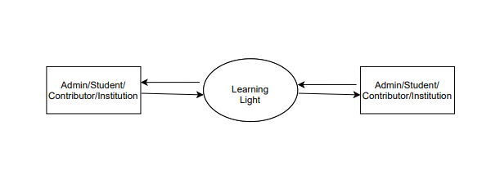
DFD 0th level
Learning light

Slide 21
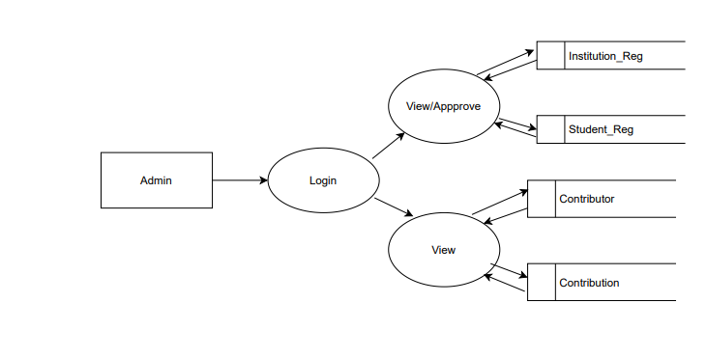
DFD first level

Slide 22
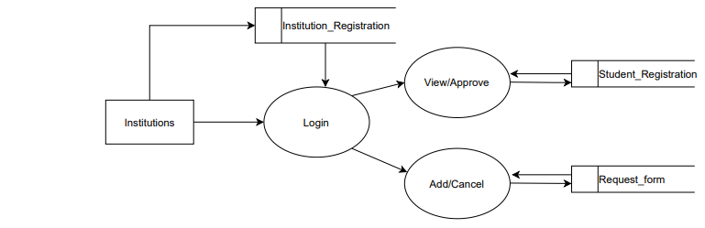
DFD first level INSTITUTIONS

Slide 23
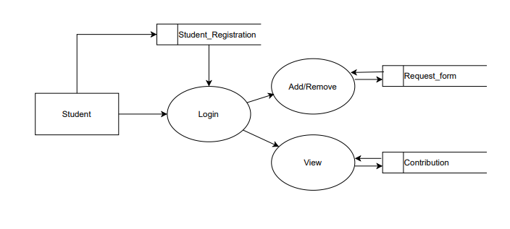
DFD first level STUDENT

Slide 24
THANK YOU

