Slide 1
COBED
Covid health care management system for Thrissur district
GUIDED BY, PRESENTED BY,
Ms. Harsha K.K Alwin M I
(Assistant Professor, CCSIT JMC)

Slide 2
CONTENTS
INTRODUCTION
EXISTING SYSTEM
PROPOSED SYSTEM AND IT’S OBJECTIVES
MODULES AND DESCRIPTION
FEASIBILITY STUDY
SOFTWARE AND HARDWARE SPECIFICATIONS
DATABASE DESIGN
DFD

Slide 3
INTRODUCTION
Cobed Simply means isolation
A online web application for covid health care management in Thrissur District
Keeps records of patients at home quarantine and also at the other care centers
Overall view of treatment for the covid patients
Can track the covid patients details
A view port for the situation analysis
Strict mechanisms for accurate proper recording through different admins
Better for future analysis

Slide 4
EXISTING SYSTEM
Covid jagratha portal
No home quarantine details added
Death rate may not be accurate
Patient complaint portal is not available

Slide 5
PROPOSED SYSTEM
Bring an accurate death rate than the existing system by dual approval/reporting way
Patients can log into the system separately and can chat with doctor
Patients can report complaints to the respective admins
Forwarding the complaints to DMO if it is not solved within 24 hrs.
By the decentralised approach of updating details, the load will be minimum
The user get a filtering and sorting view of patients data
Location based searching
Also helps for future analysis

Slide 6
Modules and Description
There are mainly 11 modules:
Admin
Doctor
Lab Admin
Hospital Admin
CFLTC Admin
CSLTC Admin
Domicile Admin
Home Admin
Patient
DMO
user

Slide 7
Admin
approve sub admins
add/update sub admin details
Doctor
Chat with patients
report death
view patient
update doctor details
Lab admin
update lab details
update tests
update test results
insert/update patient details

Slide 8
Hospital Admin
update hospital details
update patients details
view complaints and update complaint status
CFLTC admin
update hospital details
update patients details
view complaints and update complaint status
CSLTC admin
update hospital details
update patients details
view complaints and update complaint status
Domicile Admin
update Domiciliary details
update patient details
view complaints and update complaint status

Slide 9
Home Admin
update patient details
view complaints and update complaint status
Report death
Patient
Report complaints
Chat with a doctor
View his/her covid related details
DMO
view complaints
view improper death reports
view patients
search hospital /lab/CFLTC/CFLTC/DCC/ home quarantine details
view details with sorting and filtering options

Slide 10
user
map view
search hospital /lab/CFLTC/CSLTC/DCC/ home quarantine
view details with sorting and filtering options

Slide 11
FEASIBILITY STUDY
Feasibility is defined as the practical extent to which a project can be performed successfully.
Types of Feasibility study:
1.Economic feasibility
2.Operational feasibility
3.Technical feasibility

Slide 12
Economic Feasibility :
There is only initial expense with this project.
Maintenance cost is also less
Technical Feasibility :
The hardware such as i3 processor with 500 GB Hard disk , Hence it is technically feasible.
Python with more library and wide range of adaptability
Operational Feasibility :
Easy to use
Since this system ready to use in the world wide web, so the system is operationally feasible.

Slide 13
SOFTWARE AND HARDWARE REQUIREMENTS
Minimum Hardware Requirements
Input Device : Mouse, Keyboard
Output Device : Monitor (15 VGA Color)
Memory : 4 GB RAM
Processor : intel i3 processor
Hard Disk : 500 GB
Minimum Software Requirements
Operating system : WINDOWS 10 home
Front end : html, css, javaScript
Frame Work : Django
Back end : python,SQLite3

Slide 14
DATABASE DESIGN
TABLE NO : 1 PRIMARY KEY : ur_id
TABLE NAME : tb_register
Field Name | Datatype | Constraints | Description
ur_id | int(5) | Primary key ,Not Null | Id of the user/admin
ur_name | varchar(20) | Not Null | Name of the user/admin
ur_email | varchar(30) | Not Null | Email address of the user/admin
ur_password | varchar(30) | Not Null | Password of the user/admin
ur_phone | int(10) | Not Null | phone number
ur_pincode | int(6) | Not Null | Pin code
ur_type | varchar(20) | Not Null | user/admin type
ur_status | Varchar(1) | Null | approval status

Slide 15
TABLE NO : 2 PRIMARY KEY : log_id
TABLE NAME : tb_login
Field Name | Datatype | Constraints | Description
log_id | int(5) | Primary key ,Not Null | Id of the admin/user
ur_id | int(5) | foreign key ,Not Null | Registration Id of the user/admin
log_email | varchar(30) | Not Null | Email address
log_password | varchar(30) | Not Null | password
log_type | varchar(20) | Not Null | user type

Slide 16
TABLE NO : 3 PRIMARY KEY : pt_id
TABLE NAME : tb_patient
Field Name | Datatype | Constraints | Description
pt_id | int(5) | primary key, Not Null | id of patient
pt_email | varchar(30) | Not Null | Email address of the patient
pt_aadhar | Int(12) | Not Null | Aadhar id of patient
pt_name | varchar(30) | Not Null | name of patient
pt_age | int(3) | Not Null | age of patient
pt_gender | varchar(6) | Not Null | gender of patient
pt_phone | int(10) | Not Null | phone number
pt_house | varchar(20) | Not Null | patient house name
pt_place | varchar(20) | Not Null | place of patient
pt_auth_type | Varchar(20) | Not Null | Authority type municipality/coporation
pt_auth_name | Varchar(30) | Not Null | Authority name
pt_ward_no | Int(3) | Not Null | ward number
pt_village | Varchar(30) | Not Null | Village name
pt_district | Varchar(20) | Not Null | District name
pt_pincode | int(6) | Not Null | pincode of patient
pt_category | Varchar(10) | Null | Category of patient

Slide 17
TABLE NO : 4 PRIMARY KEY : status_id
TABLE NAME : tb_status
Field Name | Datatype | Constraints | Description
status_id | int(5) | primary key, Not Null | status id
ur_id | Int(5) | Foreign Key, Not NUll | Admin id
bed_id | int(5) | foreign key , Null | id of bed
cen_id | int(5) | Foreign key, Null | Center id
pt_id | int(5) | foreign key, Null | id of patient
test_id | int(5) | Null | test id
test_name | varchar(20) | Null | name of test if taken
pt_status | varchar(25) | Not Null | patient status
status_date | date | Not Null | date of status changed
status_time | time | Not Null | time of status changed

Slide 18
TABLE NO : 5 PRIMARY KEY : cen_id
TABLE NAME : tb_center
Field Name | Datatype | Constraints | Description
cen_id | int(5) | primary key, Not Null | id of hospital/CFLTC/CSLTC/ DCC
loc_id | int(5) | foreign key ,Not Null | Location id
ur_id | int(5) | foreign key ,Not Null | admin id
lab_id | int(5) | foreign key ,Null | lab id
cen_name | varchar(30) | Not Null | hospital name
cen_type | Varchar(10) | Not Null | Center type whether DCC/CFLTC/CSLTC/ hospital
cen_auth | Varchar(10) | Null | Whether private/govt center
cen_place | varchar(30) | Not Null | place of hospital
cen_hphone | int(10) | Not Null | hospital phone number
cen_district | Varchar(30) | Not Null | District of center
cen_pincode | int(6) | Not Null | hospital pincode
cen_photo | BLOB | Not Null | hospital photo

Slide 19
TABLE NO : 6 PRIMARY KEY : loc_id
TABLE NAME : tb_location
Field Name | Datatype | Constraints | Description
loc_id | int(5) | primary key, Not Null | id of location
loc_latitude | varchar(30) | Not Null | latitude of location
loc_longitude | varchar(30) | Not Null | Longitude of location

Slide 20
TABLE NO : 7 PRIMARY KEY : bed_id
TABLE NAME : tb_bed
Field Name | Datatype | Constraints | Description
bed_id | int(5) | primary key, Not Null | id of bed
cen_id | int(5) | Foreign key, Not Null | Center id
bed_no | int(5) | Not Null | bed number
ward_no | int(5) | Null | ward number
room_no | int(5) | Null | room nmber
floor_no | int(3) | Null | floor number
icu_no | int(3) | Null | icu number
venti_no | int(3) | Null | ventilator number
bed_status | Int(1) | Not Null | Bed availability status
bed_oxy | Int(1) | Not Null | Whether oxygen bed or not
bed_gender | Varchar(1) | Not Null | Gender type of bed

Slide 21
TABLE NO : 8 PRIMARY KEY : lab_id
TABLE NAME : tb_lab
Field Name | Datatype | Constraints | Description
lab_id | int(5) | primary key, Not Null | id of location
ur_id | int(5) | foreign key ,Not Null | admin id
loc_id | int(5) | Foreign key, Not Null | id of location
lab_type | varchar(30) | Not Null | Lab type
lab_name | varchar(30) | Null | lab name , if private
lab_place | varchar(30) | Not Null | lab place, if private
lab_district | Varchar(30) | Not Null | Lab district , if private
lab_pincode | int(6) | Null | lab pincode, if private
lab_certificate | BLOB | Not Null | Lab certificate
lab_availability | int(2) | Null | lab availability

Slide 22
TABLE NO : 9 PRIMARY KEY : doc_id
TABLE NAME : tb_doctor
Field Name | Datatype | Constraints | Description
doc_id | int(5) | primary key, Not Null | id for doctor for center
ur_id | int(5) | Foreign key, Not Null | Id of the doctor
cen_id | int(5) | Foreign key, Null | Center id of doctor
doc_status | varchar(15) | Not Null | availability of doctor
online_status | Int(1) | Not Null | Online availability of doctor
doc_certificate | blob | Not Null | doctor certificate

Slide 23
TABLE NO : 10 PRIMARY KEY : chat_id
TABLE NAME : tb_chat
Field Name | Datatype | Constraints | Description
chat_id | int(5) | primary key, not null | chat id
sender_type | varchar(2) | Not Null | type of sender
sender_id | int(5) | Not Null | sender id
receiver_id | int(5) | Not Null | receiver id
message_body | blob | Not Null | message content
chat_date | date | Not Null | date of chat
chat_time | time | Not Null | time of chat

Slide 24
TABLE NO : 11 PRIMARY KEY : comp_id
TABLE NAME : tb_complaint
Field Name | Datatype | Constraints | Description
comp_id | int(5) | primary key, Not Null | complaint id
pt_id | int(5) | foreign key, Not null | patient id
ur_id | int(5) | Not Null | Receiver id
comp_body | varchar(255) | Not Null | complaint body
comp_status | varchar(2) | Not Null | complaint status
comp_date | date | Not Null | reported date
comp_time | time | Not Null | reported date

Slide 25
TABLE NO : 12 PRIMARY KEY : vac_id
TABLE NAME : tb_vaccine
Field Name | Datatype | Constraints | Description
vac_id | int(5) | primary key, Not Null | vaccination id
ur_id | int(5) | foreign key, Not null | admin id
pt_id | int(5) | foreign key, Not Null | patient id
vac_name | varchar(20) | Not Null | Vaccine name
dose_no | int(2) | Not Null | dose number
vac_date | date | Not Null | vaccinated date
vac_time | time | Not Null | vaccinated time

Slide 26
TABLE NO : 13 PRIMARY KEY : test_id
TABLE NAME : tb_tests
Field Name | Datatype | Constraints | Description
test_id | int(5) | primary key, Not Null | test id
lab_id | int(5) | foreign key, Not null | lab id
test_name | varchar(10) | Not Null | test name
test_availability | Int(1) | Not Null | Test availability
test_cost | int(4) | Not Null | test charge

Slide 27
TABLE NO : 14 PRIMARY KEY : dis_id
TABLE NAME : tb_disease
Field Name | Datatype | Constraints | Description
dis_id | int(5) | primary key, Not Null | disease id
pt_id | int(5) | foreign key, Not null | patient id
pre_dis | varchar(30) | Null | pre covid disease
post_dis | varchar(30) | Null | post covid disease

Slide 28
TABLE NO : 15 PRIMARY KEY : appr_id
TABLE NAME : tb_death
Field Name | Datatype | Constraints | Description
appr_id | int(5) | primary key, Not Null | approval id
pt_id | int(5) | foreign key, Not null | patient id
doc_id | int(5) | foreign key, null | doctor id
ur_id | int(5) | foreign key, null | domicile admin id
appr_date | date | Not Null | death approval date
appr_time | time | Not Null | death approval time

Slide 29
DFD LEVEL 0 : COBED
DFD
ADMIN/DMO/
DOMICILE ADMIN/
CFLTC ADMIN/
CSLTC ADMIN
HOSPITAL ADMIN/
LAB ADMIN/
PATIENT/
HOME ADMIN/ USER
COBED
Request
Response

Slide 30
DFD LEVEL 1 : ADMIN
login
log_email,log_password
ADMIN
tb_login
log_email,log_password
view
ur_id
ur_email,ur_type…
approve
ur_id,ur_status…
tb_register
ur_id
delete
ur_id

Slide 31
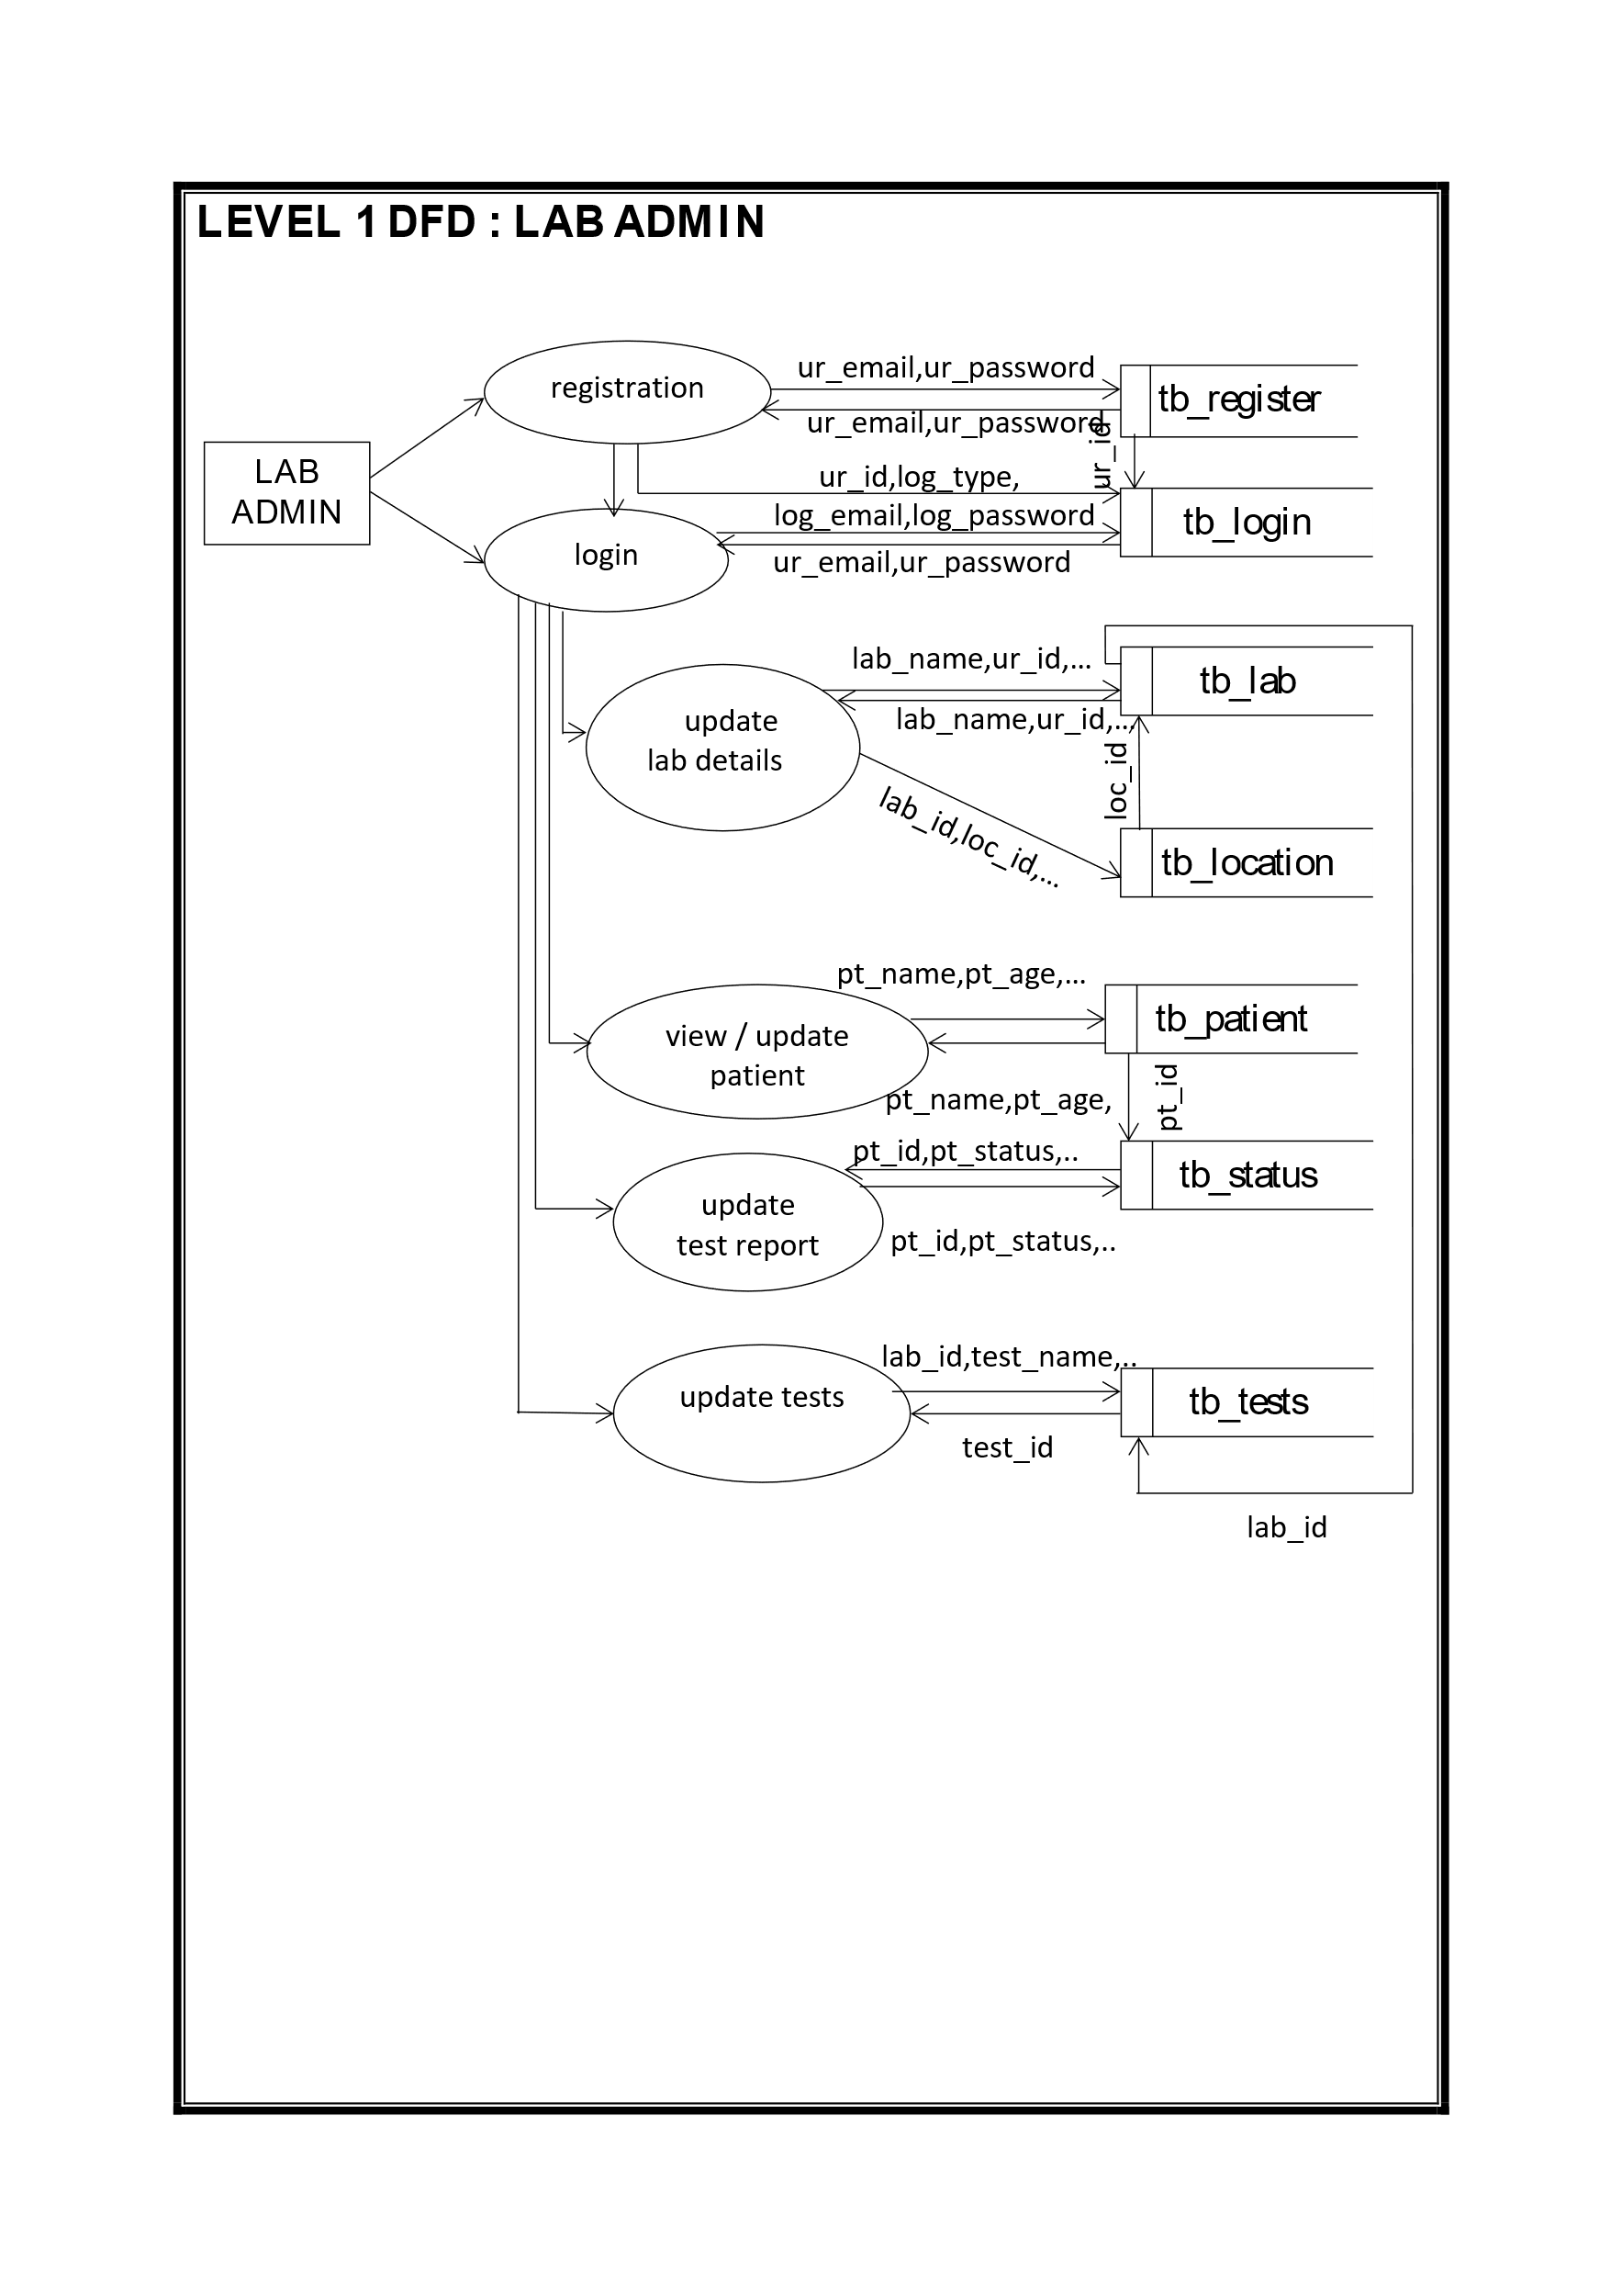
DFD LEVEL 1 : LAB ADMIN

Slide 32
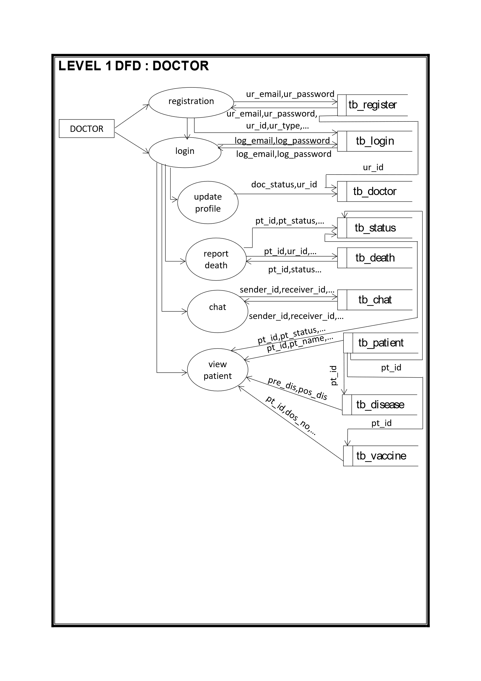
DFD LEVEL 1 : DOCTOR

Slide 33
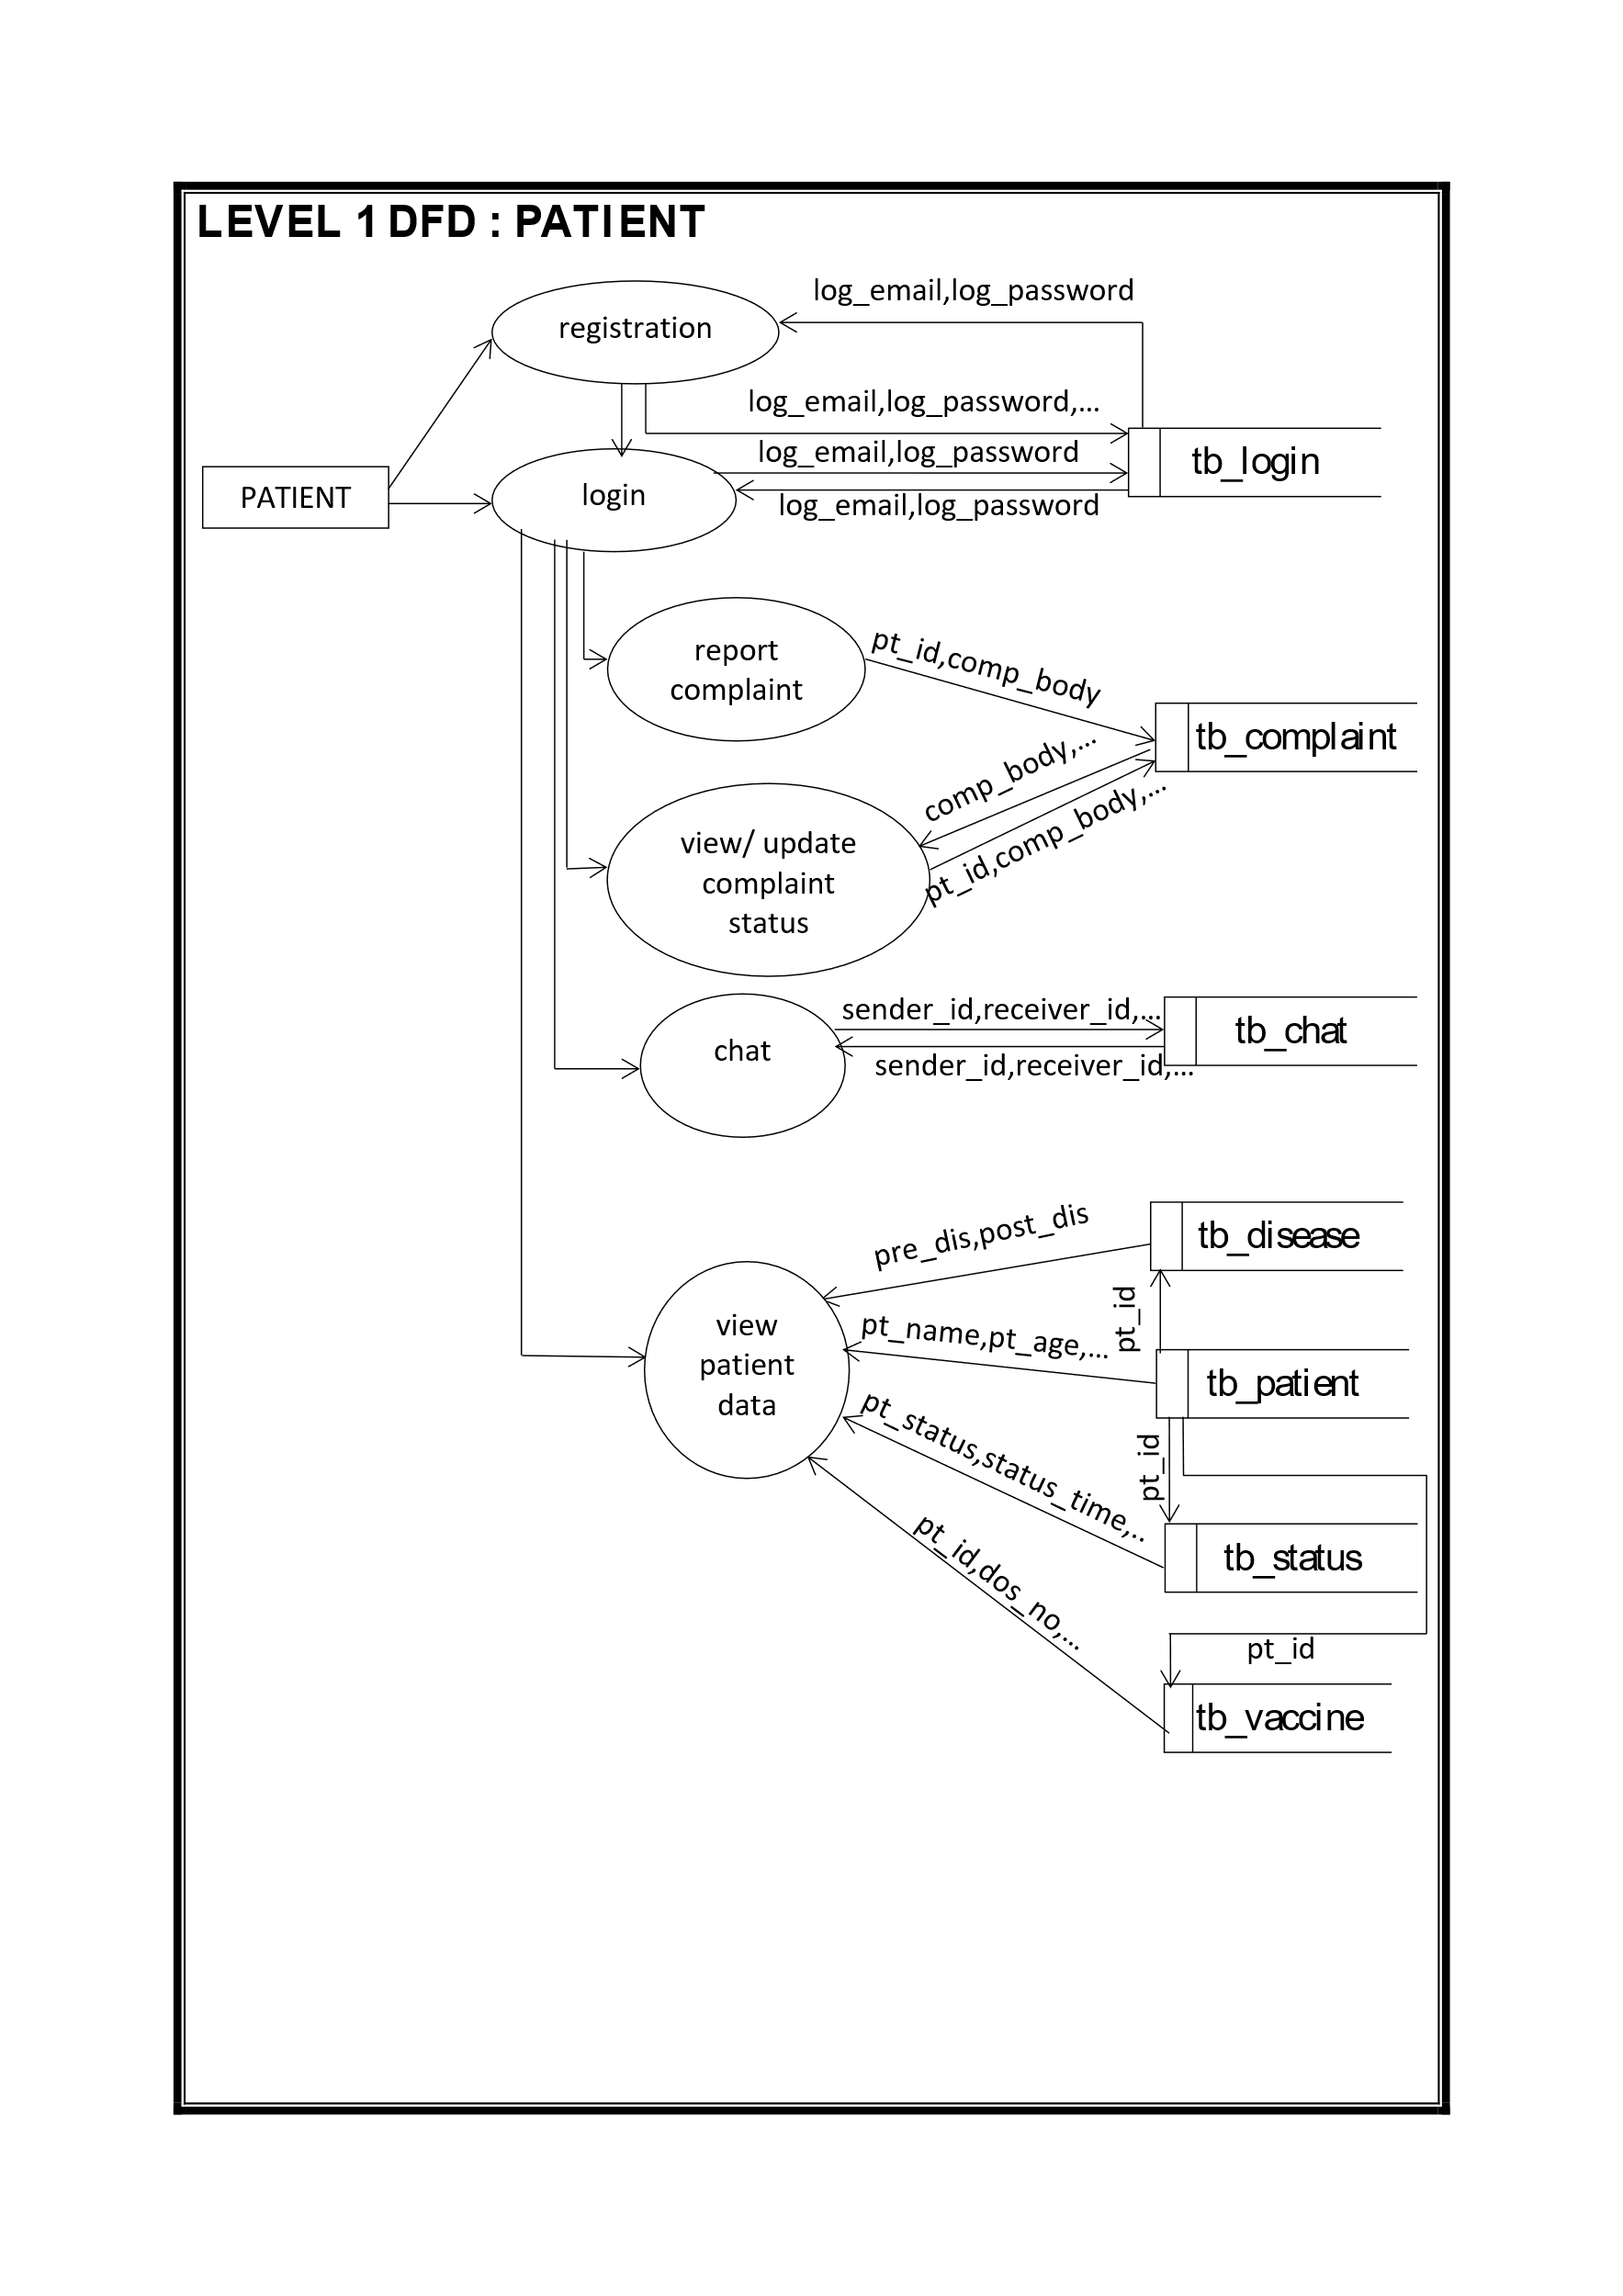
DFD LEVEL 1 : PATIENT

Slide 34
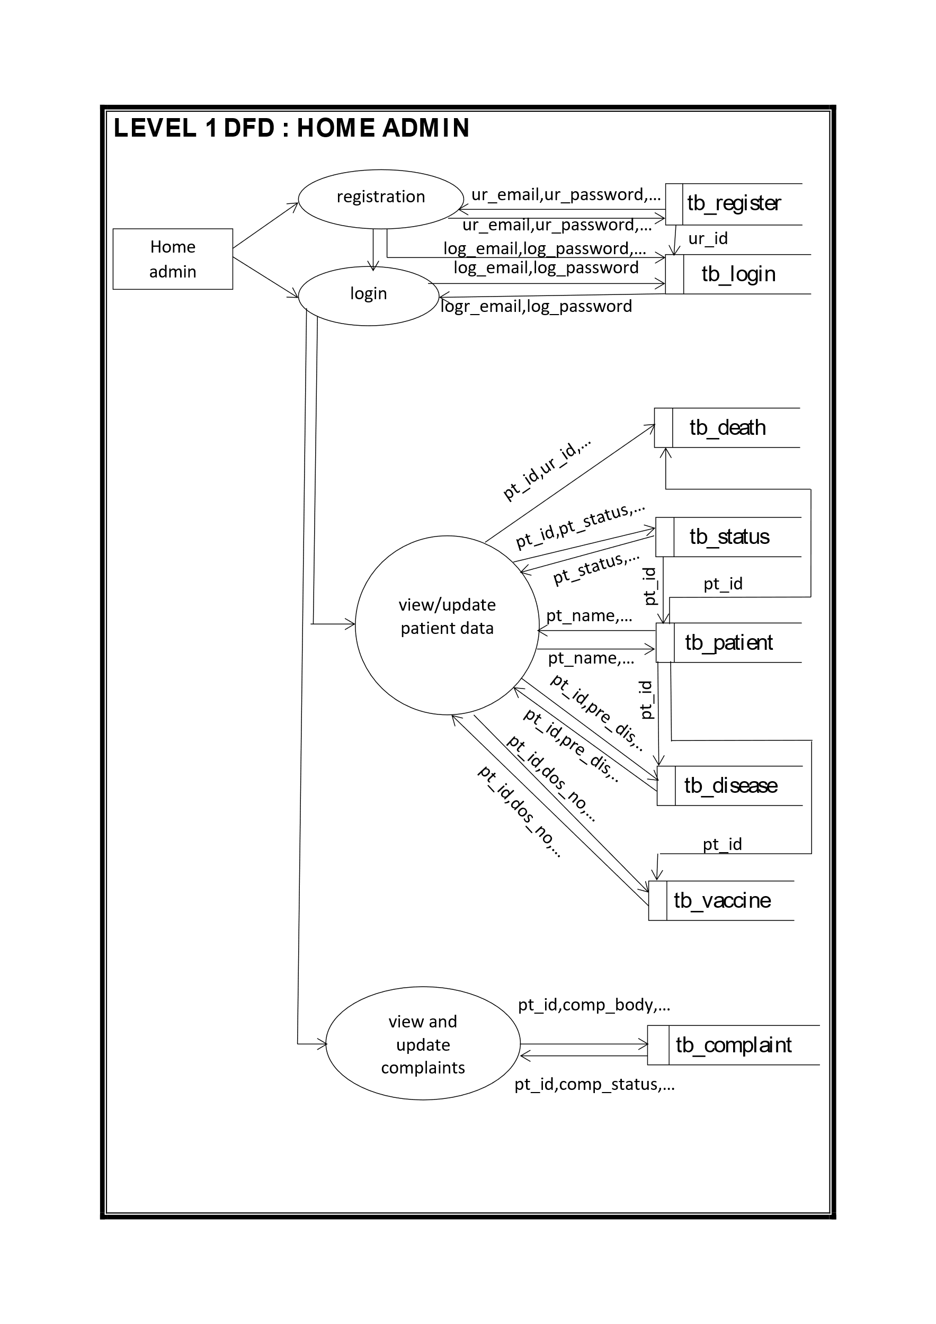
DFD LEVEL 1 : HOME ADMIN

Slide 35
DFD LEVEL 1 : DOMICILE ADMIN
registration
ur_email,ur_password,…
tb_register
ur_email,ur_password,…
log_email,log_password,…
ur_id
DOMICILE ADMIN
log_email,log_password
tb_login
login
log_email,log_password,…
ur_id,cen_name,…
tb_center
view/update domicile data
ur_id,cen_id,…
loc_id
loc_longitude…
tb_location
loc_longitude…
bed_no,bed_type,..
cen_id
update bed
tb_bed
bed_id,bed_type,…
pt_name,pt_age,…
tb_patient
view/update patient
pt_id,pt_status,…
tb_status
pt_id,pt_status,…
pt_id
Pt_id,pre_dis,…
Pt_id,pre_dis,…
tb_disease
Pt_id,ur_id,…
Pt_id,ur_id,…
tb_vaccine
view and update complaints status
Pt_id,comp_id,…
pt_id
tb_complaint
Pt_id,comp_id,…

Slide 36
DFD LEVEL 1 : HOSPITAL ADMIN
registration
ur_email,ur_password,…
tb_register
ur_email,ur_password,…
log_email,log_password,…
ur_id
HOSPITAL ADMIN
log_email,log_password
tb_login
login
log_email,log_password,…
ur_id,cen_name,…
tb_center
view/update hospital data
ur_id,cen_id,…
loc_id
loc_longitude…
tb_location
loc_longitude…
bed_no,bed_type,..
cen_id
update bed
tb_bed
bed_id,bed_type,…
pt_name,pt_age,…
tb_patient
view/update patient
pt_id,pt_status,…
tb_status
pt_id,pt_status,…
pt_id
Pt_id,pre_dis,…
Pt_id,pre_dis,…
tb_disease
Pt_id,ur_id,…
Pt_id,ur_id,…
tb_vaccine
view and update complaints status
Pt_id,comp_id,…
pt_id
tb_complaint
Pt_id,comp_id,…

Slide 37
DFD LEVEL 1 : CFLTC ADMIN
registration
ur_email,ur_password,…
tb_register
ur_email,ur_password,…
log_email,log_password,…
ur_id
CFLTC ADMIN
log_email,log_password
tb_login
login
log_email,log_password,…
ur_id,cen_name,…
tb_center
view/update CFLTC data
ur_id,cen_id,…
loc_id
loc_longitude…
tb_location
loc_longitude…
bed_no,bed_type,..
cen_id
update bed
tb_bed
bed_id,bed_type,…
pt_name,pt_age,…
tb_patient
view/update patient
pt_id,pt_status,…
tb_status
pt_id,pt_status,…
pt_id
Pt_id,pre_dis,…
Pt_id,pre_dis,…
tb_disease
Pt_id,ur_id,…
Pt_id,ur_id,…
tb_vaccine
view and update complaints status
Pt_id,comp_id,…
pt_id
tb_complaint
Pt_id,comp_id,…

Slide 38
DFD LEVEL 1 : CSLTC ADMIN
registration
ur_email,ur_password,…
tb_register
ur_email,ur_password,…
log_email,log_password,…
ur_id
CSLTC ADMIN
log_email,log_password
tb_login
login
log_email,log_password,…
ur_id,cen_name,…
tb_center
view/update CSLTC data
ur_id,cen_id,…
loc_id
loc_longitude…
tb_location
loc_longitude…
bed_no,bed_type,..
cen_id
update bed
tb_bed
bed_id,bed_type,…
pt_name,pt_age,…
tb_patient
view/update patient
pt_id,pt_status,…
tb_status
pt_id,pt_status,…
pt_id
Pt_id,pre_dis,…
Pt_id,pre_dis,…
tb_disease
Pt_id,ur_id,…
Pt_id,ur_id,…
tb_vaccine
view and update complaints status
Pt_id,comp_id,…
pt_id
tb_complaint
Pt_id,comp_id,…

Slide 39
DFD LEVEL 1 : DMO
registration
ur_email,ur_password,…
tb_register
ur_email,ur_password,…
ur_id
log_email,log_password,…
DMO
log_email,log_password
login
tb_login
log_email,log_password,…
tb_doctor
loc_id
cen_id
doc_status
tb_center
cen_id
cen_id,cen_name,…
tb_bed
Search /view
bed_no,bed_type,…
tb_location
loc_id,loc_longitude,…
loc_id
lab_name,lab_place,…
tb_lab
lab_id
test_id,test_cost,,,
tb_tests
pt_id,pt_name,…
vac_id,dos_no,…
tb_patient
pre_dis,post_dis…
tb_vaccine
pt_id
tb_disease
pt_id
View death report problems
pt_id,ur_id,…
tb_death
pt_id
View unsolved complaints
pt_id,ur_id,comp_body,…
tb_complaint
pt_id

Slide 40
DFD LEVEL 1 : USER
registration
ur_email,ur_password,…
tb_register
ur_email,ur_password,…
ur_id
log_email,log_password,…
USER
log_email,log_password
login
tb_login
log_email,log_password,…
tb_doctor
loc_id
cen_id
doc_status
tb_center
cen_id
cen_id,cen_name,…
tb_bed
Search /view
bed_no,bed_type,…
tb_location
loc_id,loc_longitude,…
loc_id
lab_name,lab_place,…
tb_lab
lab_id
test_id,test_cost,,,
tb_tests
pt_id,pt_name,…
vac_id,dos_no,…
tb_patient
pre_dis,post_dis…
tb_vaccine
pt_id
tb_disease
pt_id

