Slide 1
Radial Classifier Functionality
Shabieh Saeed
22 July, 2016

Slide 2
Explanation of Algorithm
We create 2 critical columns called
defect_length= This column tells us the continuous length of a defect along a sector
R-sq= This determines the radial orientation of the defect. Higher R-sq means it is likely to pass through the center of the disc.

Slide 3
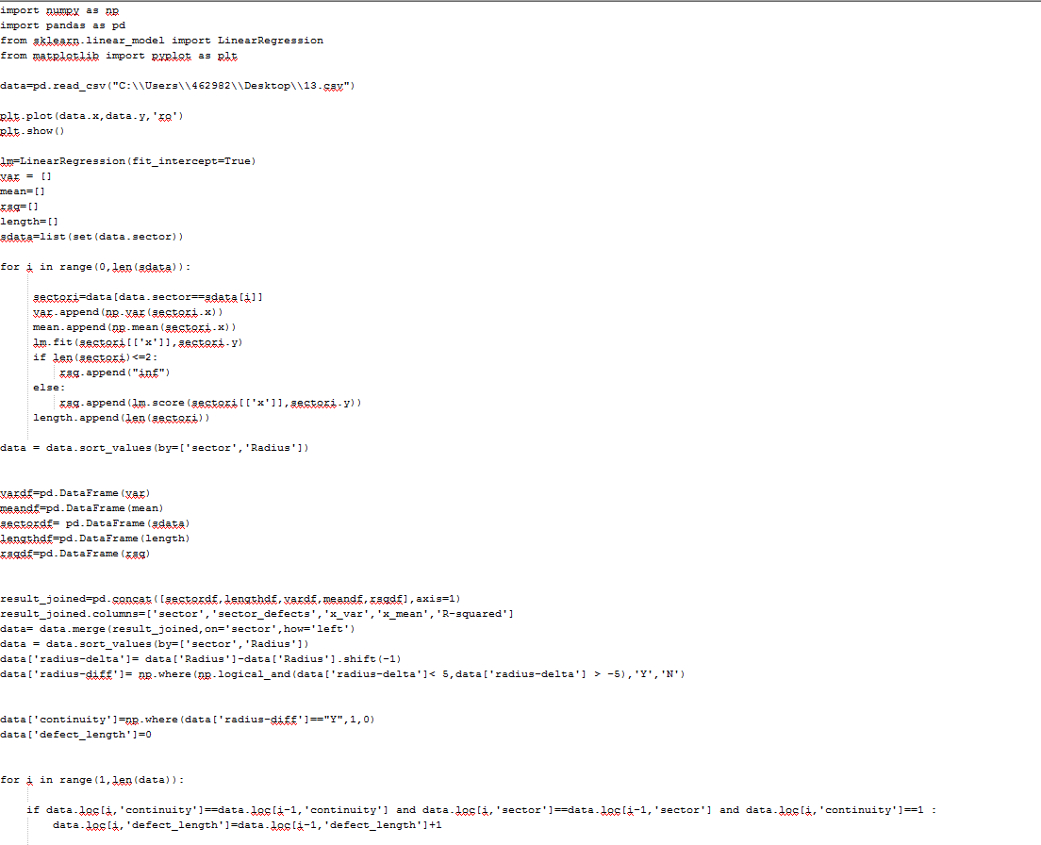
Python Code Snippet
Used:
Sklearn -> machine learning in python
Numpy
Pandas
Matplotlib

Slide 4
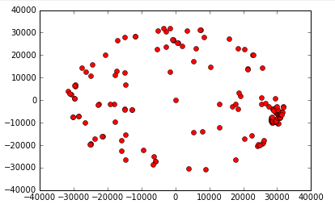
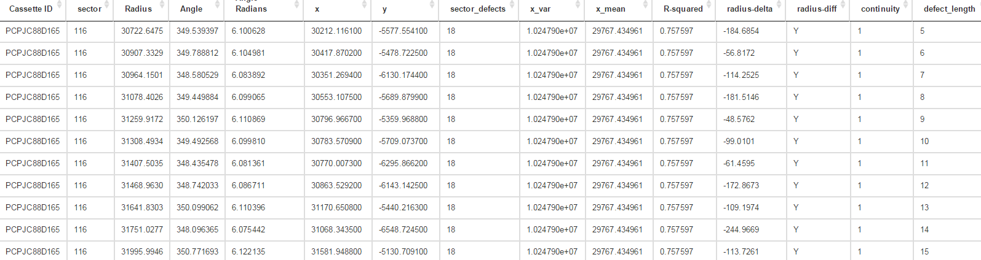
TEST_SET2
Sector
30
60 120
90
Sector 116 identified
Good signal detected in data: high R-sq and long defect length

Slide 5
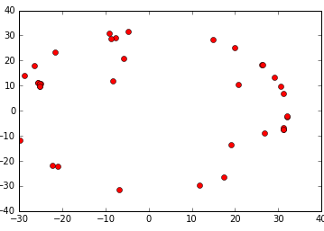
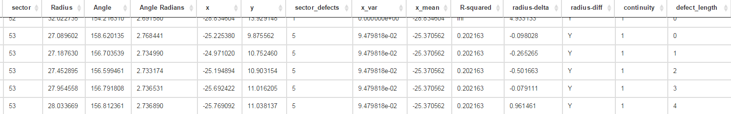
1.csv
Sector
30
60 120
90
No Radial visually detected
No signal detected in data

Slide 6
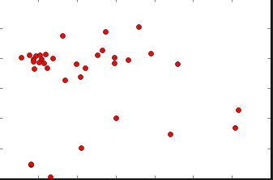
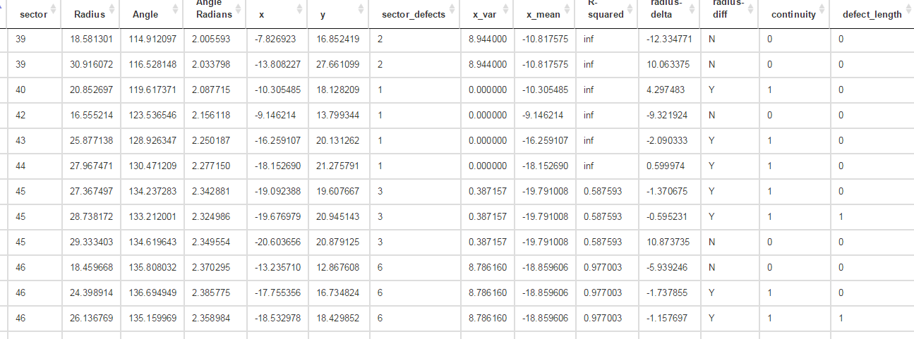
10.csv
Sector
30
60 120
90
No Radial visually detected
PS: Any project help can be forwarded to Dodi
No signal detected in data

Slide 7
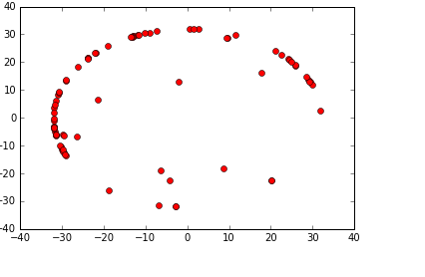
12.csv
Sector
30
60 120
90
No Radial visually detected
No signal detected in data

Slide 8
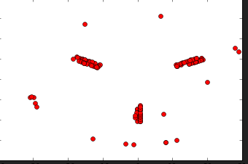
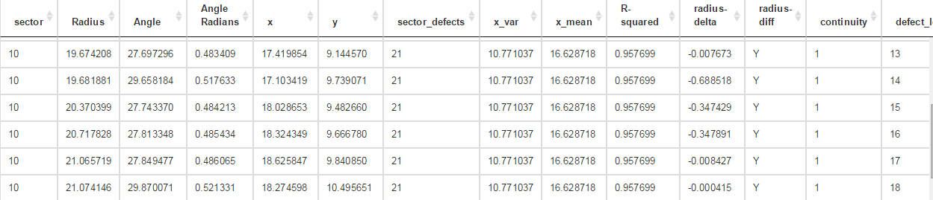
13.csv
Sector
30
60 120
90
3 Radials visually detected
Algorithm does great job of detecting radial defects around Sector 10 and Sector 50. Vertical orientation of sector 90 throws it off, but on sector 30/90 the condition can be relaxed to check only continuity and not R-sq.

Slide 9
CONCLUSION
Excellent algorithm with high precision and fast runtime!
Further tuning available to detect skew by modifying the fitting algorithm.
For tailored analytics services, please contact
Shabieh Machine Learning Solutions (SMLS).
shabieh2@gmail.com

