Slide 1
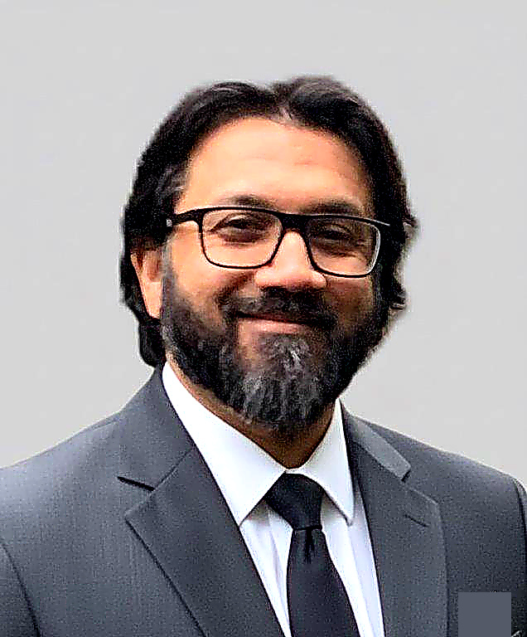
AVAILABLE · MIDDLE EAST & NORTH AMERICA
Driving Digital
Transformation
[ Photo ]
Through AI, Data & Enterprise Systems
Shabih Hasnain
Sr. Manager · Digital Transformation & AI Enablement
shabih@cuttingedgeai.tech · cuttingedgeai.tech · calendly.com/shabih-hasnain
23+
$30B+
120+
5
600+
Years Experience
Programs Supported
Projects Delivered
Countries Worked
Users Trained

Slide 2
── EXECUTIVE SUMMARY
Who I Am & What I Deliver
Shabih Hasnain is a seasoned Digital Transformation & AI Enablement Leader with 23+ years of proven impact across construction, energy, aviation, and public infrastructure. Currently serving as Sr. Manager of Digital Transformation at El-Seif Engineering & Contracting in Saudi Arabia, he leads enterprise-wide AI adoption, intelligent automation, and data modernization — delivering measurable results including hundreds of hours per month recovered through automation.
KEY FIGURES
23+
Yrs Exp
$30B+
🤖 AI Enablement
⚡ Digital Transformation
📊 Business Intelligence
Programs
Claude, Copilot, n8n, Emergent, Lovable
Governance, BPO, Change Management
Power BI, Tableau, SQL, Denodo
6TB
Data Migrated
98%
☁️ Oracle & Cloud
📐 Project Controls
🏛️ PMO & Governance
Query Reduction
Unifier, PCM, Contract Mgmt, APIs
P6, EVM, Cost Control, Reporting
Portfolio Mgmt, Frameworks, Agile
35%
Adoption Increase
600+
Users Trained

Slide 3
── CAREER JOURNEY
23 Years of Impact
2023–Present
El-Seif Engineering & Contracting
EDUCATION & CREDENTIALS
Sr. Manager, Digital Transformation · Saudi Arabia
InEight rollout · REST API integration · AI automation suite · Digital Governance Framework
🎓
Masters in Project Management
2020–2023
Metrolinx / Comtech
2007
Migration Lead / Integration Manager · Toronto, Canada
6TB Oracle migration · 120+ projects · Power BI rollout · P6+ECOSYS integration
💻
Bachelor of Computer Engineering
2019–2020
Trans Alta
2002
BI Developer · Calgary, Canada
98% Denodo query optimisation · 5 executive dashboards · COVID capacity dashboard
2016–2018
Cenovus Energy
🏆
PMP — PMI Certified
Sr. Business Analyst — SCMT · Calgary, Canada
Valid 2021–2027
Oracle CM implementation · 8-feed Maximo integration · Weeks → 2-3hr reconciliation
2009–2011
PARSONS International
⚙️
ARES PRISM Administration
Program Controls Systems Manager · Abu Dhabi, UAE
$10B+ Airport Expansion · ARES-PRISM · 60-80 hrs/month reporting savings
2010
2007–2009
ALDAR Laing O'Rourke
Project Controls Manager · Abu Dhabi, UAE
📋
Primavera CM Training
$20B Al Raha Beach · Largest PCM deployment in region · 1,000 active users
CMCS · 2006
2002–2006
PROJACS International
Project Controls Engineer · Abu Dhabi & Dubai, UAE
$850M Shuweihat WTS (6 months vs 2-yr plan) · Palm Jumeirah Tunnel

Slide 4
DIGITAL TRANSFORMATION
InEight Platform — Company-Wide Rollout
El-Seif Engineering & Contracting · Saudi Arabia · 2023–Present
End-to-end implementation of InEight Project Management with a live two-way REST API integration with ACONEX, scaling to 80+ active users and permanently eliminating 80–100 hours per week of manual document entry.
80–100h
Per week recovered
⚠ CHALLENGE
✦ SOLUTION
80+
35 document controllers manually re-entering data between ACONEX and InEight — 80–100 hrs/week lost, high error risk, unscalable.
Engineered a live bidirectional REST API integration. Designed phased project-by-project adoption strategy. Built automated executive dashboards. Created Digital Governance Framework.
Active users
35
TECHNOLOGY
Controllers freed
InEight PM
REST API
ACONEX
Power BI
SharePoint
Claude
Copilot
0
Manual transfers
cuttingedgeai.tech · shabih@cuttingedgeai.tech

Slide 5
AI ENABLEMENT
Enterprise AI Workflow Automation Suite
El-Seif Engineering & Contracting · Saudi Arabia · 2023–Present
Deployed a suite of intelligent automation workflows using Claude, Microsoft Copilot, n8n, Emergent, and Lovable — eliminating hundreds of hours of manual work per month across all departments.
100s hrs
Saved monthly
⚠ CHALLENGE
✦ SOLUTION
35%
Teams spending hundreds of hours monthly on report compilation, data re-entry, document formatting — consuming skilled professionals and slowing decisions.
Identified high-impact workflows. Built executive dashboard automation. Deployed n8n workflows. Implemented Claude & Copilot across all departments. Created custom AI apps via Lovable & Emergent. Ran data literacy program.
Self-service adoption
5
TECHNOLOGY
AI platforms deployed
Claude
MS Copilot
n8n
Emergent
Lovable
Power BI
Power Automate
All Depts
AI adoption
cuttingedgeai.tech · shabih@cuttingedgeai.tech

Slide 6
DIGITAL TRANSFORMATION
PowerApps Site Inspection Digitization
El-Seif Engineering & Contracting · Saudi Arabia · 2023–Present
Replaced entirely paper-based SOR and site inspection workflows with a custom PowerApps solution on iPads — enabling real-time photo uploads and recovering 4–5 hours per engineer per week.
4–5h
Per engineer saved/week
⚠ CHALLENGE
✦ SOLUTION
Zero
Site engineers spending 4–5 hrs/week on paper forms, manual photo printing, and data re-entry. No real-time visibility. Data often incomplete or delayed by days.
Built custom PowerApps with native camera integration and form validation. Connected to SharePoint central database. Configured Power Automate notifications. Deployed on iPads with on-site training.
Paper forms remaining
100%
TECHNOLOGY
Data completeness
PowerApps
SharePoint
Power Automate
iPad/Tablet
Microsoft 365
Real-time
Central database
cuttingedgeai.tech · shabih@cuttingedgeai.tech

Slide 7
DATA MIGRATION · PROJECT CONTROLS
Oracle PCM → Unifier Migration (Metrolinx)
Metrolinx / Comtech · Toronto, Canada · 2020–2023
End-to-end migration of 120+ live projects and ~6TB of contract data from Oracle PCM to Oracle Unifier — delivered on time, within budget, and 2–3 months ahead of schedule through SQL-driven efficiency discovery.
120+
Projects migrated
⚠ CHALLENGE
✦ SOLUTION
~6 TB
120+ active projects with no freeze window. Fundamentally different PCM and Unifier data structures. Zero tolerance for data errors on publicly-funded transit programs.
Full data inventory & SQL workflow analysis (saved 250–300 hrs). ETL pipeline design. Phased migration with live continuity. Tableau & Power BI rollout to 200+ users. P6+ECOSYS integration.
Data migrated
2–3 Months
TECHNOLOGY
Ahead of schedule
Oracle Unifier
Oracle PCM
SQL
Power BI
Tableau
Primavera P6
ECOSYS
200+
BI users onboarded
cuttingedgeai.tech · shabih@cuttingedgeai.tech

Slide 8
BUSINESS INTELLIGENCE
98% Query Reduction — Denodo BI (Trans Alta)
Trans Alta Corporation · Calgary, Canada · 2019–2020
Transformed Trans Alta's BI infrastructure by rebuilding Denodo virtual data models and VQL — cutting critical query execution from 40–50 minutes to 30–40 seconds, enabling near-real-time C-suite decision-making.
98%+
Query time reduction
⚠ CHALLENGE
✦ SOLUTION
40–50 min
Critical reports taking 40–50 minutes to run. C-suite confidence in BI eroding. Denodo models built without performance optimisation across multiple source systems.
Full query performance diagnostic. Denodo VQL model reconstruction with push-down optimisation. Intelligent caching configuration. Role-based security & data masking. 5 executive Power BI dashboards.
Previous execution
30–40 sec
TECHNOLOGY
New execution
Denodo VQL
Power BI
SQL
REST APIs
Cloud Data Sources
RBAC & Masking
5
Executive dashboards
cuttingedgeai.tech · shabih@cuttingedgeai.tech

Slide 9
PROJECT CONTROLS · AVIATION
$10B+ Abu Dhabi Airport Expansion
PARSONS International · Abu Dhabi, UAE · 2009–2011
Supported a 150–200 person program management team on one of the Gulf's largest aviation infrastructure programs — implementing ARES-PRISM systems that replaced entirely manual reporting and saved 60–80 hours per month.
$10B+
Program value
⚠ CHALLENGE
✦ SOLUTION
200
150–200 professionals compiling monthly executive reports entirely by hand. Dozens of hours lost every month on a decade-long, publicly critical aviation megaprogram.
Implemented ARES-PRISM & PRISM G2 for full program controls. Configured monthly actuals & commitment imports. Maintained P6 schedule integration. Automated executive reporting cycle.
Professionals supported
60–80h
TECHNOLOGY
Saved per month
ARES-PRISM
PRISM G2
Primavera P6
EVM
Contracts & Variations
10+ yrs
Program duration
cuttingedgeai.tech · shabih@cuttingedgeai.tech

Slide 10
PROJECT CONTROLS · REAL ESTATE
$20B+ Al Raha Beach Development
ALDAR Laing O'Rourke JV · Abu Dhabi, UAE · 2007–2009
Led the Primavera Contract Manager rollout across one of the Middle East's largest real estate programs — training 500–600 users and supporting 1,000 simultaneous active platform users.
$20B+
Program value
⚠ CHALLENGE
✦ SOLUTION
1,000
Rolling out PCM to 1,000 users across a $20B program from diverse backgrounds — contractors, engineers, document controllers, commercial managers — in a compressed timeframe.
PCM platform configuration aligned to ALDAR LOR workflows. Role-based training for 500–600 users over 12 months. ACONEX integration managed. Monthly executive dashboards aggregating PCM, ACONEX & P6.
Active platform users
600
TECHNOLOGY
Users trained
Primavera PCM
ACONEX
Primavera P6
Executive Dashboards
3 Systems
Consolidated in dashboards
cuttingedgeai.tech · shabih@cuttingedgeai.tech

Slide 11
BUSINESS INTELLIGENCE · OIL & GAS
Oracle Contracts + Maximo 8-Feed Integration
Cenovus Energy · Calgary, Canada · 2016–2018
Designed and implemented Oracle Contract Management across all Cenovus oil sands projects, and architected an 8-feed Maximo integration — reducing monthly reconciliation from weeks to 2–3 hours.
40–50h
Per week saved
⚠ CHALLENGE
✦ SOLUTION
8 Feeds
Cost Engineers spending 40–50 hrs/week on manual Access/Excel extraction. Monthly Maximo reconciliation taking several weeks with frequent discrepancies.
Oracle CM implementation across all oil sands projects. 8-feed bidirectional Maximo integration (AFEs, Contracts, POs, Vouchers, Receipts, Invoices, Actuals, Commitments). Oracle BI reporting & Publisher templates.
Integration feeds built
Weeks→2h
TECHNOLOGY
Monthly reconciliation
Oracle Contract Mgmt
IBM Maximo
Oracle BI
Oracle BI Publisher
SQL
100%
Reconciliation automated
cuttingedgeai.tech · shabih@cuttingedgeai.tech

Slide 12
PROJECT CONTROLS · WATER INFRASTRUCTURE
$850M Shuweihat Water Transmission Scheme
PROJACS International · Abu Dhabi, UAE · 2002–2006
Delivered the Primavera Expedition implementation for Abu Dhabi's critical $850M water infrastructure program — going live in 6 months against a 2-year planned timeline. The project that started a 23-year career.
$850M
Program value
⚠ CHALLENGE
✦ SOLUTION
6 Months
Implementing Primavera Expedition across 4 geographically distributed UAE sites before cloud deployment existed. 2-year plan allocated — team had no precedent for compressing this timeline.
Requirements analysis & full system configuration. Citrix-based multi-site deployment architecture. 6-month go-live (75% timeline compression). Structured training for 60 users across 4 sites.
Go-live vs 2-year plan
75%
TECHNOLOGY
Timeline compressed
Primavera Expedition
Citrix Remote Access
Cost-Loaded Scheduling
Contract Management
60
Users across 4 sites
cuttingedgeai.tech · shabih@cuttingedgeai.tech

Slide 13
PROJECT CONTROLS · ICONIC INFRASTRUCTURE
Palm Jumeirah Vehicular Tunnel
PROJACS International · Dubai, UAE · 2002–2006
Supported project controls on one of the world's most iconic construction programs — managing schedule updates, resource loading, and cost-loaded baseline tracking on a subaqueous tunnel beneath the Arabian Gulf.
Iconic
World-famous project
⚠ CHALLENGE
✦ SOLUTION
Subaqueous
Subaqueous tunnel construction with zero sequencing margin. High-profile pressure with dozens of contractor interfaces. Managed concurrently with the Shuweihat implementation.
Regular schedule update cycles incorporating contractor progress. Resource & cost tracking in Primavera Expedition. Progress reporting & variance analysis. Full application stewardship.
Tunnel beneath Arabian Gulf
Concurrent
TECHNOLOGY
With Shuweihat implementation
Primavera Expedition
Cost-Loaded Scheduling
EVM
Resource Tracking
23 yrs
Career built from here
cuttingedgeai.tech · shabih@cuttingedgeai.tech

Slide 14
── LET'S BUILD SOMETHING TRANSFORMATIVE
Ready to drive your
Digital Transformation?
Available for executive leadership roles and consulting engagements across the Middle East & North America.
🌐 Website
📧 Email
📅 Calendly
💼 LinkedIn
cuttingedgeai.tech
shabih@cuttingedgeai.tech
calendly.com/shabih-hasnain
linkedin.com/in/shabih
AVAILABLE FOR:
Executive Leadership
Digital Transformation
AI Strategy
Oracle / PMO
Training & Enablement
ME & NA Markets
Shabih Hasnain · Sr. Manager, Digital Transformation & AI Enablement · cuttingedgeai.tech

