Slide 1
E-Commerce Data Analysis using SQL
SQL-First Analytics Project with Pandas Visualizations

Slide 2
Project Objective
To analyse an e-commerce dataset using SQL as the primary analysis tool
To design a normalized relational database from raw transactional data
To answer real business questions related to revenue, customers, products, and geography
To support SQL insights with lightweight Python visualizations

Slide 3
Dataset Overview
Dataset represents online retail transactions
Each record corresponds to a single product purchase
Data includes:
  Customer details
  Product and category information
  Order date and payment method
  Quantity, price, and review score
Dataset was cleaned and prepared before analysis

Slide 4
Data Modeling Approach
Raw transactional data was first stored in a staging table
Data was then transformed into a normalized relational schema
Separate tables were created for:
  Customers
  Orders
  Order Items
  Products
  Categories
  Reviews
This design ensures:
  Reduced data redundancy
  Clear relationships between entities
  Accurate analytical queries

Slide 5
Tools & Technologies
Python (Pandas)
  Initial data loading and inspection
  Data cleaning and preprocessing
  Handling missing values and date formatting
  Early exploratory visualizations
MySQL
  Relational database design and normalization
  Creation of fact and dimension tables
  Core analytical SQL queries to answer business questions
Seaborn & Matplotlib
  Simple visualizations to understand data distribution and trends

Slide 6
Business Questions Addressed
What is the total revenue generated by the business?
How does revenue change over time (monthly trend)?
What is the average order value?
Which products and categories generate the most revenue?
Who are the highest-value customers?
Which cities contribute most to total revenue?
Do customers make repeat purchases or buy only once?

Slide 7
Key SQL Insights – Revenue & Products
Calculated using order quantity and product price across all transactions.
Total Revenue:
Calculated using order quantity and product price across all transactions.
Monthly Revenue Trend:
Revenue shows variation across months, indicating possible seasonality in customer purchases.
Top Products by Revenue:
High-volume, low-cost products contribute more to total revenue than high-priced items.
Revenue by Category:
Certain product categories dominate revenue contribution, highlighting key business focus areas.

Slide 8
Key SQL Insights – Customers & Behaviour
Top Customers by Revenue:
A small group of customers contributes a significant share of total revenue.
City-wise Revenue Performance:
Revenue contribution varies significantly across cities, suggesting opportunities for location-based strategies.
Repeat vs One-time Customers:
All customers in the dataset placed only a single order, indicating no repeat purchases in the available data.
Customer Retention Insight:
Although the dataset does not contain repeat buyers, the SQL logic supports churn and retention analysis for real-world scenarios.

Slide 9
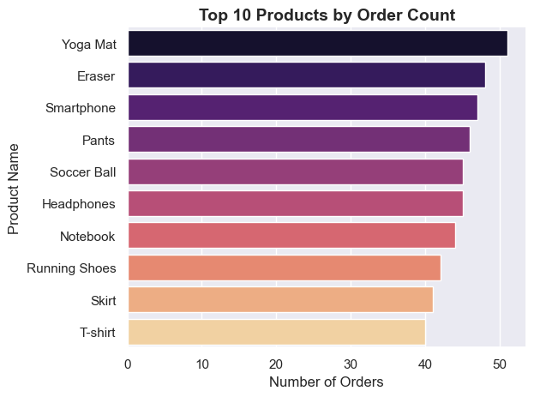
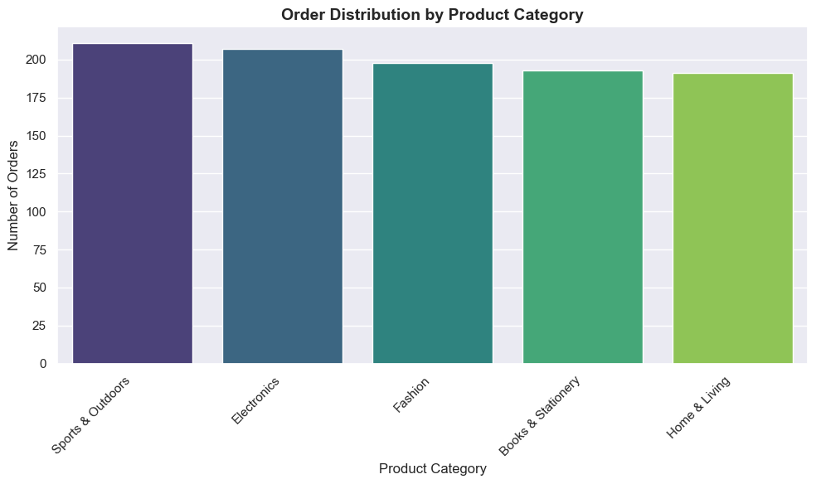
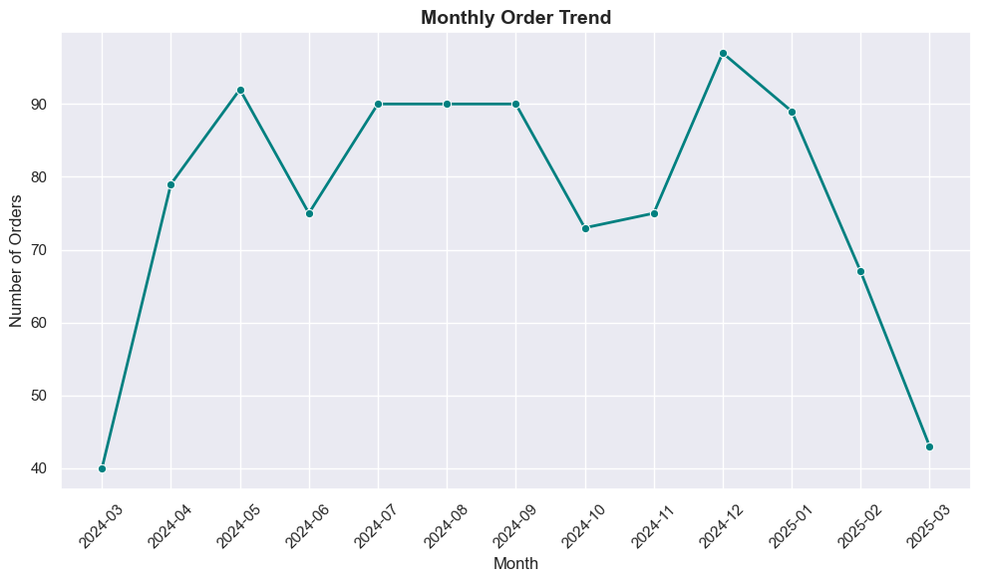
Exploratory Visualizations

Slide 10
Conclusion & Project Scope
Conclusion
  Built a normalized relational database from raw e-commerce transactional data.
  Performed end-to-end analysis using SQL to answer key business questions.
  Identified revenue concentration across products, categories, customers, and cities.
  Observed that all customers in the dataset were one-time buyers.
Project Scope & Limitations
  Analysis was performed on a synthetic dataset with limited customer repetition.
  Insights reflect transactional behaviour within the available data only.
  Focus of the project was SQL-based analytics rather than predictive modeling or dashboards.

Slide 11
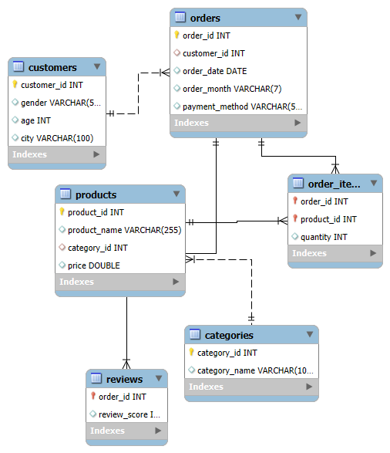
Entity Relationship Diagram (ERD)
Normalized schema designed to separate customers, orders, products, and transactional data.

Slide 12
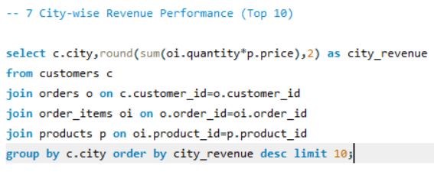
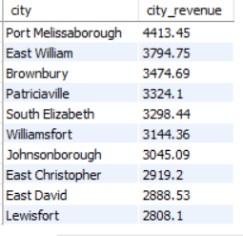
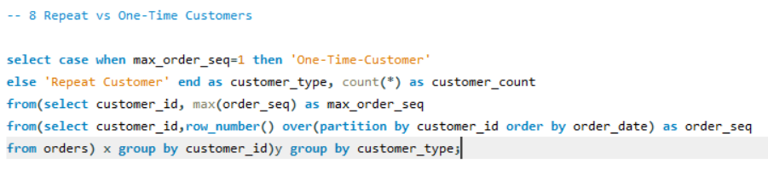

Sample SQL Queries & Results

