Slide 1

CAPSTONE PROJECT · 2026
BrickView
Real Estate Analytics Platform
Developed by Shabitha Sree S
Python
Streamlit
MySQL
Pandas
Plotly
GitHub
github.com/shabithasree3-creator/BrickView-Real-Estate-Analytics
Notes:
Good morning/afternoon. I'm Shabitha Sree, and today I'll be presenting my capstone project, BrickView — a Real Estate Analytics Platform. This project brings together Python, Streamlit, MySQL, Pandas and Plotly to turn raw real-estate data into an interactive, decision-ready dashboard. Over the next few minutes I'll walk through the problem I set out to solve, how the system is designed, the database behind it, the features I built, the insights it surfaces, and what I learned along the way.

Slide 2


THE CHALLENGE
Problem Statement
Real estate data is large — making it hard to spot pricing trends, demand patterns, and business opportunities in time to act.
No Easy Filtering
No Visual Insight
Hard to search properties by city, type, price range or amenities
Raw tables don't reveal trends — decisions need visuals, not rows
BrickView solves this by consolidating data into a structured MySQL database and delivering it through an interactive analytics dashboard.
Problem Statement
2
Notes:
Real estate generates huge volumes of data — listings, agent records, buyer activity, sales history — but it's usually scattered across spreadsheets, inconsistent in format, and full of duplicates or missing values. That makes it very hard for anyone to quickly filter properties or spot pricing and demand trends. Raw tables alone don't tell a story. BrickView was built to solve exactly this: bring the data into one structured database and present it through an interactive dashboard so patterns become obvious at a glance.

Slide 3







PROJECT GOALS
Centralize Data
Objectives
Consolidate listings, agents, buyers & sales into one MySQL database
Automate Cleaning
Use Python & Pandas to clean and standardize raw datasets
Enable Exploration
Let users filter & search properties by city, type and price
BrickView
Goals
Visualize Trends
Turn data into interactive Plotly charts and dashboards
Drive Insight
Surface business insights for smarter real-estate decisions
Support CRUD
Allow create, read, update & delete on real estate records
Objectives
3
Notes:
The project has six core objectives, all centered around one goal: turning raw real estate data into actionable insight. First, centralize all the data — listings, agents, buyers and sales — into one MySQL database. Second, automate data cleaning using Python and Pandas. Third, let users explore the data through filters. Fourth, visualize trends with Plotly. Fifth, support full CRUD operations so the data stays live and editable. And finally, surface business insights that help real-estate decision-makers act with confidence.

Slide 4








TOOLS & FRAMEWORKS
Technology Stack
Python
Streamlit
MySQL
Pandas
Core Language
Web Dashboard
Database
Data Wrangling
Full-Stack
Data Workflow
Plotly
Git
GitHub
Visualization
Version Control
Code Hosting
Technology Stack
BrickView
4
Notes:
BrickView is built on a focused, modern data stack. Python is the core language tying everything together. Streamlit powers the interactive web dashboard with minimal front-end code. MySQL stores and organizes all structured real-estate data. Pandas handles data cleaning and transformation. Plotly generates the interactive charts. And Git and GitHub manage version control and host the project's source code for collaboration and deployment.

Slide 5





HOW IT WORKS
System Architecture
Dataset
Data Cleaning
MySQL Database
Python Backend
Raw real-estate records
Python & Pandas processing
Structured, relational storage
Business logic & queries
Streamlit Dashboard
User
Business Insights
Interactive web interface
Evaluator / business user
Data-driven decisions
Data flows from raw files through cleaning and structured storage into a live dashboard that turns numbers into decisions.
System Architecture
BrickView
5
Notes:
Here's how data moves through BrickView end to end. It starts with the raw dataset, which goes through a data cleaning stage using Python and Pandas to fix missing values and inconsistencies. The cleaned data is loaded into a MySQL database for structured, relational storage. A Python backend then queries that database and applies the business logic. That logic feeds the Streamlit dashboard, which the user interacts with directly. Finally, that interaction — filtering, exploring, visualizing — produces real business insights for real-estate decision-making.

Slide 6
DATA MODEL
Database Design
Buyers
Property Attributes
PK buyer_id,
FK sale_id,
buyer_type,
payment_mode,
loan_taken, loan_provider, loan_amount
PK attribute_id,
FK listing_id, bedrooms, bathrooms, floor_number, total_floors, year_built, is_rented, tenant_count, furnishing_status, metro_distance_km, parking_available, power_backup
Listings
PK Listing_id,
City, Property_type,
Price, Sqft,
Date_listed,
Agent_ID,
Latitude, Longitude
Agents
Sales
PK Agent_ID,
Name, Phone, Email, commission_rate,
deals_closed, rating, experience_years,
avg_closing_days
PK sale_id,
FK listing_id,
sale_price,
date_sold, days_on_market
Listings is the central entity — linked to property details, the responsible agent, and completed sales.
Database Design
BrickView
6
Notes:
The database is structured around five relational tables. Listings sits at the center, holding core property records and linking out via foreign keys. Each listing has one set of Property Attributes — bedrooms, area, type and amenities. Every listing is managed by an Agent, a many-to-one relationship since one agent can handle many listings. When a property sells, that's recorded in the Sales table, linked to both the Listing and the Buyer who purchased it. This normalized design keeps data consistent and makes SQL joins straightforward when querying insights.

Slide 7

INSIDE THE APP
Application Features
Home Dashboard
Filters
Visualizations
CRUD Operations
SQL Queries
At-a-glance KPIs & market overview
Search by city, price, type & more
Interactive Plotly charts & trends
Add, update & remove property records
Run live queries directly on MySQL
Application Features
BrickView
7
Notes:
The application is organized into five key areas. The Home Dashboard gives an instant overview of market KPIs. Filters let users narrow properties by city, price range, and type. The Visualizations page turns that filtered data into interactive Plotly charts. CRUD Operations let users add, edit, or delete listings directly from the interface. And the SQL Queries panel lets a technical user run live queries against the MySQL database. In the actual demo, I'll show a live screenshot or walkthrough for each of these.

Slide 8
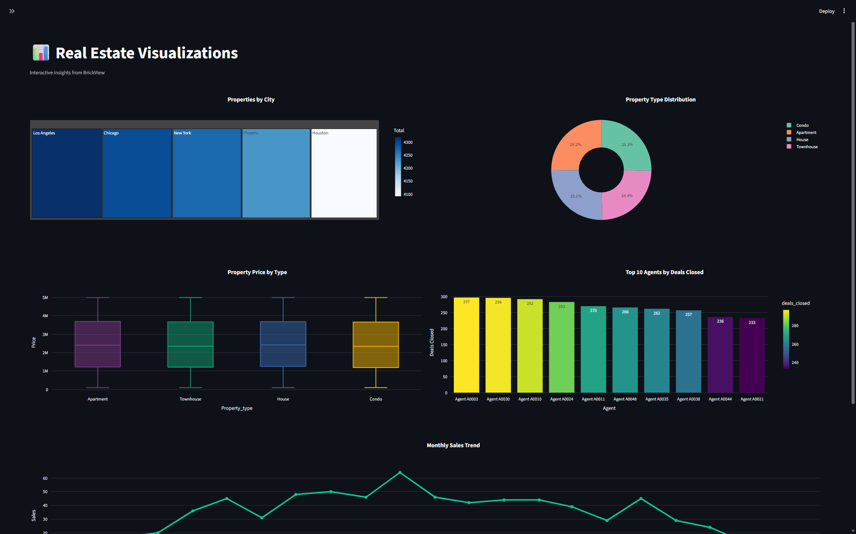
SAMPLE ANALYTICS
Data Visualizations
Data Visualizations & Insights
BrickView
8
Notes:
These are sample visualizations generated from the platform. On the top left, average property price by city highlights Mumbai and Bengaluru as the highest-value markets. Top right shows the mix of property types — apartments dominate at roughly half of all listings. Bottom left tracks monthly sales volume, showing a clear upward trend through the middle of the year. Bottom right ranks top-performing agents by closed sales. All of these charts are generated live in the Streamlit dashboard using Plotly, driven directly by the underlying MySQL data.

Slide 9



THE JOURNEY
Challenges & Learning Outcomes
CHALLENGES
LEARNING OUTCOMES
Database integration across app & MySQL
Stronger Python programming fluency
Writing correct multi-table SQL joins
Practical SQL query writing skills
Implementing reliable CRUD operations
Relational database management
Structuring smooth Streamlit navigation
End-to-end dashboard development
Designing clear, meaningful visualizations
Version control with Git & GitHub
Challenges & Learning Outcomes
BrickView
10
Notes:
Building BrickView wasn't without its challenges. Integrating the Streamlit app cleanly with MySQL took iteration, especially getting multi-table SQL joins right across listings, agents and sales. Implementing full CRUD operations safely, and structuring smooth navigation in Streamlit, also took real problem-solving — as did designing visualizations that were genuinely informative rather than just decorative. In return, this project strengthened my Python programming, gave me hands-on SQL and database management experience, taught me end-to-end dashboard development, and built my confidence with Git and GitHub for version control.

Slide 10

WRAPPING UP
Conclusion
BrickView successfully delivers a complete, data-driven real estate analytics experience:
Interactive Dashboard
Property Analytics
CRUD Operations
SQL Analytics
Real-time Data Exploration
Together, these components turn scattered real estate data into a single platform for exploration, management, and business insight.
Conclusion
BrickView
11
Notes:
To summarize, BrickView successfully delivers on every objective I set out with: an interactive dashboard, rich property analytics, full CRUD operations for managing records, SQL-powered analytics, and real-time data exploration. Together, these pieces turn what used to be scattered spreadsheets into one coherent platform — one that supports both day-to-day property management and higher-level business decision-making.

Slide 11
Thank You
BrickView – Real Estate Analytics Platform
Shabitha Sree S
github.com/shabithasree3-creator/BrickView-Real-Estate-Analytics
Questions & Discussion Welcome
Notes:
Thank you for your time and attention. That brings me to the end of my presentation on BrickView — a Real Estate Analytics Platform built with Python, Streamlit, MySQL, Pandas and Plotly. I'm happy to answer any questions, walk through the live dashboard, or dive deeper into any part of the architecture or database design.

