Slide 1
Fake news detection using nlp

Slide 2
Introduction:
The fake news has been rapidly increasing in numbers. It is not a new problem but recently it has been on a great rise. According to Wikipedia Fake news is false or misleading information presented as news.[1] Detecting the fake news has been a challenging and a complex task. It is observed that humans have a tendency to believe the misleading information which makes the spreading of fake news even easier. According to reports it is found that human ability to detect deception without special assistance is only 54%. Fake news is dangerous as it can deceive people easily and create a state of confusion among a community. This can further affect the society badly .The spread of fake news creates rumors circulating around and the victims could be badly impacted. Recent reports showed that due to the rise of fake news that was being created online it had impacted the US Presidential Elections. Fake news might be created by people or groups who are acting in their own interests or those of third parties. The creation of misinformation is usually motivated by personal, political, or economic agendas. Since a lot of time is spent by users on social media and people prefer online means of information it has become difficult to know about the authenticity of the news. People acquire most of the information by these means as it is free and can be accessed from anywhere irrespective of place and time. Since this data can be put out by anyone there is lack of accountability in it which makes it less trustable unlike the traditional methods of gaining information like newspaper or some trusted source. In this paper, we deal with such fake news detection issue. We have used the techniques of NLP and ML to build the model .We have also compared text vectorization methods and obtained the one which gives a better output.

Slide 3
Fake News Detection using NLP techniques:
Fake news detection is a most important topic in the field of natural language processing. In this article, we are using this dataset for news classification using NLP techniques. We are given two input files. One with real news and the other one with fake news. Let us dig further into the given data.

Slide 4
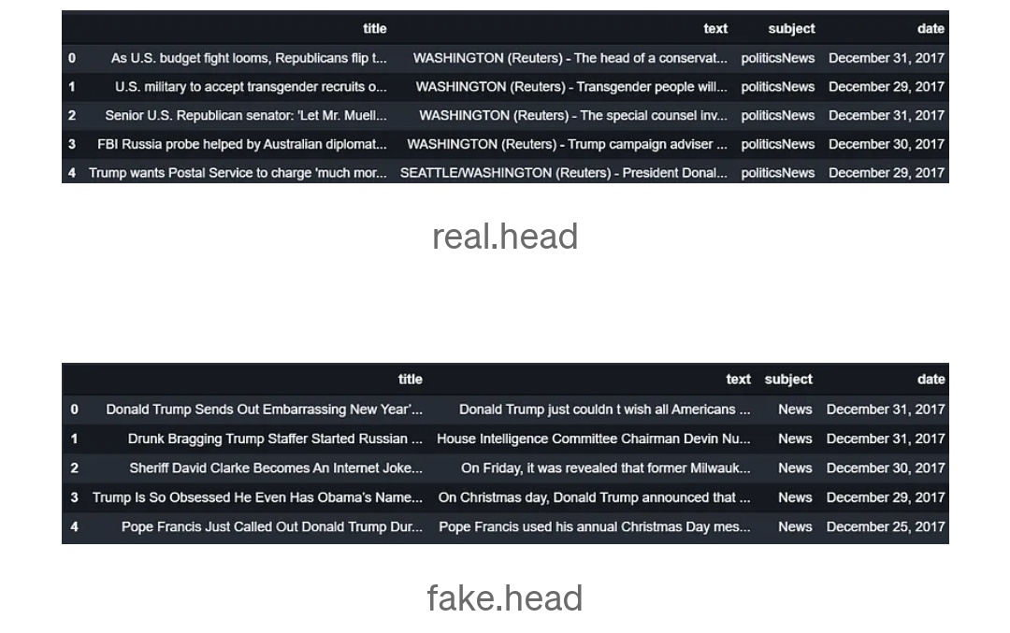

Slide 5
Our job is to create a model which predicts whether a given news is real or fake. As this is a supervised learning problem, we are creating a target column named ‘label’ in both real and fake news data and concatenating them.
Real[‘label’] = 1 fake[‘label’] = 0 data = pd.concat([real, fake])

Slide 6
Now we have the input where real news has the value of label as 1 and fake news have the value of label as 0. We have to check whether our data is balanced. We use seaborn library to plot the counts of real and fake news.
Import seaborn as sns sns.set_style(“darkgrid”) sns.countplot(data[‘label’]);

Slide 7
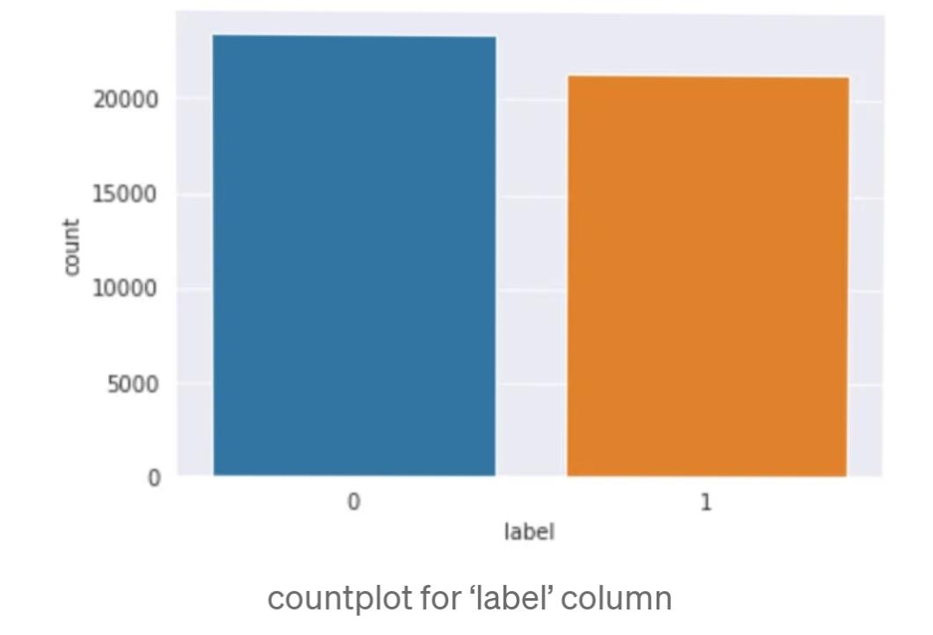

Slide 8
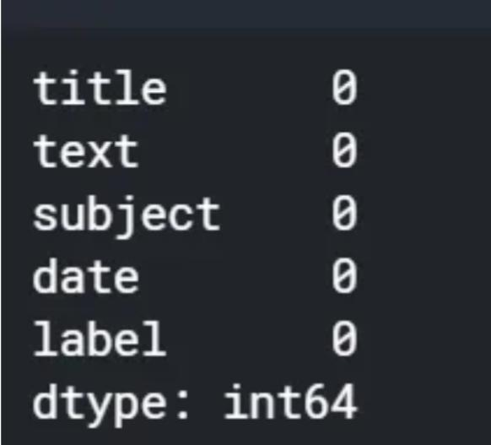
data.isnull().sum()

Slide 9
Luckily, we have no null values. Then, we look at all the columns in the data. There are 5 columns in the data- title, text, subject, date and label. Let us examine the subjects.
Import matplotlib.pyplot as plt data[‘subject’].value_counts() plt.figure(figsize = (10,10)) sns.set_style(“darkgrid”) sns.countplot(data[‘subject’]);

Slide 10
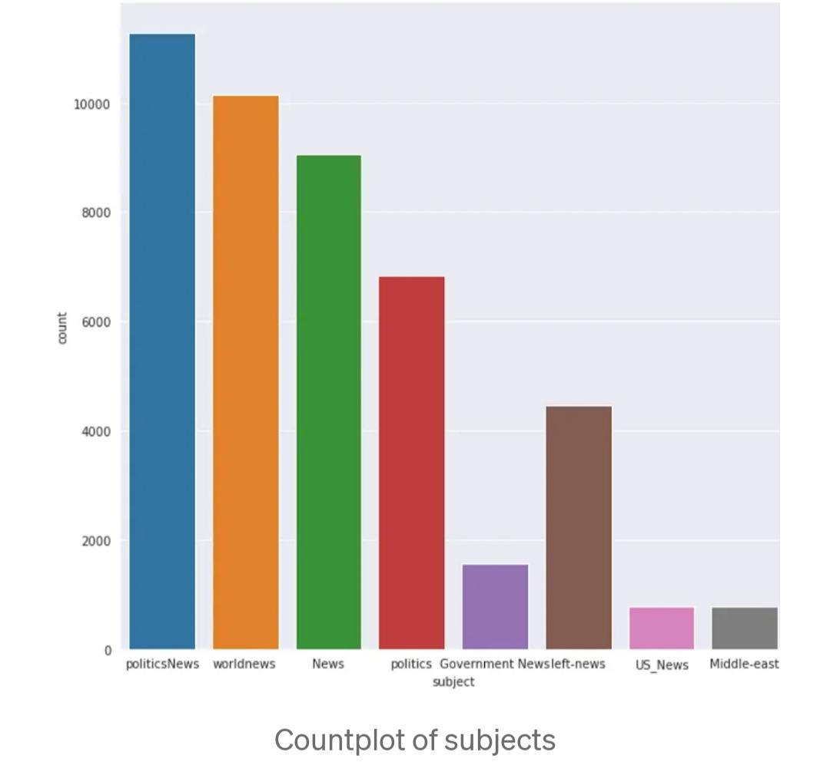

Slide 11
There are news about 8 subjects. We have the largest number of news from politicsNews.
Plt.figure(figsize = (10,10)) sns.set_style(“dark”) chart = sns.countplot(x = “label”, hue = “subject” , data = data , palette = ‘muted’) chart.set_xticklabels(chart.get_xticklabels(),rotation=90)

Slide 12
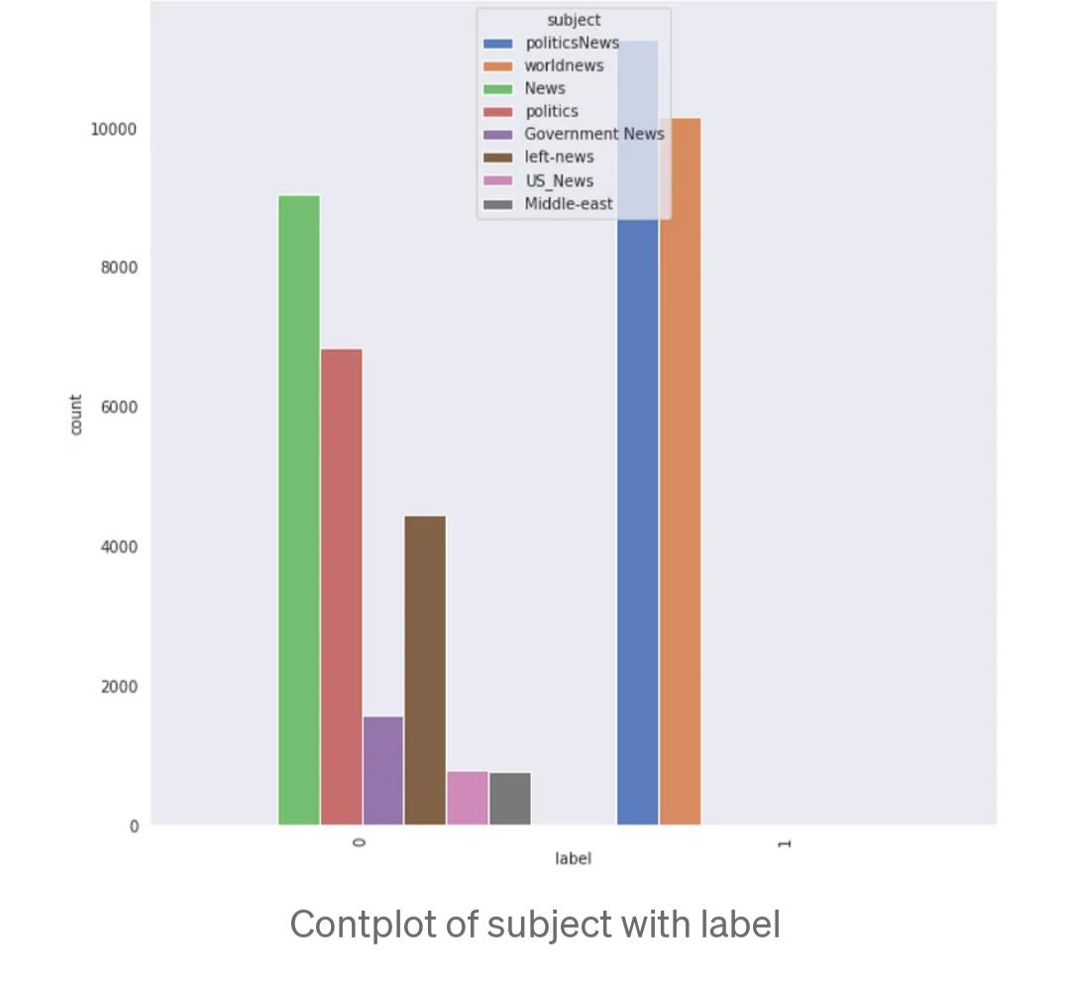

Slide 13
It is clear from the plot that all our real news belongs to 2 subjects. That seems to be strange. It might be because our data is taken only from a small period of time. Let us concatenate title and text fields into one column and drop all other columns.
Data[‘text’] = data[‘title’] + “ “ + data[‘text’] data = data.drop([‘title’, ‘subject’, ‘date’],axis=1)
Now, let us create a word cloud to analyse the most frequent words in our data. The stop words are removed from the data, and the word clouds are generated. Stop words are commonly used words in a language. Search engines ignore the stop words while indexing data as well as retrieving results for search queries.

Slide 14
from nltk.corpus import stopwords from wordcloud import WordCloud
Wordcloud = WordCloud(width = 800, height = 800, background_color =‘white’, stopwords = stopwords.words(‘english’), min_font_size = 10).generate(“ “.join(data[data[‘label’] == 0].text)) # plot the word cloud for fake news data plt.figure(figsize = (8, 8), facecolor = None) plt.imshow(wordcloud) plt.axis(“off”) plt.tight_layout(pad = 0) plt.show()

Slide 15
We can conclude from the word clouds that there are lot of real and fake news

Slide 16
Classification:
Now, let us move into the classification models. We will try different models and evaluate the performance. As classification is a supervised learning, we have to first split the data into training and test data. We train the model using the train data, and test the performance of our model using test data. Generally, the data is split in such a way that we have 80% of our data in train set, and 20% of our data in test set. This is because of the fact that the more the training set, the more the model learns from the data.

Slide 17
#splitting data for training and testing import sklearn from sklearn.model_selection import train_test_split x_train,x_test,y_train,y_test = train_test_split(data[‘text’],data[‘label’],test_size=0.2, random_state = 1)
Now, we will look into some basic classification models.

Slide 18
MultiNomial Naive Bayes:
Naive Bayes are mostly used in natural language processing. Naive Bayes classifier algorithm is a family of algorithms which use Bayes Theorem. It uses the naive assumption that all the features are independent of each other. Bayes theorem calculates the probability P(c|x) where c is the class of possible outcomes and x is the given instance which has to be classified. P(c|x) = P(x|c) * P(c) / P(x) According to our data, the class is 0 or 1, where 0 implies fake news and 1 implies true news. Given a news x, we will compute P(true news|x) as well as P(fake news|x). If P(true news|x) > P(false news|x), the algorithm predicts it is a true news. Otherwise, the news will be predicted as fake.

Slide 19
Support Vector Machine:
Support Vector Machine or SVM is a linear model for classification and regression problems. SVM model takes the data in the training set, and maps it to data points in space so that there is a clear gap between points belonging to different categories. This gap is made as wide as possible to improve the performance of the model. Whenever a new data point is given to the model, it maps the point to the same space, and predict the category based on the side of the gap on which they fall.

Slide 20
Passive Aggressive Classifier:
Passive aggressive classifier is an online algorithm that learns from massive streams of data. The idea is to get an example, update the classifier, and throw away the example. It is fast and easy to implement, but does not provide global guarantees like SVM.
Now we can apply these models to our data. But, we cannot give the text directly as an input to the classifier. Instead, we will convert the text to numbers. Machine learning uses a simple model called bag-of-words to deal with text data. The idea is to find all the unique words in the document, and create a vector of size equal to the number of unique words. Each word is assigned an index in the vector. The index corresponding to the word is filled with the frequency of that word in the document. The main drawback with this approach is that it ignores all the information related to the order of the words, and only takes into account the frequency of the words. We are using CountVectorizer and TfidfTransformer for the transformation.

Slide 21
Count Vectorizer:
The count vectorizer tokenizes a collection of documents and builds a vocabulary of unique words. It can also encode new documents using this vocabulary.

Slide 22
Tfidf Transformer:
Fit_transform: this method is called for each transformer and each time the result is fed into the next transformer. Fit_predict: if your pipeline ends with an estimator, fit_predict is called on the estimator.

Slide 23
True positive: The cases in which the predicted values and the actual values are the same, and the value is positive. True Negative: The cases in which the predicted values and the actual values are the same, and the value is negative. False Positive: The cases in which the prediction is ‘YES’ ,but the actual value is ‘NO’. False Negative: The cases in which the prediction is ‘NO’, but the actual value is ‘YES’. Finally, let us apply various models and evaluate the performance.

Slide 24
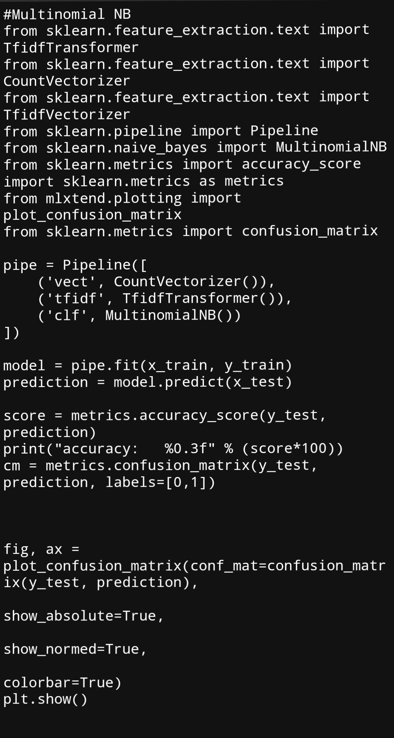

Slide 25
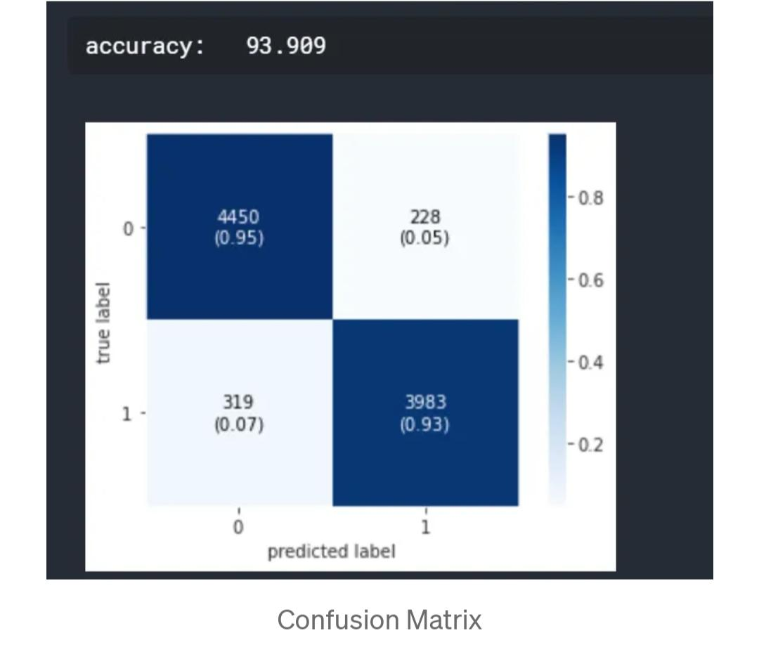

Slide 26
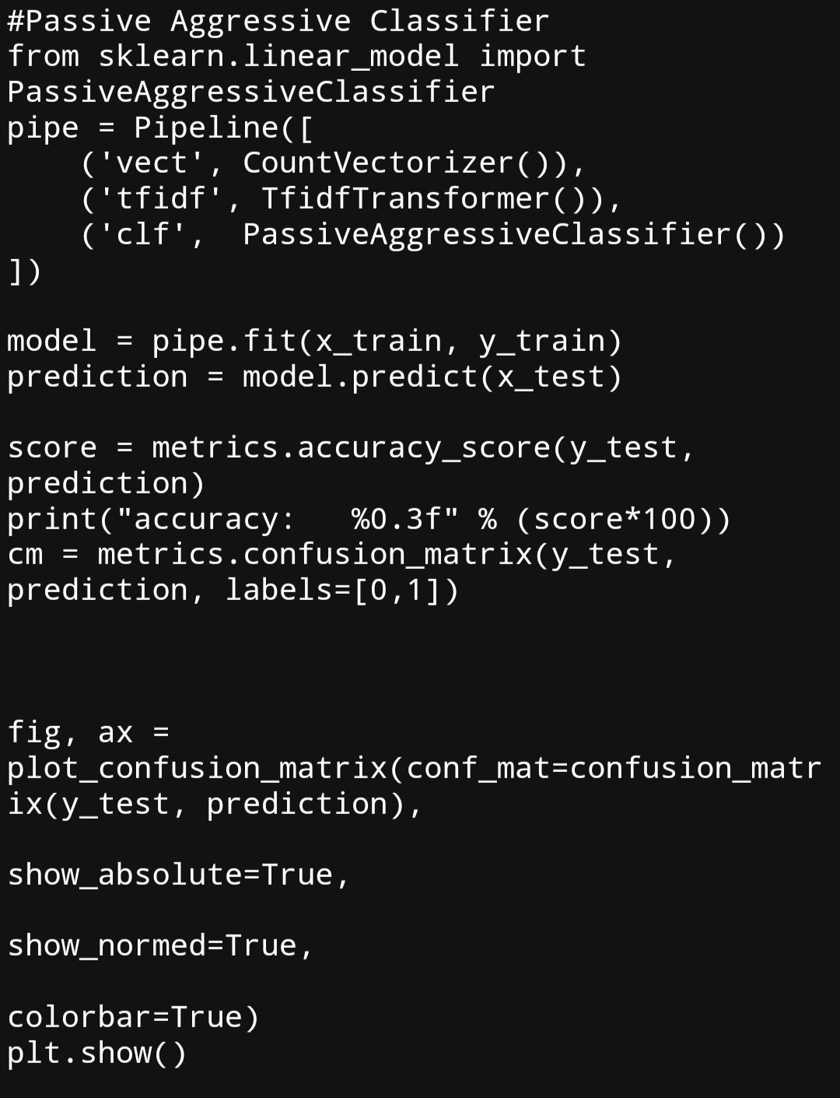

Slide 27
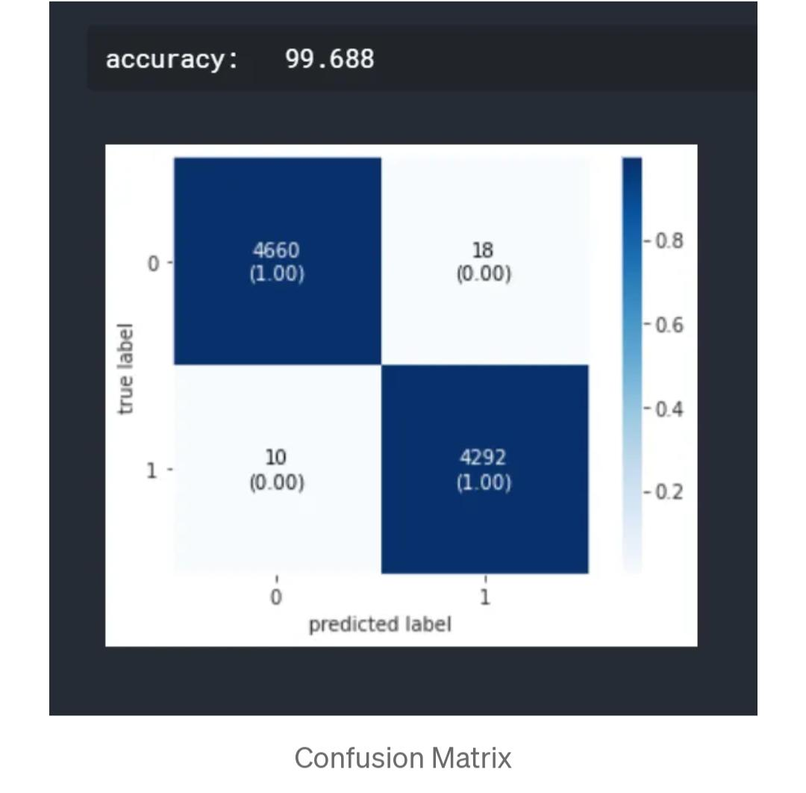

Slide 28
It is clear that multinomial naive bayes is not performing well as compared to other models. SVM and passive aggressive classifier have almost similar performance

Slide 29
Conclusion:
We have classified our news data using three classification models. We have analysed the performance of the models using accuracy and confusion matrix. But this is only a beginning point for the problem. There are advanced techniques like BERT, GloVe and ELMo which are popularly used in the field of NLP.

