Slide 1
Fake news detection using nlp

Slide 2
Fake news:
The fundamental definition of fake news is information that leads people wrong. Nowadays, fake news spreads like wildfire, and people share it without confirming it. This is frequently done to advance or enforce specific beliefs and is frequently accomplished through political agendas. The ability to draw users to media organizations’ websites is required to create online advertising revenue. As a result, it is vital to recognize fake news.

Slide 3
How to Create a Fake News Detection System?
To create a Fake news detection system and to make the system functional, python provides a bunch of libraries. To understand how to create a system using python and make it functional for the Fake News detection system, stay tuned till the end of the article.

Slide 4
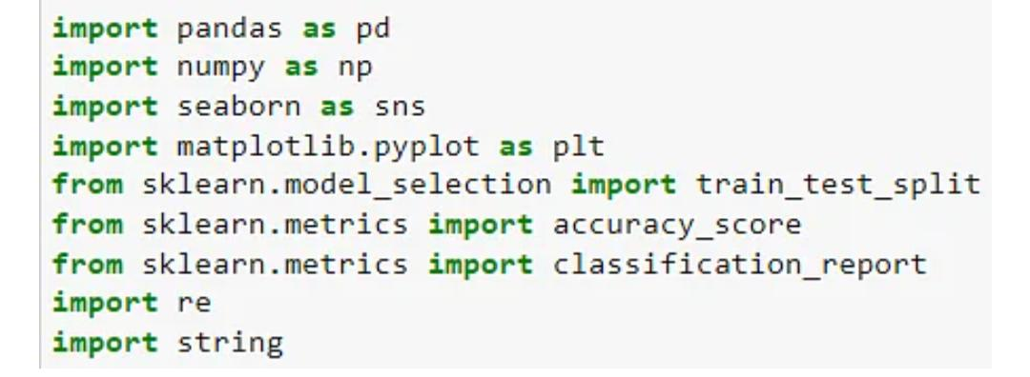
Step 1: Importing Libraries.

Slide 5
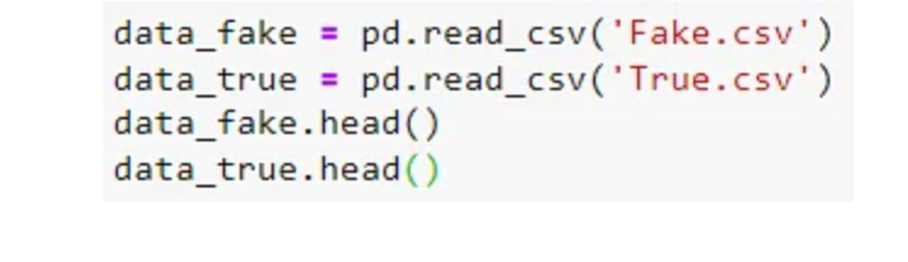
Step 2: Importing the Dataset:

Slide 6
Result: 1: Fake news data 2: True news data

Slide 7
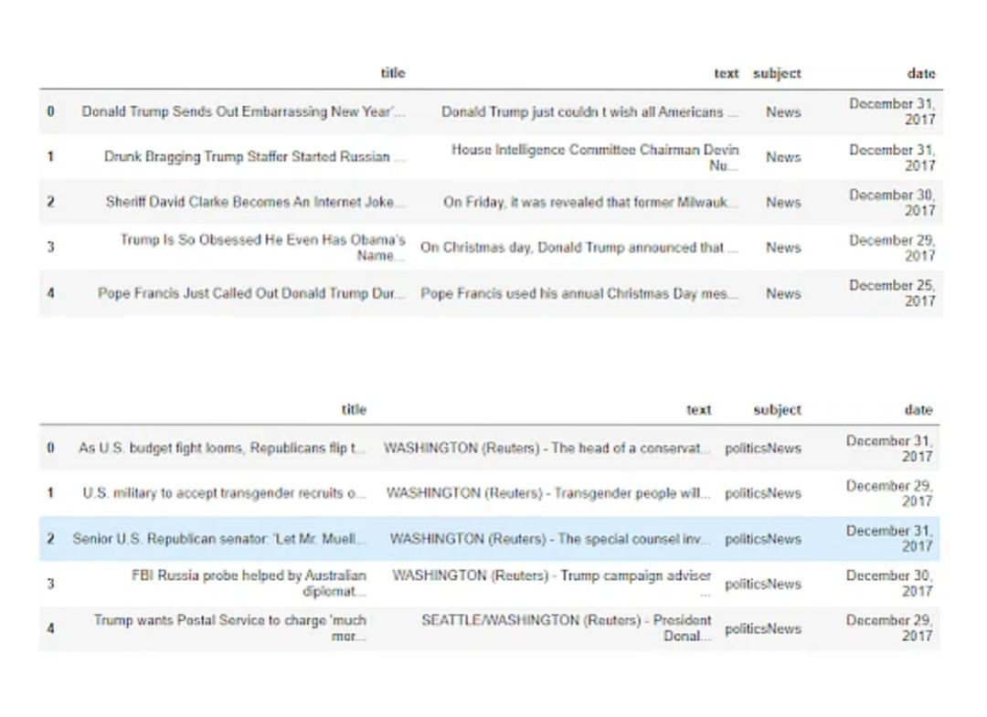

Slide 8

Step 3: Assigning Classes to the Dataset:

Slide 9

Step 4: Checking Number of Rows and Columns in the Dataset

Slide 10
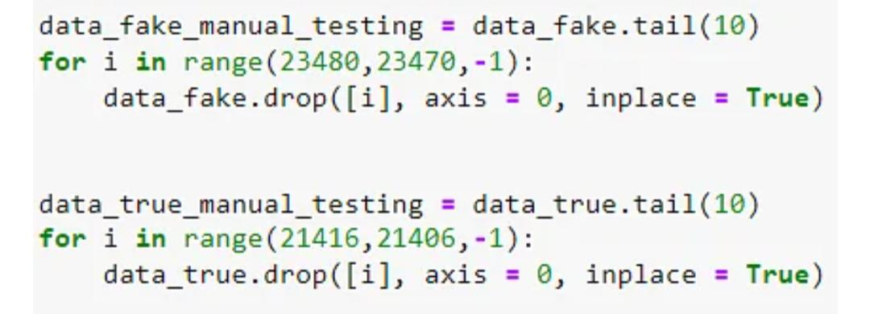
Step 5: Manual Testing for Both the Dataset

Slide 11
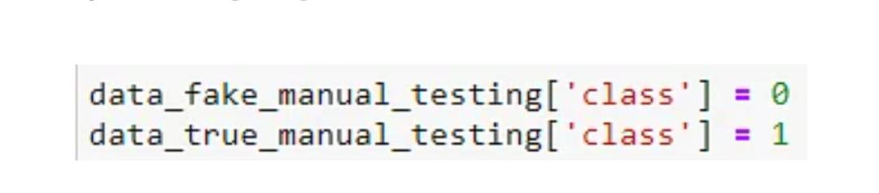
Step 6: Assigning Classes to the Dataset

Slide 12
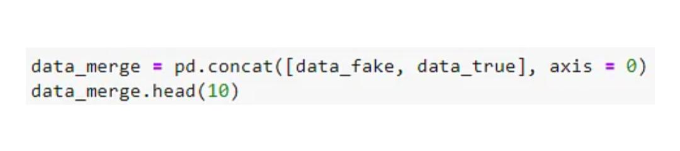
Step 7: Merging Both the Dataset

Slide 13
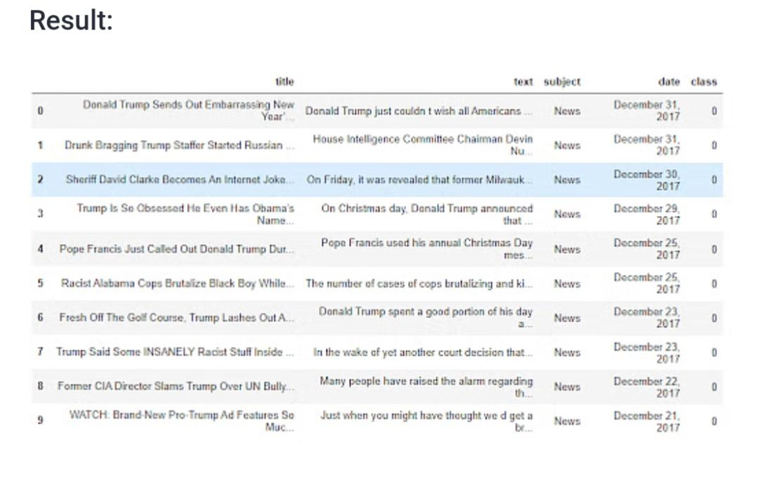

Slide 14
Step 8: Dropping Unwanted Columns

Slide 15
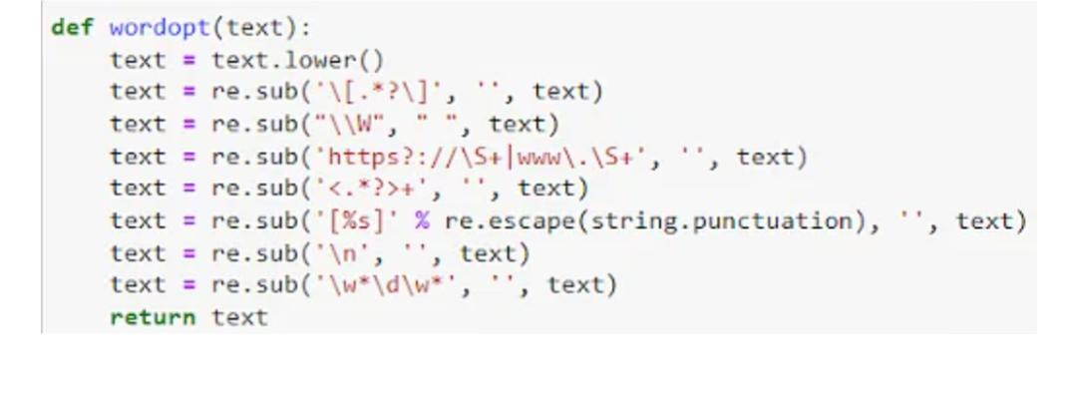
Step 9: Create a Function to Clean Text

Slide 16
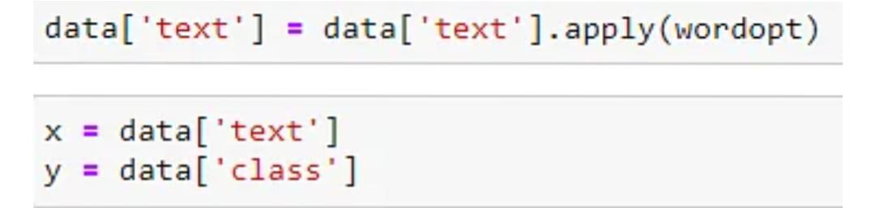
Step 10: Applying Function to Text Column and Assigning X and Y

Slide 17
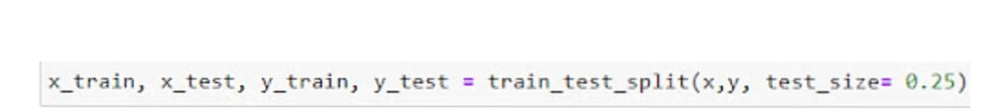
Step 11: Defining Training and Testing Data and Splitting Them Into &5 -25 Percent Ratio.

Slide 18
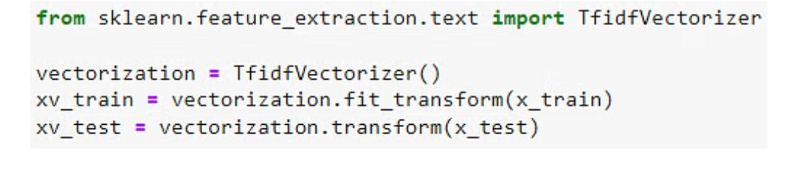
Step 12: Converting Raw Data Into Matrix for Further Process.

Slide 19
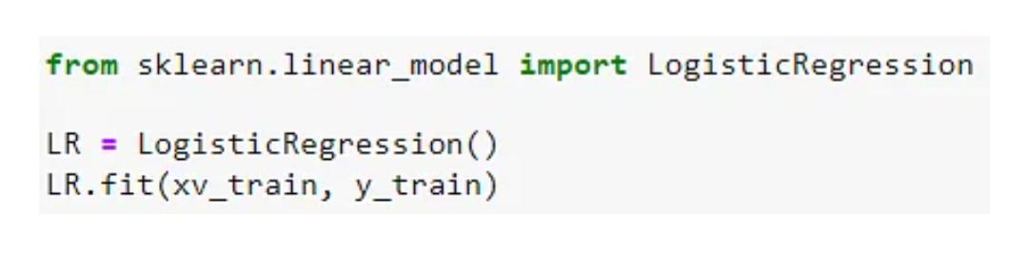
Step 13: Creating First Model.

Slide 20
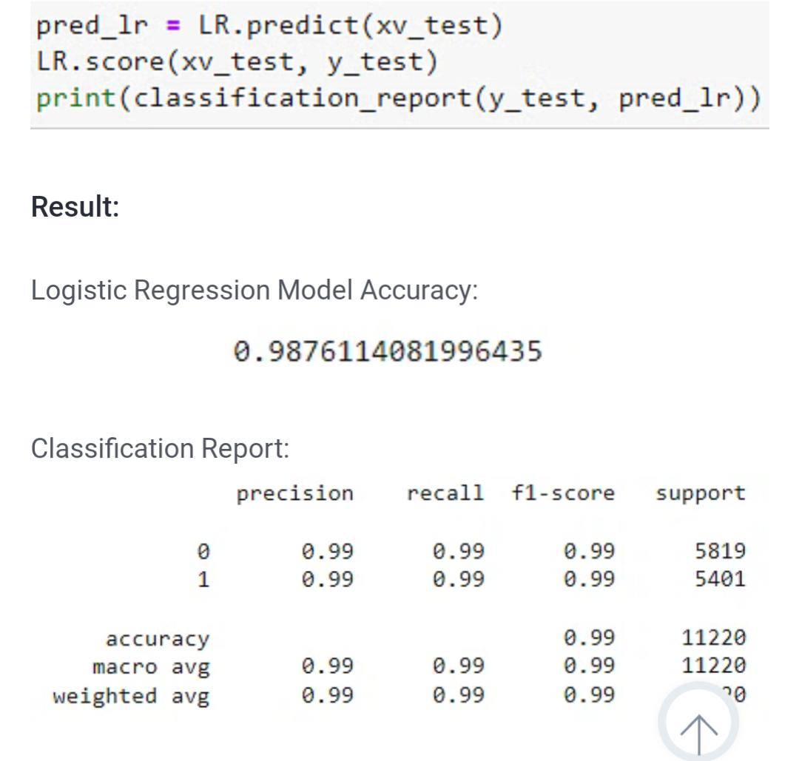
Step 14: Checking the Model Accuracy and Classification Report

Slide 21
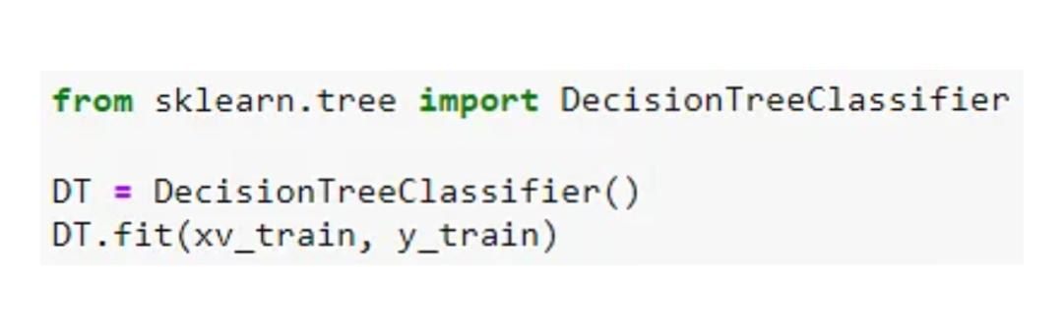
Step 15: Creating a Second Model.

Slide 22
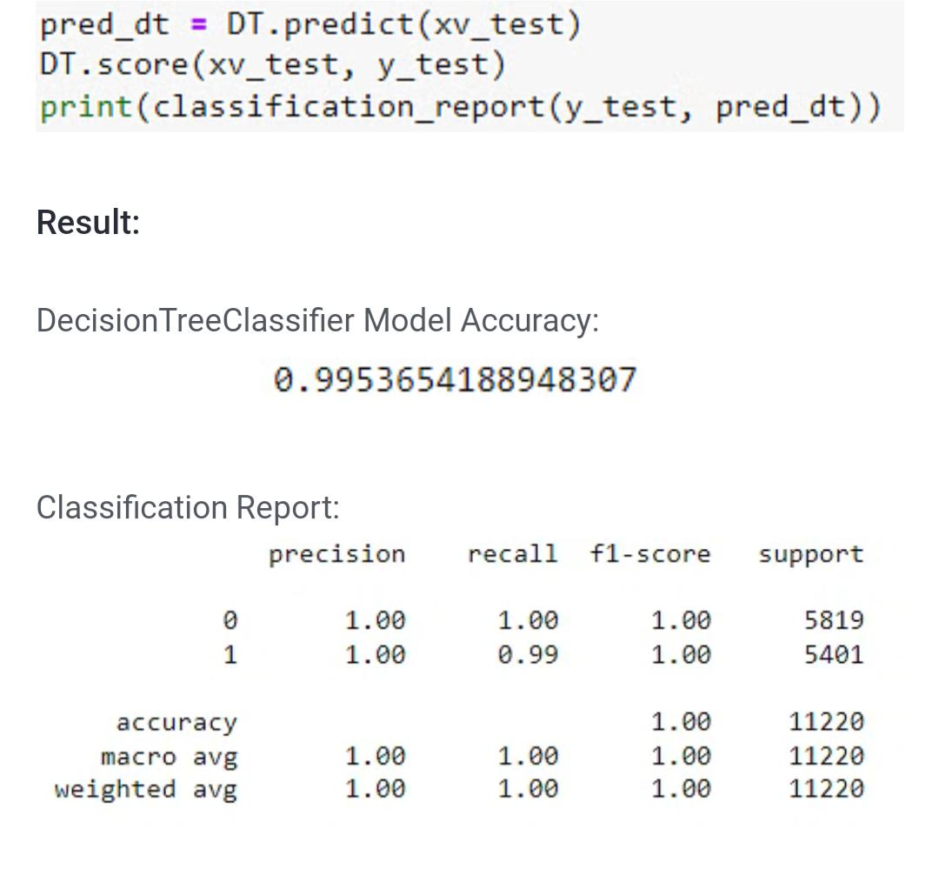
Step 16: Checking the Model Accuracy and Classification Report

Slide 23
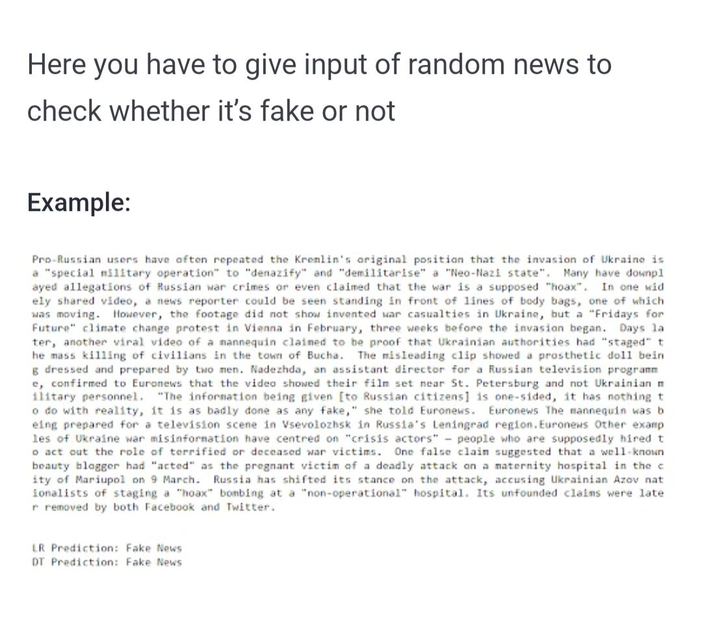
Step 17: Checking Fake News

Slide 24
Conclusion:
The manual classification of false political news requires for a deeper understanding of the field. The problem of predicting and categorizing data in the fake news detection issue needs to be confirmed using training data. Reducing the amount of these features could increase the accuracy of the fake news detection algorithm because the majority of fake news datasets have many attributes, many of which are redundant and useless. As a result, this research suggests a technique for dimensionality reduction-based fake news detection. The dimension-reduced dataset is constructed using the final set of features.

