Slide 1
Classification:
Classification is a process of identifying, interpreting, and arranging concepts and things into predetermined groups or “subpopulations” is known as categorization. When a pattern is detected in a subsequent batch of data , it is known as ”pattern recognition”. Classification is a sort of pattern recognition.

Slide 2
Methodology:
Feature Extraction Vectorizers like TF-IDF and count vectorizer are used to do the word embedding and data set cleaning in this approach .It’s done by removing stop word like “the,” ”when,” and “there,” as well as utilising an n-number of the most often used words , phrases , lowercased or not ,as well as using keywords that appear at least a certain number of times in a certain text corpus . The classifiers train the data and check the relativity of the features in the test data and gives the result as ’Fake’ or ’Real’ along with the accuracy if the classifiers.

Slide 3
Terminologies:
Fake news:
This is regularly done to further or force certain kinds thoughts or for false promotion of products and its frequently accomplished with political plans.
TF vectorizer:
In the document, words are present so many times that is called term frequency.

Slide 4
Key Features:
Multimodal Data Collection
Text Analysis with Transformer Models
Image Analysis using Deep Learning
Metadata and Contextual Information
Fusion and Attention Mechanisms
Dynamic Learning and Adaptation
Explainability and Interpretability

Slide 5
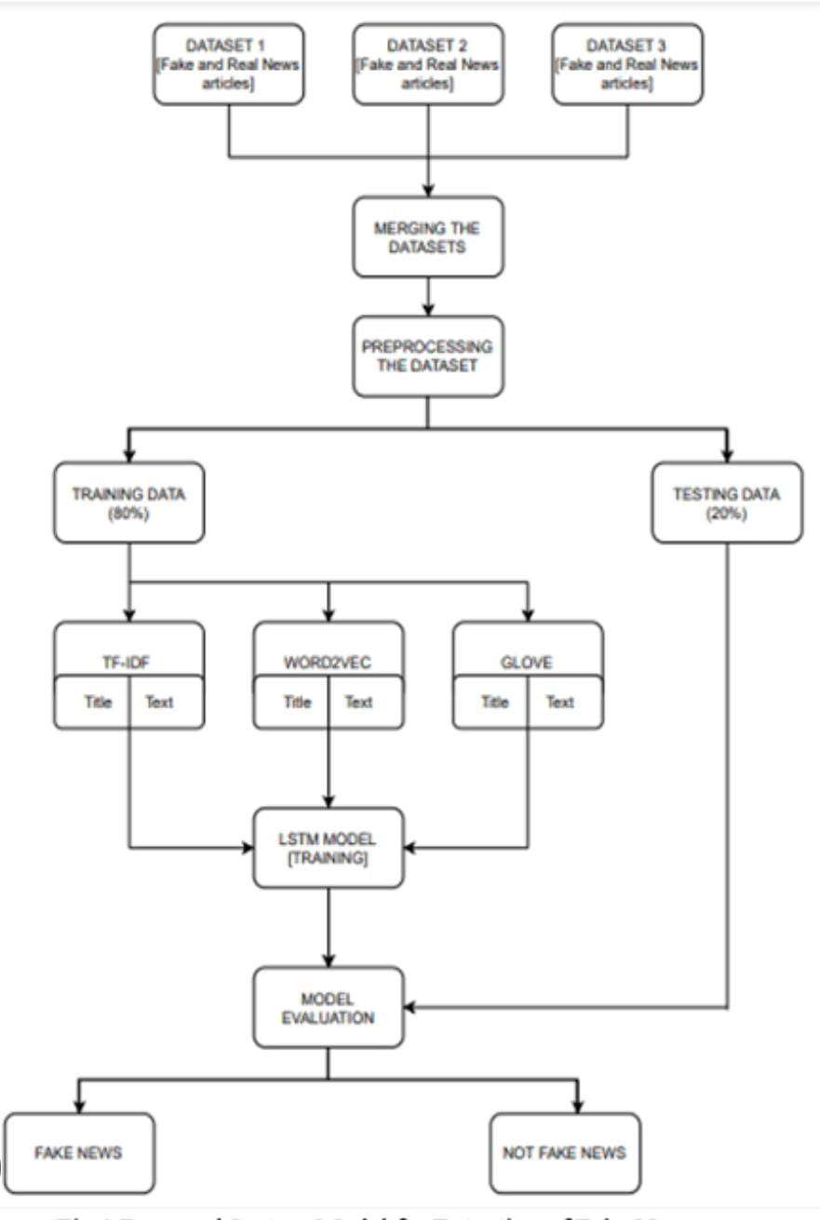
Architecture Design:

