Slide 1
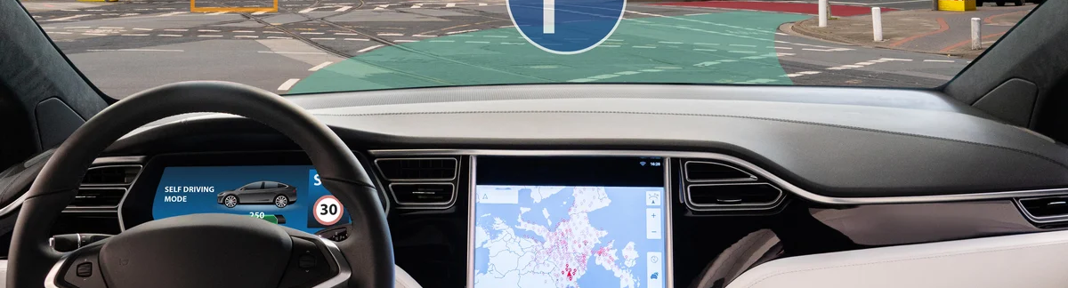
High-Performance
Semantic Segmentation
for Autonomous Urban Navigation
https://www.a2d2.audi/

Slide 2
Table of Content
01.
02.
03.
Project Overview
Glimpse of Data set
Baseline Model
04.
05.
06.
Model Evolution
Demo
Conclusion

Slide 3
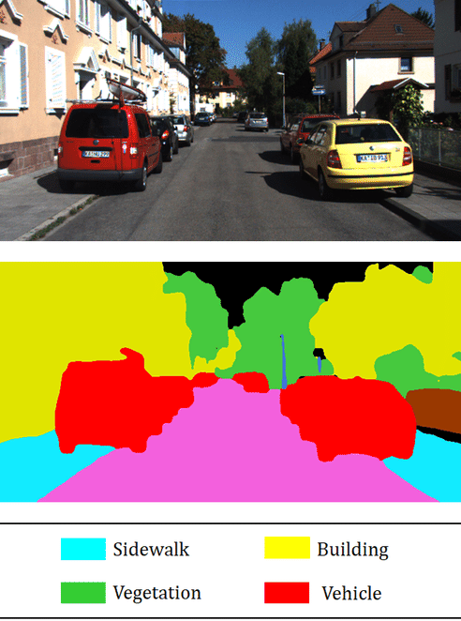
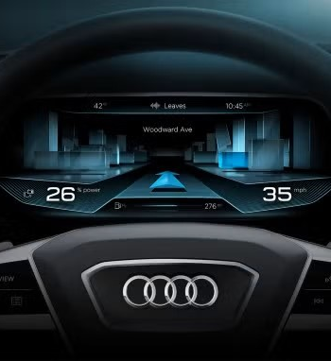


Project Overview
Purpose:
To enhance our understanding of autonomous driving systems through advanced semantic segmentation of urban scenes, enabling pixel-level comprehension of critical elements like roads, vehicles, and pedestrians to improve real-time decision-making capabilities.
Autonomous Navigation
Relies on scene comprehension for path planning and obstacle avoidance
Requires instant classification of dynamic objects for decision-making
Semantic Segmentation
2D Segmentation
3D Segmentation
Classifies each pixel in 2D camera images
Creates color-coded maps of urban scene elements
Enables region-based reasoning about urban environments

Slide 4
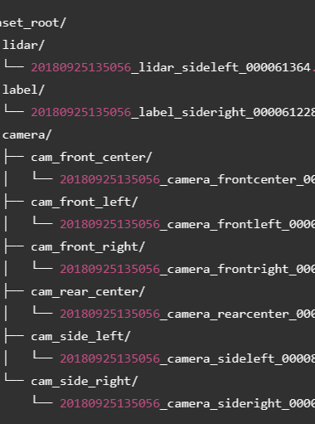
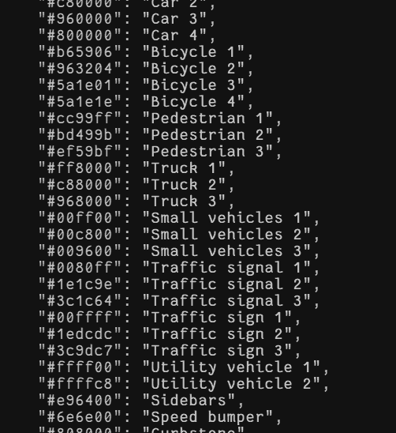
Glimpse
of Dataset
https://www.a2d2.audi/a2d2/en/download.html
Training Sample: 31448
RGB Image
Label Mask
Lidar
Classes: 55
Class-to-Class Mapping

Slide 5
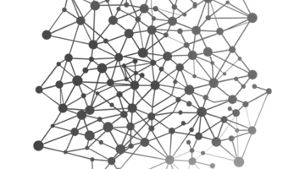

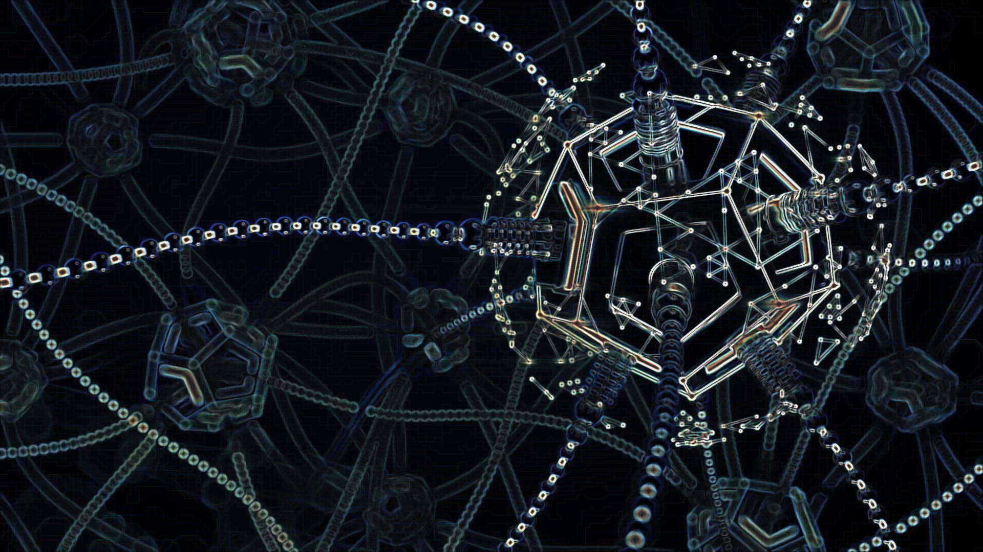
Baseline Model
https://github.com/aws-samples/sagemaker-a2d2-segmentation-pytorch
Architecture
Training Strategy
Deployment
DeepLabV3 with MobileNetV3-Large backbone
Supports high-resolution image processing
Custom learning rate scheduling
Automatic Mixed Precision (AMP) for efficient GPU utilization
Regular model checkpointing : versioned and latest snapshots
Observations:
Missing Train-Test-Validation Split
Inadequate performance metrics
Architectural Limitations
Lack of assessment visualization
Excessive checkpoints: consuming too much storage
Notes:
Confidence map

Slide 6
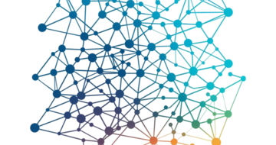

Model Evolution
Baseline to Enhanced Architecture
Architecture
Training Strategy
Deployment
DeepLabV3
DeepLabV3+ with ResNet-50 backbone
Segmentation Transformer
Comprehensive train-validation-test split with proper randomization
Efficient model storage and Visualization pipeline

Slide 7
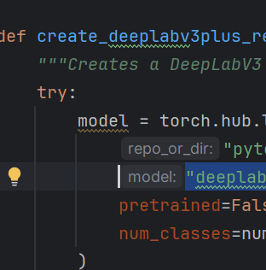
Model Evolution-Part 1
Architecture
DeepLabV3, DeepLabV3+ (ResNet-50 backbone)
Multiple loss function options
Optimizer: SGD, AdamW
Confidence visualization capability

Slide 8
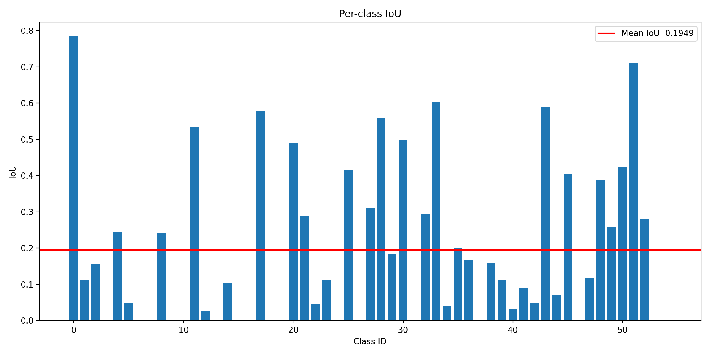
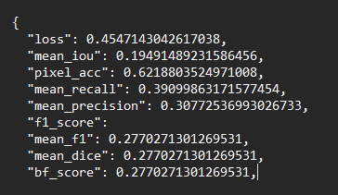
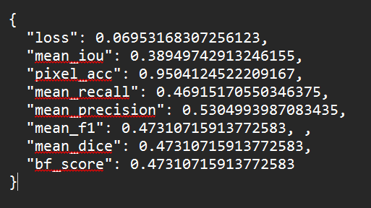
Model Evolution-Part 1
Training
Initial Considerations:
Data Split 80/10/10
Computational Feasibility
Performance Metrics
Mean Intersection over Union (mIoU)
Pixel Accuracy
F1-Score
Loss
Journey at a Glance:
High-performing classes (IoU > 0.8): 0, 11, 43, 50, 51, 52 (mostly common classes)
Poorly-performing classes (IoU < 0.2): 2, 3, 5-7, 9-10, 12-13, 15-16, 18 (mainly rare objects)
Zero IoU classes: 12 classes have IoU of 0 (complete failure to detect)
High-performing classes (IoU > 0.8): 0, 11, 17,28, 33,43, 51 (mostly common classes)
Poorly-performing classes (IoU < 0.2): 3, 6, 7, 10, 13, 15, 16, 18, 24, 31, 37, 46, 53 (mainly rare objects)
Zero IoU classes: 12 classes have IoU of 0 (complete failure to detect)
DeepLabV3
U-Net
DeepLabV3+
DeepLabV3+
ResNet-50 backbone (pre-trained on ImageNet)
Xception backbone (pre-trained on ImageNet)
ResNet-50 backbone (pre-trained on ImageNet)
ResNet-50 backbone (pre-trained on ImageNet)
- No Data Augmentation
- No Class Imbalance Handling
- Optimizer: SGD
- No Data Augmentation
- No Class Imbalance Handling
- Added Data Augmentation
- Added Class Imbalance Handling
- Optimizer: AdamW
U-Net
Xception backbone (pre-trained on ImageNet + COCO)

Slide 9
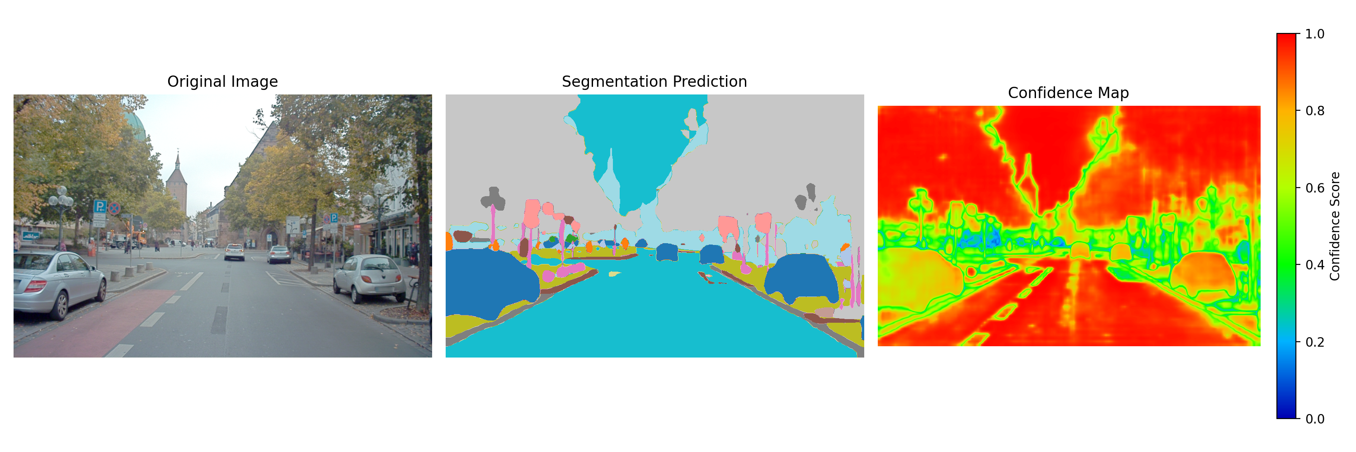

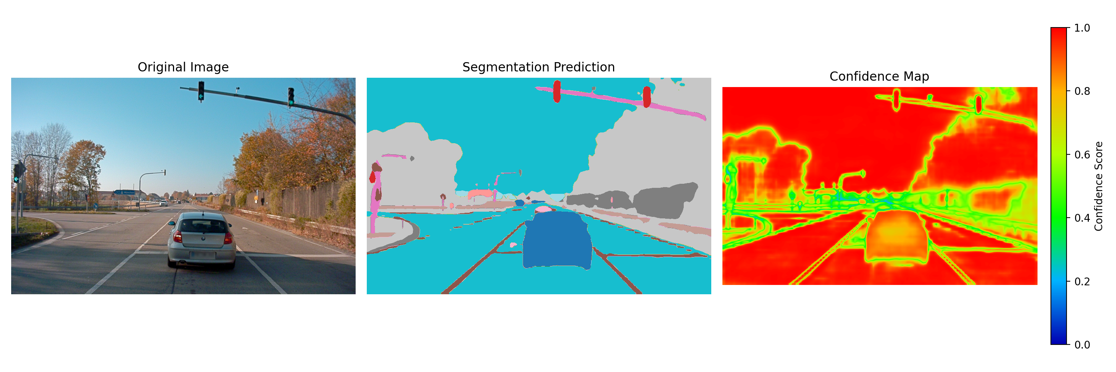
Deployment
Segmentation outputs
Side-by-side comparison of original image and segmentation prediction
Heatmap visualization of pixel-level confidence scores
Comprehensive performance reports in Markdown format
Class-wise confusion analysis
Model checkpoints saved after each epochs
JSON-formatted metric history
Storage Management
Visualization
Performance Analysis

Slide 10
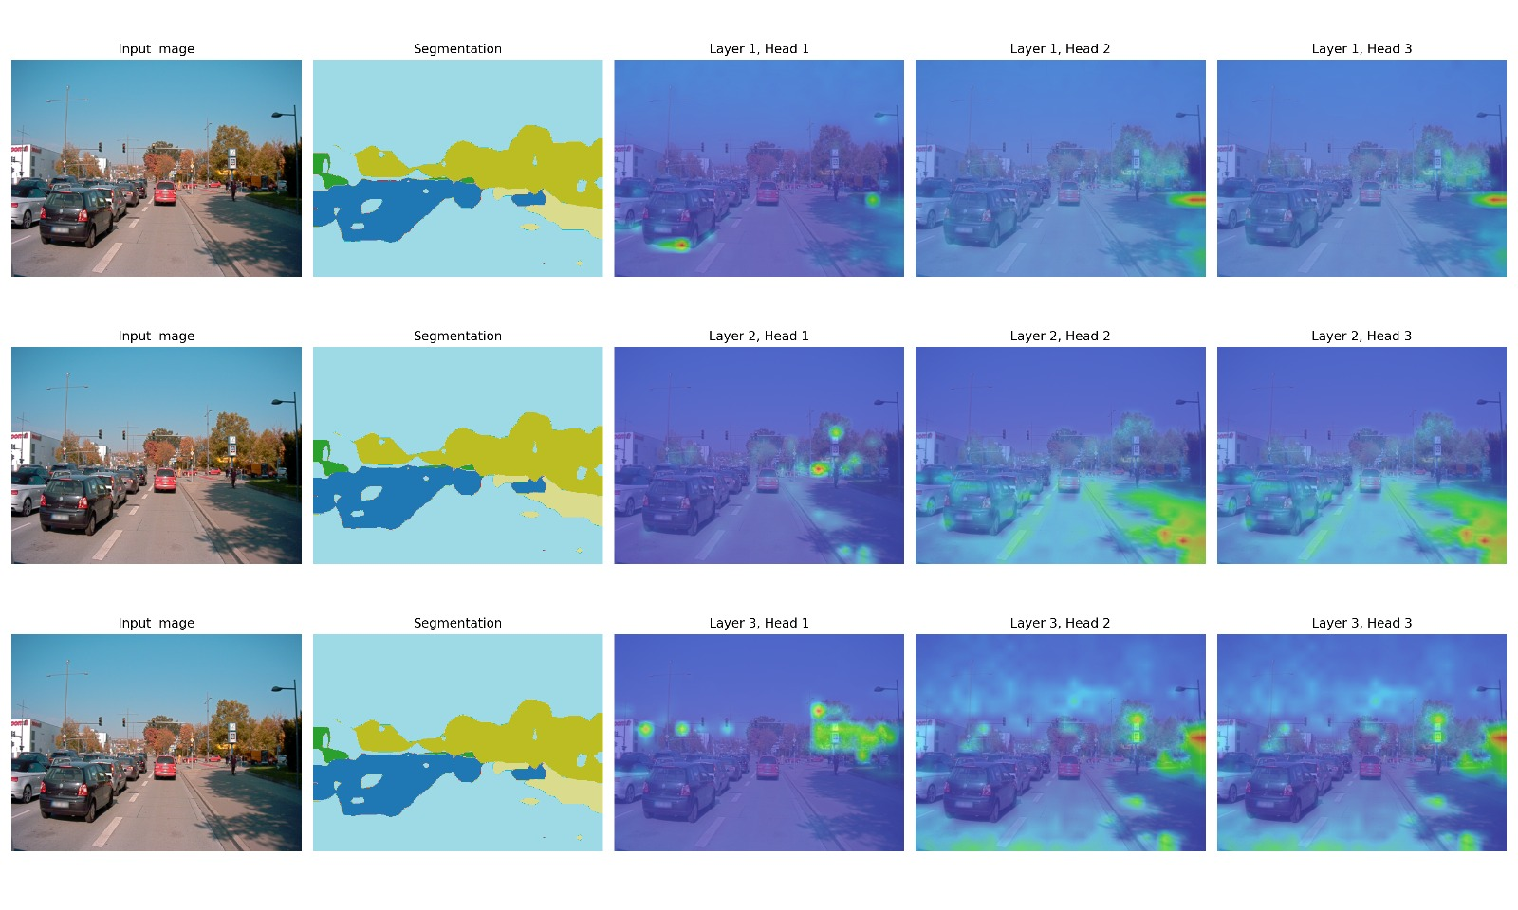
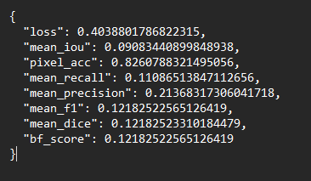
Model Evolution-Part 2
Training
Initial Considerations:
Data Split 70/15/15
Computational Feasibility
Performance Metrics
Mean Intersection over Union (mIoU)
Pixel Accuracy
F1-Score
Loss
Journey at a Glance:
Segmentation Transformer
- No Data Augmentation
- Flexible Loss Function
- Optimizer: AdamW

Slide 11
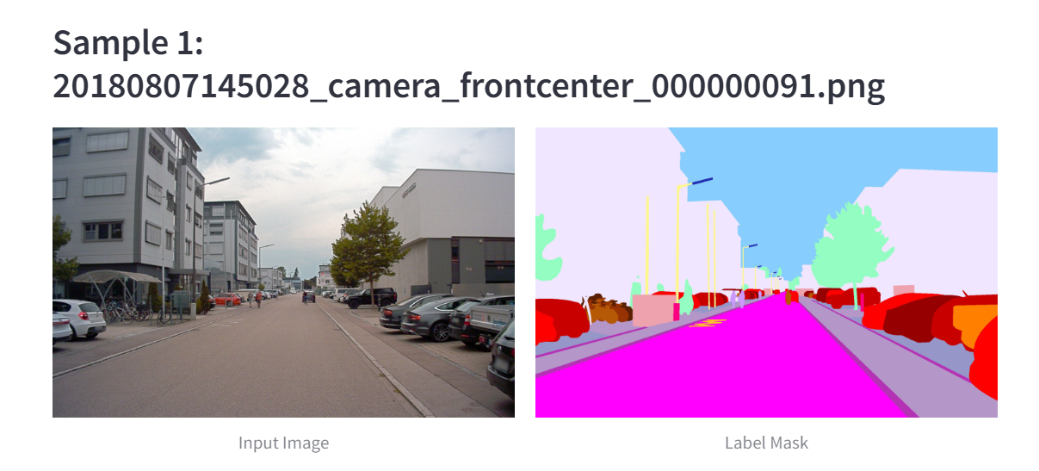
Demo

Slide 12
1
2
Conclusion
Evolving to production level performing model: - 100% Image Resolution - more epochs
- Learning rate scheduler Computationally expensive
Better architecture: not always improve performance Need proper hyperparameter tuning
3
More image samples are required for rare objects Crucial

Slide 13
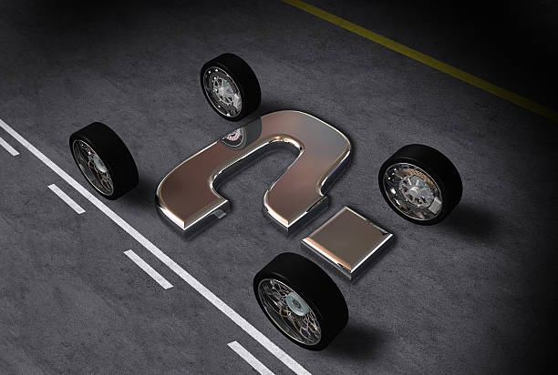
Q & A

Slide 14

Thank You

Slide 15
Appendix:

