Slide 1
Unemployment Rate
Business, Economics and Financial Data
Roya Ghamari, Shabnam Sattar
January 2024

Slide 2

Introduction
Unemployment in Europe has been a persistent and multifaceted challenge, influenced by a combination of economic, social, and political factors. Despite the region's diverse economies and policy frameworks, the issue of unemployment has manifested differently across European countries, with some nations experiencing higher rates than others.
In the present work, we will analyze the unemployment rates in three European countries, each situated in distinct regions: North, Middle, and South.

Slide 3

Dataset
Main dataset
Complementary dataset
Gross Domestic Product (GDP) for Greece
Consumer Price Index: All Items: Total for Greece
Compiling agency: Economic Research Division Federal Reserve Bank of St. Louis
Unemployment by sex and age monthly data
Compiling agency: The statistical office of the European Union, Eurostat
Balance of payments by Greece
Compiling agency: The statistical office of the European Union, Eurostat

Slide 4
People between the ages of 15 and 74 who were not working in the past week, actively looked for a job in the last four weeks and are ready to start working either immediately or within two weeks are considered unemployed.
The unemployment rate is the number of people unemployed as a percentage of the labor force. The labor force is the total number of people employed and unemployed.

Slide 5
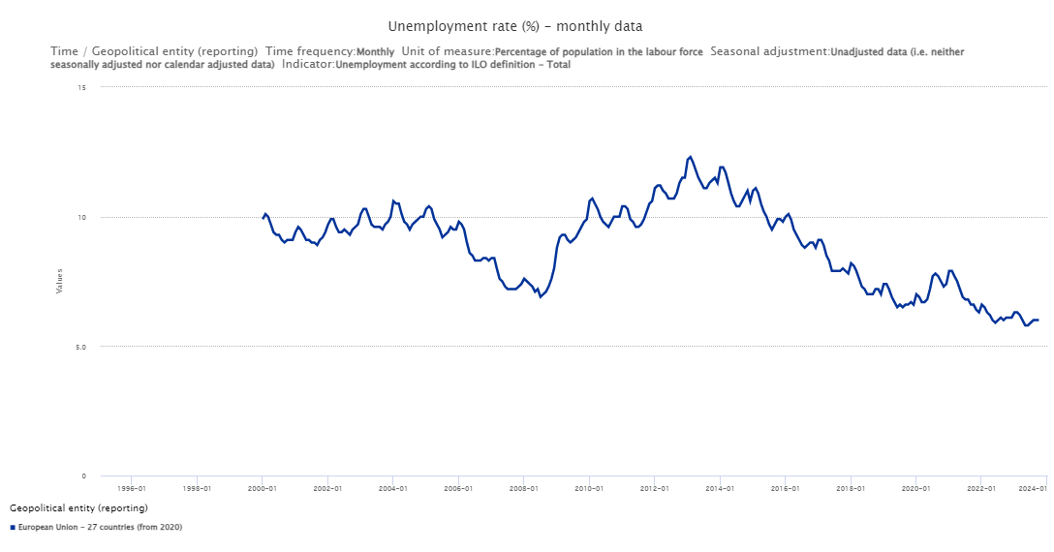
European Union Unemployment Rate

Slide 6
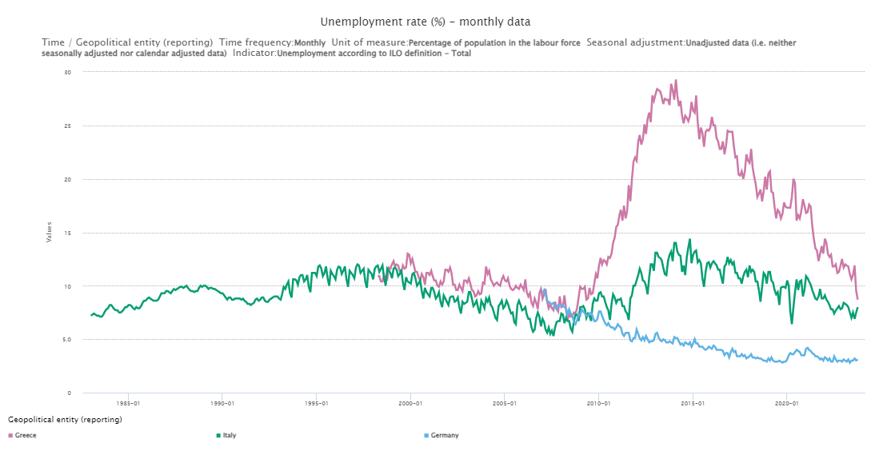
Germany, Italy and Greece Unemployment Rate

Slide 7
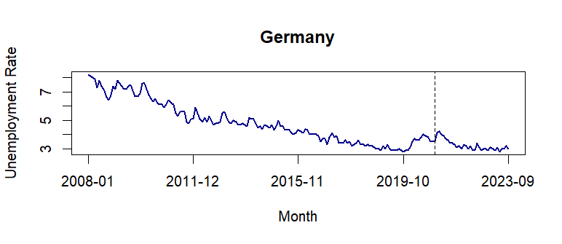
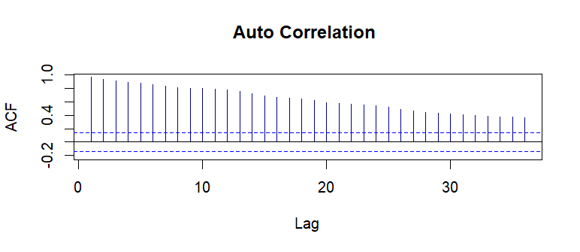
Germany
Longterm decreasing trend
Correlations are positive and significant(decreasing). This is a confirmation of existence of the trend

Slide 8
Modelling
The time-series is divided into two periods: the training set and the test set. The models are built using the training set. Once the models are defined, they are tested on the test set to assess their performance.
Linear Regression model ( trend + seasonality)
Linear regression model (y ~ t + (t^2) + season)
Holt Winters methods
ARIMA
Generalized additive model (y ~ s(t) + s)

Slide 9
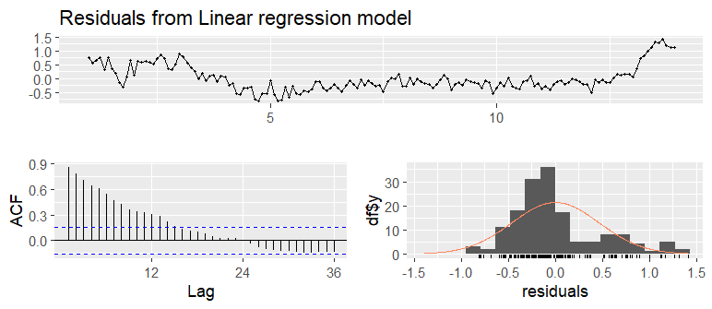
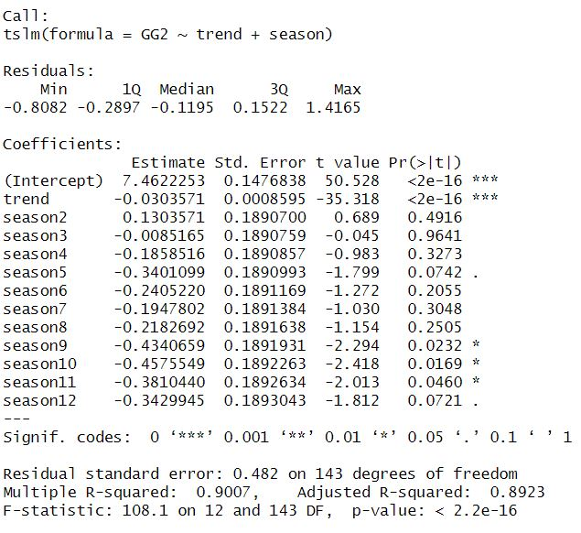
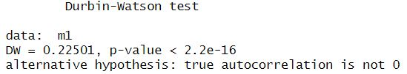
Linear Regression (y ~ t + s)
Motivation: Simple and interpretable
highly correlated residuals

Slide 10
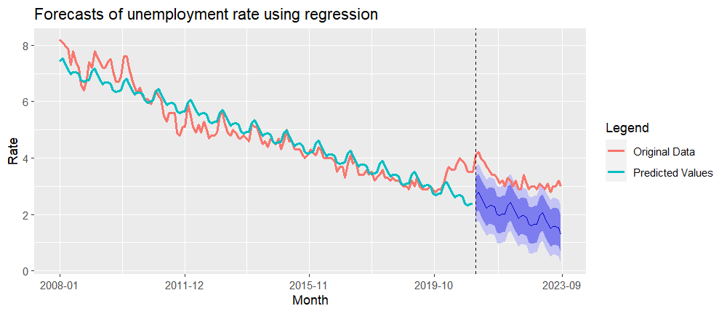
Linear Regression (y ~ t + s)

Slide 11
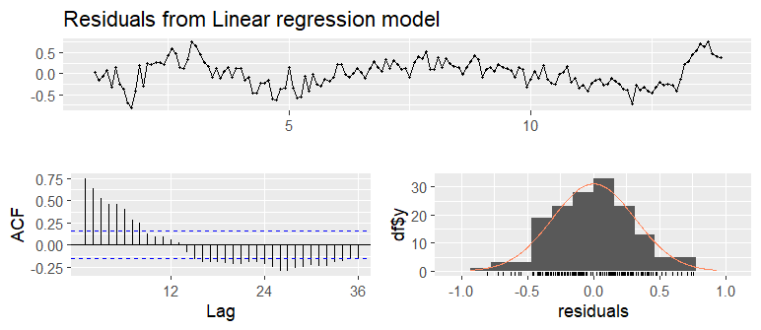
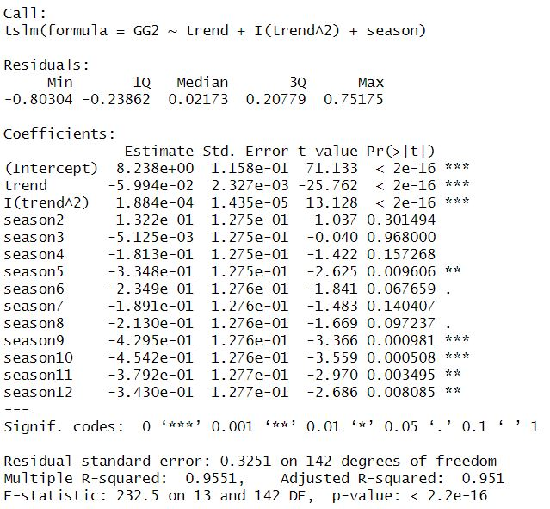
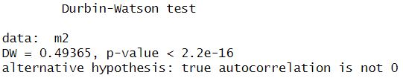
Linear regression (y ~ t + (t^2) + season)

Slide 12
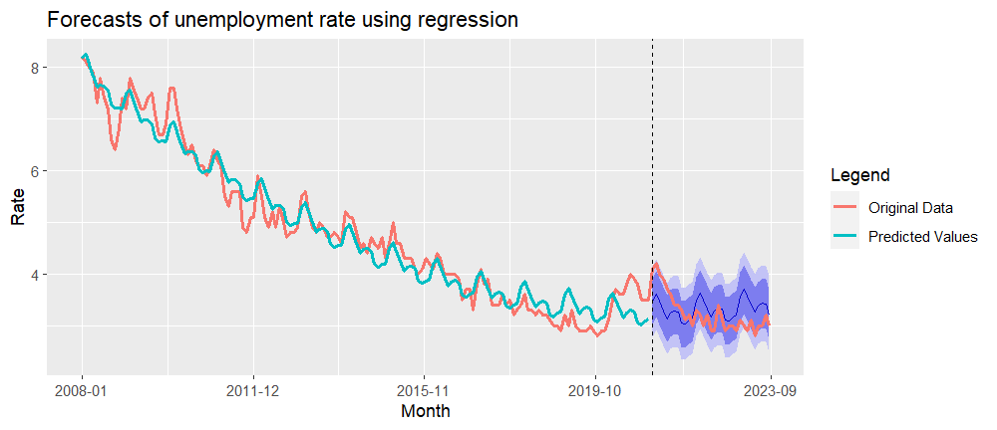
Linear regression (y ~ t + (t^2) + season)

Slide 13
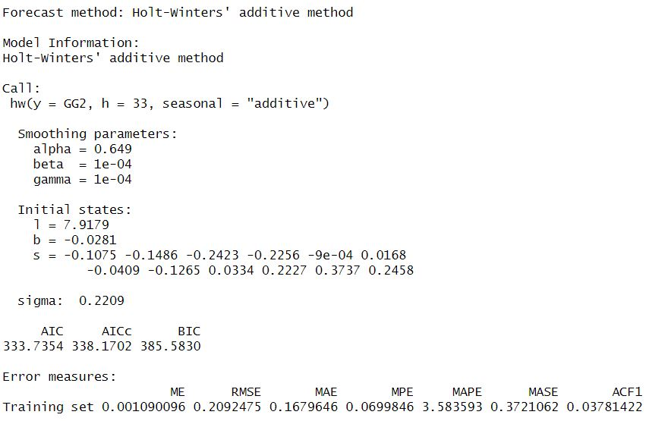
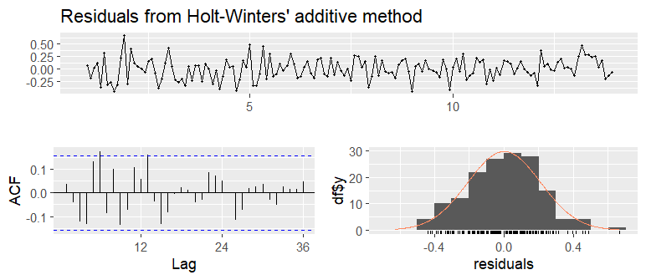
Holt-Winters method (additive)
Motivation:
capture both the trend and seasonality
Adaptability to Changing Patterns
Forecasting Accuracy

Slide 14
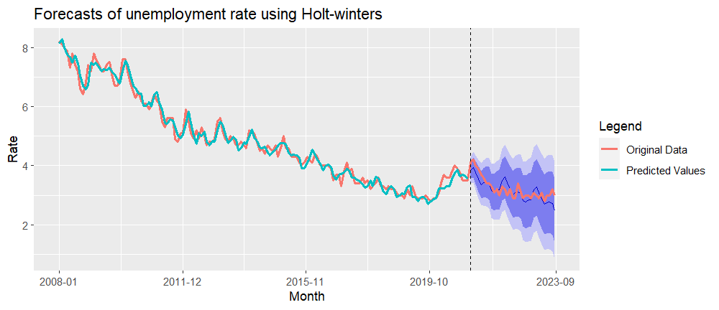
Holt-Winters method (additive)

Slide 15
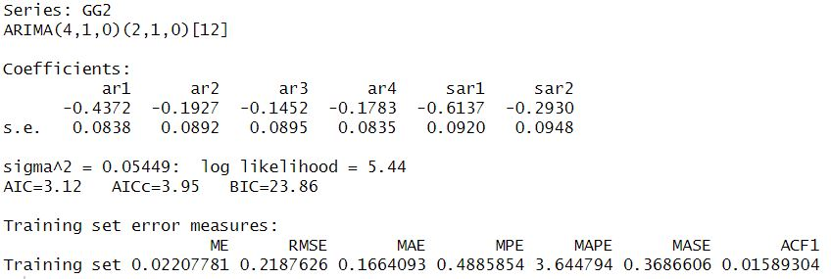
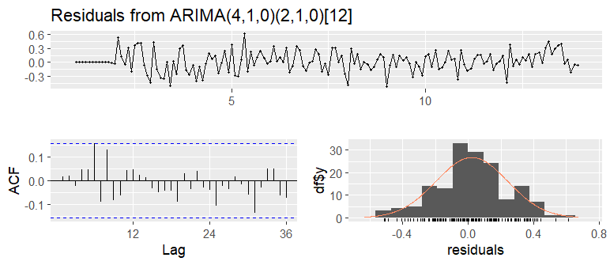
Seasonal ARIMA (4,1,0)(2,1,0)[12]
Motivations:
Robustness
Interpretability
No Assumptions about Data Distribution
Ease of Use

Slide 16
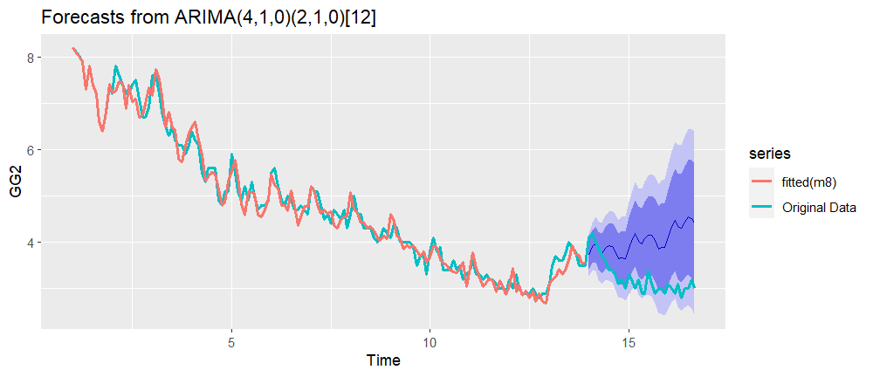
Seasonal ARIMA (4,1,0)(2,1,0)[12]

Slide 17
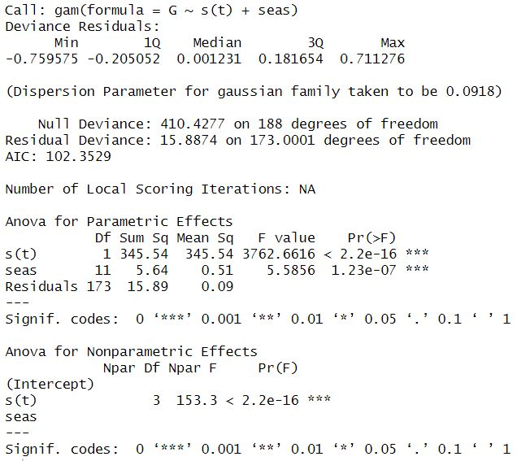
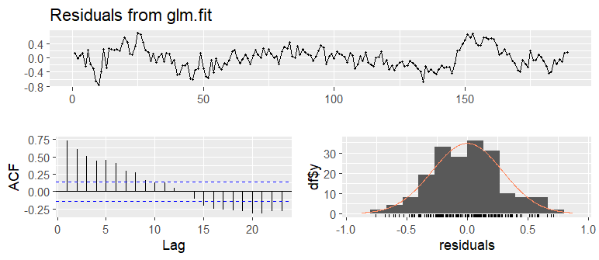
Generalized Additive Model ( y ~ s(t) + s )
Motivation:
Capturing Non-Linear Patterns

Slide 18
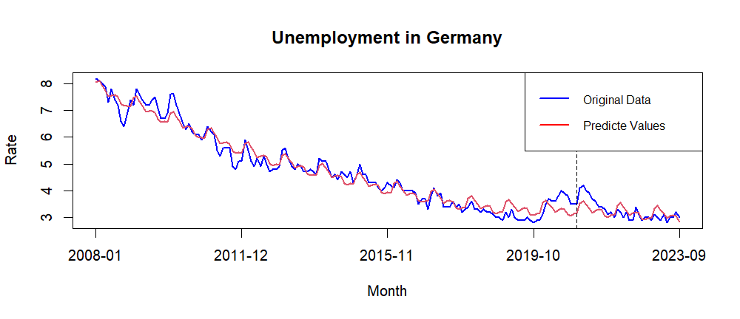
Generalized Additive Model ( y ~ s(t) + s )

Slide 19
Comparing Models for Germany Via Metrics
Models | Train/Test | RMSE | MAPE | AIC | BIC
TSLM1 | Training set | 0.46 | 7.52 | 229.45 | 272.15
 | Test set | 1.25 | 38.31
TSLM2 | Training set | 0.31 | 5.77 | 107.48 | 153.23
 | Test set | 0.38 | 10.12
Holt-Winters method(additive) | Training set | 0.21 | 3.58 | 333.73 | 385.58
 | Test set | 0.24 | 6.18
SARIMA | Training set | 0.21 | 3.64 | 3.12 | 23.86
 | Test set | 0.96 | 27.71
GAM | Training set | 0.29 | 5.54 | 102.35 | 147.74
 | Test set | 0.86 | 25.69

Slide 20
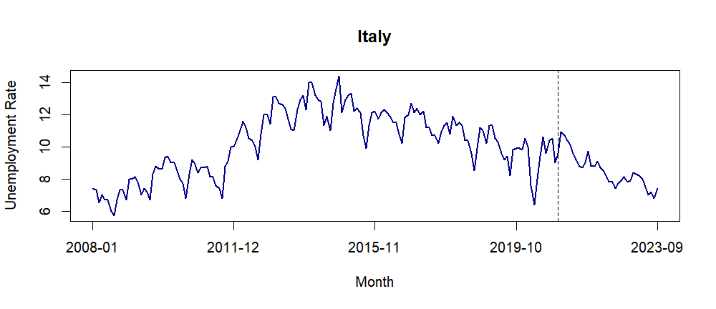
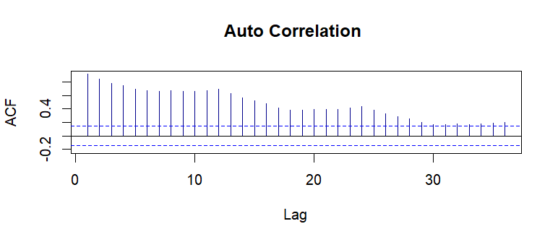
Italy
Political Instability
Banking Sector Challenges
Before the COVID-19 pandemic, which began in 2019, Italy's unemployment rate was gradually declining
Trend and Seasonality

Slide 21
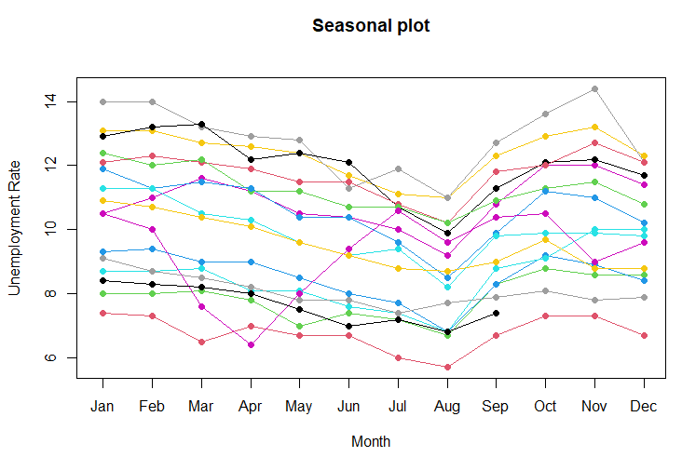
Seasonal Plot
Lowest rate in August:
Seasonal Employment
Summer Hiring
Youth Employment
Government Employment Programs

Slide 22
Modelling
Linear regression model (y ~ t + (t^2) + season)
Holt Winters methods
ARIMA
Generalized additive model (y ~ s(t) + s)

Slide 23
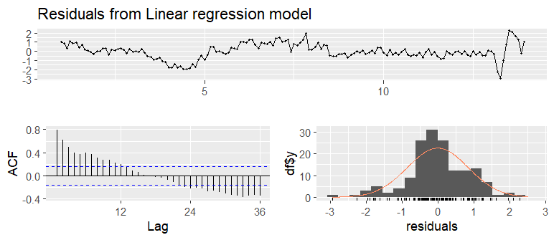
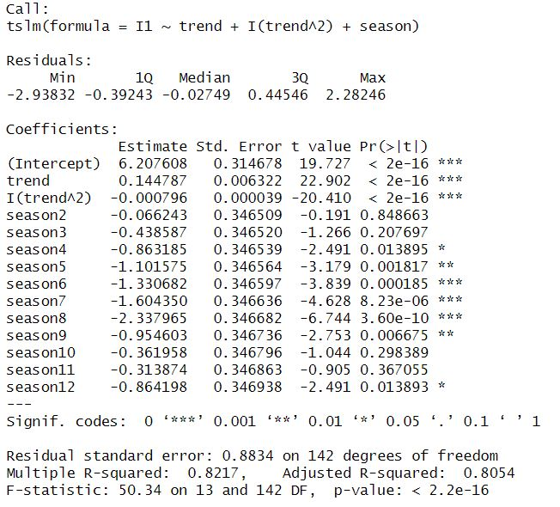
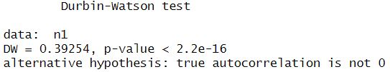
Linear regression (y ~ t + (t^2) + season)

Slide 24
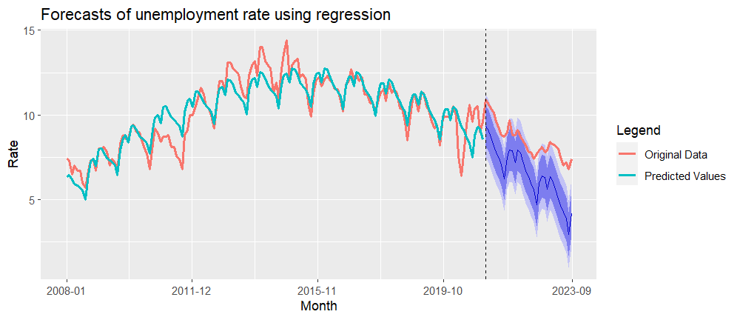
Linear regression (y ~ t + (t^2) + season)

Slide 25
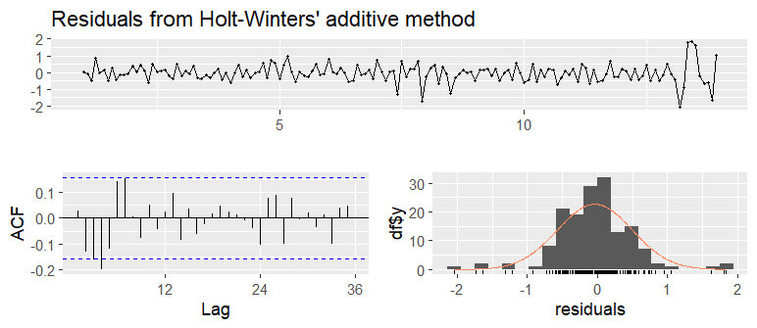
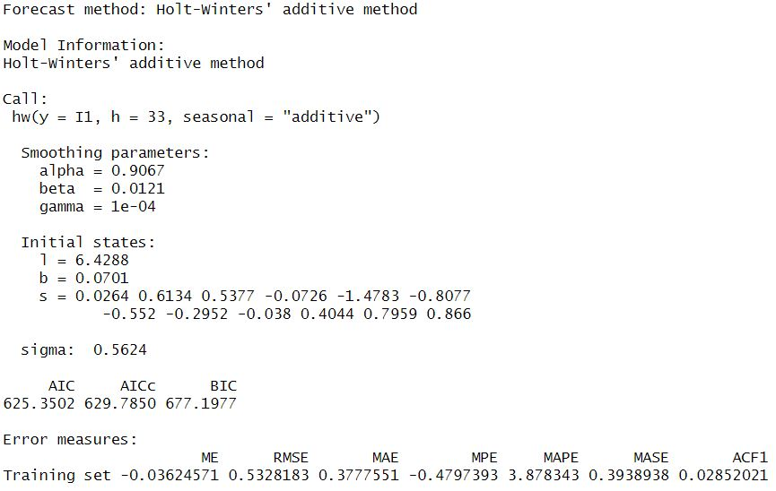
Holt-Winters method (additive)

Slide 26
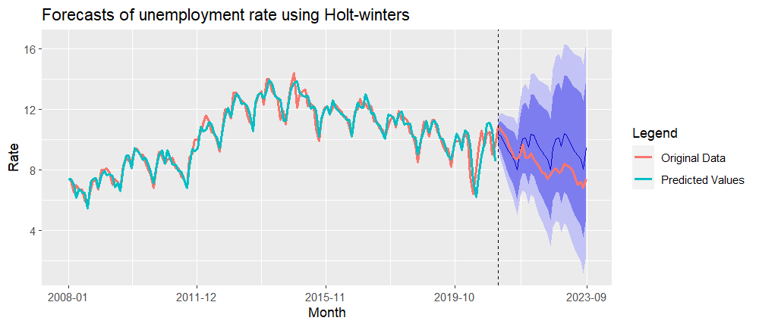
Holt-Winters method (additive)

Slide 27
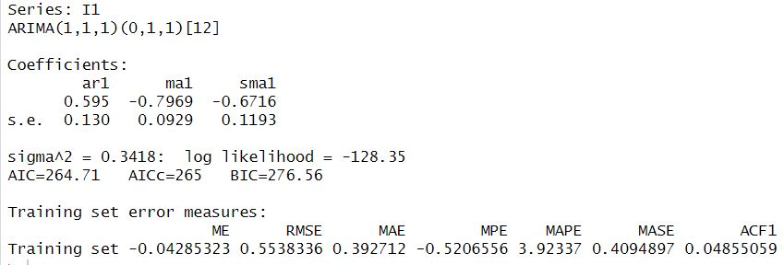
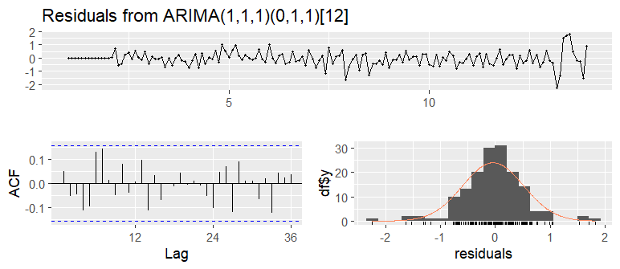
Seasonal ARIMA (1,1,1)(0,1,1)[12]

Slide 28
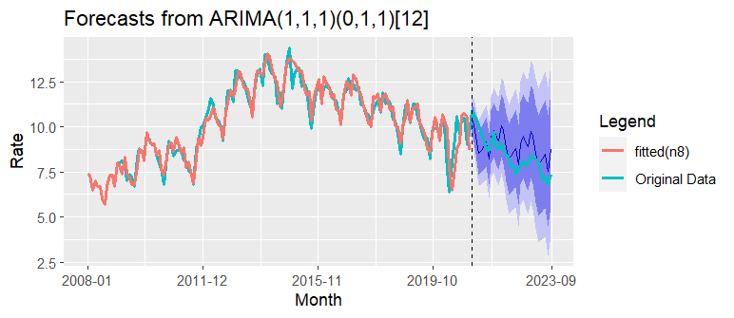
Seasonal ARIMA (1,1,1)(0,1,1)[12]

Slide 29
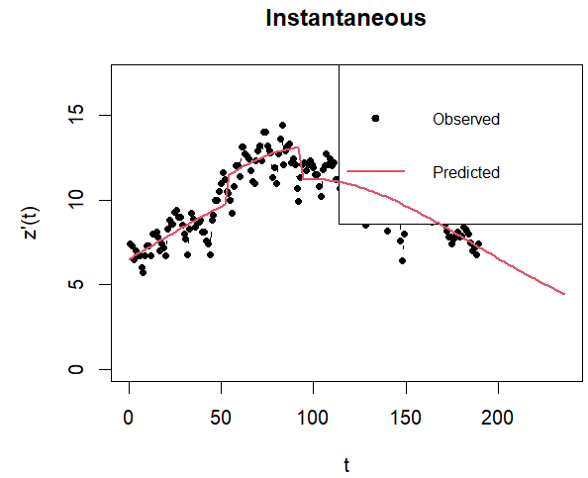
Generalized Bass Model
Motivation: Check if there is shock after the 2008 economic crisis
may not be good models because of their assumptions

Slide 30
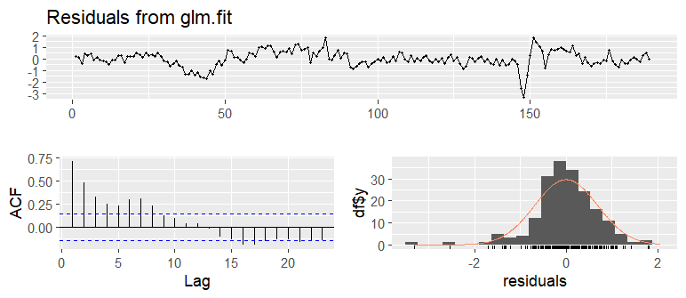
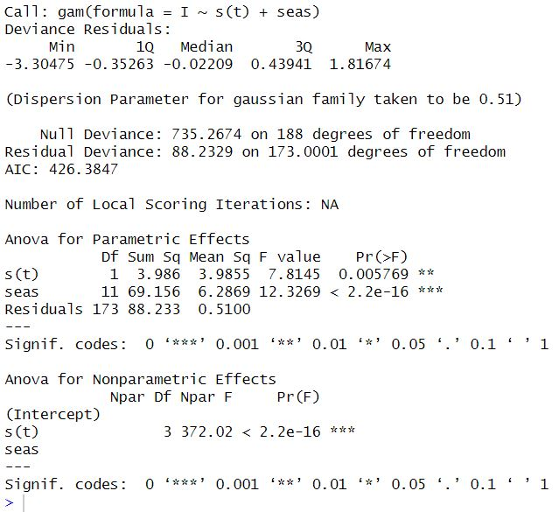
Generalized Additive Model ( y ~ s(t) + s )

Slide 31
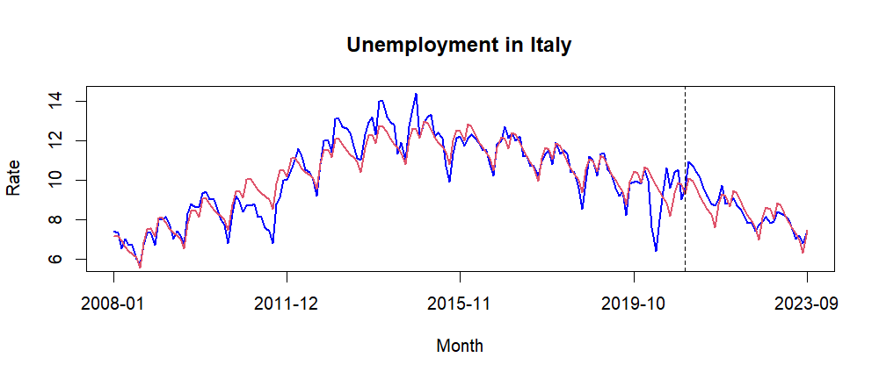
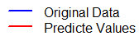
Generalized Additive Model ( y ~ s(t) + s )

Slide 32
Comparing Models For Italy Via Metrics
Models | Train/Test | RMSE | MAPE | AIC | BIC
TSLM | Train set | 0.84 | 6.52 | 419.36 | 465.11
 | Test set | 2.14 | 24.68
Holt-Winters method(additive) | Train set | 0.53 | 3.88 | 777.46 | 832.57
 | Test set | 1.34 | 14.72
SARIMA | Train set | 0.55 | 3.92 | 264.71 | 276.56
 | Test set | 0.91 | 9.49
GAM | Train set | 0.68 | 5.29 | 426 | 471.76
 | Test set | 1.12 | 12.31

Slide 33
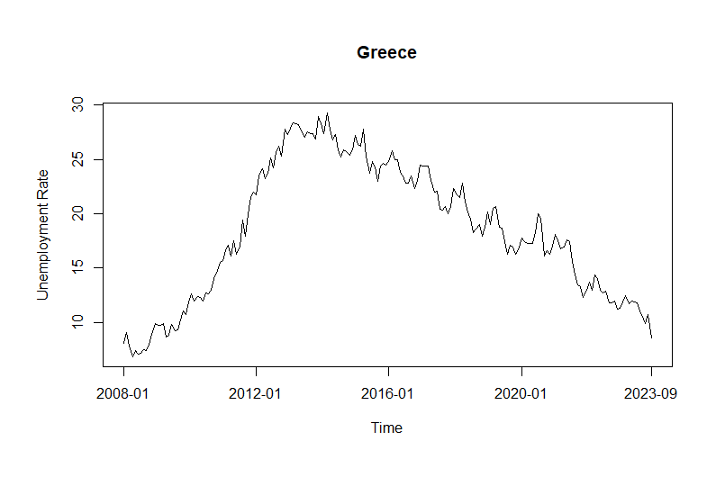
Greece
Great Recession (2007-2009)
Eurozone Crisis (2010-2012)
Greece's Own Debt Crisis
EU Funding and Support
Structural Reforms

Slide 34
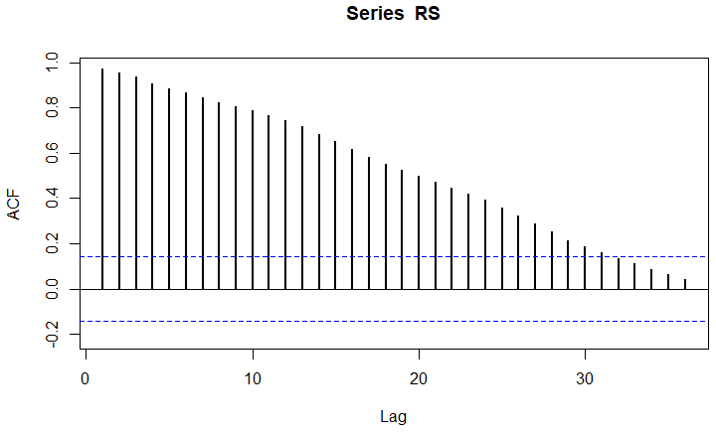
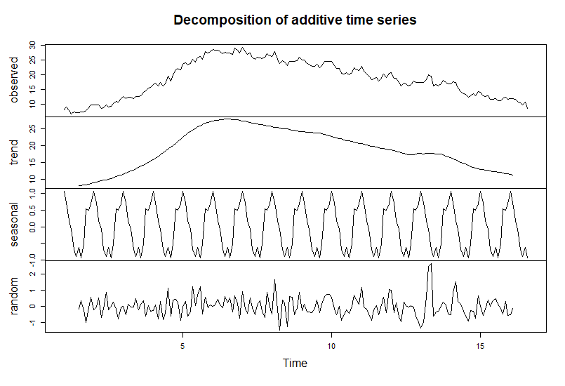
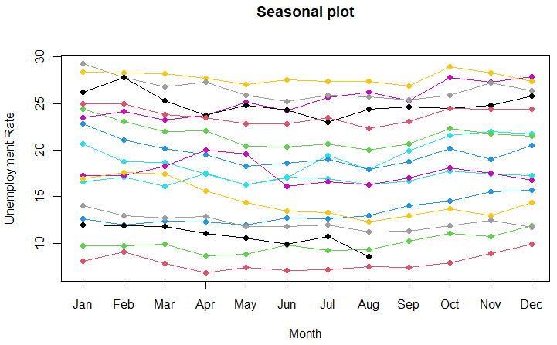

Slide 35
Modelling
Linear regression model (y ~ t + (t^2) + season)
Smoothing Spline
Diffusion models
Holt Winters method (additive)
Gradient Boosting

Slide 36
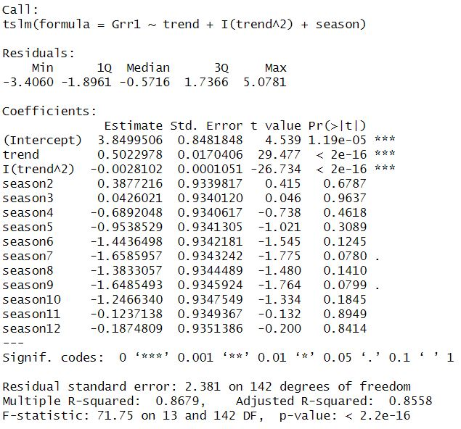
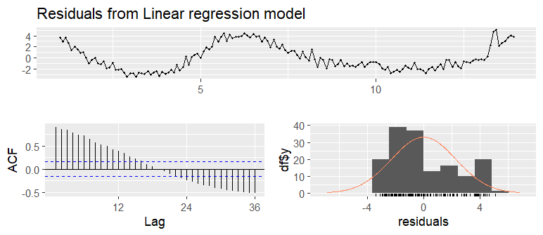
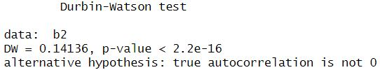
Linear regression (y ~ t + (t^2) + season)
Motivations:
Simple and interpretable

Slide 37
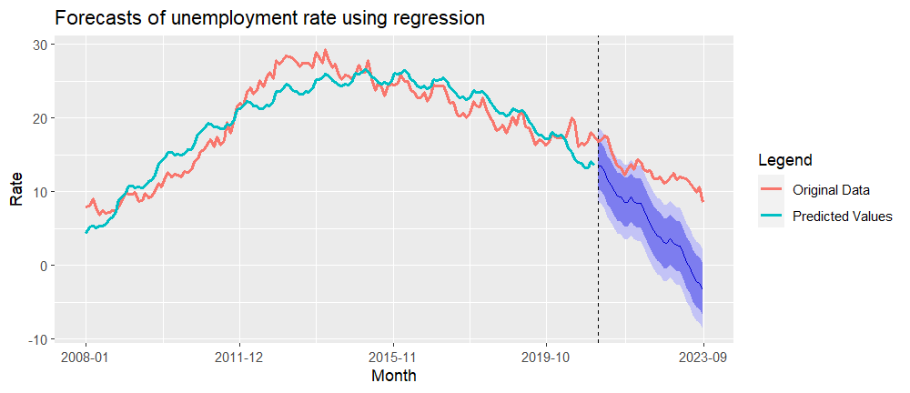
Linear regression (y ~ t + (t^2) + season)

Slide 38
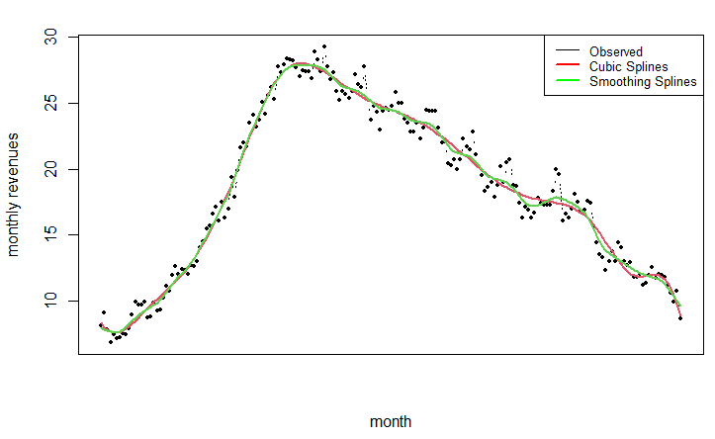
splines
Motivation: flexible and can capture complex patterns with the ability to balance flexibility and overfitting.
cubic splines
Smoothing splines

Slide 39
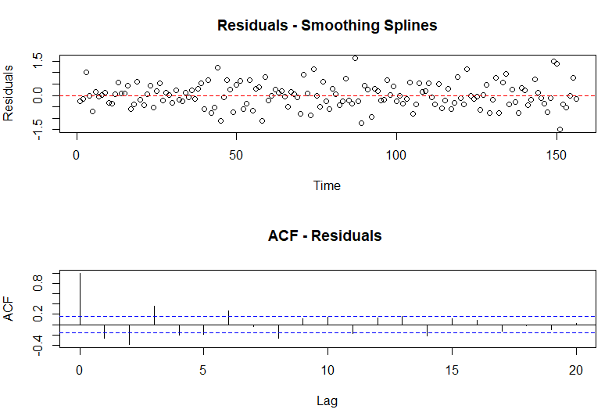
Smoothing Splines

Slide 40
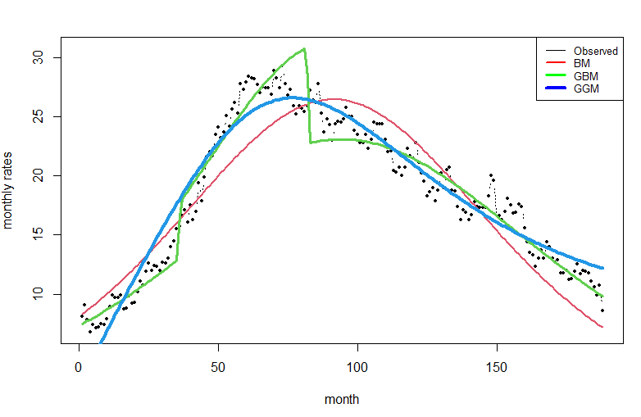
Diffusion Models
Motivation: Check if there is shock after the 2008 economic crisis
BM, GBM and GGM
may not be good models because of their assumptions

Slide 41


Holt-Winters method (additive)
Motivation:
capture both the trend and seasonality
Adaptability to Changing Patterns
Forecasting Accuracy

Slide 42

Holt-Winters method (additive)

Slide 43
Adding Features
GDP
Consumer Price Index
Balance Of Payment
Gross Domestic Product normalized for Greece, Index
Monthly
All Items, Total for Greece
Index 2015=100,
Monthly
Currency: Million euro
Total economy
Monthly
Partner: Rest of the world

Slide 44

Correlation Matrix
Response variable: rates

Slide 45


Gradient Boosting
Motivations: a different approach compared to previous models, Combine multiple weaker models
No cross validation
rates ~ .-Greece, data=data.train, n.trees=5000, interaction.depth=1, shrinkage=0.01)
minimum error: 15.56

Slide 46


Results

Slide 47
Comparing Models for Greece Via Metrics
Models |  | RMSE | MAPE | AIC | BIC
TSLM | Train set | 2.27 | 11.31 | 728.73 | 774.47
 | Test set | 7.82 | 60.66
Smoothing Splines | Data set | 0.79 | 3.84 | 455.07 | 464.78
Holt-Winters method(additive) | Train set | 0.77 | 3.32 | 740.82 | 792.66
 | Test set | 3.4 | 26.63
Gradient Boosting | Train set | 3.32 | 15.06 | - | -
 | Test set | 3.94 | 17.8

Slide 48
Conclusions and Future Works
After 2008 we have the most variations in unemployment rates in Europe countries
Holt-Winters methods for Germany and Greece and SARIMA for Italy seems to be the best models for forecasting
The Greece time series is less regular and predictable
The other predictors found for Greece seems to be relevant and effective
Further analysis can exploit the usage of other predictors in the data

Slide 49

Thank you

