Slide 1
Praktikum Data Preprocessing
Predictive Mining for Time-Series Data
Ulima Inas Shabrina(2110181048)

Slide 2
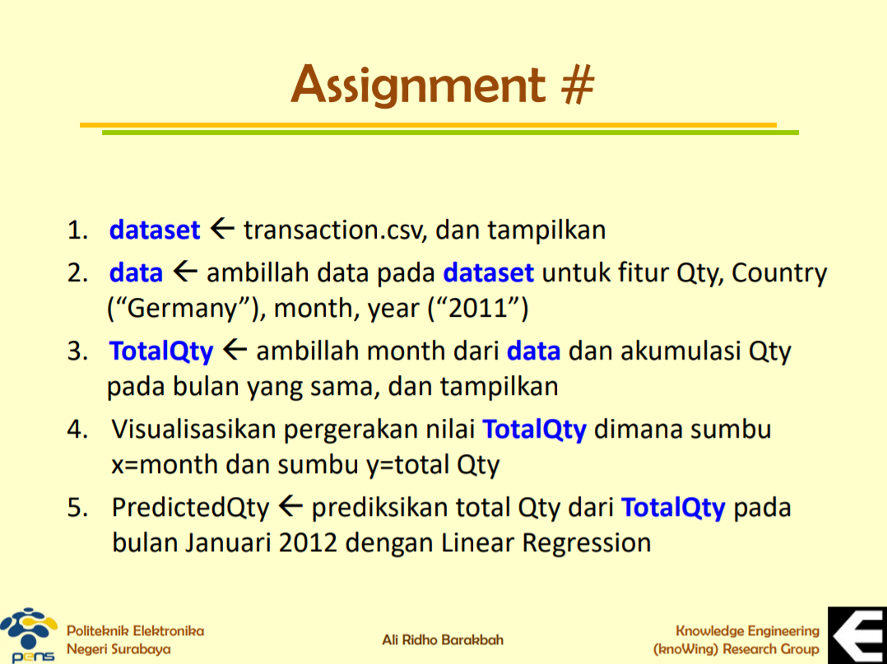

Slide 3
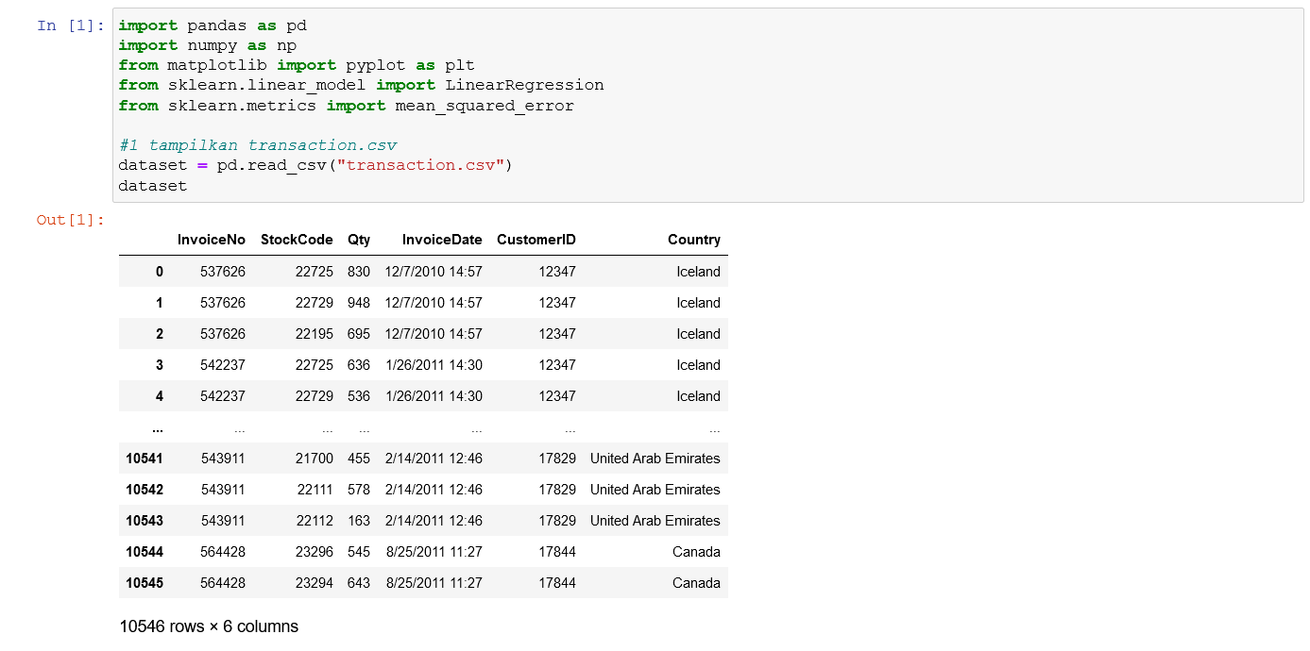

Slide 4
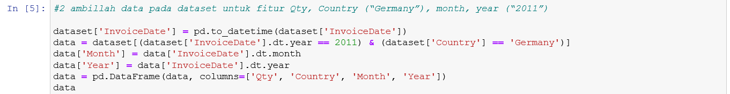
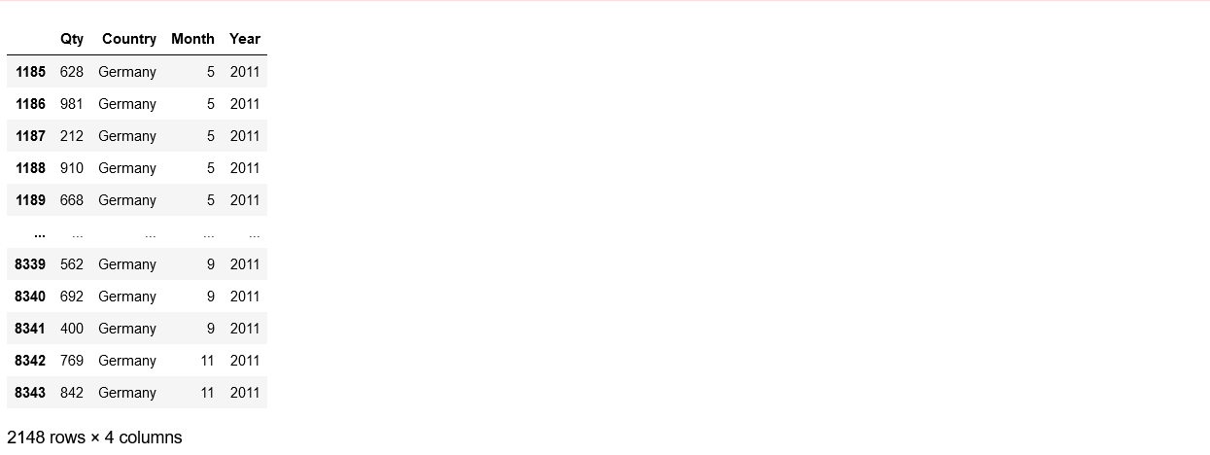

Slide 5
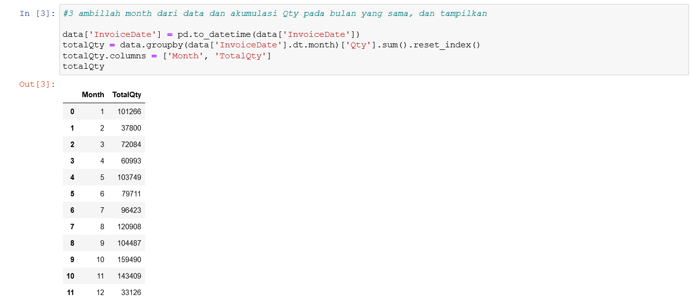

Slide 6
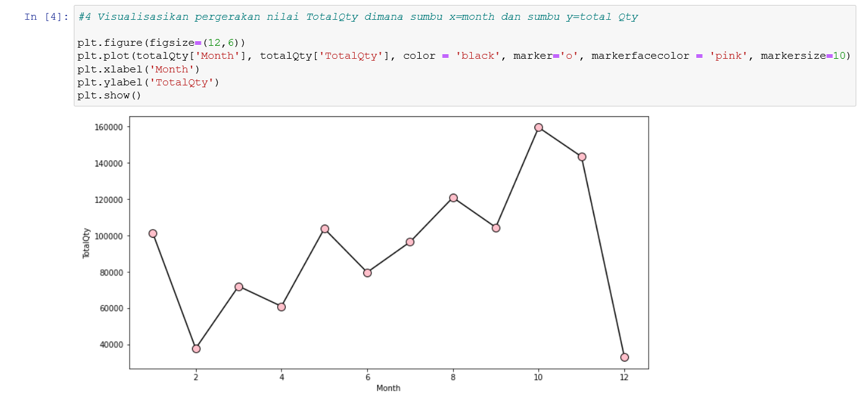

Slide 7


Slide 8
Terimakasih

