Slide 1
Praktikum Data Preprocessing
Classification
Ulima Inas Shabrina(2110181048)

Slide 2
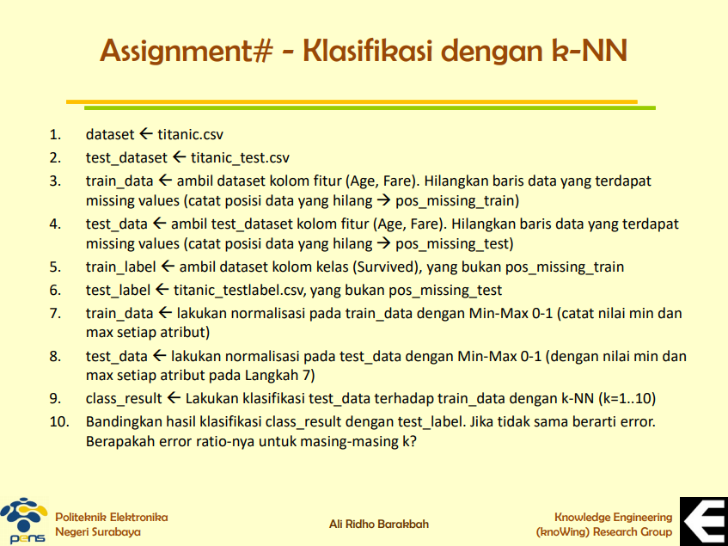

Slide 3
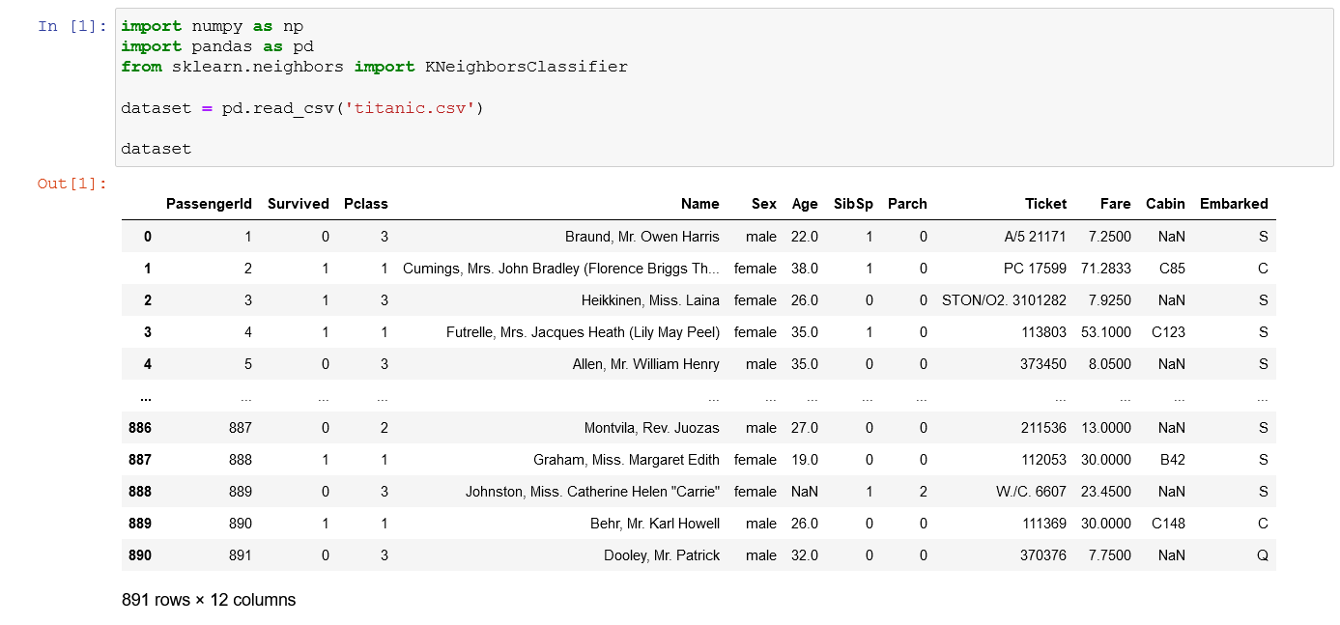
No 1

Slide 4
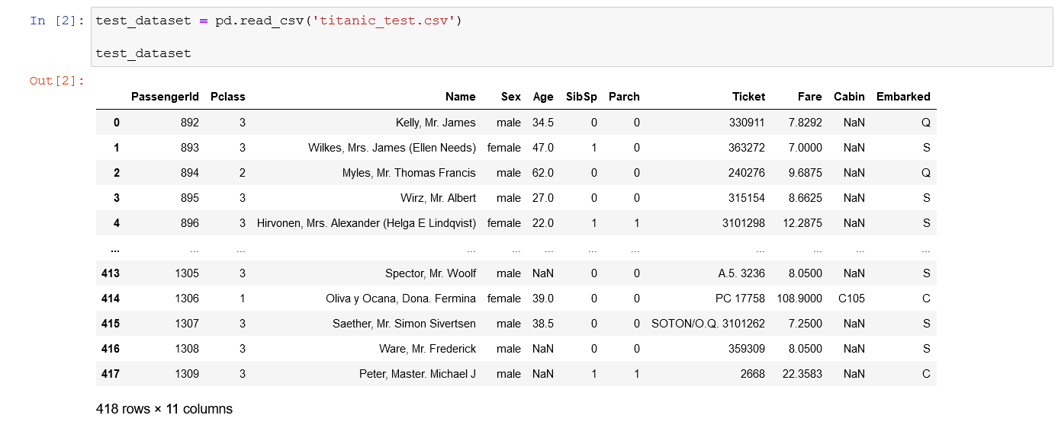
No 2

Slide 5
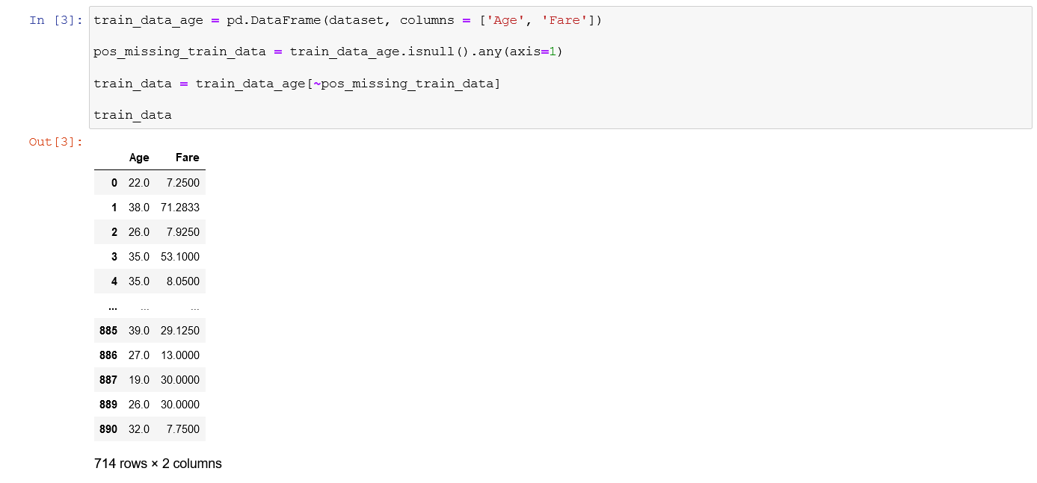
No 3

Slide 6
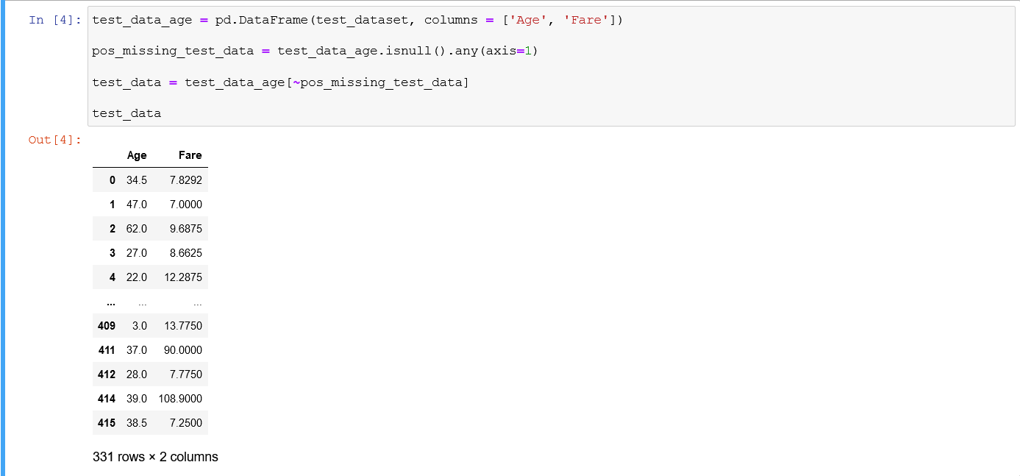
No 4

Slide 7
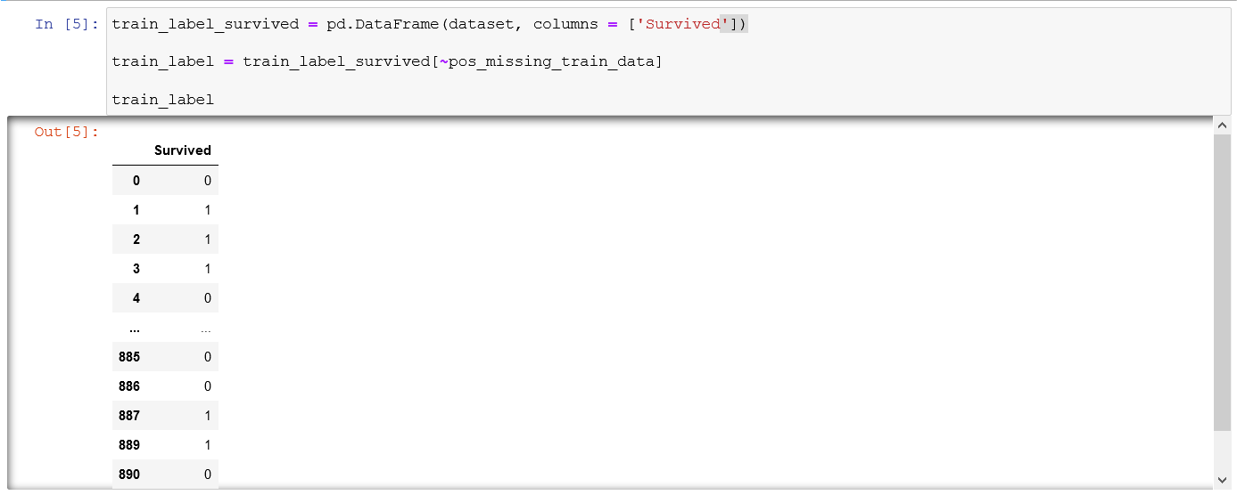
No 5

Slide 8
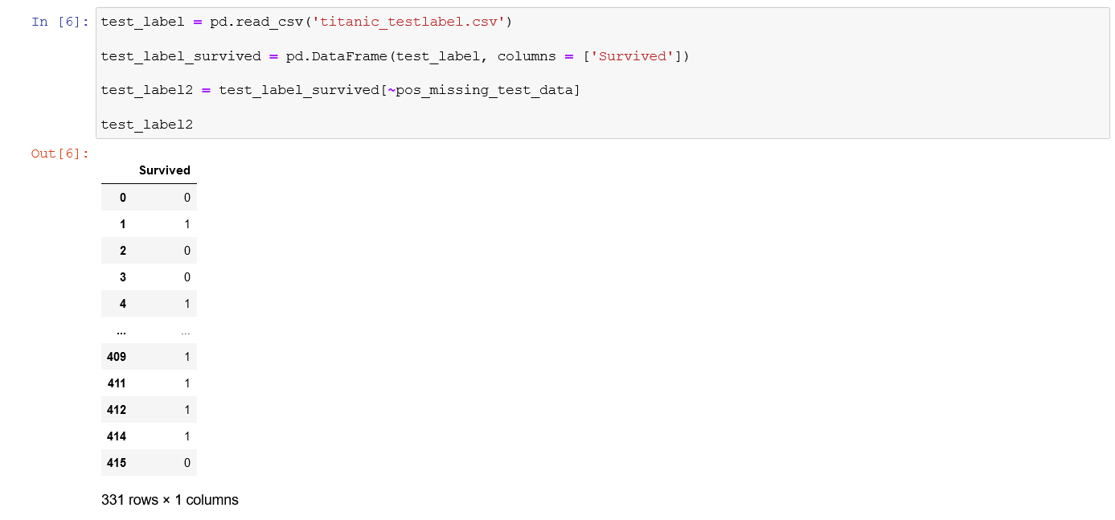
No 6

Slide 9
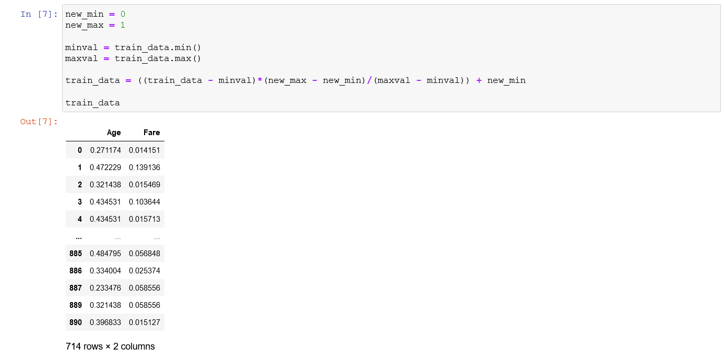
No 7

Slide 10
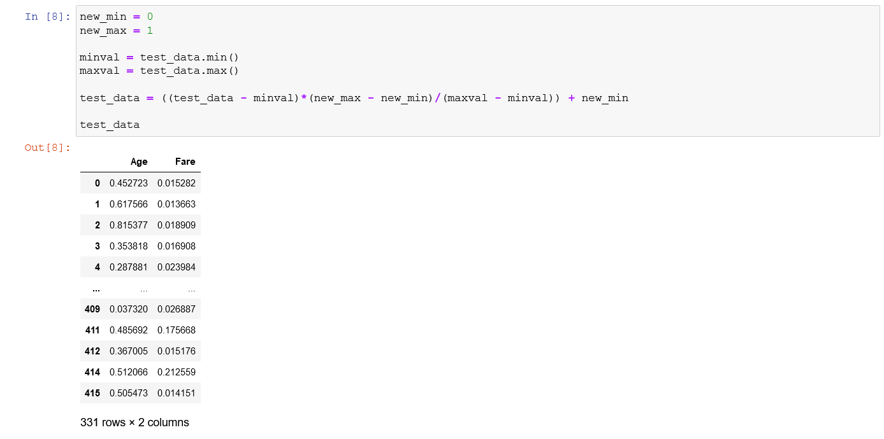
No 8

Slide 11
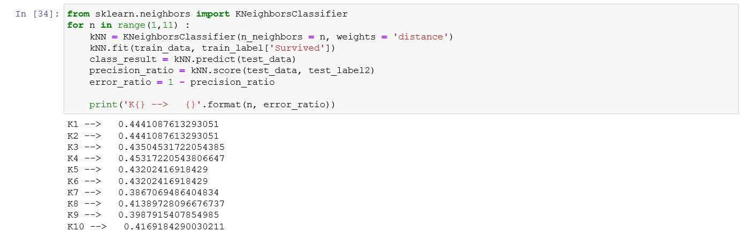
No 9 & 10

Slide 12
Terimakasih

