Slide 1
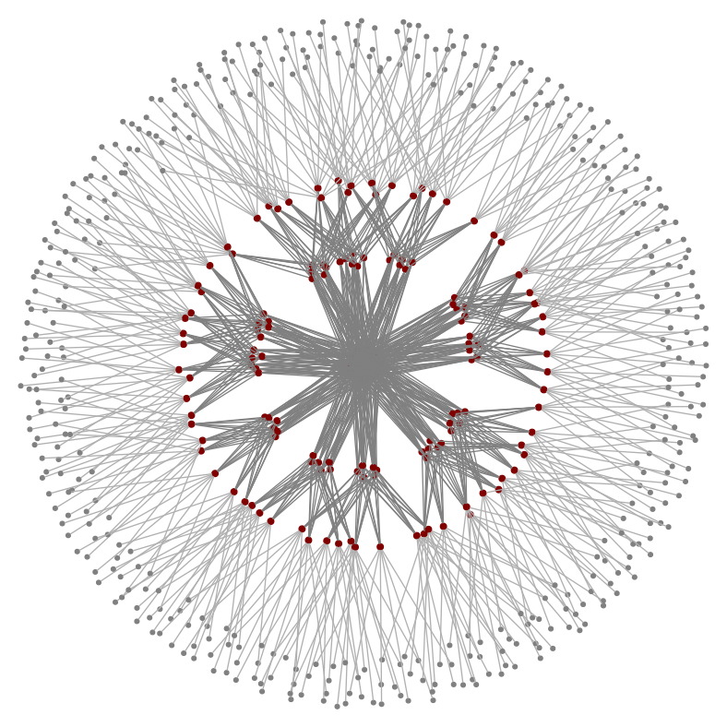
Hawkeye Performance Monitoring for Data Centers
Shabbir Suterwala
Insight DE Fellow
Notes:
I have been an engineer for number of years and I have not been able to figure out how my application performs along with other applications in a datacenter.
I present to you Hawkeye, which is a performance monitoring solution for datacenters and an answer to my problem

Slide 2
Hawkeye – Use cases
Analyze over or under performance
Preemptively reorganize cluster
Load balance
Capacity planning
MTBF stats
Power consumption
Scheduled batch jobs
At second’s time window
Notes:
What does hawkeye do?

Slide 3
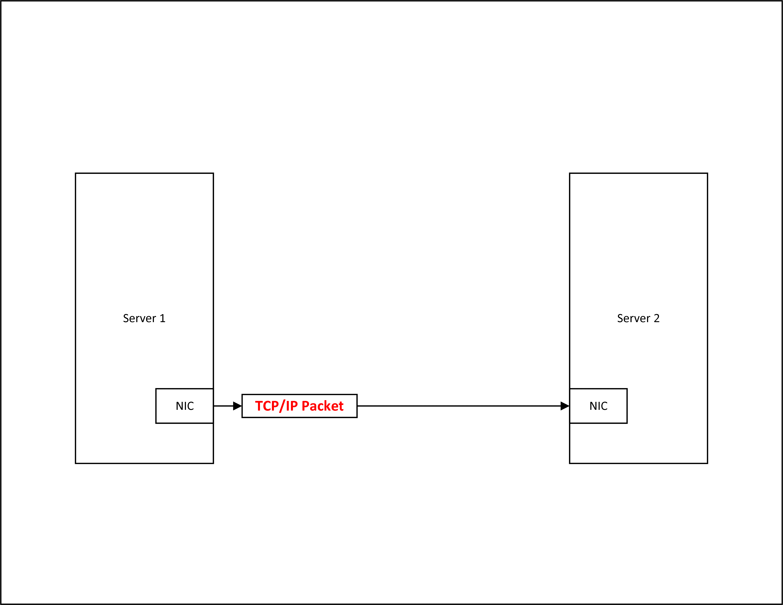
Hawkeye - Approach
Notes:
As you know systems talk to each other by sending TCP/IP packets

Slide 4
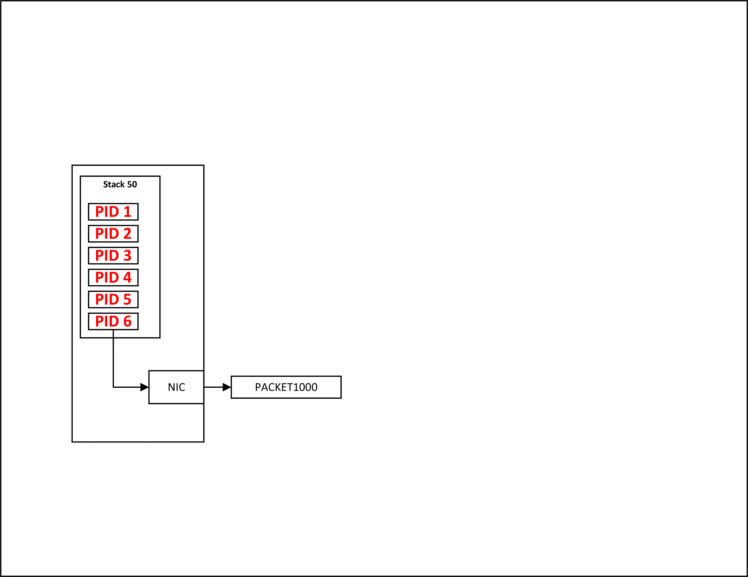
Hawkeye - Approach
Notes:
If we think about it, that packet is generated for a stack of processes

Slide 5
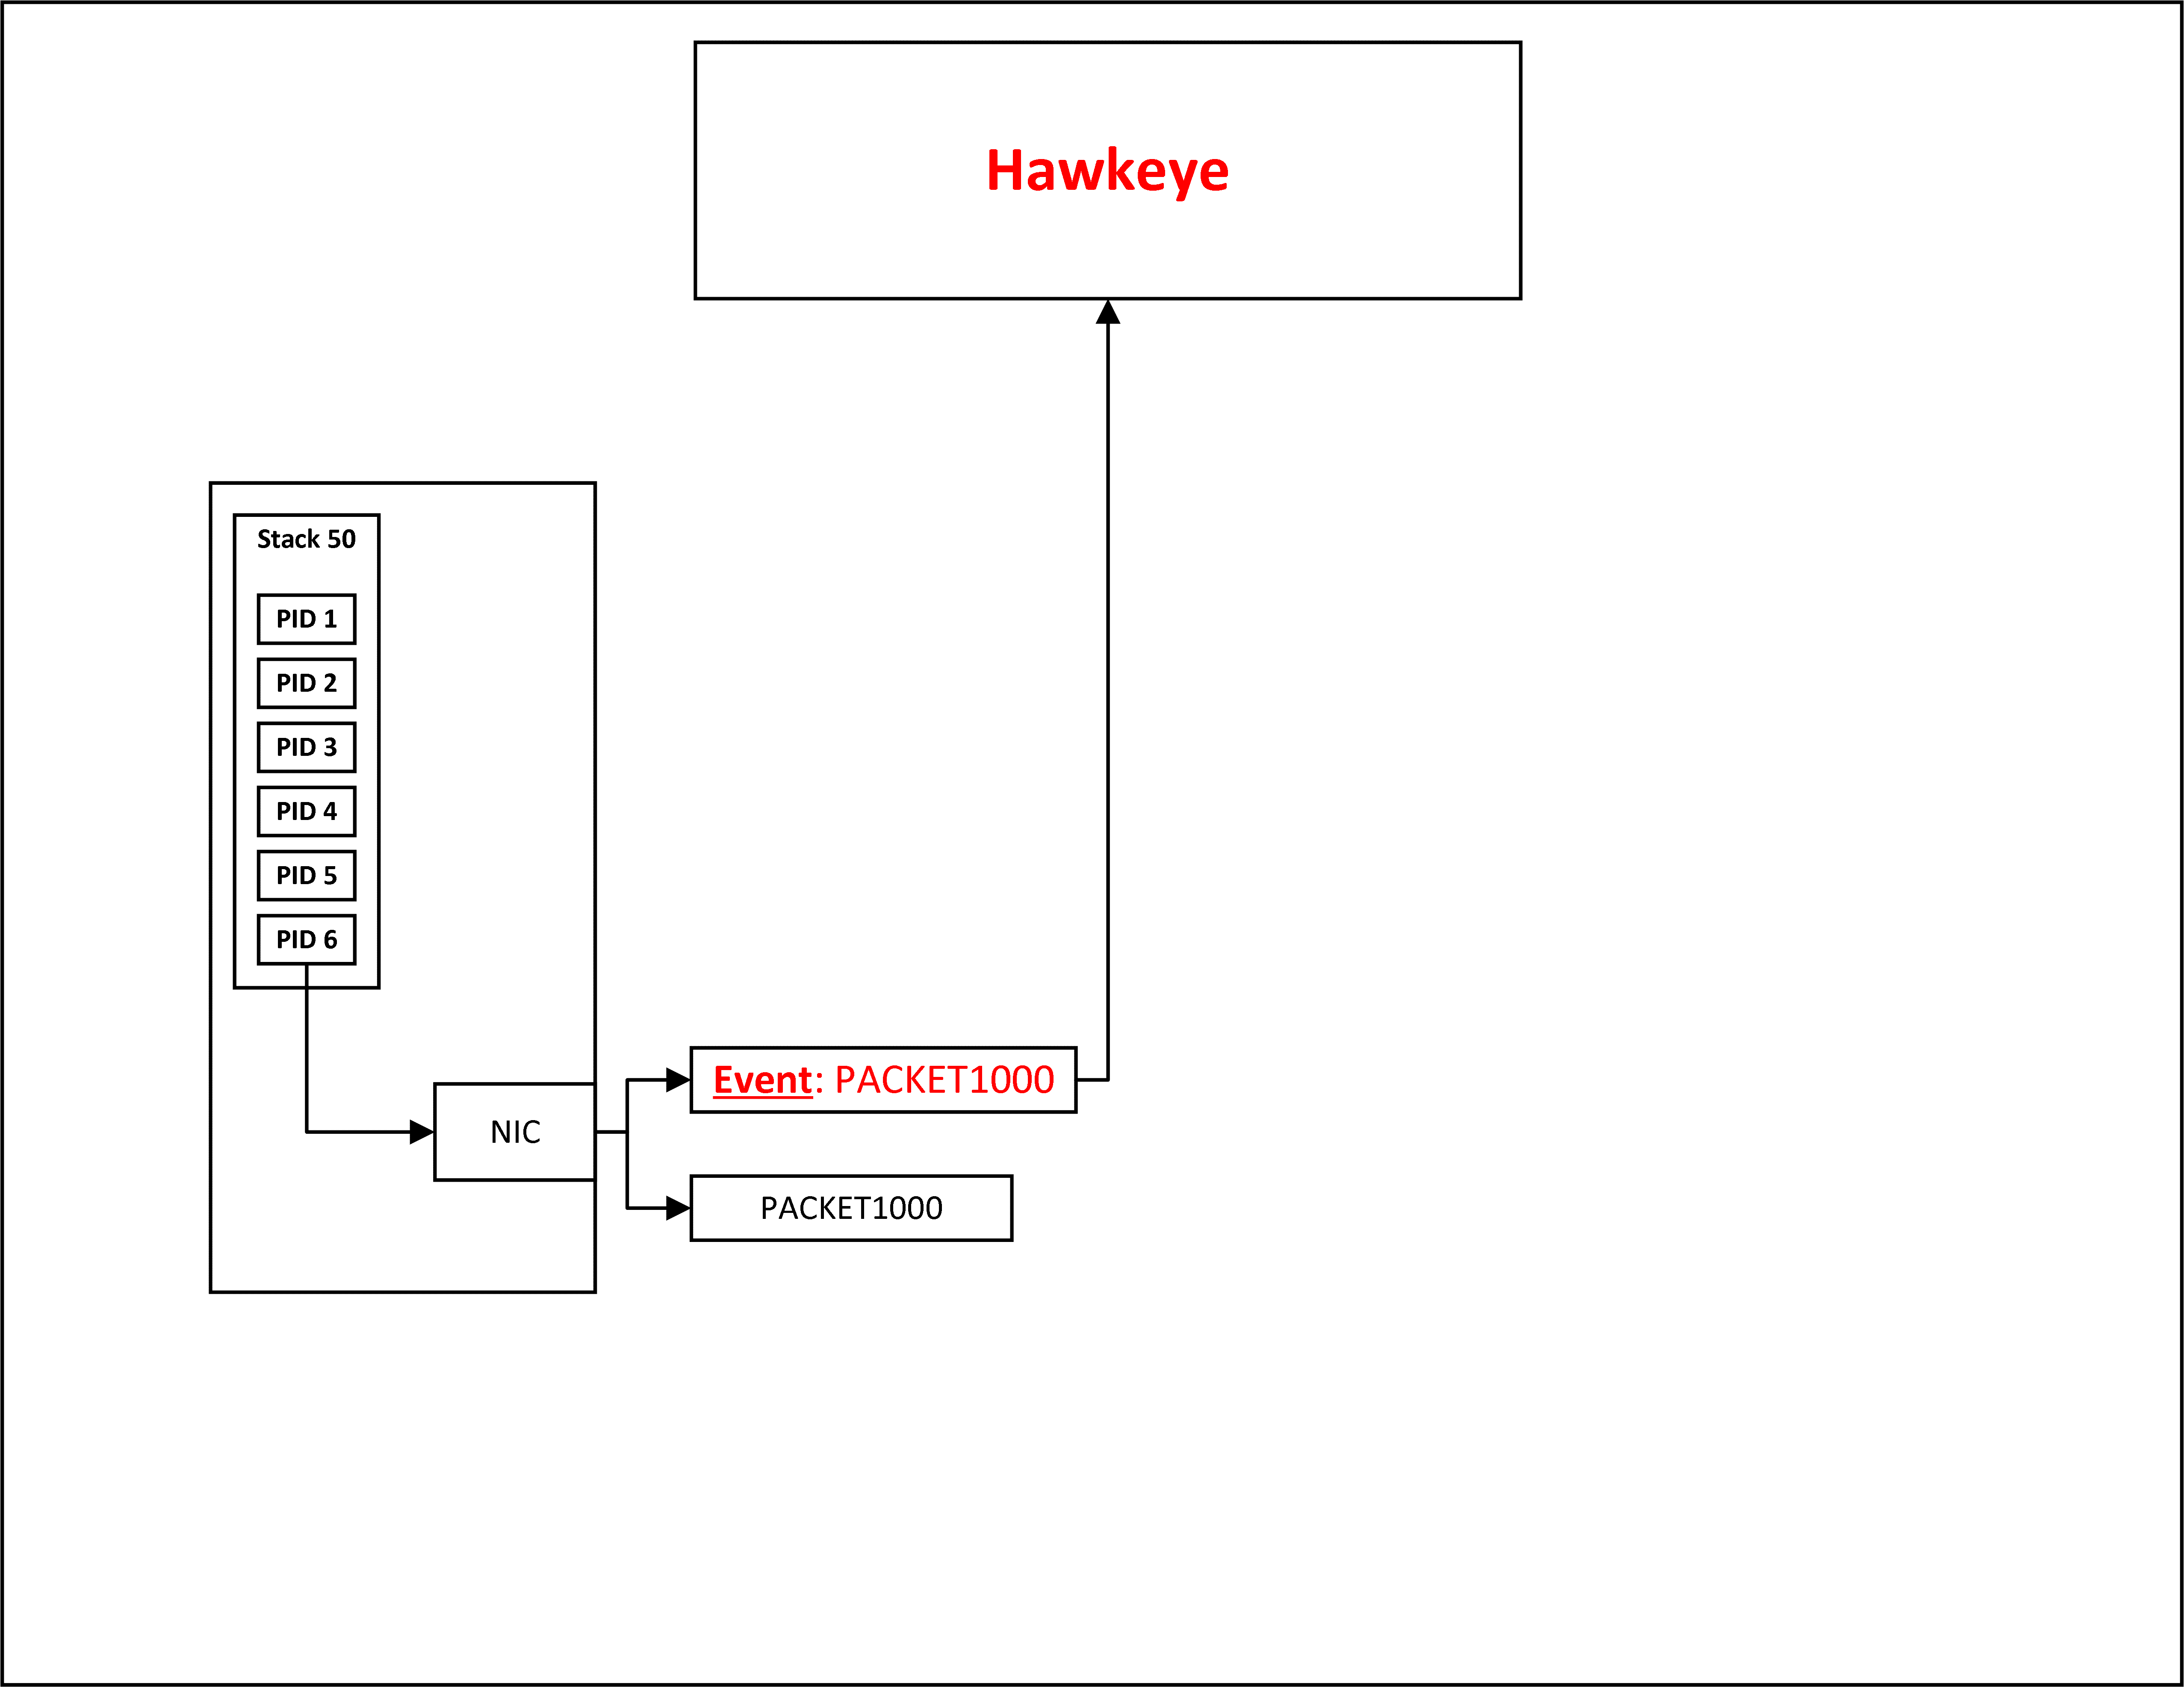
Hawkeye - Approach
Notes:
A small module sits at NIC and sends an event out to Hawkeye when a packet is sent out
This is done for every outbound packet

Slide 6
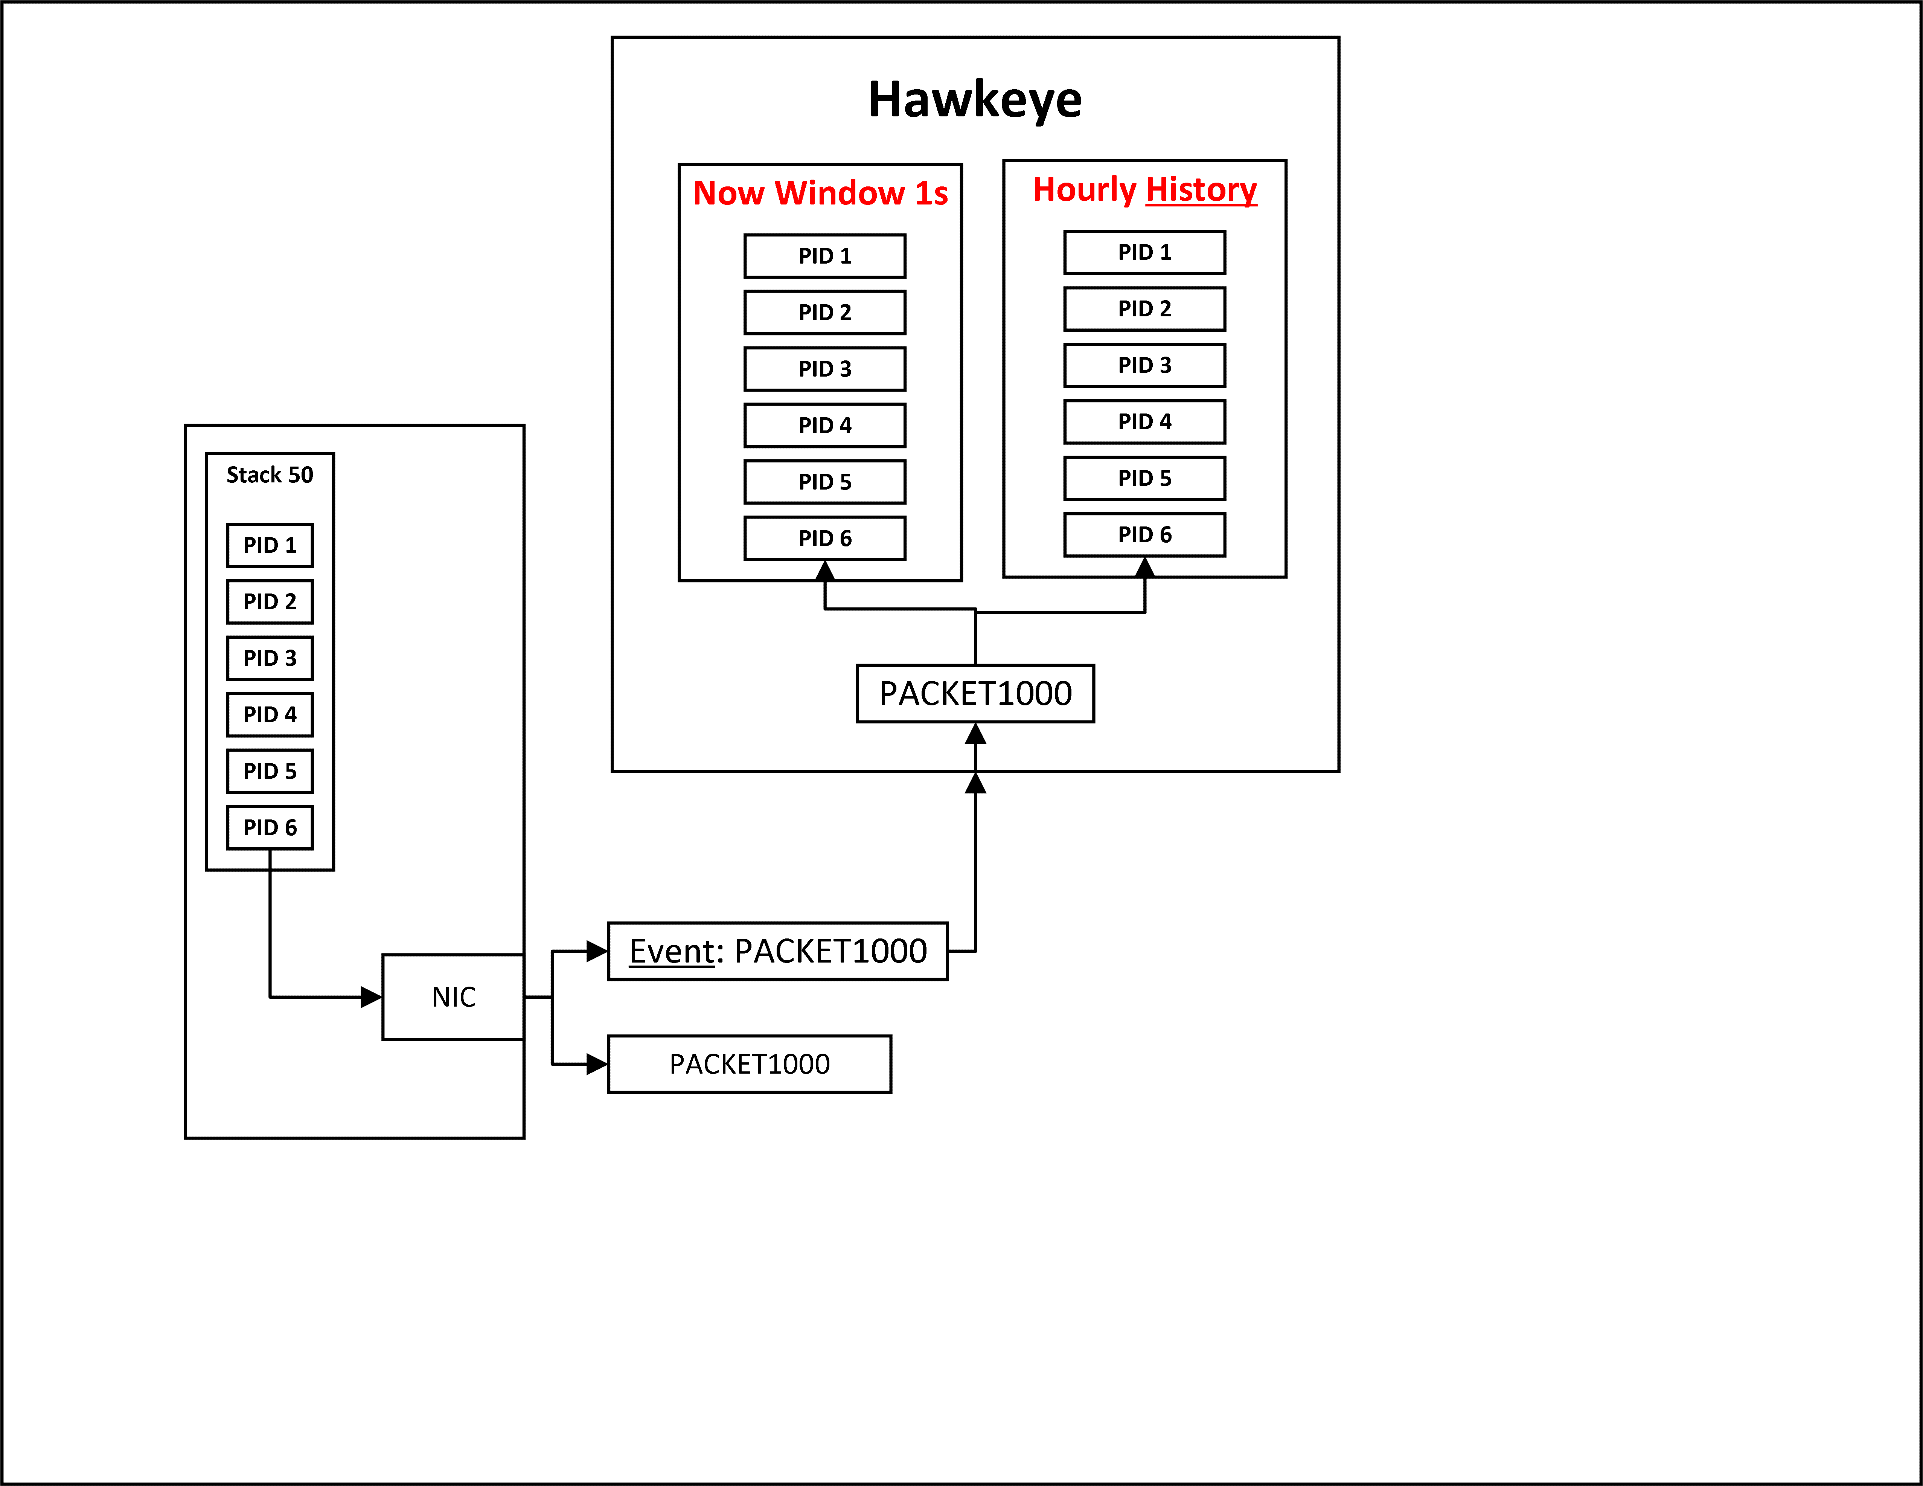
Hawkeye - Approach
Notes:
Hawkeye calculates throughput every second and maintains an hourly history

Slide 7
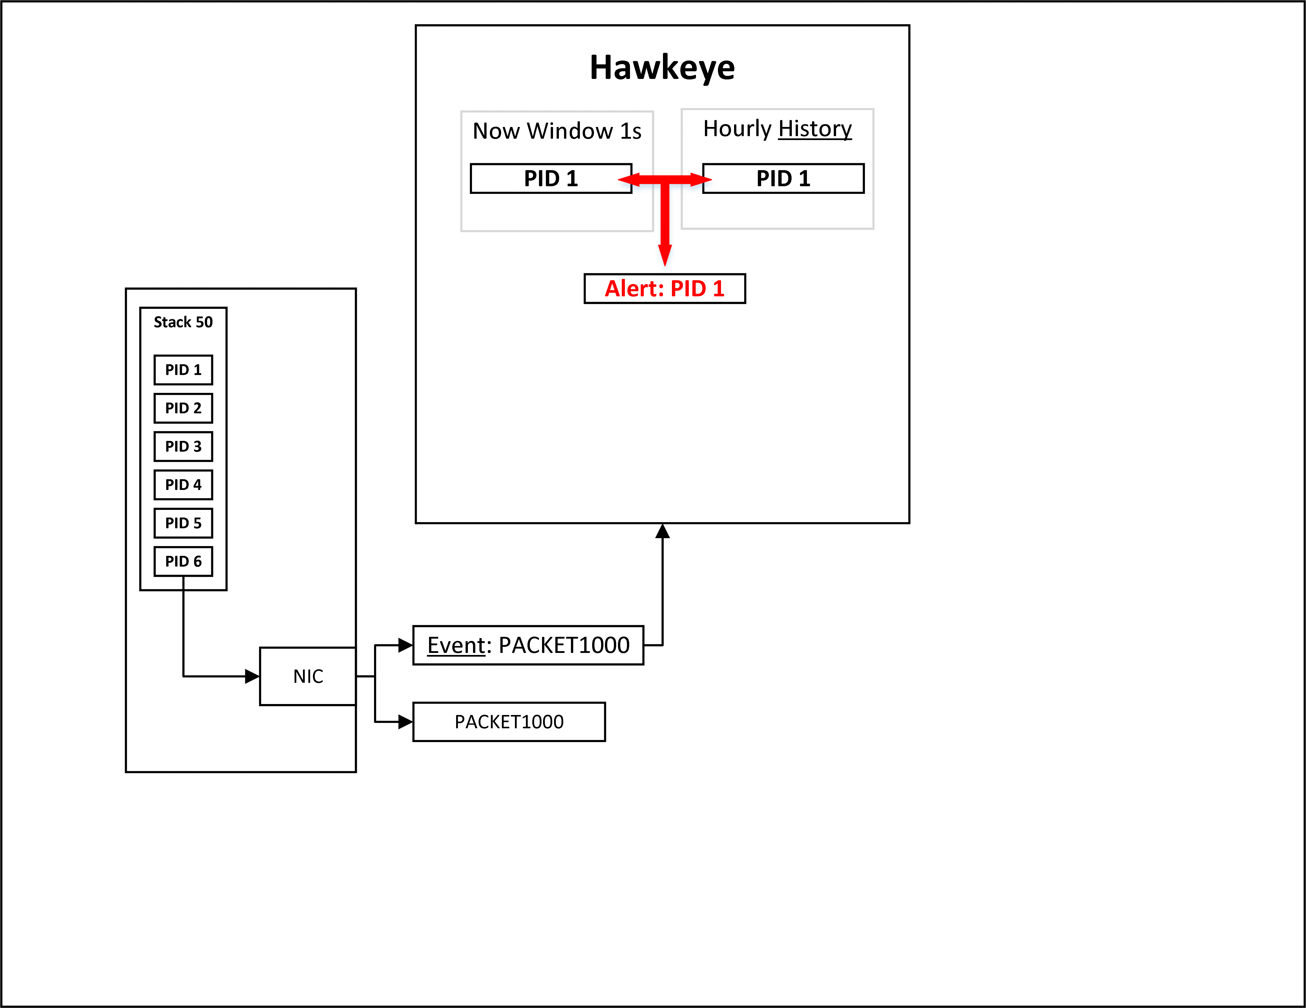
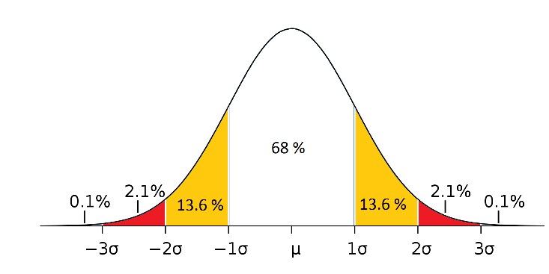
Hawkeye - Approach
Notes:
Compares now value with history summary and sends alerts if an anomaly is detected

Slide 8
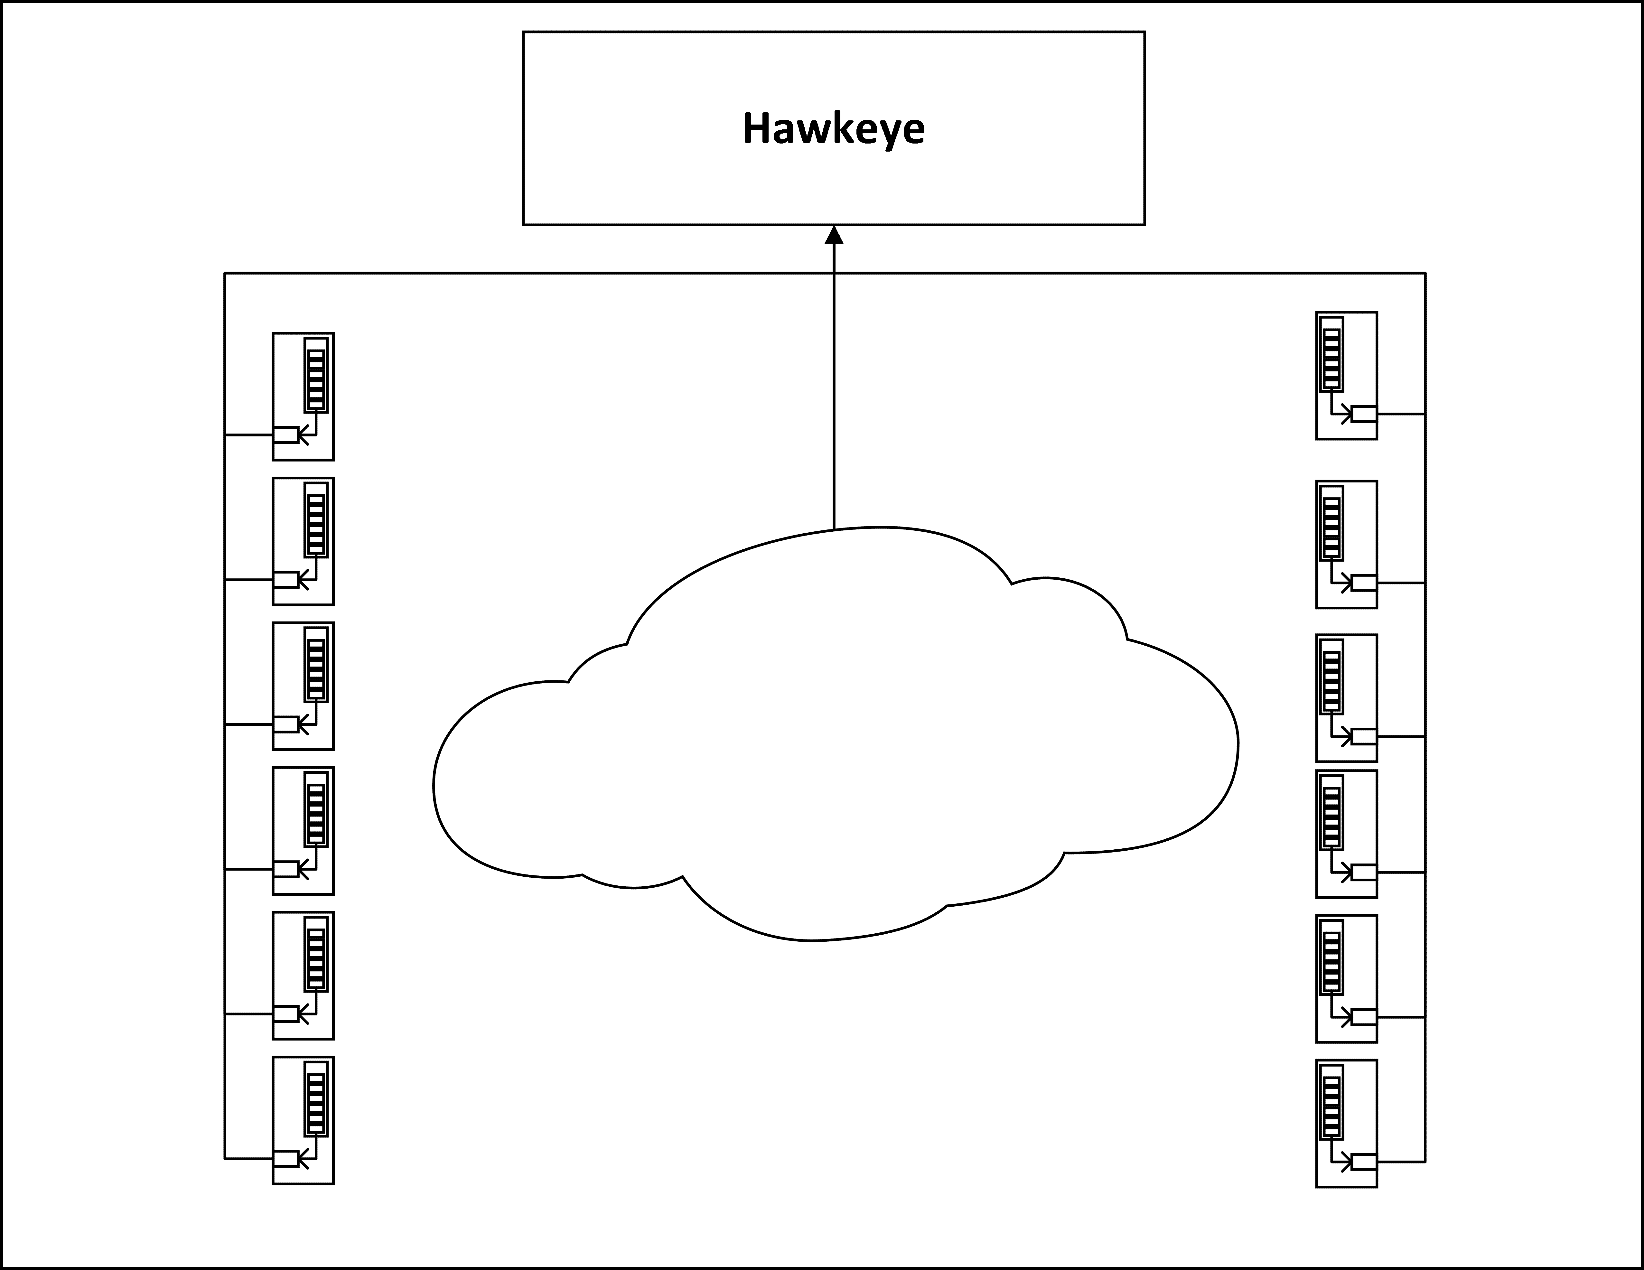
Hawkeye - Approach
Notes:
All computers in datacenter are continuously sending packets to Hawkeye
Hawkeye is continuously calculating throughput

Slide 9
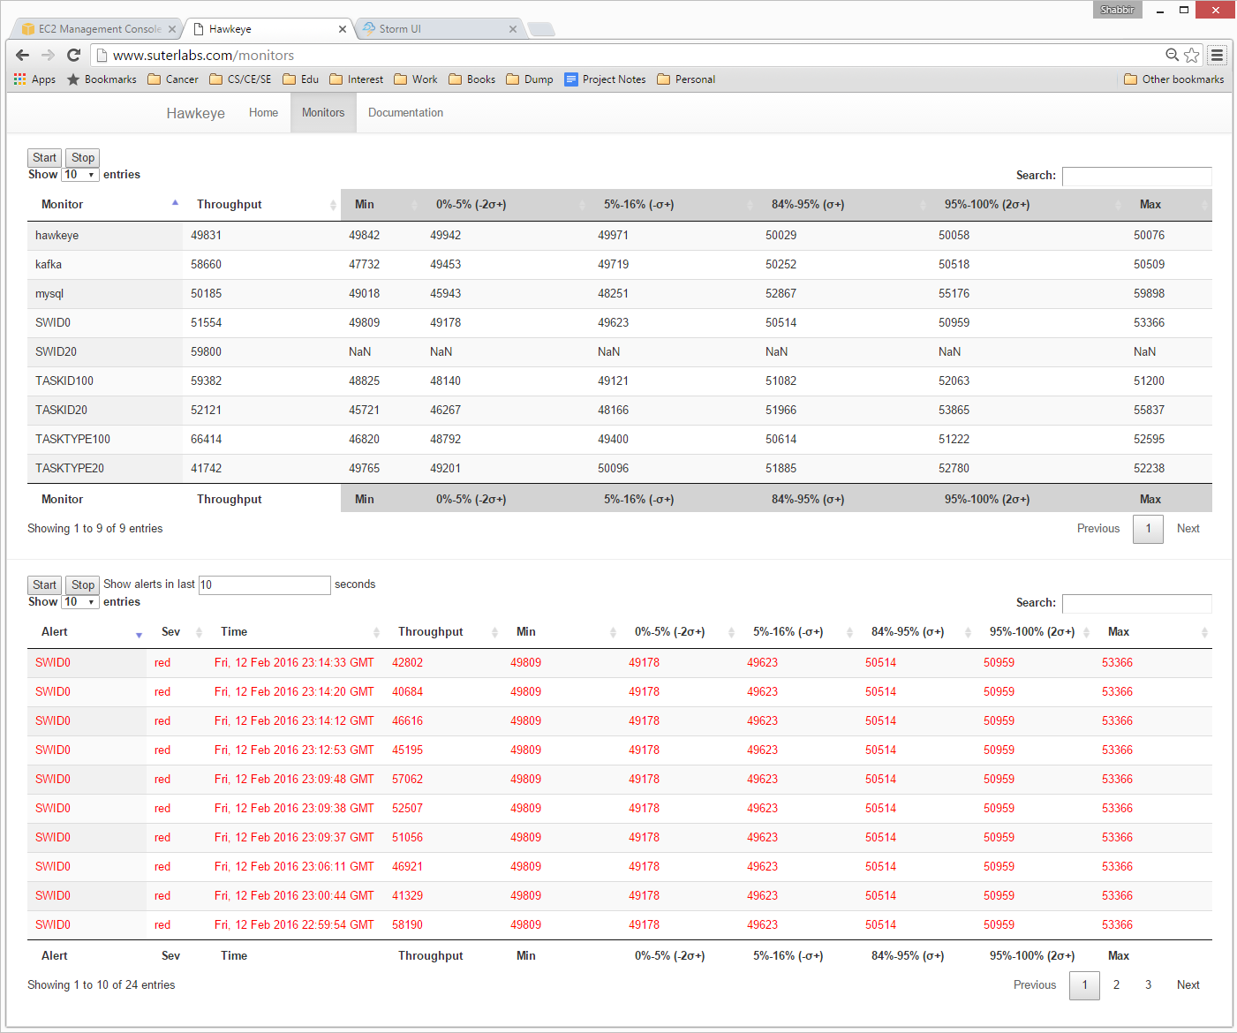

Slide 10
Data – 5TB / day
HawkeyeEvent: {
tsIn: 1453407175613828, tsOut: 1453407175614662,
packetID: "PACKET19083“,
monitorGroup: [
{type: “T”, subgroup: “AppType“, id: “App“, power: 6},
{type: “I”, subgroup: "AppID“, id: "Hawkeye“, power: 5},
{type: “T”, subgroup: "SwType“, id: "SWTYPE42“, power: 4},
{type: “I”, subgroup: "SwID“, id: "SWID20“, power: 3},
{type: “T”, subgroup: "TaskType“, id: "TASKTYPE21“, power: 2},
{type: “I”, subgroup: "TaskID“, id: "TASKID154“, power: 1}
]
}

Slide 11
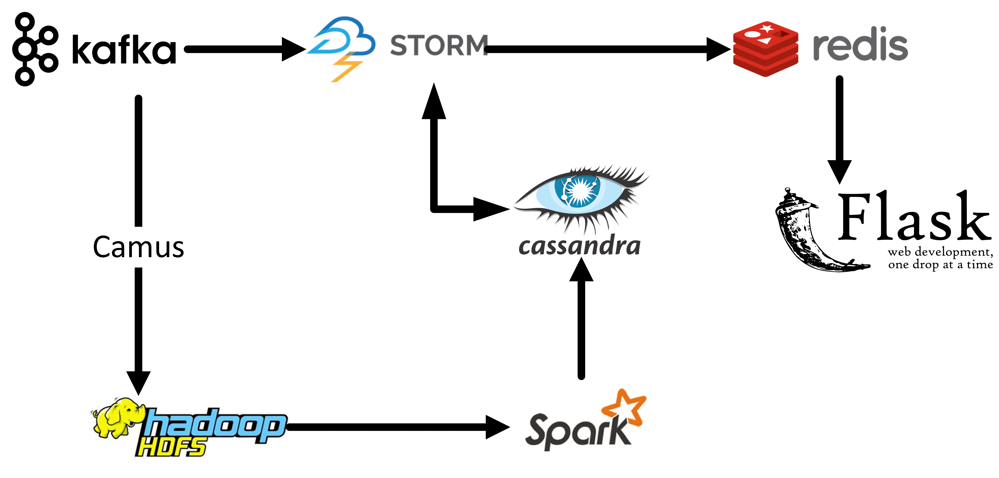
Pipeline

Slide 12
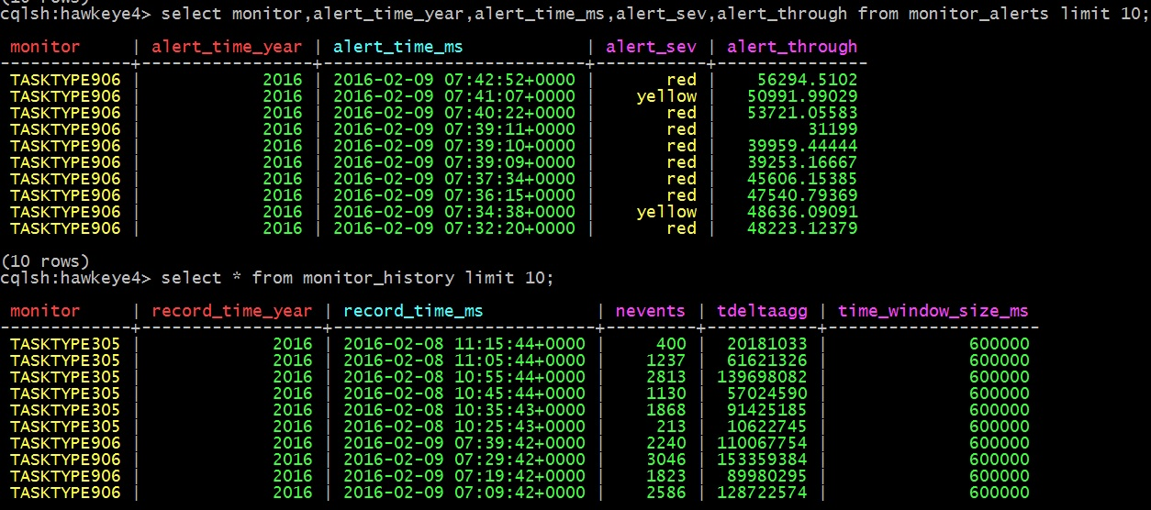
Schema - Subset

Slide 13
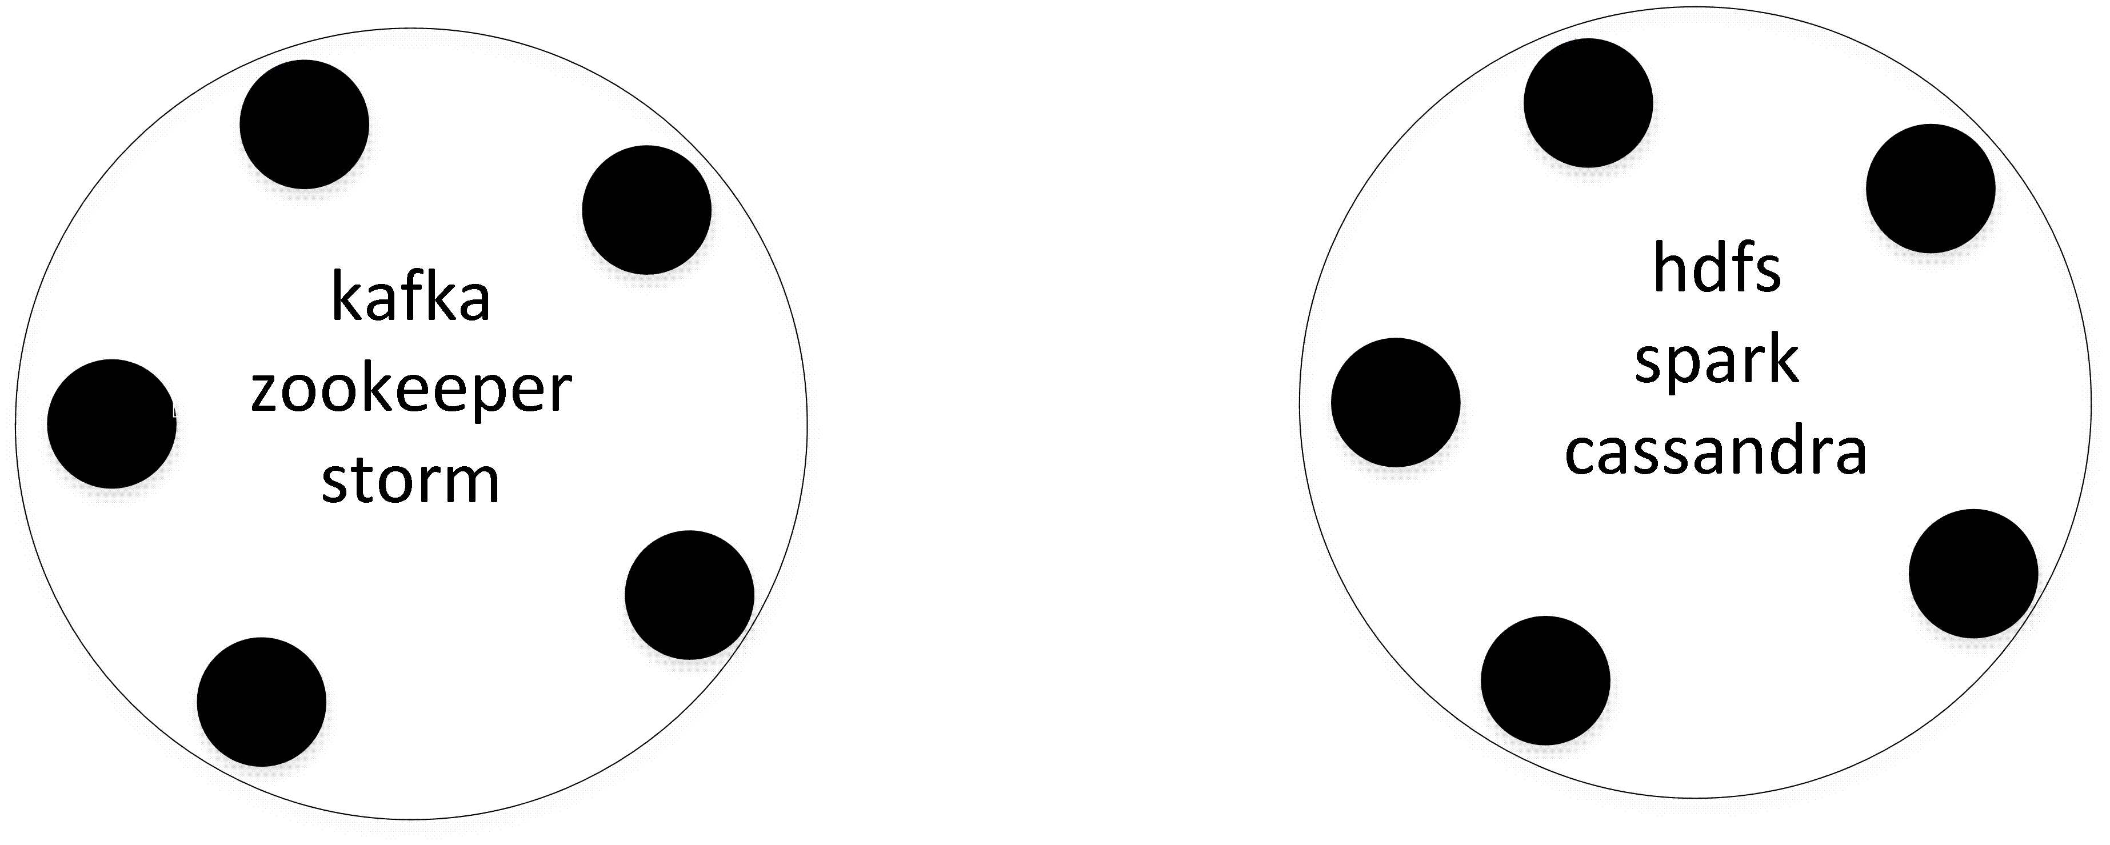
Cluster
10 m4.xlarge
1TB
Instances : $57.36 / 24 hours
Storage : $70 / month

Slide 14
Lessons Learned
Start with Query
Invest in a scheduler
Make the cluster secure from day 0

Slide 15

Shabbir Suterwala
Team Lead, Architecture / Principal Architect @ Infor
Cloverleaf → Ingestion & processing engine for healthcare market
Previously worked at Cisco, AMD and Storage Startup
Built OS, Virtual Machines, File Systems

Slide 16
Backup Slides

Slide 17
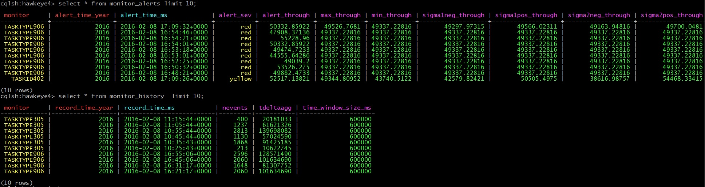
Schema - Full

Slide 18
Hawkeye – How?
Chatty App → Low Performance
Measure by counting TCP/IP Packets
Throughput = Total Packets / Time
Include Network Latency
Throughput = (Total Latency / Total Packets) / Time

Slide 19
Hawkeye – When?
Alerts – per monitor
Throughput now vs. historical data
Upper bound and lower bound
Game – per stack
Rank user’s stack’s performance in real time
Notes:
Move to backup section

Slide 20
Data
Event:
TCP/IP packet timestamp In / Out
List of Monitors
Engineered Data for Insight Project
Real World
Hook into kernel: network stack, scheduler
Hi priority demon using *top*
Hypervisor

Slide 21
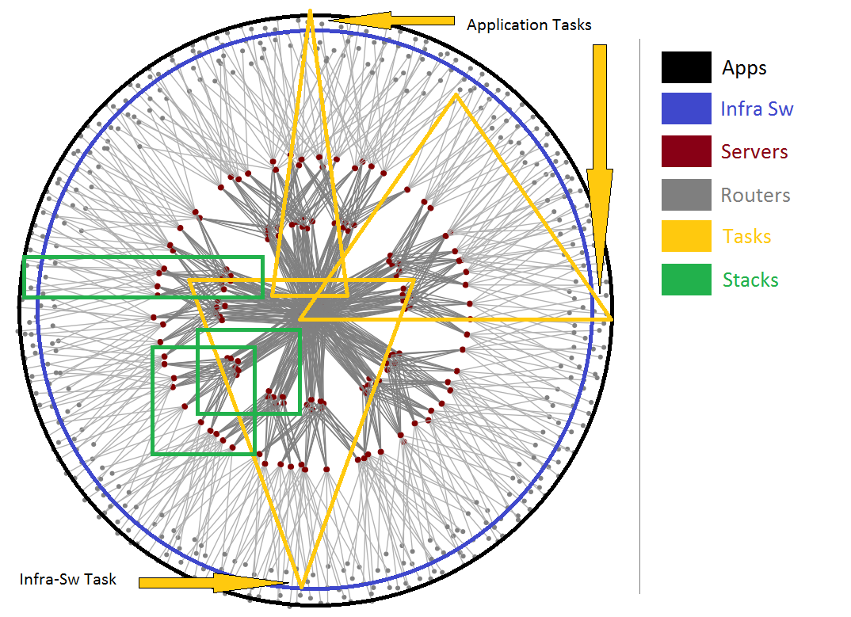
Hawkeye Monitors

Slide 22
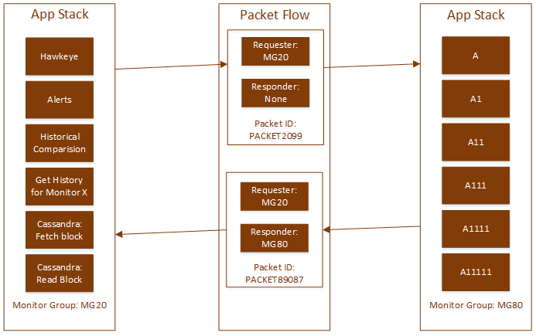
Hawkeye – Execution

Slide 23
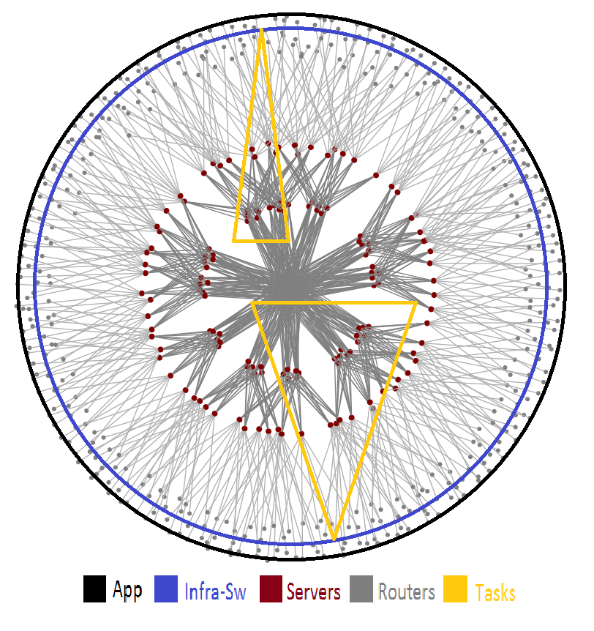
Hawkeye - Approach
Sniff each TCP/IP packet
Packet (P) → Source Stack (SS)
At P’s arrival:
For each source in SS
Add P’s latency to source
Now Window (1s):
For each source in Hawkeye
Alert of throughput’s pvalue < 0.05

