Slide 1
HawkEye Performance Monitoring Solution for Data Centers
Shabbir Suterwala
Insight DE Fellow

Slide 2
HawkEye
Monitors performance for hardware, software and apps running in a datacenter.
Hardware could be servers, routers/switches etc.
Software can be OS, DB Servers, web-servers, lambda stack etc.
Applications can be any custom apps deployed in the data center.
Users can register for hardware, software, apps that they are interested in.

Slide 3
Data
Data Points; time stamped:
TCP/IP packet In/Out info
CPU/DiskIO/Mem/NetIO consumption info
Engineered Data for Insight Project
Real World
Hook into kernel: network stack, scheduler
Hi priority demon using *top*

Slide 4
Data
{
//Timestamp in/out
"TsIn": 1453407175613828,
"TsOut": 1453407175614662,
//Monitors:
"SwType": "SWTYPE42",
"SwID": "SWID20",
"TaskType": "TASKTYPE217",
"HwID": "HWID85730",
"HwType": "HWTYPE48",
"TaskID": "TASKID154",
"AppID": "HawkEye",
//Track packets across the network
"PacketID": "PACKET79217“
}

Slide 5
Queries
MVP
List N monitors
Final
Which of my hardware, software, apps are not performing now - have a delay of greater than threshold
Top N bottlenecks hotspots over time T for hardware, software and apps individually or in a combination
Which N hardware, software, app combination produce bottlenecks and where.

Slide 6
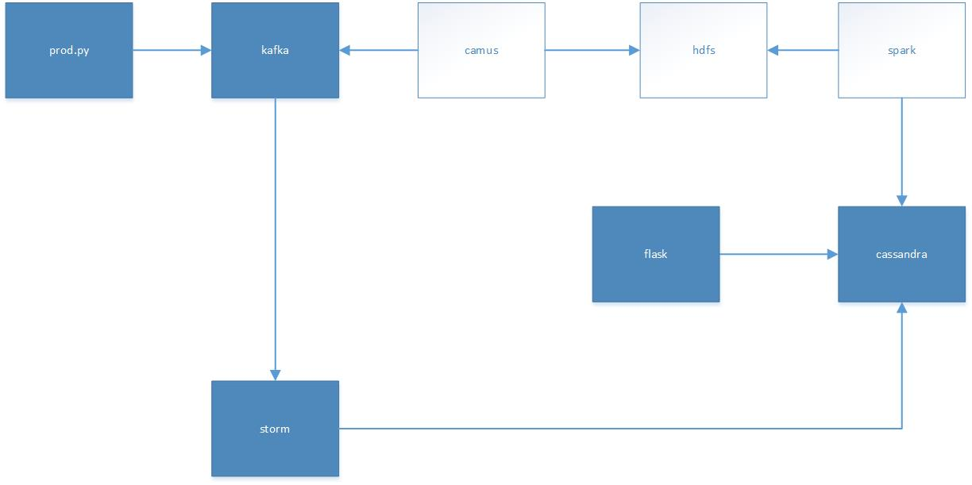
Pipeline

Slide 7
Challenges
Stitching the pipeline
Making spark and Cassandra talk
Cassandra schema / design
Context switching
Sessions / talks etc

Slide 8

Shabbir Suterwala
Team Lead, Architecture / Principal Architect @ Infor
Cloverleaf → Ingestion middleware for healthcare products.
Previously worked at Cisco, AMD and Storage Startup

