Slide 1
HawkEye Performance Monitoring for Data Centers
Shabbir Suterwala
Insight DE Fellow

Slide 2
Intuition
Chatty App → Low Performance
Measure by counting TCP/IP Packets
Throughput = Total Packets / Time
How to measure latency ?
Throughput =
Total Time of Packets Delivery / Total Packets / Time

Slide 3
HawkEye
HawkEye Monitor
Hardware, Infra Software, Applications
Drill down to SW Tasks, HW Devices
Group based Monitors
Detects anomalies and alerts now!
Throughput now vs. historical

Slide 4
Data
Event:
TCP/IP packet timestamp In / Out
List of Monitors
Engineered Data for Insight Project
Real World
Hook into kernel: network stack, scheduler
Hi priority demon using *top*
Hypervisor

Slide 5
Data
HawkeyeEvent: {
//Timestamp in/out
"TsIn": 1453407175613828,
"TsOut": 1453407175614662,
//Monitors:
"SwType": "SWTYPE42",
"SwID": "SWID20",
"TaskType": "TASKTYPE217",
"HwID": "HWID85730",
"HwType": "HWTYPE48",
"TaskID": "TASKID154",
"AppID": "HawkEye",
//Track packets across the network
"PacketID": "PACKET79217“
}

Slide 6
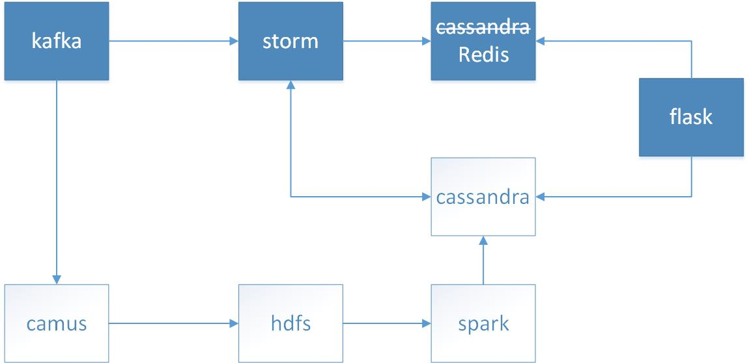
Pipeline

Slide 7
Challenges
Picking the right technology
Tuning & Debugging
Cassandra schema / design

Slide 8

Shabbir Suterwala
Team Lead, Architecture / Principal Architect @ Infor
Cloverleaf → Ingestion & processing engine healthcare market.
Previously worked at Cisco, AMD and Storage Startup

