Slide 1

Data Analysis
Electric Vehicles
Shahar Berenson 208608414
Shlomi Fridman 318187002
GitHub
Notebook

Slide 2


Members
Shahar Berenson
Shlomi Fridman

Slide 3
Introduction
Electric Vehicle Population Data
This dataset shows the Battery Electric Vehicles (BEVs) and Plug-in Hybrid Electric Vehicles (PHEVs) that are currently registered through Washington State Department of Licensing (DOL).
Source
metadata: May 17th 2025
246,138 rows x 17 columns

Slide 4
Features (1)
Feature | Description
VIN (1-10) | First 10 characters of the Vehicle Identification Number.
County | The county where the vehicle is registered or located.
City | The city where the vehicle is registered or located.
State | The U.S. state abbreviation (e.g., WA for Washington).
Postal Code | ZIP/postal code of the vehicle's location.
Model Year | The year the vehicle was manufactured.
Make | The manufacturer (e.g., Tesla, Nissan).
Model | The specific model of the car (e.g., Model 3, Leaf).
Electric Vehicle Type | Type of EV (Battery Electric Vehicle (BEV), Plug-in Hybrid Electric Vehicle (PHEV)).

Slide 5
Features (2)
Feature | Description
Clean Alternative Fuel Vehicle (CAFV) Eligibility | Indicates whether the vehicle qualifies under CAFV rules.
Electric Range | How many miles the vehicle can travel on electricity alone.
Base MSRP | Manufacturer's Suggested Retail Price at base level (starting price).
Legislative District | Legislative district associated with the vehicle's location.
DOL Vehicle ID | Department of Licensing Vehicle ID (state-assigned).
Vehicle Location | More detailed info about where the vehicle is located.
Electric Utility | The electric company servicing that area.
2020 Census Tract | Census tract identifier from the 2020 census (used for demographic/geographic analysis).

Slide 6

Dropped Features
We didn’t find interesting details about the following features, so we chose to drop them:
Base MSRP
Vehicle Location
DOL Vehicle ID
2020 Census Tract

Slide 7
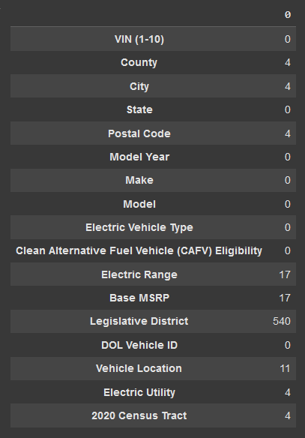
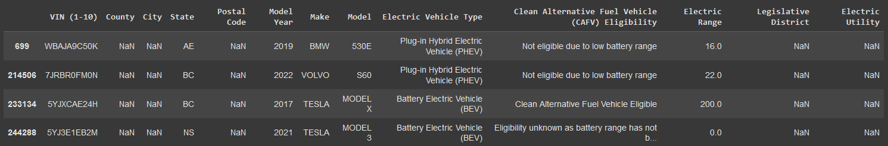

Missing Values
The only missing values we cared about were the County and City values, thus we chose to drop those rows.
The missing values in Electric Range and Base MSRP were indication that the data was unknown, which we used in statistics later on

Slide 8
Questions
Legend:
Univariate
Bivariate
Multivariate
The questions we’ve had about the dataset were:
Vehicles per State
Vehicles per WA County
Vehicles per City
Vehicles per Electric Utility
Vehicles per Electric Vehicle Type
Top 5 makes
Top 5 models
Models per Make (top 3)
Top Make per County (top 10)
Top Models per County (top 10)
Top 3 Make per CAFV Eligibility
Mean Electric Range of Top 3 Make per CAFV Eligibility
Top models of Make per CAFV Eligibility

Slide 9
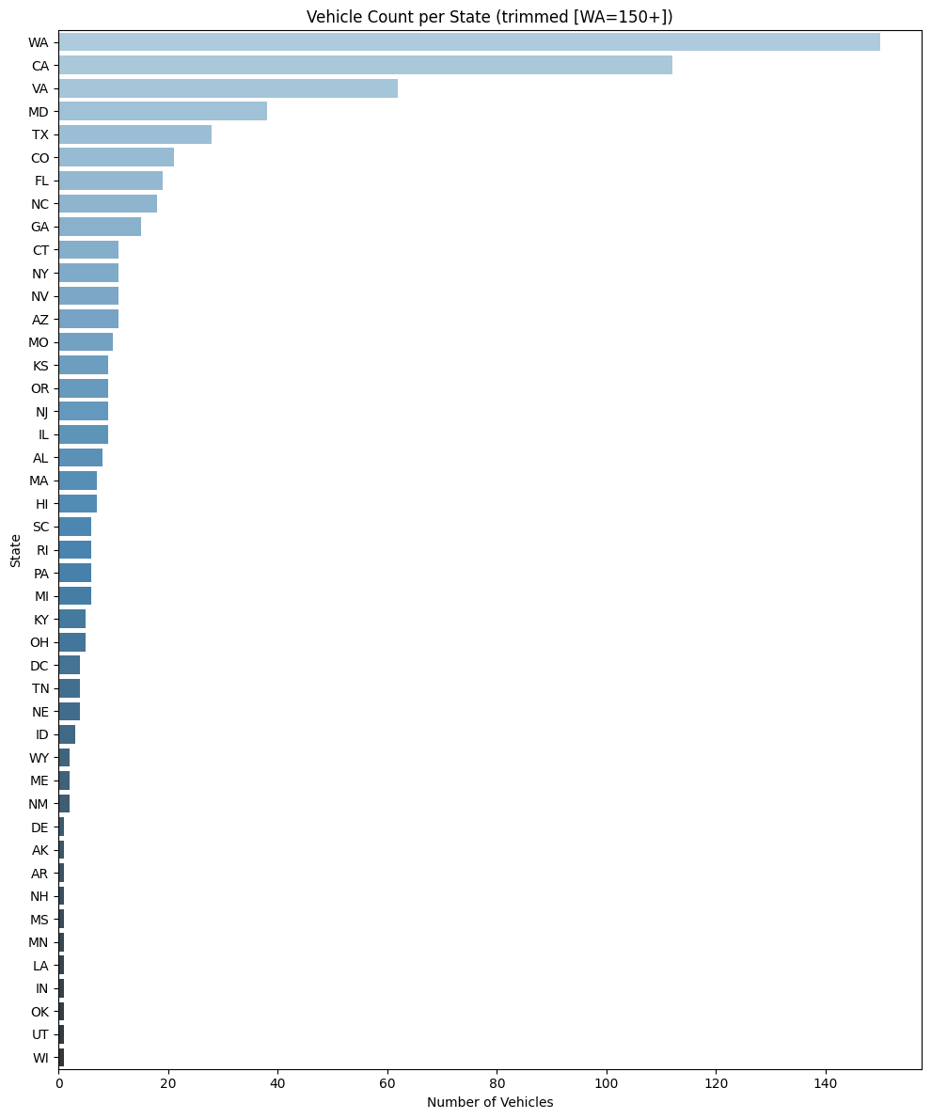
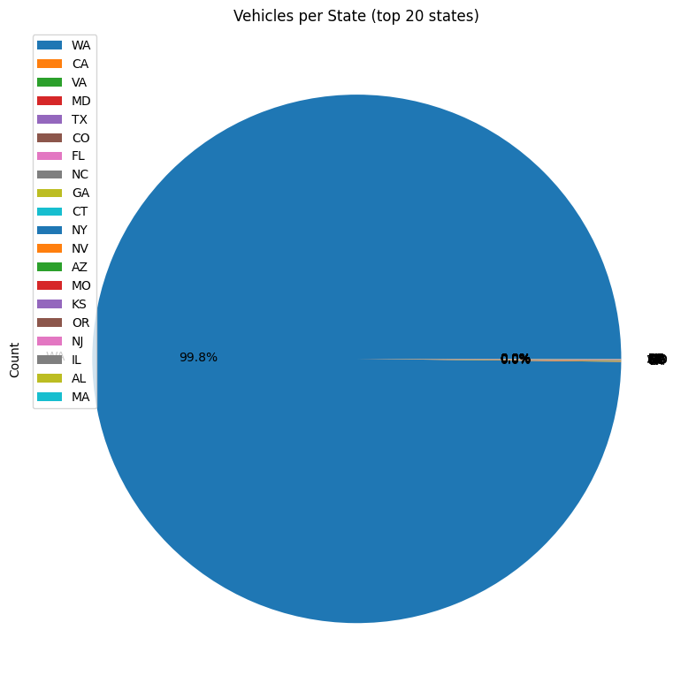
Vehicles per State
WA Trimmed
Conclusion: Most vehicles in the databset are from from Washington, roughly ~235,000 in WA followed by ~100 in CA Thus we concluded that vehicles not from WA are outliers

Slide 10
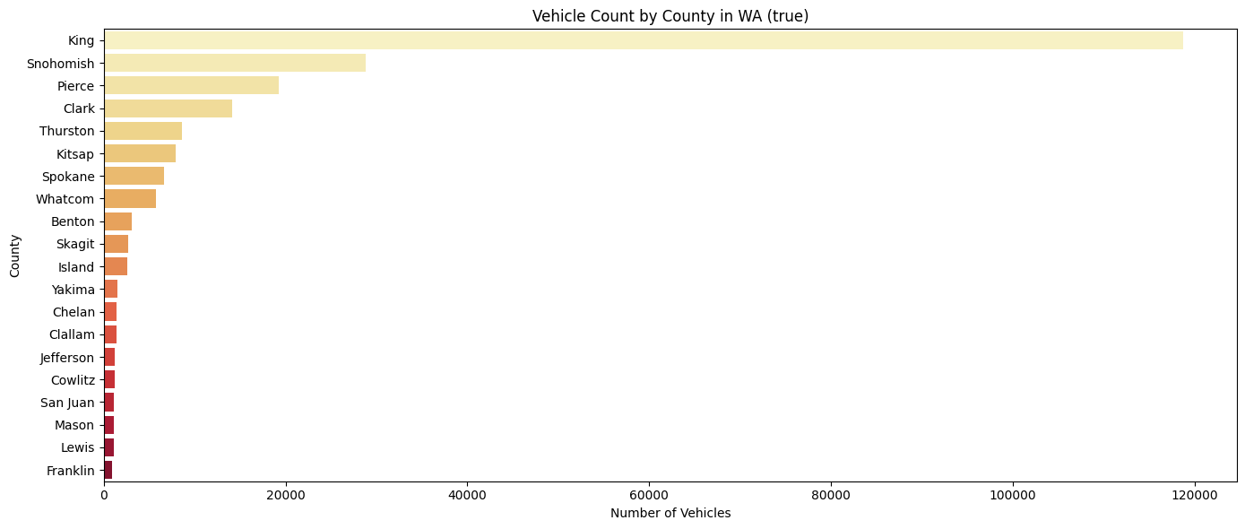
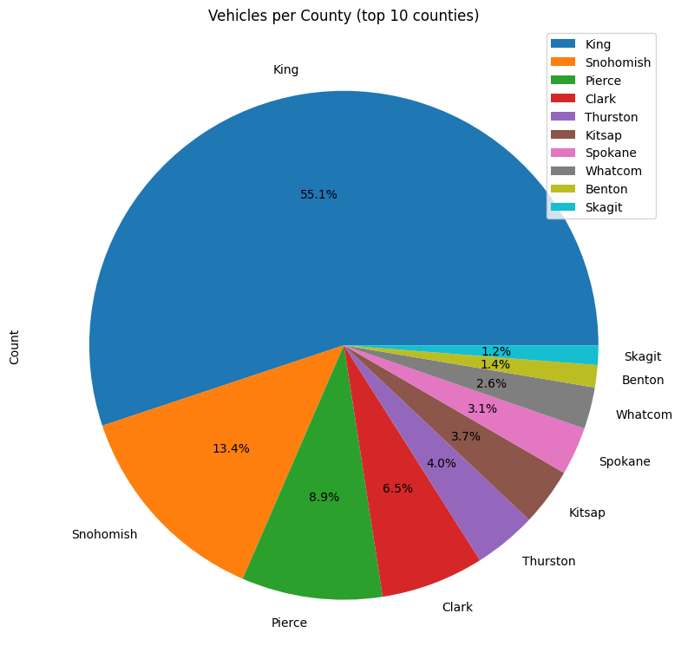
Vehicles per WA County
Conclusion: King county has the most (118,711) by a large margin, followed by Snohomish Thus we can conclude that any vehicle not in King county is a minor outlier in the dataset

Slide 11
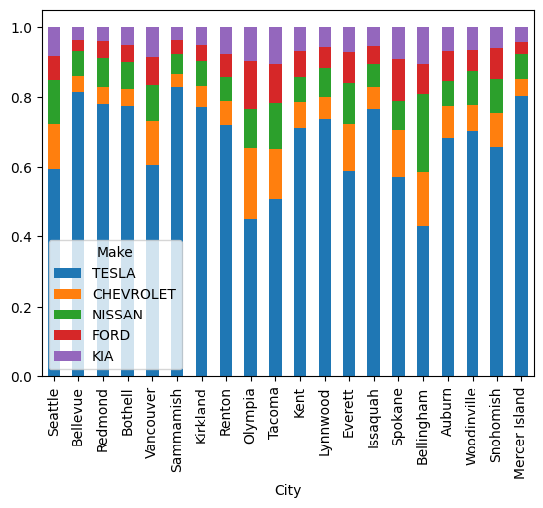
Vehicles per City
Conclusion: Tesla is the most popular make in the top 20 cities by a large margin

Slide 12
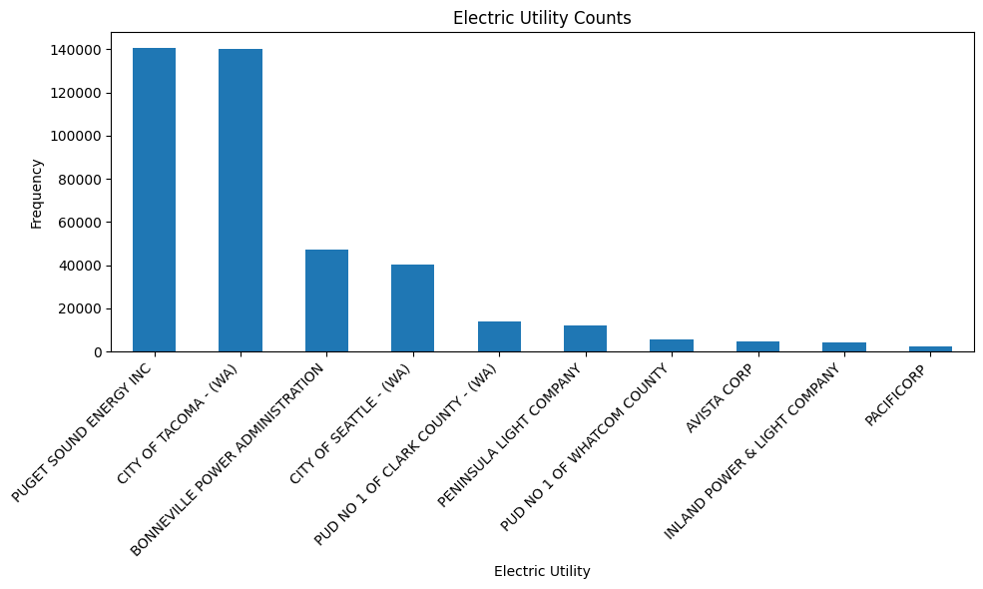
Vehicles per Electric Utility
Conclusion: We see that 'Puget Sound Energy Inc' is the utility that service the most vehicles, followed closely by 'City of Tacoma'

Slide 13
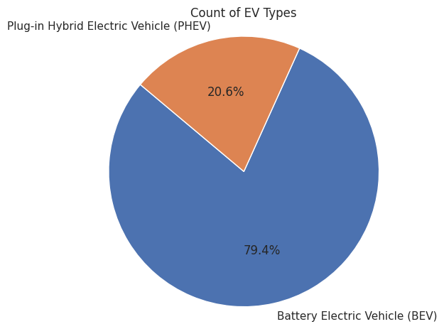
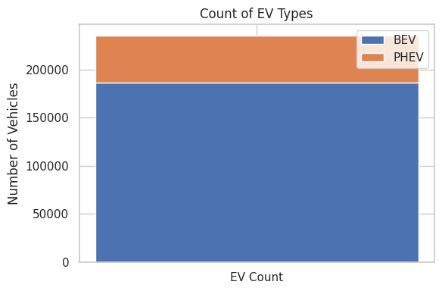
Vehicles per Electric Vehicle Type
Conclusion: ~80% of vehicles are Battery Electric Vehicle
1 out of 5 vehicles is Plug-in Hybrid Vehicle

Slide 14
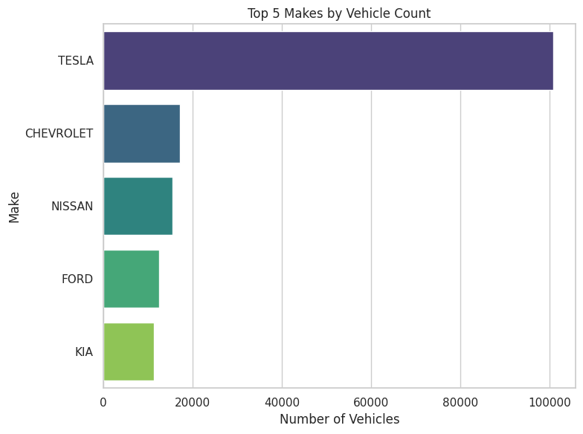
Top 5 Makes
Conclusion: TESLA is the top Make in the dataset by a large margin, followed by CHEVROLET and NISSAN.

Slide 15
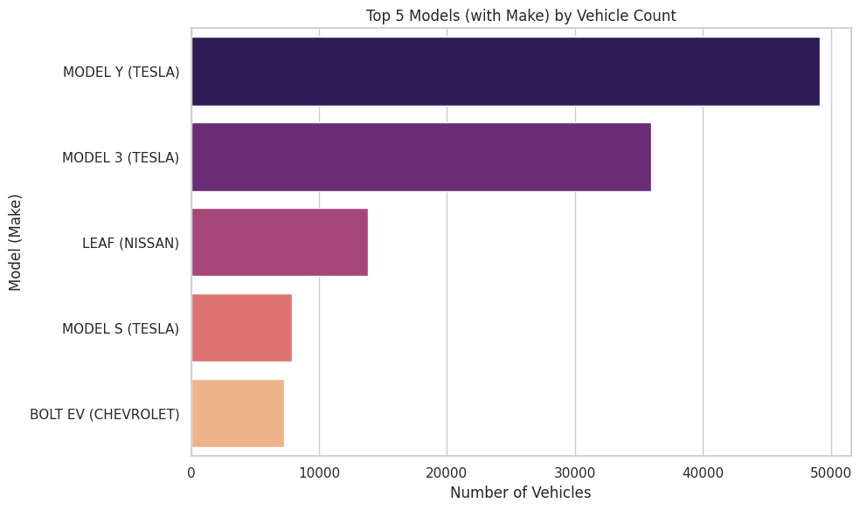
Top 5 Models
Conclusion:
The top models are Model Y and 3 of TESLA followed by Leaf of Nissan.

Slide 16
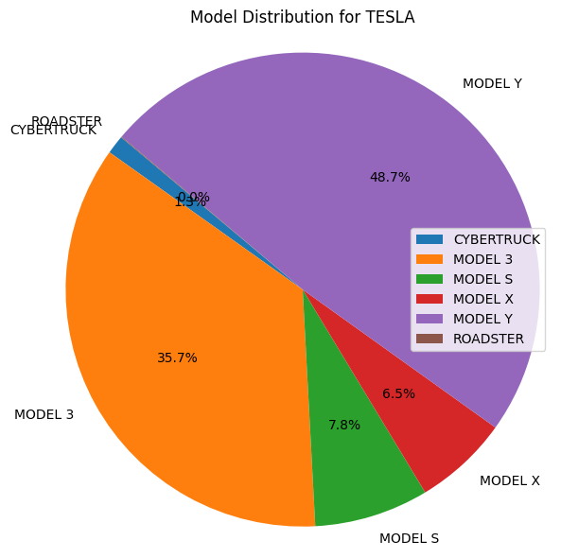
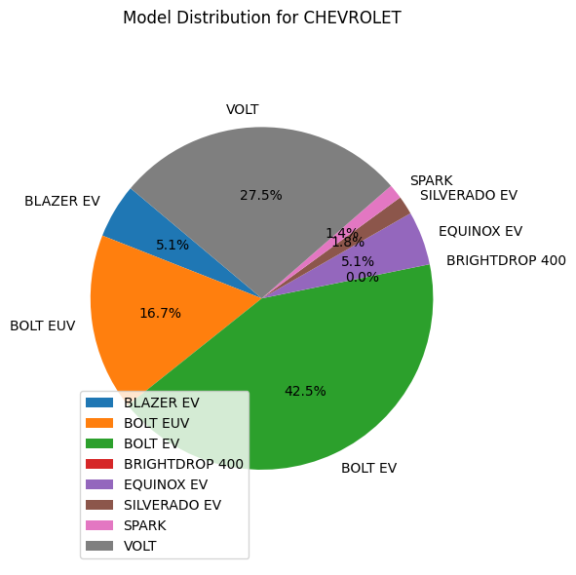
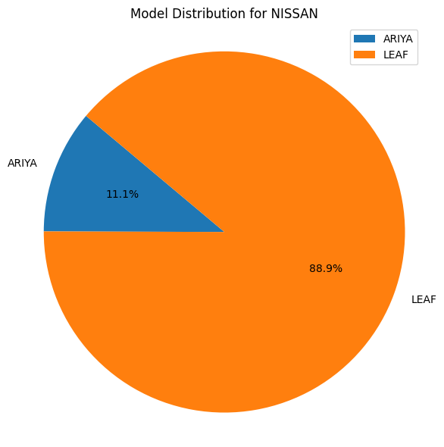
Models per Make (top 3 Make)
Conclusion:
48.7% of Tesla Models are the Model Y
42.5% of CHEVROLET Models are BOLT EV
88.9% of NISSAN models are LEAF.

Slide 17
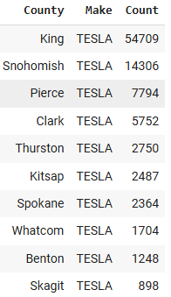
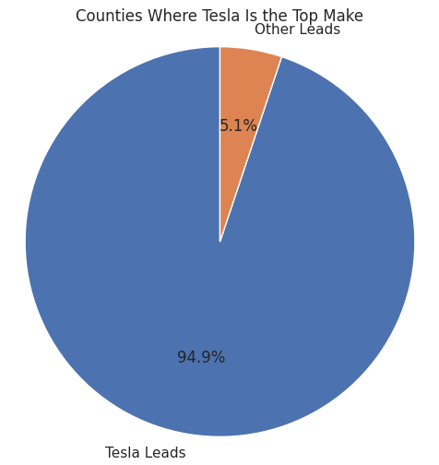
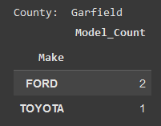
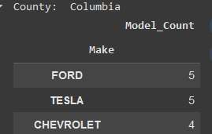
Top Makes in WA Counties
Conclusion: TESLA is leading in the top 10 counties and in 95% of all counties in Washington (WA)
And the only county TESLA isn’t in the lead is Garfield
And TESLA is actually tied with FORD in Columbia

Slide 18
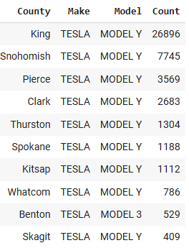
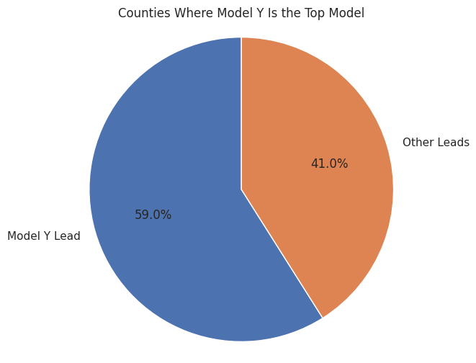
Top Models in WA Counties
Conclusion: The Model Y is the most popular in the top 10 counties and is the top model in 59% of all counties in Washington (WA).

Slide 19
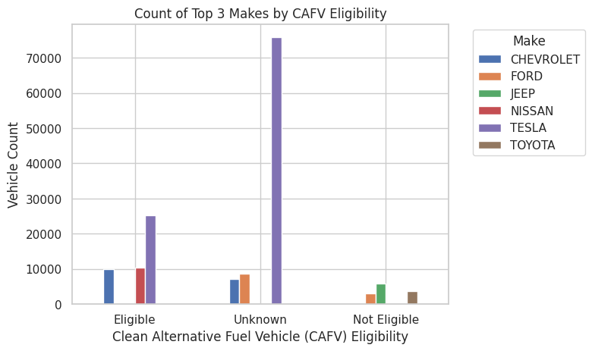
Amount of Top 3 Make of each CAFV Eligibility
Conclusion:
Most unknown eligibility are TESLA vehicles.
Most eligible vehicles are by Tesla
Most not eligible vehicles are by Jeep
Notes:
התייחסות לערכי 0 למצב בטריה לא ידוע

Slide 20
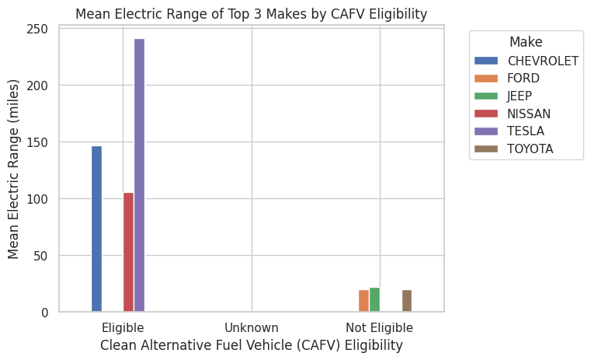
Mean of Top 3 Make of each CAFV Eligibility
Conclusion:
TESLA has the highest mean of Electric Range
Unknown eligibility has no known electric range.
Low battery not eligibility vehicles have lower electric range than eligible vehicles

Slide 21
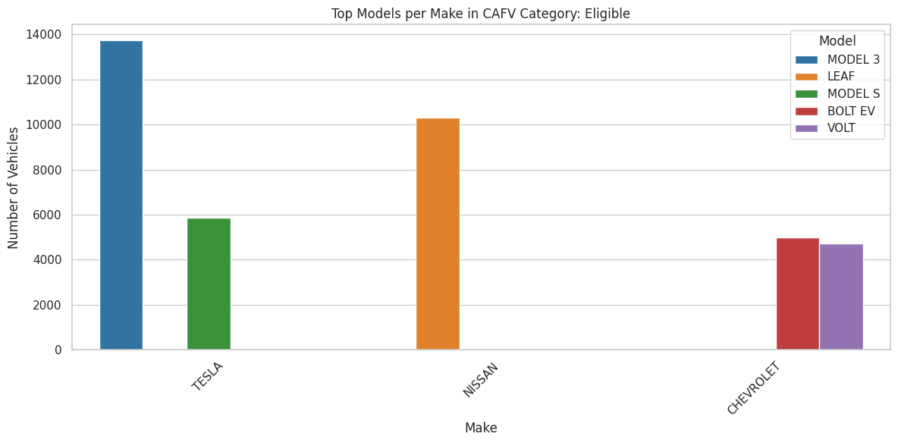
Top models in each eligibility category - CAFV Eligible
Conclusion: The Tesla Model 3 is the top model that is Eligible with close to 14 thousands vehicles, followed by the Nissan Leaf with ~10 thousands vehicles

Slide 22
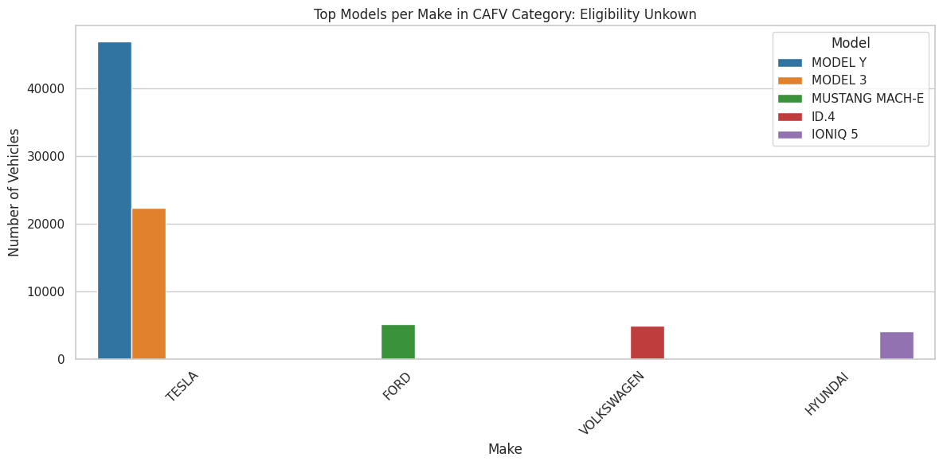
Top models in each eligibility category - CAFV eligibility unknown
Conclusion: The Tesla Model Y is the model that leads followed by the Model 3

Slide 23
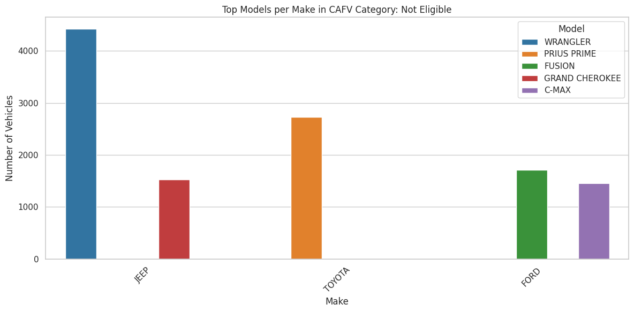
Top models in each eligibility category - Not CAFV eligible
Conclusion: The JEEP Wrangler is the top model that is not eligible with over 4 thousands vehicles, followed by the Toyota Prius Prime with ~3600 vehicles

Slide 24
THANKS FOR LISTENING

