Slide 1





Defining QM4A User Profiles & Flows

Slide 2

What are we going to talk about?
Into agile testing – QA in agile & challenges
The role and tasks of the QA manager
Flows
Concept
Q&A

Slide 3

QA in Agile
Getting potential shippable product every Build
Part of the Delivery team
Estimate the tasks together with the R&D
Gaining full visibility on the build & product
QA is a part of the definition of done
Notes:
רמת מוכנות ובשלות של המוצר בכל בילד
עובד בצמוד לצוות הפיתוח
נראות מלאה על המוצר והבילד

Slide 4
QA in Agile
Overall responsibility on Quality of the product.
Overall testing: regression tests, exploratory sessions, performance testing, usability testing and support of different environments.
Smart testing - automate as much as possible
Test health – QA is required to react to constant changes and broken tests
Notes:
אחריות מלאה על איכות המוצר
אחריות מלאה על כל הטסטים והסביבות השונות
אוטומציה – כמה שיותר
איכות הטסטים – צריך לתת מענה לשינויים התכופים בקוד ולתחזק ברמה היומיומית את הטסטים

Slide 5
Challenges
De-centralized Test Management
No tractability between Test & Requirements
Fragmented testing frameworks and tools
Cumbersome or missing tools
Manual testing for agile
More quality, less time
Constant change, user stories and code refactors
Measuring Quality
Defining Quality
Notes:
העובדה שאין לנו מקום מרכזי אחד לנהל את כל הטסטים
הקשיים בחיבור הטסטים לדרישות
ריבוי כלים ופריים וורקס, כלים מגושמים או כלים שחסרים
טסטים מנואלים, עדיין יש צורך להריץ טסטים ידנית וצריך לאפשר את הדרך המהירה ליצור ולהריץ אותם ולחבר אותם לאקו סיסטם של האגייל, למייל סטונס
יש לנו פחות זמן והרבה יותר לבדוק
יש לנו אתגרי במדידה
וההגדרה של איכות היא דינאמית ויכולה להשתנות בין ספריט לספרינט, אנחנו צריכים להיות ערוכים לזה.

Slide 6
QA manager

Slide 7
User profile
QA Manager
User Type | Role Description | User Traits
 | Quality management - Quality plan and execution Quality standard compliance (Functional and non functional) Automated testing development Development field operations supporting user acceptance testing. Release Management and alignment with production management. Responsibility on “Test health” | BS in Computer Science or equivalent degree 1+ years of software testing experience Experience building computers, swapping hardware, and installing Windows Experience with test automation and QA tools Knowledge of Java, C++, SQL, UNIX, RESTful web services
Notes:
ניהול הקוולטי, תכנון וביצוע
תכנון אוטומציה
הגדרות הקוולטי
בדיקת איכויות הטסטים

Slide 8
Responsibilities
QA manager
Writes test plans which enforce the acceptance criteria of features
Keeps all test plans and cases updated to changing requirements
Continually integrates the code base with automated builds and functional-level regression tests
Notifies when production is blocked due to errors in development
Measuring Quality
Defining Quality
Improving Quality
Enforces QA Best Practices
Provides visibility into end-to-end product quality
Owns QA Health status of releases/projects in SM dashboard
Test fast and efficient

Slide 9
Main tasks
QA manager
Task | Description
Manage all product tests | Maintain? Create? Review? Disable a test?
Monitor the quality of tests | Check / Locate for problematic tests
Maintain the product’s high quality status | Monitor the product’s quality status 24/7
Monitor the builds status | Review if the build status reflects the product quality?
Manage test sets | Maintain? Create? Review? Define?
Manage tests on a specific build | The ability to set which tests will cover the specific build.
Monitor the product quality in the sprint | The ability to spot improvements comparing to the previous sprint.
Monitor the product quality in the Release | The ability to spot improvements comparing to the previous Release.
Monitor team’s performance | Make sure the team’s deliveries improves over time.
Monitor Release quality / Ready to production. | See that the quality criteria match release
Monitor Done requirements | Make sure the Done’s were covered.

Slide 10
Flow types
QA manager tasks
Application Health Assessment
Test Health Assessment
Defining Quality
Measuring Quality
Monitor the quality of tests
Check / Locate for problematic tests
Check the proportion between test types (Unit vs. integration vs. UI).
Compare test converge with production data
Configure product tree
Define Sprint/Release quality goals
Apply best practices
Define build break criteria
Measure the product’s current quality status
Measure the product’s quality in the Sprint
Measure the product’s quality in the Release
Operations
Agile Test planning & optimization
Agile Manual testing
Identifying and resolving problems;
Manage build breakers
Keep up to date on overall activities of the teams
Identify issues early and take constructive corrective actions
Define and manage test policies
Smart testing - Automation
Smart manual testing
Manage and plan exploratory sessions

Slide 11
Main flows
Daily
QA manager
As a QA manager I would like to get a daily overview, so I can understand the current Quality status and my team’s progress.
Daily routine dashboard:
- Quality traffic light (Quality status + current build status) KPI’S
- Testing velocity + coverage
- Defects Progress
- Alert area (urgent issues that were detected and need my attention)
- Followed entities/metrics section ( A metric/entity that I want to follow up).

Slide 12
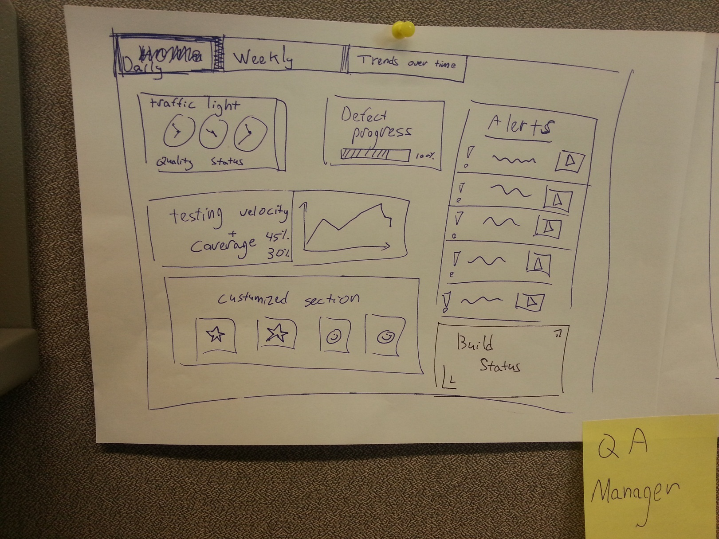
Notes:
Configuration phase?
A role defined dashboard?
Product quality status
Readiness to production
Team’s performance

Slide 13
Main flows
Sprint
QA manager
As a QA manager I would like to measure the product’s sprint quality state, so I can provide my PMO and R&D manager the sprint status report.
Sprint routine dashboard:
- US status – New, In testing, In progress, Done
- Defects (new / Done) +Defects Severity – New, Done. Medium, Critical, High…
- Test that were added/modified during the sprint
Notes:
Configuration phase?
A role defined dashboard?
Product quality status
Readiness to production
Team’s performance

Slide 14
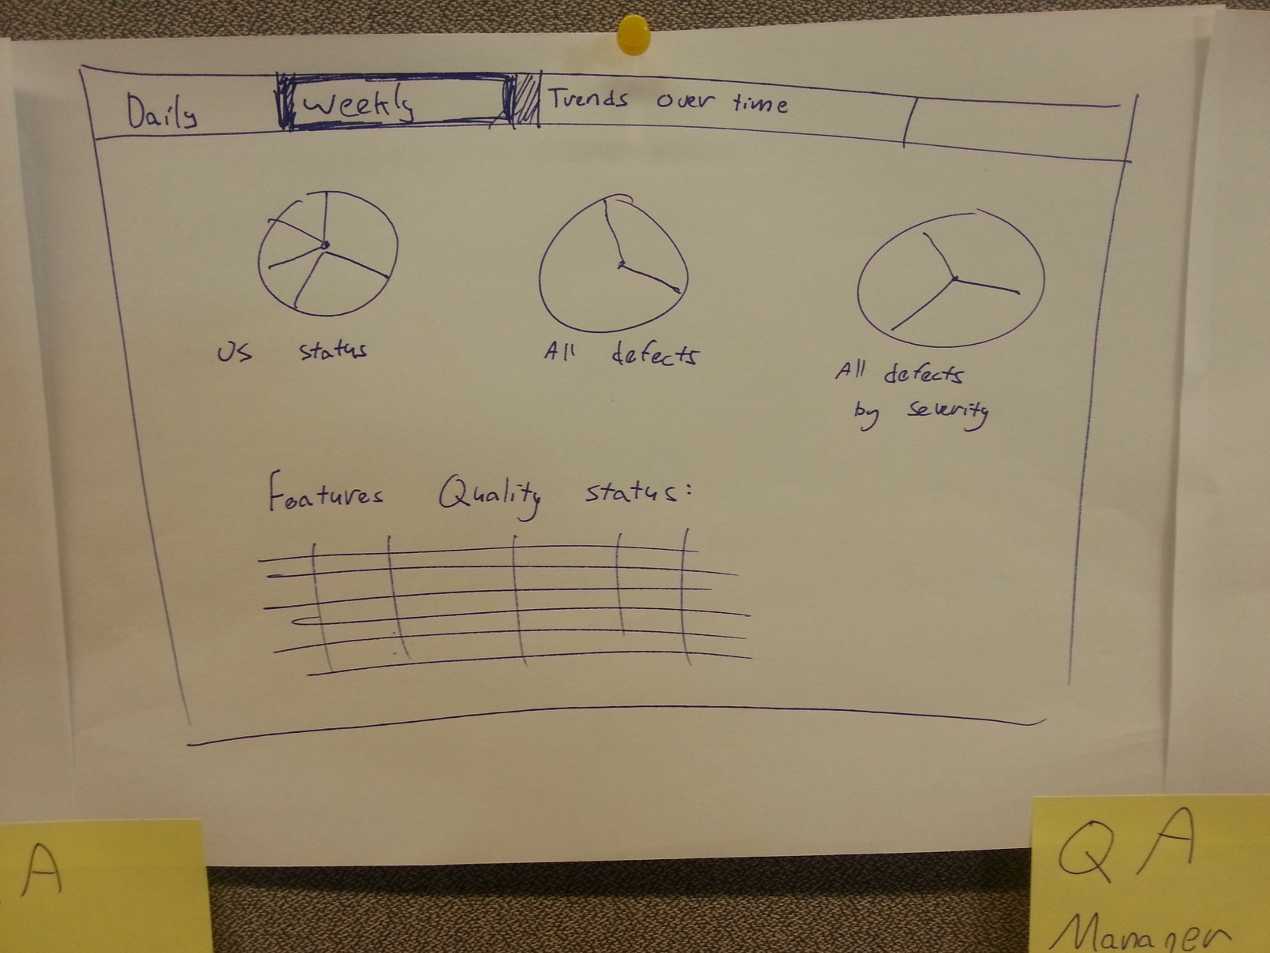
Notes:
Configuration phase?
A role defined dashboard?
Product quality status
Readiness to production
Team’s performance

Slide 15
Main flows
Release
QA manager
As a QA manager I would like to measure quality trends from previous sprints, so I can look for improvements/ dis improvements.
Release dashboard:
- Tests insights overview – Problematic tests, traceability
- (Missing) Defect insights overview – how quickly is the team resolving and closing bugs? Bug trend rate, active bugs by priority, bug progress (active, resolved, closed)
- Release/sprint overview - test creation velocity and quality are aligned? Are we executing the relevant tests for the features? Are we properly investing in tests which cover the features?
- (?)Product tree overview – How many defects and failing test we have on different areas of the product over time? Which areas are covered properly?
Notes:
Configuration phase?
A role defined dashboard?
Product quality status
Readiness to production
Team’s performance

Slide 16
Main flows
Sprint/Monthly
QA manager
As a QA manager I would like to measure trends from previous sprints, so I can look for improvements/ dis improvements in the quality measuring.
Trends (over time insights) module
Trends overview dashboard page (High level)
Tab
Tab
Tab
Tab
Tests insights overview
(?)Product tree overview
Release/sprint overview
Defect insights overview (Missing)
Report
Report
Report
Report
Notes:
Configuration phase?
A role defined dashboard?
Product quality status
Readiness to production
Team’s performance

Slide 17
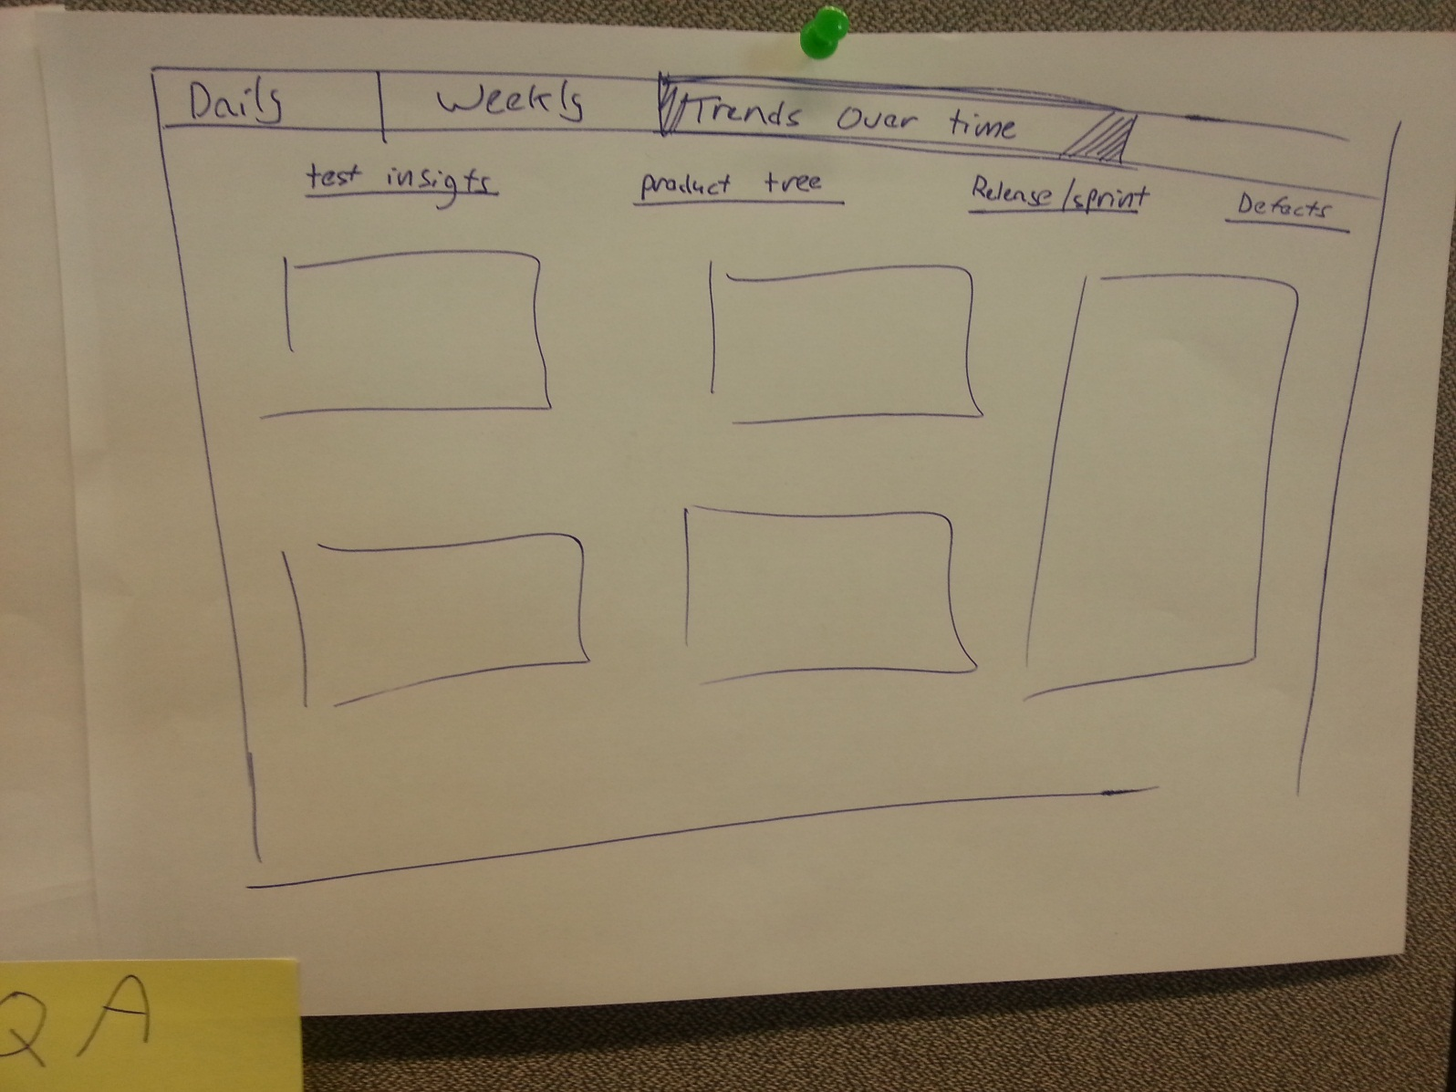
Notes:
Configuration phase?
A role defined dashboard?
Product quality status
Readiness to production
Team’s performance

Slide 18

Home / Welcome page
Tests
Builds
Config
Insights
Sprint overview
Release overview
Quality
Overview
Tests Reports
Manual
Products
Dashboard
Tree overview
Release overview
Editor
Products areas
Test pages
Test pages
Report page
Builds list page
Test pages
Test sets
Test pages
Build config
Build report page
Tracks
Integrations
Test page
QA Manager
Devtester
Developer
CI manager

Slide 19
User profile
Devtester
User Type | Role Description | User Traits
 | Execute manual and automatic tests. Define appropriate test cases. Incorporate developer feedback into test plans. Set up appropriate test environments. Perform integration, functionality, system, regression, load and acceptance test using manual or automation methods and testing tools. Record tests results and document problems and system errors. Provide feedback on the product’s state for general release. Troubleshooting-software behavior analysis Recording defects, verifying fixed defects Consolidating, reporting and sharing tests results. Writing test result reports using Quality Center graphs. | • BS in Computer Science or equivalent degree • 1+ years of software testing experience • Experience building computers, swapping hardware, and installing Windows • Experience with test automation and QA tools • Knowledge of Java, C++, SQL, UNIX, RESTful web services

Slide 20
Main tasks
Devtester
Task | Description
Coding automated tests Refactoring existing tests Define product tree manfully Opening defects Validating fixed defects
Define the sync with AGM / requirements system
Connect the tests with the US’s
Update the agents
Monitor defects
Write tests Participate in exploratory testing

Slide 21
Flows types
Devtester tasks
Application Health Assessment
Measuring Quality
Configuration
Define product tree manfully
Define the sync with AGM
Connect the test with the US
Update the agents
Build status check up
Tests overview (what failed / passed)
Measure testing coverage
Measure and track test results
Agile test management
Open defects
Execute tests
Write manual tests
Execute manual tests
Coding automatic tests

Slide 22
Main flows
Daily
Dev tester
As a Dev tester I would like get a daily overview so I can understand the current Quality status, and get updated regarding my recent assignments.
Daily routine dashboard:
- Quality traffic light (Quality status + current build status)
- Testing coverage
What I tested what II haven’t and the relevant defects.
Product area tree with indications of defects per area
- Alert area (urgent issues that were detected and need my attention)
- Followed entities/metrics section ( A metric/entity that I want to follow up).

Slide 23
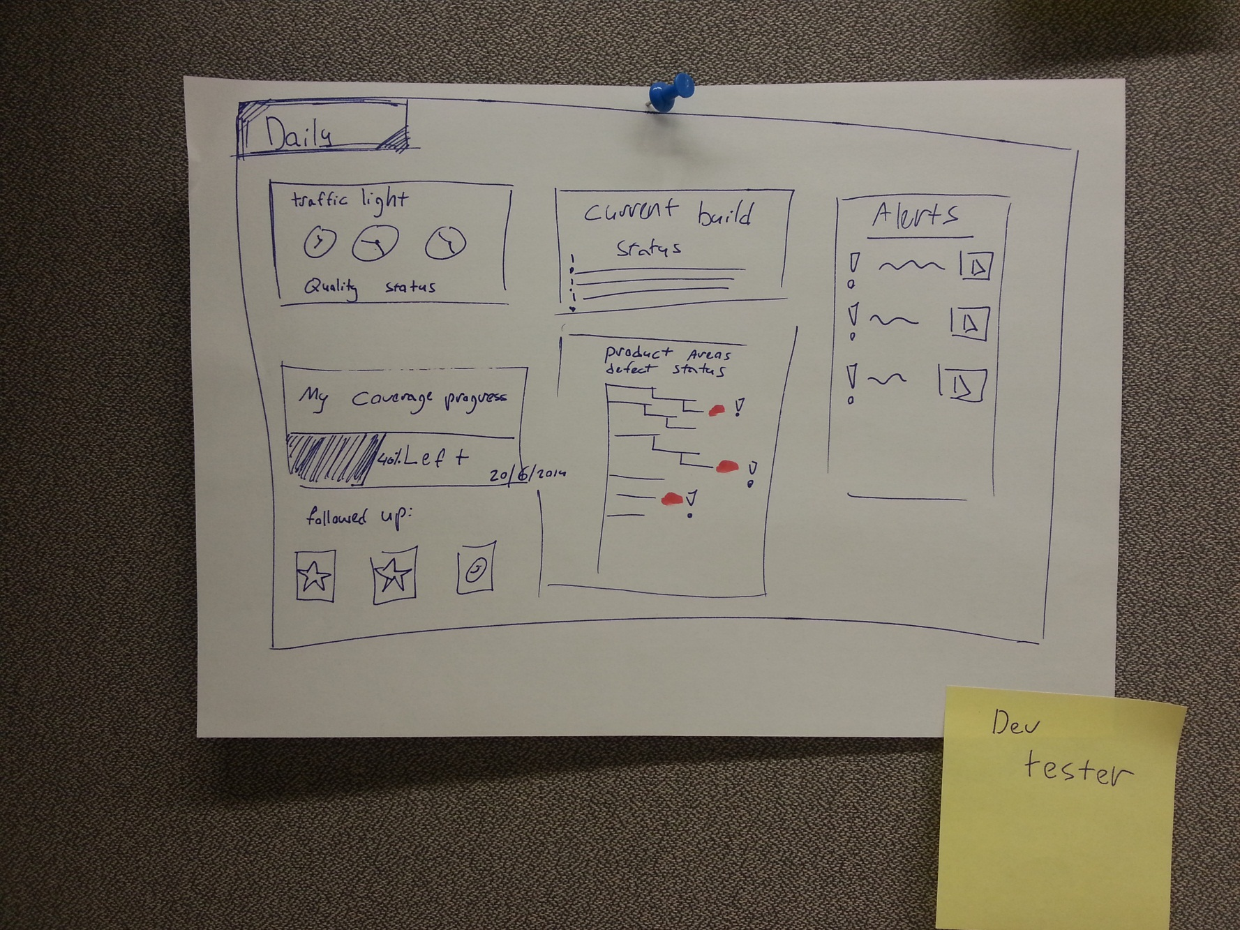

Slide 24
Home / Welcome page
Tests
Builds
Config
Insights
Sprint overview
Release overview
Quality
Overview
Tests Reports
Manual
Products
Dashboard
Tree overview
Release overview
Editor
Products areas
Test pages
Test pages
Report page
Builds list page
Test pages
Test sets
Test pages
Build config
Build report page
Tracks
Integrations
Test page
Dev Tester
Developer
QA Manager
CI Manager

Slide 25
Responsibilities
CI manager
Configure and maintaining CI build system, in collaboration with build engineering team members
Work with software developers and QA and Operating’s team to ensure build requirements are met and that build configurations are written in a reusable and scalable way.
Configure build agents to keep up with latest relevant operating systems and targets

Slide 26
User profile
CI Manager
User Type | Role Description | User Traits
 | Deliver and maintain continuous integration. Manage the deploy builds into appropriate environments. Responsible for the processes and tools required to generate deployable software artifacts. Design, debug and maintain installs for enterprise software products. Define and automate software builds for products with the Dev team. Ensure that the continuous integration environments meet the needs of the developers. Implement continuous integration/test/deploy systems Establishes the final release configuration (e.g. knowledge, information, hardware, software and infrastructure) | Software Development experience. Experience with automated builds. Java, Unix Shell, ANT, Linux, Oracle. Familiarity deploying to EC2/S3 or similar cloud infrastructure

Slide 27
Main tasks
TBD
CI Manager
Task | Description | Frequency | Required Proficiency
Configure build agents Configure build system Maintain build system

Slide 28
Main flows
TBD
Daily
CI Manager
As a CI Manager, I would like to ______________ so I can __________________

Slide 29
Home / Welcome page
Tests
Builds
Config
Insights
Sprint overview
Release overview
Quality
Overview
Tests Reports
Manual
Products
Dashboard
Tree overview
Release overview
Editor
Products areas
Test pages
Test pages
Report page
Builds list page
Test pages
Test sets
Test pages
Build config
Build report page
Tracks
Integrations
Test page
CI Manager
Developer
Dev Tester
QA Manager

Slide 30

Responsibilities
Release Manager
Architect : the release manager helps to identify, create, and implement processes or products to efficiently manage the release of code.
Gatekeeper :a release manager “holds the keys” to production systems and takes responsibility for their quality and availability.
Facilitator :a release manager serves as a liaison between varying business units and users to guarantee smooth and timely delivery of software products or updates.
Release Management is the discipline of building, packaging, and deploying software for consumption.

Slide 31
User profile
Release Manager
User Type | Role Description | User Traits
 | Manage all aspects of the end to end release process Ensures coordination of build and test environments teams and release teams Service release and deployment policy and planning Deals with release package design, build and configuration Deals with release package acceptance including business sign off Deals with service roll out planning including method of deployment Deals with release package testing to predefined acceptance criteria Signs off the release package for implementation Audits hardware and software before and after the implementation of release package changes Deals with storage and traceability/auditability of controlled software in both centralized and distributed Systems Deals with release, distribution and the installation of packaged software | Software Development experience. Experience with automated builds. Java, Unix Shell, ANT, Linux, Oracle. Familiarity deploying to EC2/S3 or similar cloud infrastructure

Slide 32
What’s next?
Notes:
Configuration phase?
A role defined dashboard?
Product quality status
Readiness to production
Team’s performance

Slide 33
Concept : Role & Agile flavored dashboard
Notes:
Configuration phase?
A role defined dashboard?
Product quality status
Readiness to production
Team’s performance

Slide 34
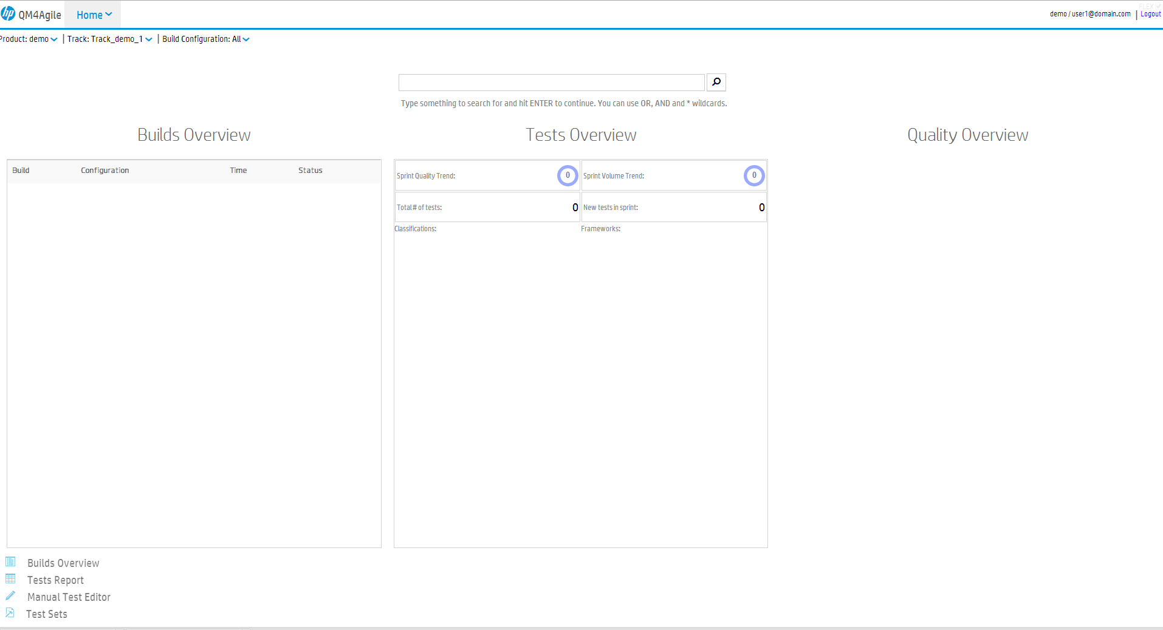















Daily
Sprint
Create a new test set
Create policy
Add a product area
Recent Builds
Team’s progress
Storefont I4 Nightly_2003453.1
Main Night Build I4_2003453.1
Tests
Release
Storefront Night_2003453.1
CI_2003453.1
Defects
Settings
Settings
Product area snapshot
Tree
List
Settings
Contact us
Payments
My followed
T
Login_frontpage_1256
Product catalog
T
Logout_frontpage_1256
Shipments
D
Defect2378
In progress
D
Defect2378
Done !
My KPI’s
Settings
Notes:
Consider, changing the build to CI
Ci manager
KPI’s of the CI – configured on the CI. Today the use the CI log.
They use Sonar – for trends regarding the jobs on the
They use mail alert for green or red

Slide 35
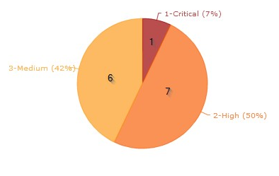
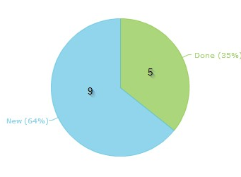
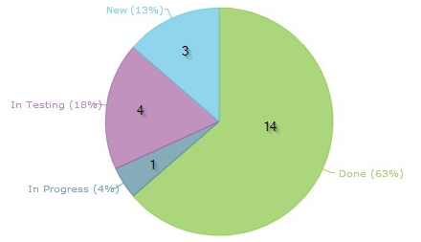
Daily
Added / modified tests
Sprint
Test name
12998 - Search monitor in test
12998 - Search monitor in test
12998 - Search monitor in test
12998 - Search monitor in test
12998 - Search monitor in test
12998 - Search monitor in test
Requirement | Status | Tests
US 12998 - Search monitor in test | In progress
US 12998 - Search monitor in test | In testing
US 12998 - Search monitor in test | In progress
US 12998 - Search monitor in test | In testing
US 12998 - Search monitor in test | In progress
US 12998 - Search monitor in test | In progress
Integration
Acceptance
End2End
End2End
Release
Integration
Acceptance
Integration
End2End
Integration
Acceptance
End2End
Acceptance
End2End
Integration
My KPI’s
Settings
Notes:
CI trends over sprint/ release
What were the causes for the trends.
Think of drill downs for unit tests..etc

Slide 36
Thanks.
Notes:
Configuration phase?
A role defined dashboard?
Product quality status
Readiness to production
Team’s performance

Slide 37
Main flows
Weekly
Build Manager
As a build manager, I would like to ______________ so I can __________________

Slide 38

User profile
Release Manager
User Type | Role Description | User Traits

Slide 39
Main flows
Sprint/Monthly
Build Manager
As a build manager, I would like to ______________ so I can __________________

Slide 40
Daily
Sprint
Product area snapshot
Tree
List
Recent Builds
Team’s progress
Settings
Storefont I4 Nightly_2003453.1
Contact us
Main Night Build I4_2003453.1
Tests
Release
Payments
Storefront Night_2003453.1
CI_2003453.1
Defects
Product catalog
Settings
Settings
Shipments
My followed
T
Login_frontpage_1256
T
Logout_frontpage_1256
D
Defect2378
In progress
D
Defect2378
Done !
My KPI’s
Settings

Slide 41

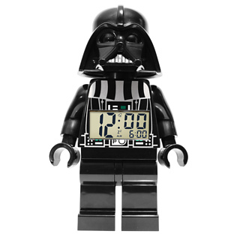




Slide 42
Home / Welcome page
Tests
Builds
Config
Insights
Sprint overview
Release overview
Quality
Overview
Tests Reports
Manual
Products
Dashboard
Tree overview
Release overview
Editor
Products areas
Test pages
Test pages
Report page
Builds list page
Test pages
Test sets
Test pages
Build config
Build report page
Tracks
Integrations
Test page
Developer
Dev Tester
QA Manager

Slide 43
Home / Welcome page
Tests
Builds
Config
Insights
Sprint overview
Release overview
Quality
Overview
Tests Reports
Manual
Products
Dashboard
Tree overview
Release overview
Editor
Products areas
Test pages
Test pages
Report page
Builds list page
Test pages
Test sets
Test pages
Build config
Build report page
Tracks
Integrations
Test page
Developer
Dev Tester
QA Manager

Slide 44

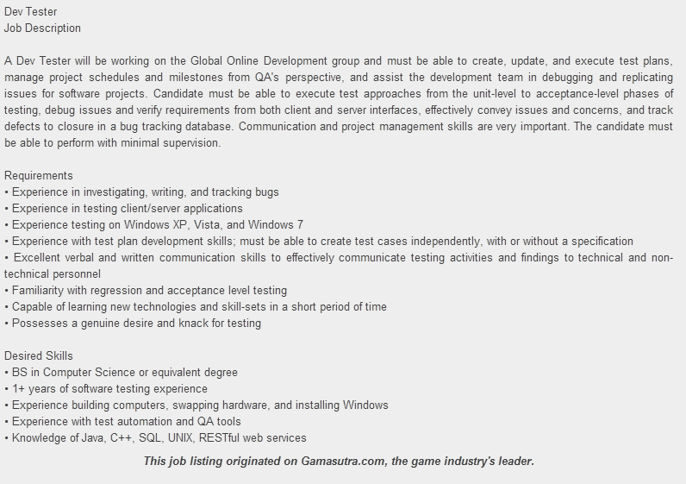
Using job descriptions for a user profile definition can provide us with some useful insights and market overview as well.

Slide 45
User profile
Developer
User Type | Role Description | User Traits | Common Tasks in System | Frequency of Use
 | Writes Code. Deliver user stories and features, fix defects. Design an elegant, efficient solution to problems, and deliver it quickly. Has high commitment to the quality of features he delivers (usability, performance) Understands that testing is an integral part of the Agile flow | BsC in Computer Science, Software Engineering, or a similar degree 2+ years experience in development Has a “favorite language” – Java / C++ / C# + Javascript etc. But is proficient in other languages (and in learning other languages as well) Has a set of favorite tools (IDE, Source control, build tool, browser, OS) but will reluctantly use other tools when required to Has a favorite methodology (Scrum / Kanban etc.), and is interested in discussing methodoligies used and demonstrated by “famous” players (e.g. Google, Facebook, Mozilla, and specifically – open source projects) |  | Medium

Slide 46
Main tasks
Developer
Task | Description | Frequency | Required Proficiency
Looks for a specific build status. | Locate the reason for the builds failure.
Looks for specific tests statuses. | Locate the reason for the failing tests and what wa
Get the QA point of product’

Slide 47



Daily
Sprint
Release
My KPI’s
Product area snapshot
Tree
List
Recent Builds
Team’s progress
Contact us
Storefont I4 Nightly_2003453.1
Main Night Build I4_2003453.1
Tests
Payments
Storefront Night_2003453.1
CI_2003453.1
Defects
Product catalog
Settings
Settings
Shipments
My followed
T
Login_frontpage_1256
T
Logout_frontpage_1256
D
Defect2378
In progress
D
Defect2378
Done !
Settings
D
Defect2378
In progress
Settings
Notes:
Configuration phase?
A role defined dashboard?
Product quality status
Readiness to production
Team’s performance

Slide 48
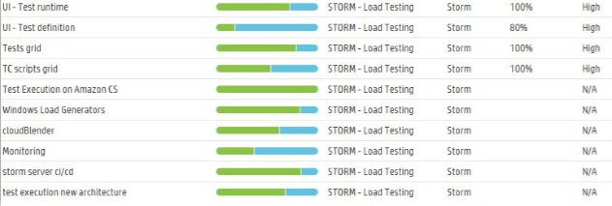
Daily
Sprint
Release
My KPI’s
User stories status
Defects severity
All Defects
Features Quality Status (product level):
Settings
Notes:
Configuration phase?
A role defined dashboard?
Product quality status
Readiness to production
Team’s performance

Slide 49
Daily
Sprint
Release
Product area snapshot
Tree
List
Recent Builds
Team’s progress
Settings
Storefont I4 Nightly_2003453.1
Contact us
Main Night Build I4_2003453.1
Tests
Payments
Storefront Night_2003453.1
CI_2003453.1
Defects
Product catalog
Settings
Settings
Shipments
My followed
T
Login_frontpage_1256
T
Logout_frontpage_1256
D
Defect2378
In progress
D
Defect2378
Done !
My KPI’s
Settings
Notes:
Configuration phase?
A role defined dashboard?
Product quality status
Readiness to production
Team’s performance

Slide 50
Daily
Sprint
Release
Added / modified tests
Requirement | Status | Tests
US 12998 - Search monitor in test | In progress
US 12998 - Search monitor in test | In testing
US 12998 - Search monitor in test | In progress
US 12998 - Search monitor in test | In testing
US 12998 - Search monitor in test | In progress
US 12998 - Search monitor in test | In progress
Test name
12998 - Search monitor in test
12998 - Search monitor in test
12998 - Search monitor in test
12998 - Search monitor in test
12998 - Search monitor in test
12998 - Search monitor in test
Integration
Acceptance
End2End
End2End
Integration
Acceptance
Integration
End2End
Integration
Acceptance
End2End
Acceptance
End2End
Integration
My KPI’s
Settings
Notes:
Configuration phase?
A role defined dashboard?
Product quality status
Readiness to production
Team’s performance

