Slide 1

CPP Beginners
CPP Intermediate – Polymorphism

Slide 2

Polymorphism
Polymorphism is a concept in object-oriented programming that refers to the ability of a function or method to behave differently based on the data type of the input parameters.
In C++, polymorphism can be implemented using virtual functions.

Slide 3
Polymorphism
Virtual functions are a way to achieve polymorphism by allowing a subclass to provide a different implementation of a method that is defined in a base class.
When a virtual function is called on an object, the C++ runtime system determines the actual type of the object and calls the appropriate version of the function.

Slide 4
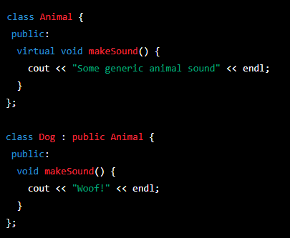
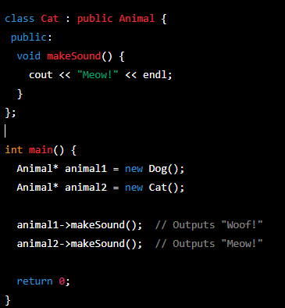
Example

Slide 5
References and Inheritance
Any base class function can be called through a base reference to a derived instance
Virtual function – derived class function executes
Nonvirtual function – base class functions executes
This is C++, you get to choose…
Can’t call derived class (only) functions
We can’t create a “derived class reference”
Derived& d = a; // when a is of type Base
Some derived-class member variables would be missing

Slide 6
Pointers and Inheritance
A “pointer to a base class” can also point to a derived class instance
Any base class functions can then be called through the pointer
Virtual function – derived class function executes
Nonvirtual function – base class functions executes
We can’t use a “pointer to a derived class” at a base class instance
Derived* d = new Base; // when a is of type Base

Slide 7
Slicing
If you copy objects around, slicing can occur
Copy a derived object into a base object – extra member variables fall away
We can’t copy a base object into a derived object as well
Same rules apply when passing to a function by value
A copy is made
Slicing will happen and data will be lost
Use references or pointers to avoid slicing

Slide 8
Casting pointers
When you have a base class pointer but you know it really points to a derived instance
You can cast it to a derived class pointer, and now you can call derived methods with it
Warning: you need to make sure that you are not trying to cast to a wrong type

Slide 9
C-Style cast
(type)instance;
GameObject* instance = new Player();
GameObject* instance = new GameObject();
Player* p = (Player*)instance;
p->print_lives();
If instance is an actual GameObject, this will do the casting to a wrong type and will result with a crash

Slide 10
Static_cast<type>
static_cast<type>(instance);
GameObject* instance = new Player();
Player* p = static_cast<Player*>(instance);
p->print_lives();
Compile time only
You need to verify its safety

Slide 11
dynamic_cast<type>
dynamic_cast<type>(instance);
GameObject* instance = new Player();
Player* p = dynamic_cast<Player*>(instance);
p->print_lives();
Runtime check
Works only when casting a pointer to a class with a virtual table
Returns nullptr if cast fails
Slower but safer

Slide 12


Resources
https://en.cppreference.com/book/intro/inheritance
PluralSight.com – “C++ fundamentals including c++ 17 by Kate Gregory”
PluralSight.com – “Learn to program with c++ 17 by Kate Gregory”
ChatGPT

Slide 13
Thank you!
Best of luck!

