Slide 1

CPP Beginners
CPP – Memory Types

Slide 2

CPP memory types
In C++, there are several types of memory that are used to store data during the execution of a program.
These include:
Code
Static/Global
Stack
Heap

Slide 3

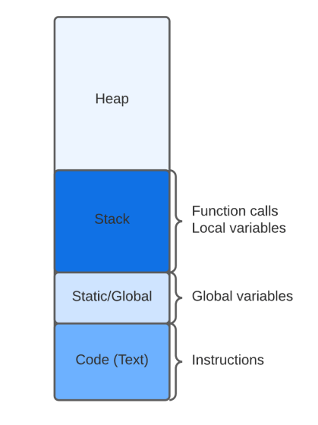
CPP memory types

Slide 4
Code (instructions)
Code memory segment refers to the memory where the executable instructions of the program are stored.
This segment holds the machine code that is generated by the compiler from the source code.
The code segment is read-only and is shared among all the processes running the same program, it's loaded into memory when the program starts and remains there until the program exits.

Slide 5
Static/global
Global/Static memory: The global/static memory refers to variables and objects that are defined outside of any function, method or class and thus are globally accessible by the whole program.
OR
Local/member variables that are defined as static (more on that later).

Slide 6
Stack
The stack is a region of memory that is used to store local variables and function call frames.
Stack memory is often referred to as LIFO (last in, first out).
Think of this as a bunch of building bricks stacked on top of one another, you can’t take from the middle as the stack will fall so the last brick placed on top has to first be removed.

Slide 7
HEAP (Free store)
The heap is a region of memory that is used to dynamically allocate and deallocate memory at runtime.
Memory allocated on the heap is accessed by a pointer and can be deallocated manually when it is no longer needed.

Slide 8

Resources
https://www.baeldung.com/cs/memory-allocation
chatGPT

Slide 9
Thank you!
Best of luck!

