Slide 1

CPP Beginners
CPP – Templates

Slide 2

Templates
In C++, templates are a mechanism for creating generic functions and classes.
They allow you to write code that can work with any type, rather than being specific to one type.

Slide 3
Templates
In C++, there are two main types of templates:
Function templates and
Class templates.

Slide 4
Templates
Function Templates: These are templates for functions that can be used with any data type.
You can use function templates to create generic functions that can be used with different types, such as a function to swap the values of two variables.

Slide 5
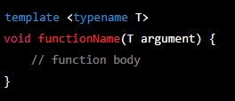
Templates
The syntax for creating a function template is:

Slide 6
Templates
Class Templates: These are templates for classes that can be used with any data type.
You can use class templates to create generic classes that can be used with different types, such as a stack class that can hold elements of any type.

Slide 7
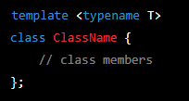
Templates
The syntax for creating a class template is:

Slide 8
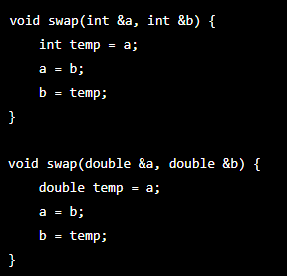
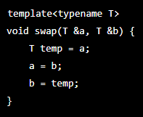
Why should we use templates
consider a simple function to swap the values of two variables. Without templates, you would need to write a separate version of the function for each type of variable:
With templates, you can write the function once and use it for any type:

Slide 9
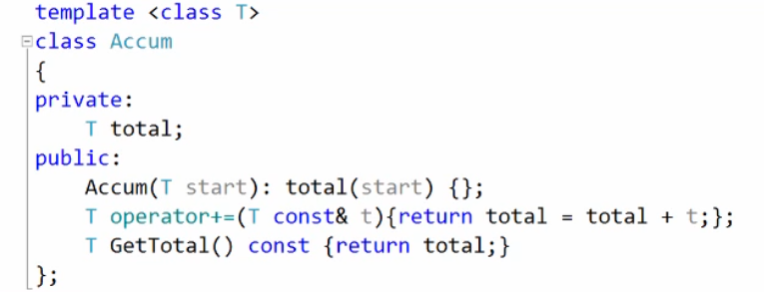
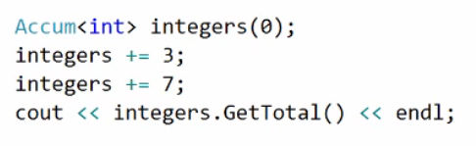
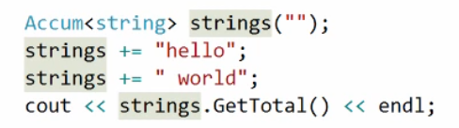
Why should we use templates
You can also create generic classes using templates. A simple example would be a accumulator class that can sum elements of any type:
When you use a template, you provide the type as an argument in angle brackets, like this:

Slide 10
Advantages
Code Reusability: Templates allow you to write generic code that can be used with different types, reducing the need to write multiple versions of the same code.
Type Safety: Templates can help prevent type-related errors by ensuring that the correct types are used with a function or class.
Performance: Templates can lead to more efficient code, because the code is generated specifically for the types that are used. This is known as "template instantiation" and the generated code is as efficient as if it were hand-written.

Slide 11
Advantages
Compile-time Polymorphism: Templates allow for compile-time polymorphism, meaning that the code is generated at compile-time, rather than runtime. This can lead to faster execution times and smaller binary size.
Flexibility: Templates allow you to create generic classes and functions that can be used with any data type, including user-defined types, which makes your code more flexible and adaptable to changing requirements.
Abstraction: Templates can be used to provide a level of abstraction, making it possible to write code that can work with different types without knowing the specific type at the time of writing the code.

Slide 12
Template specialization
Sometimes a template won’t work for a particular class
Operator or function is missing (and you can’t add it)
Logic in the operator won’t work for this case
First choice: add the operator or function with the right logic
Second choice: specialize the template (example in class 12 – Templates project)

Slide 13
conclusion
Templates add tremendous power to C++
Compile time checks mean no runtime hit
Author of code that uses template must ensure that types are compatible with the template chosen
Template specializations let you handle special cases

Slide 14


Resources
https://www.mygreatlearning.com/blog/templates-in-cpp/
C++ fundamentals including c++ 17 – Kate Gregory – Plural Sight
chatGPT

Slide 15
Thank you!
Best of luck!

