Slide 1

Unreal engine advnced
Basic Physics Game Helper

Slide 2

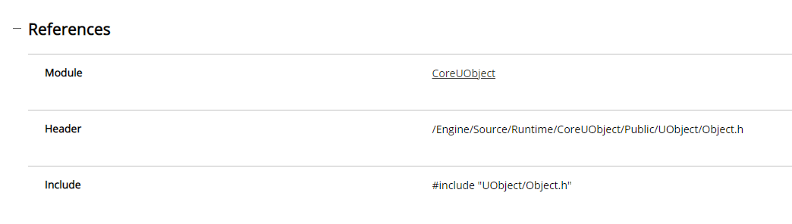
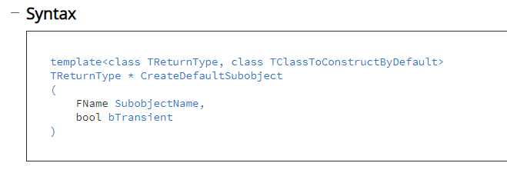
Create Default Sub-Object
Create a component or subobject, allows creating a child class and returning the parent class.

Slide 3
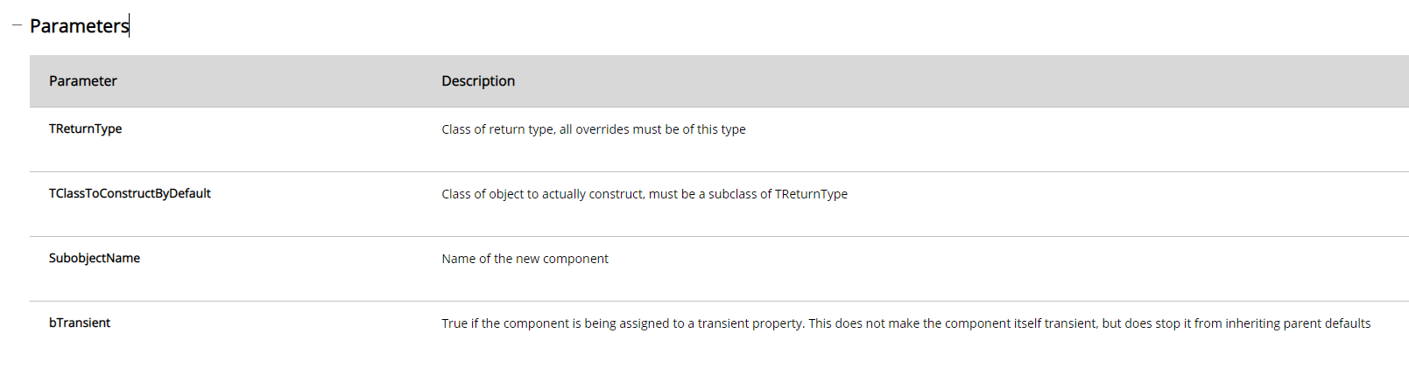
Create Default Sub-Object

Slide 4
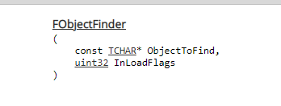
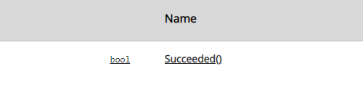
Constructor Helpers:: FObjectFinder
A Struct used for loading assets

Slide 5
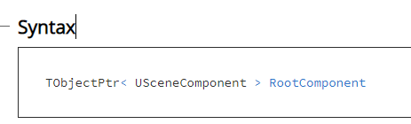
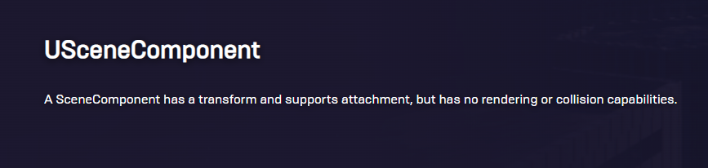
Root Component
The component that defines the transform (location, rotation, scale) of this Actor in the world, all other components must be attached to this one somehow

Slide 6
Root Component
The component that defines the transform (location, rotation, scale) of this Actor in the world, all other components must be attached to this one somehow

Slide 7
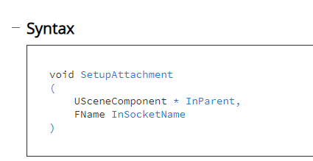
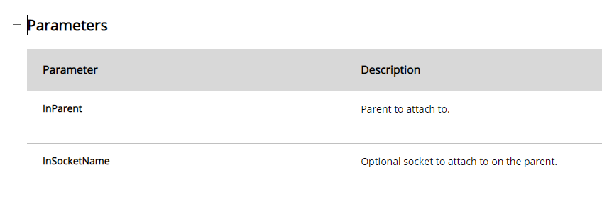
Setup Attachment
Initializes desired Attach Parent and SocketName to be attached to when the component is registered.
Generally intended to be called from its Owning Actor's constructor and should be preferred over AttachToComponent when a component is not registered.
Sockets:
https://docs.unrealengine.com/5.0/en-US/using-sockets-with-static-meshes-in-unreal-engine/

Slide 8
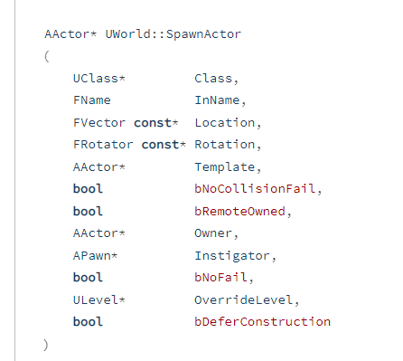
Spawn Actor
The process of creating a new instance of an Actor is known as spawning.
Spawning of Actors is performed using the UWorld::SpawnActor() function.
This function creates a new instance of a specified class and returns a pointer to the newly created Actor.
UWorld::SpawnActor() may only be used for creating instances of classes which inherit from the Actor class in their hierarchy.

Slide 9
Player Camera Manager
A PlayerCameraManager is responsible for managing the camera for a particular player.

Slide 10
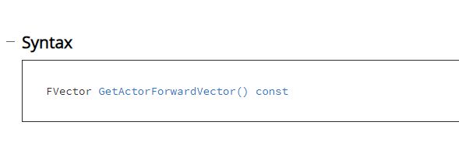
Get Actor Forward Vector
Get the forward (X) vector (length 1.0) from this Actor, in world space.

Slide 11
Get Actor Forward Vector
AACTOR method
Get the forward (X) vector (length 1.0) from this Actor, in world space.

Slide 12
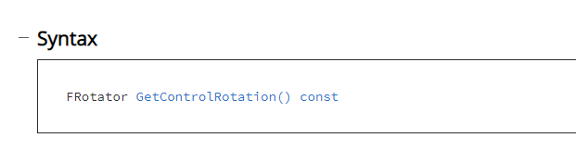
Get Control Rotation
APawn method
Get the rotation of the Controller, often the 'view' rotation of this Pawn.
https://docs.unrealengine.com/5.1/en-US/API/Runtime/Core/TRotator/

Slide 13
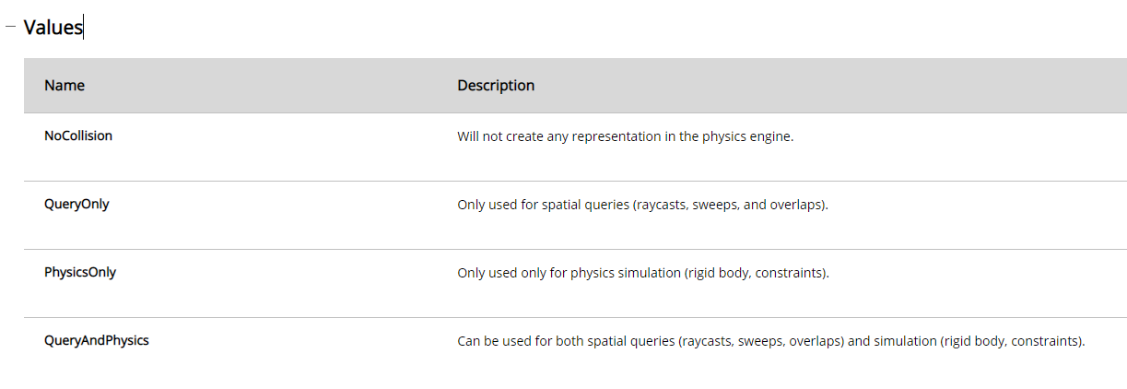
Collision – Ecollision Enabled::Type
Enum used to describe what type of collision is enabled on a body.

Slide 14
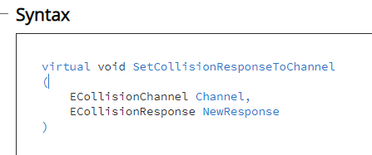
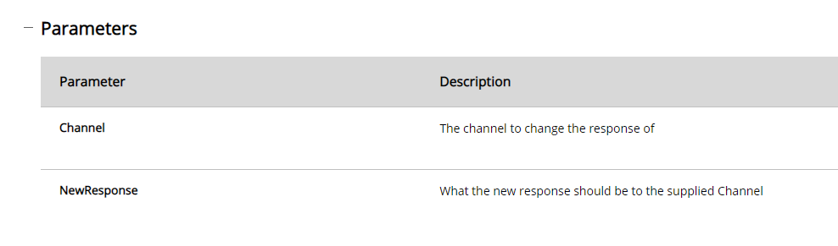
Collision – Set Collision Response To Channel
Changes a member of the ResponseToChannels container for this PrimitiveComponent.

Slide 15
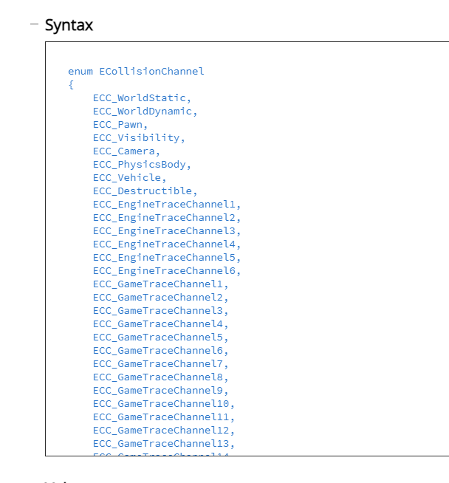
Collision – Channel and response

Slide 16
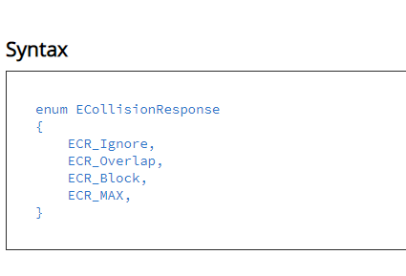
Collision – Channel and response

Slide 17

Resources
https://docs.unrealengine.com/5.0/en-US/

Slide 18
Thank you!
Best of luck!

