Slide 1

CPP Beginners
CPP Intermediate – Iterators

Slide 2

Iterators
Iterators are used to point at the memory addresses of values in STL containers.
They are primarily used in sequences of numbers, characters etc.
They reduce the complexity and execution time of the program.

Slide 3
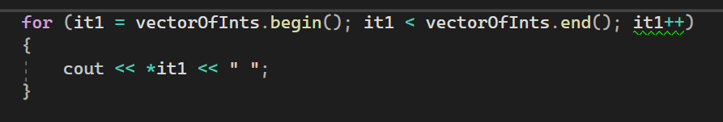
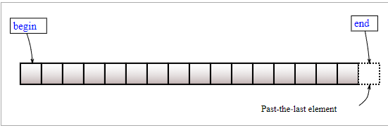
Common methods
begin() : This function is used to return the beginning position of the container.
end() : This function is used to return the after end position of the container.

Slide 4
Common methods
begin() : This function is used to return the beginning position of the container.
end() : This function is used to return the after end position of the container.
Should be ++it1
Notice the dereference (*) operator

Slide 5
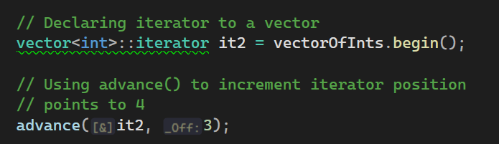
Common methods
advance() : This function is used to increment the iterator position till the specified number mentioned in its arguments.

Slide 6
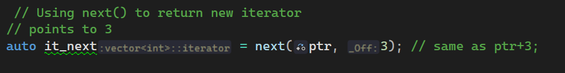
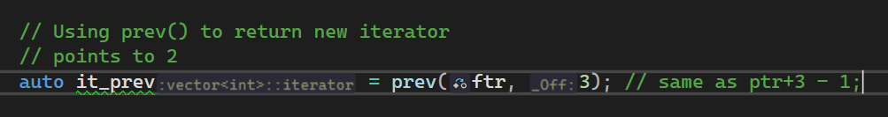
Common methods
next() : This function returns the new iterator that the iterator would point after advancing the positions mentioned in its arguments.
prev() : This function returns the new iterator that the iterator would point after decrementing the positions mentioned in its arguments.

Slide 7
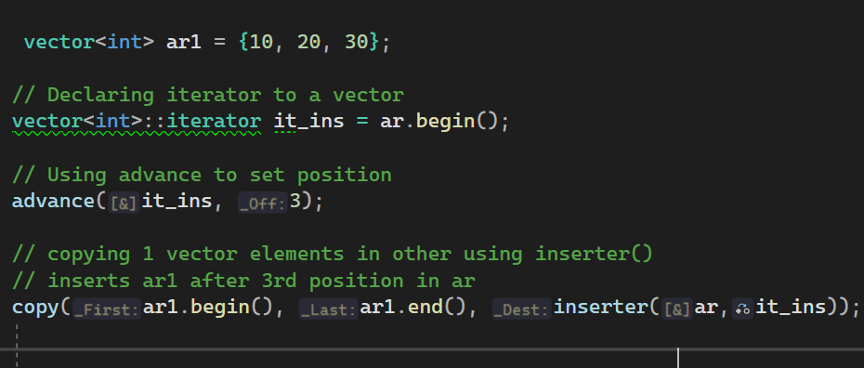
Common methods
inserter() : This function is used to insert the elements at any position in the container.
It accepts 2 arguments, the container and iterator to position where the elements have to be inserted.

Slide 8


Resources
https://www.geeksforgeeks.org/iterators-c-stl/
Plural sight – “C++ beyond the basics” – Kate Gregory

Slide 9
Thank you!
Best of luck!

