Slide 1

CPP Beginners
CPP Abstract Classes

Slide 2

Abstract Classes
In C++, an abstract class is a class that cannot be instantiated on its own and serves as a base class for one or more derived classes.
It is used to define a common interface or set of characteristics that the derived classes must implement.

Slide 3
Abstract Classes
An abstract class is created by using the virtual keyword in the function declaration of at least one of its member functions, and then leaving the function definition (implementation) empty.
This is called a "pure virtual function".

Slide 4
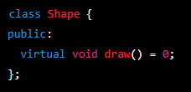
Example
In this example, the Shape class is an abstract class because it has a pure virtual function draw().
This means that any class derived from Shape must implement the draw() function.

Slide 5
Abstract Classes
You cannot create an object of an abstract class, but you can create pointers or references to an abstract class.
This allows you to store objects of derived classes in a collection of abstract class pointers or references, and then call the derived class's implementation of the pure virtual function through the abstract class interface.

Slide 6
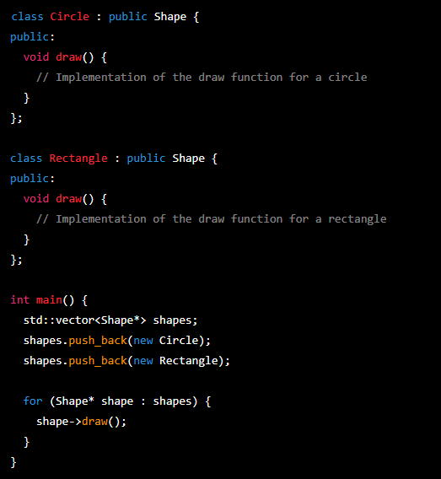
Example
In this example, Circle and Rectangle are derived classes that implement the pure virtual function draw() inherited from the Shape abstract class.
An object of each derived class is stored in a vector of Shape pointers, and the draw() function is called on each object through the abstract class interface.

Slide 7


Resources
https://en.cppreference.com/w/cpp/language/abstract_class
ChatGPT

Slide 8
Thank you!
Best of luck!

