Slide 1

Unreal engine advnced
Introduction

Slide 2

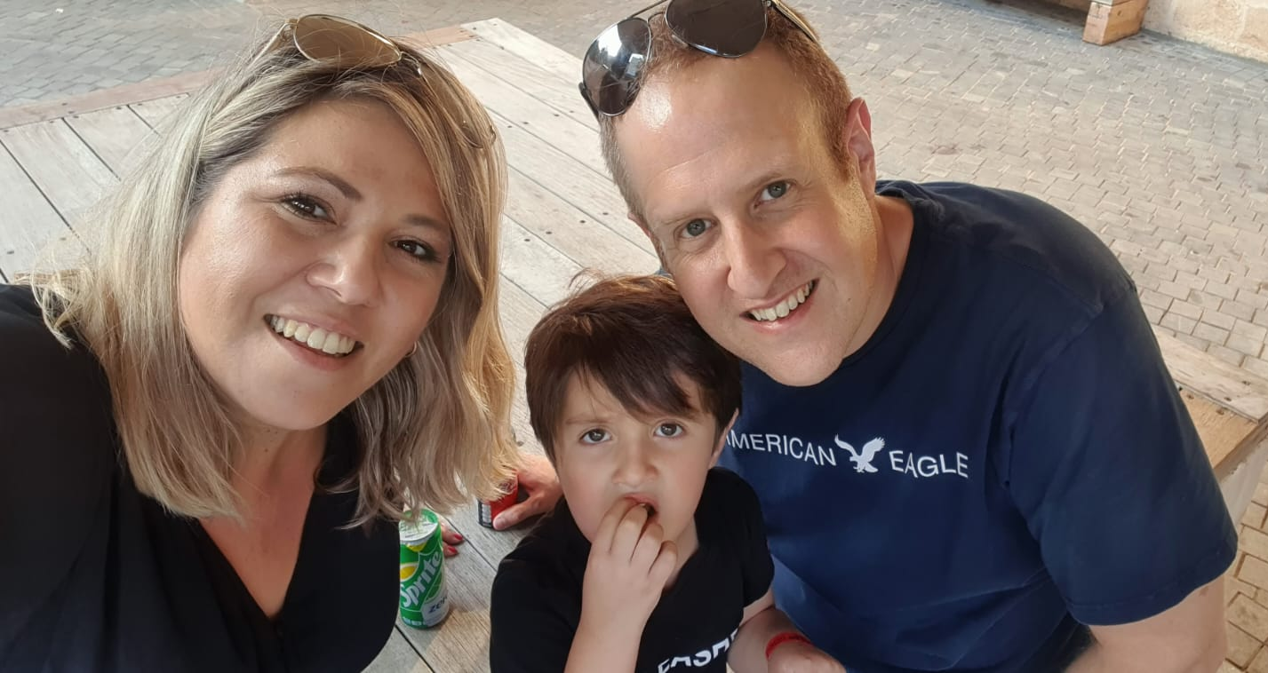
A little about me
Shahar Schneider – shachash1984@gmail.com
Married to Meital and father to Re’em
38 years old
From Nordiya (Near Netanya)
In the Game Development area since 2015
Currently working as a Senior Software Engineer and Development team leader at Elbit Systems LTD
Graduate of Tiltan (2019)

Slide 3
Wanted outcome of this course
You can develop a full game in Unreal Engine using CPP
You can read and understand code written in CPP (for the most part)
You have the motivation to extend your game dev horizons
You had fun!

Slide 4
Thank you!
Best of luck!

