Slide 1

Unreal engine advnced
CPP Basics –
Do While Loop

Slide 2
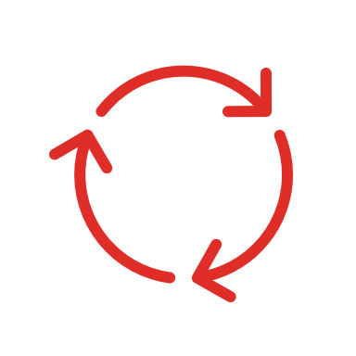
Do While Loop-
Executes a statement repeatedly, until the value of expression becomes false. The test takes place after each iteration.

Slide 3
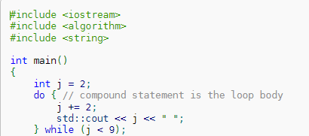
Example

Slide 4


Resources
https://en.cppreference.com/w/cpp/language/do

Slide 5
Thank you!
Best of luck!

