Slide 1

Unreal engine advnced
CPP Basics –
If Statements

Slide 2

If statement -
Conditionally executes code.
Used where code needs to be executed only if some condition is true.

Slide 3
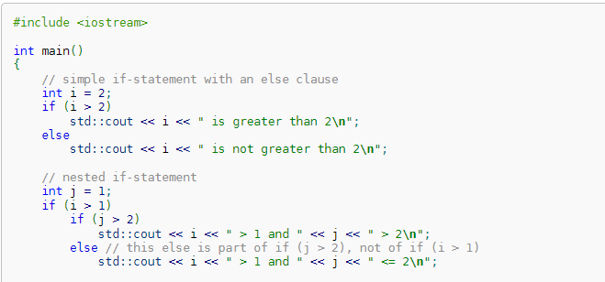
explanation
expression must be an expression of any scalar type.
If expression compares not equal to the integer zero, statement-true is executed.
In the form (2), if expression compares equal to the integer zero, statement_false is executed.

Slide 4


Resources
https://en.cppreference.com/w/c/language/if

Slide 5
Thank you!
Best of luck!

