Slide 1

Unreal engine advnced
CPP Basics – Const

Slide 2

CONST – Immutable values
const is an annotation to an arbitrary type that ensures, that it will not be changed.
const affects whatever is on its left, UNLESS… there is nothing, then it affects what’s on its right.
Let's start by looking at const variables, also called constants

Slide 3
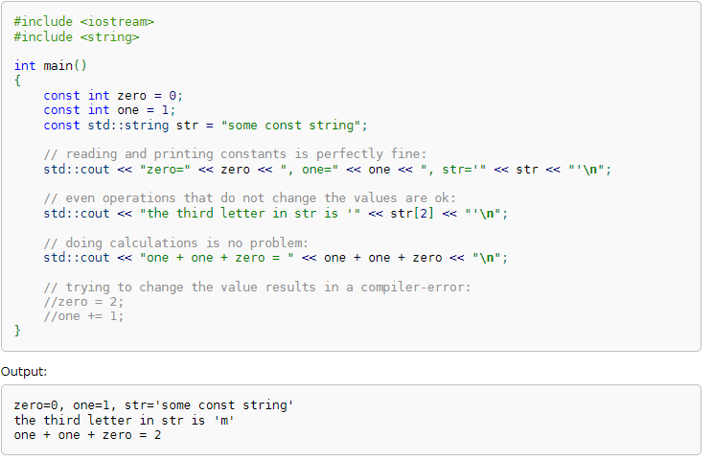
Immutable values

Slide 4


Resources
https://en.cppreference.com/book/intro/const

Slide 5
Thank you!
Best of luck!

