Slide 1

Unreal engine advnced
CPP Basics –
While Loop

Slide 2
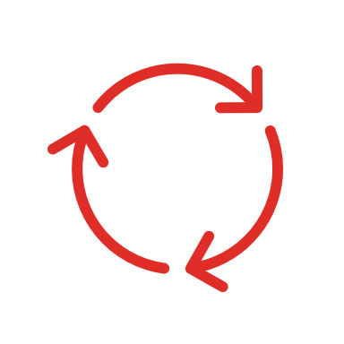
While Loop-
Executes a statement repeatedly, until the value of condition becomes false. The test takes place before each iteration.

Slide 3
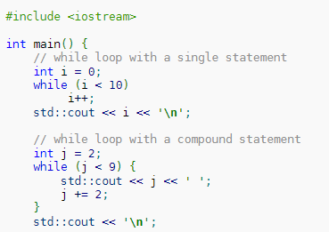
Example

Slide 4


Resources
https://en.cppreference.com/w/cpp/language/while

Slide 5
Thank you!
Best of luck!

