Slide 1

Unreal engine advnced
CPP Introduction

Slide 2
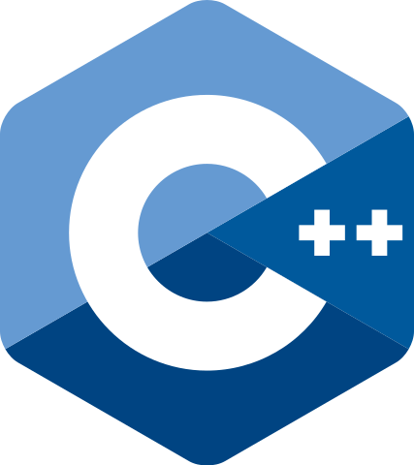
C++
Creator: Bjarne Stroustrup
The Language’s first commercial release was in 1985
The first standard (ISO) was in 1998. First major update was in the CPP 2011 release.
Controlled by a Standard committee.
Originally called “C with classes”
This Photo by Unknown Author is licensed under CC BY-SA

Slide 3
Why c++?
Pros:
Cross-platform
Highly performant
Low level control and access
Abstraction and OOP
Proven reliability (Google Chrome, Unreal Engine, Unity, Adobe Tools and many more…
Cons:
Difficult to learn
A lot of options of achieving the same goal
Book-keeping
Dangerous (if you don’t know what you’re doing
This Photo by Unknown Author is licensed under CC BY-SA

Slide 4
Why c++?
Pros:
Cross-platform
Highly performant
Low level control and access
Abstraction and OOP
Robust and well-tested standard library
Proven reliability (Google Chrome, Unreal Engine, Unity, Adobe Tools and many more…
Cons:
Difficult to learn
A lot of options of achieving the same goal
Book-keeping
Dangerous (if you don’t know what you’re doing
This Photo by Unknown Author is licensed under CC BY-SA

Slide 5
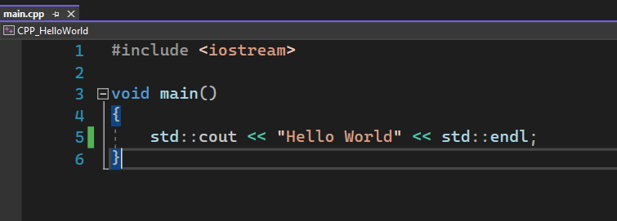
Requirements
Text Editor
Compiler (the most commons are: MSVC, GNU and Clang)
Debugger
This Photo by Unknown Author is licensed under CC BY-SA

Slide 6
Thank you!
Best of luck!

