Slide 1

CPP Beginners
CPP Files

Slide 2

Files I/O
The std::fstream class is a part of the C++ Standard Library that provides an interface for reading from and writing to files.
It is derived from the std::istream and std::ostream classes and inherits their behavior and functionality.
The std::fstream class provides several member functions for opening and closing files, reading and writing data, seeking to specific positions within the file, and checking the status of the stream.

Slide 3
Files I/O
Here is a brief overview of some of the member functions of the std::fstream class:
fstream::open: Opens a file and associates the stream with it.
fstream::close: Closes the file and disassociates the stream from it.
fstream::is_open: Returns a boolean value indicating whether the stream is associated with a file.
fstream::read: Reads a block of data from the file into a buffer.

Slide 4
Files I/O
fstream::write: Writes a block of data from a buffer to the file.
fstream::seekg: Seeks to a specific position within the file for reading.
fstream::seekp: Seeks to a specific position within the file for writing.
You can use the std::fstream class to perform both input and output operations on files in a flexible and convenient way.

Slide 5
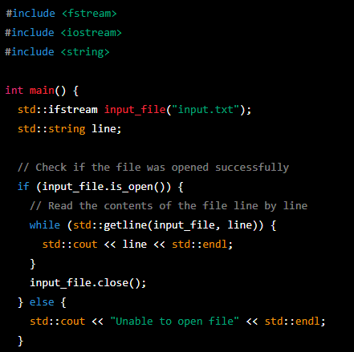
Reading from a text file
This code will open the file “input.txt” and read its contents line by line, printing each line to the standard output.

Slide 6
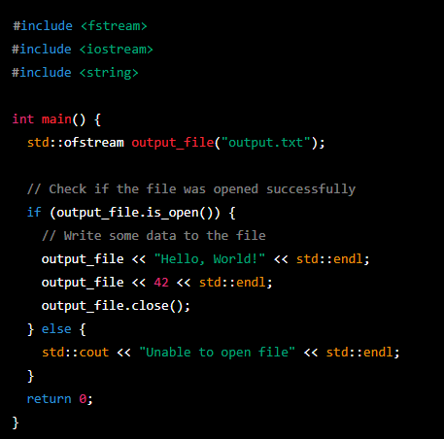
Writing to a text file
This code will open the file output.txt and write the string "Hello, World!" and the integer 42 to the file, each on a separate line.
If the file does not exist, it will be created. If the file already exists, its contents will be overwritten.

Slide 7


Resources
https://en.cppreference.com/w/cpp/io
ChatGPT

Slide 8
Thank you!
Best of luck!

