Slide 1

Unreal engine advnced
CPP Basics –
Enumerations

Slide 2

Enumerations (Enum) -
An enumerated type is a distinct type whose value is a value of its underlying type (see next), which includes the values of explicitly named constants (enumeration constants).

Slide 3

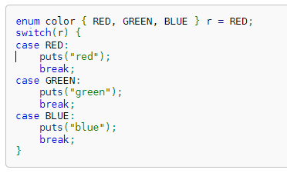


syntax
Enumerated type is declared using the following enumeration specifier as the type-specifier in the declaration grammar:

Slide 4


Resources
https://en.cppreference.com/book/intro/enum

Slide 5
Thank you!
Best of luck!

